Slide 1
Hypertensive disorders of pregnancy
Dr.Fadia J Alizzi
Assistant prof/ Consultant OBG

Slide 2
Definition:
Hypertension is defined as changes of BP recorded on at least 2 occasions of either:
Diastolic BP >90 mmHg, or
Systolic BP >140 mmHg, or
A rise (compared to booking) in diastolic BP of at least 15 mmHg, or
A rise (compare to booking) in systolic BP of at least 30 mmHg.

Slide 3
Degrees of hypertension
1. Mild: diastolic blood pressure 90–99 mmHg, systolic blood pressure 140–149 mmHg.
2. Moderate: diastolic blood pressure 100–109 mmHg, systolic blood pressure 150–159 mmHg.
3. Severe: diastolic blood pressure ≥110 mmHg, systolic blood pressure ≥160 mmHg

Slide 4
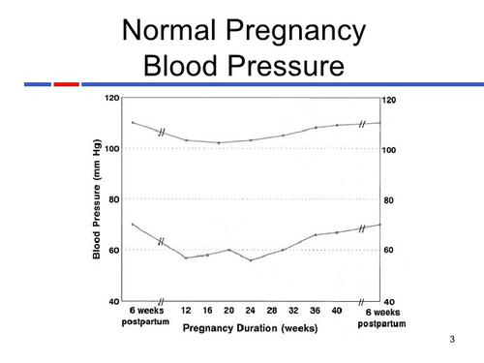

Slide 5
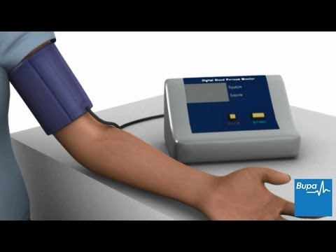
HOW TO MEASURE BP DURING PREGNANCY

Slide 6
Classification:
Pregnancy-induced hypertension
Chronic hypertension
Pre-eclampsia:
Eclampsia:
Imminent eclampsia (fulminating pre-eclampsia)

Slide 7
Pregnancy-induced hypertension (Non-proteinuric pregnancy-induced hypertension or Gestational hypertension alone):
hypertension arising for the first time in the second half of pregnancy &in the absence of proteinuria or any other features of pre-eclampsia.
It is not associated with adverse pregnancy outcome and mild and moderate increases in blood pressure in this setting do not require treatment.
However, up to one-third of women who present with gestational hypertension will progress to pre-eclampsia

Slide 8
Chronic hypertension:
pre-existing hypertension may be diagnosed before gestation or assumed when a women is found to be hypertensive in early pregnancy.
It can predispose to the later development of superimposed pre-eclampsia.
Even in the absence of superimposed preeclampsia, chronic hypertension is associated with increased maternal and fetal morbidity and pregnancies complicated by chronic hypertension should therefore be regarded as high risk.

Slide 9
Pre-eclampsia:
Defined as hypertension of at least 140/90 mmHg recorded on 2 separate occasions at least 4 hours apart & in the presence of at least 300 mg protein in a 24-hour collection of urine, arising de nova after the 20th week of gestation in a previously normotensive women & resolving completely by the sixth postpartum week

Slide 10
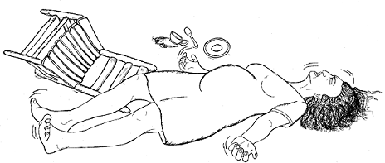
Other …..
▪ Eclampsia: is a serious & life-threatening complication of pre-eclampsia.It is defined as convulsions occurring in a woman with established pre-eclampsia, in the absence of any other neurological or metabolic cause. It is an obstetric emergency.
▪ Imminent eclampsia (fulminating pre-eclampsia): is the transitional condition characterized by increasing symptoms & signs, it’s the sever form of pre-eclampsia.

Slide 11
Pre-eclampsia:
Incidence&Epidmiology:
It complicates approximately 2-3% of pregnancies.
It is more common in primigravida (effect of fetal and hence paternal genome).
Maternal genetic predispositions (3-4 folds increase in the first-degree relatives of affected women).

Slide 12
Risk factors for pre-eclampsia (predisposing factors):
First pregnancy.
Multiparous with a previous history of pre-eclampsia.
Pre-eclampsia in any previous pregnancy.
10 years or more since last baby.
Age 40 years or more.
Body mass index (BMI) of 35 or more.
Family history of pre-eclampsia (in mother or sister).
Booking diastolic blood pressure of 80 mmHg or more.
Booking proteinuria ( of ≥1+ on more than one occasion or quantified at ≥0.3 g/24 h).
Multiple pregnancies.
Certain underlying medical conditions:
pre-existing hypertension;
pre-existing renal disease;
pre-existing diabetes;
antiphospholipid antibodies

Slide 13
Clinical presentation:-
Symptoms
May be asymptomatic.
Headache.
Visual disturbances.
Epigastric& right upper abdominal pain.

Slide 14
Signs of pre-eclampsia:
Elevation of BP.
Fluid retention (non-dependent oedema).
Brisk reflexes.
Ankle clonus (more than 3 beats).
Uterus & fetus may feel small for gestational age.

Slide 15
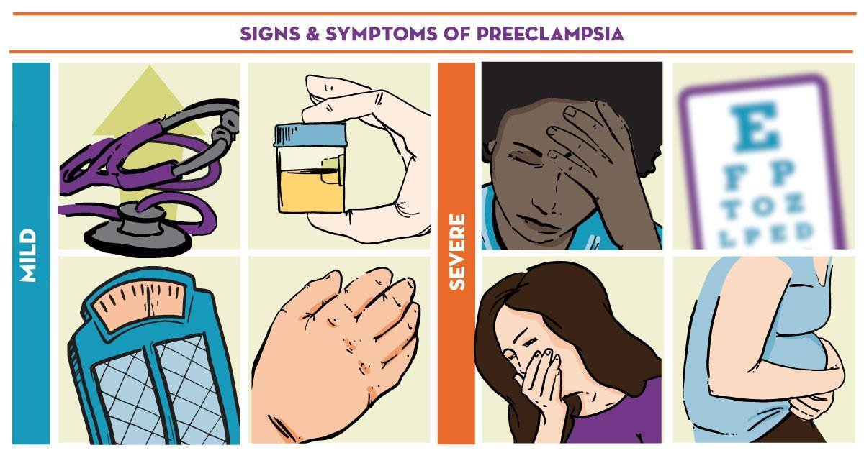

Slide 16
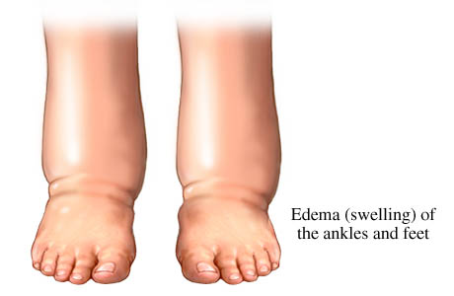
Which oedema is more significant ?

Slide 17
Etiology:
Trophoblastic tissue provides the stimulus for the disorder, so its only occurs in pregnancy ,but it has been described in pregnancy lacking a fetus(molar pregnancy)& in the absence of the uterus
( abdominal pregnancy) .
Trophoblastic invasion is patchy& the spiral arteries retain their muscular walls which interne prevent the development of a high flow, low-impedance uteroplacental circulation, the reason for that is unknown.

Slide 18
Pathophysiology

Slide 19
Organ-specific changes associated with pre-eclampsia
Central nervous system:
Cerebral oedema.
Cerebral hemorrhages.
Retinal haemorrhage, exudates &papillodema are characteristic of hypertensive encephalopathy.

Slide 20
Cardiovascular
Generalized vasospasm.
Increased peripheral resistance.
Reduced central Venus/pulmonary wedge pressures.

Slide 21
Hematological
Platelet activation & depletion.
Coagulopathy.
Decreased plasma volume.
Increased blood viscosity.

Slide 22
Renal
Proteinuria
Decreased GFR(oliguria)
Decreased urate excretion (increase serum uric acid).
Hepatic
Periportal necrosis
Sub- capsular haematoma.
Elevation of liver enzymes.

Slide 23
HELLP syndrome:
it is sever form of pre-eclampsia, occur in 2-4% of women with pre-eclampsia
it is associated with fetal loss rate of up to 60% if occur antenatally& a maternal mortality of up to 24%.
It may be associated with DIC & placental abruption.
it is abbreviation of :
H=Haemolysis.
EL=Elevated Liver enzymes.
LP=Low Platelet count.

Slide 24
DIAGNOSIS:
A diagnosis of pre-eclampsia usually requires admission of the patient for more intensive investigations & monitoring of her condition.

Slide 25
DIAGNOSIS:
1.) Mild form:
BP mildly elevated i.e. diastolic BP of 90-95 mmHg.
Minimal proteinuria.
Normal haematological &biochemical parameters.
Patient can be monitored as an outpatient, attending for regular fetal & maternal assessment.
2.) Moderate (95-105mmHg), it requires admission to the hospital for investigation &follow up.

Slide 26
3.) Sever pre-eclampsia is identified by symptoms of sever pre-eclampsia:-
Frontal headache
Visual disturbance
Epigastric pain
General malaise & nausea
Restlessness
Signs of sever pre-eclampsia:
Agitation
Hyper- reflexia (clonus)
Facial &peripheral odema
Right upper quadrant tenderness
Poor urine output

Slide 27
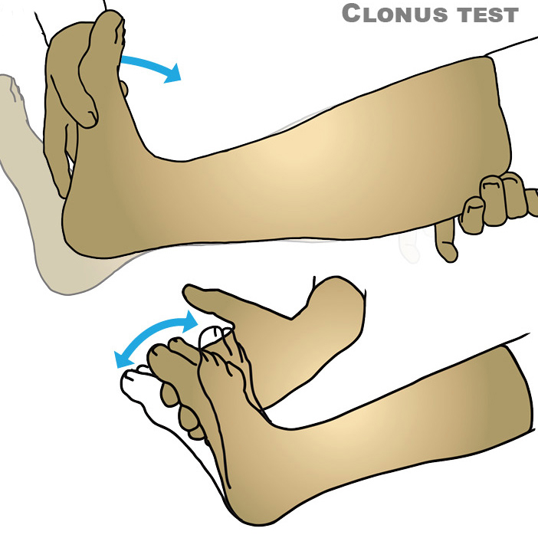
HYPER-REFLEXIA

Slide 28
Investigation for pre-eclampsia
These investigations will be repeated at interval depending on the overall clinical picture.
Urinalysis by dipstick (quantitatively inaccurate).
24-hour urine collection for total protein &creatinine clearance).
Full blood count (platelets &haematocrit).
Blood chemistry (renal function , protein concentration ).
Plasma urate concentration.
Liver function.
Coagulation profile.
Ultrasound assessment
Fetal size.
Amniotic fluid volume.
Doppler.

Slide 29
Protein in urine

Slide 30
MATERNAL COMPLICATIONS
Increase maternal morbidity &mortality because of:
Cerebral oedema, cerebral haemorrhage& retinal haemorrhage.
Eclampsia.
Heart failure , pulmonary oedema & Adult Respiratory Distress Syndrome (ARDS)
Sub-capsular haematoma, Periportal necrosis& elevated liver enzymes.
Renal failure
Hematological complications:-Decrease platelets count, Haemolysis, Coagulopathy & DIC.
HELLP syndrome.
Increase risk of thrombosis (DVT, pulmonary embolism).
Increase risk of APH & PPH.
Increase risk of surgical interventions(c/s, instrumental delivery).

Slide 31
Fetal complications:
Increase perinatal morbidity & mortality.
Preterm delivery (iatrogenic).
IUGR.
IUD.
Birth asphyxia.

Slide 32
Treatment:
The mainstay of treatment is ending the pregnancy by delivering the fetus & placenta; this can be significant problem at 24-32 weeks.
The aim of antihypertensive therapy is to lower the BP & reduce the risk of maternal cerebrovascular accident without reducing uterine blood flow & compromising the fetus.

Slide 33
Antihypertensive drugs are:
Methyldopa: centrally acting antihypertensive agent, safe, can only giving orally ,need at least 24 hours to work, & it is the drug of choice antenatally.
Labetolol: is an alpha & beta- blocking agent ,it can be given orally or IV, safe , can be given antenatally&intrapartum to control BP in sever pre-eclampsia .
Nifedipine : calcium-channel blocker with a rapid onset of action.It can, however , cause sever headache that mimic worsening disease.
Hydralazine : arterial vasodilator , used IV in sever pre-eclampsia.
So sever form of pre-eclampsia , IV infusion of hydralazine/labetolol can be titrated rapidly against changes in the BP.

Slide 34
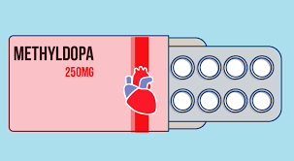
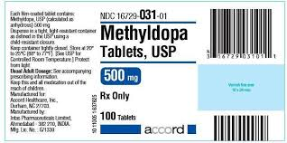
Methyldopa = aldomet

Slide 36
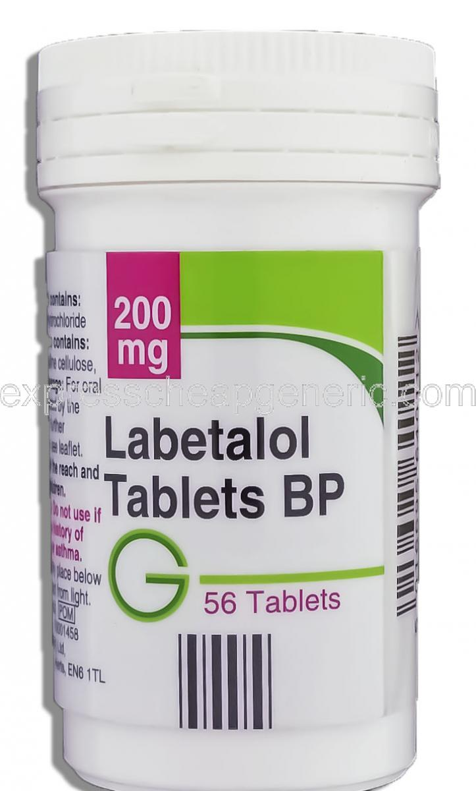
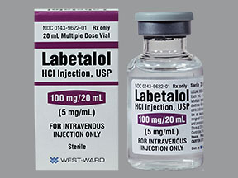
Labetalol

Slide 37
Management of eclampsia :
Maintain an open air way by mouth piece & oxygen .
maintain an 2 IV line & take blood samples for :
Blood group &Rh.
CBC & Blood film.
LFT
RFT
Serum uric acid.
Coagulation profile.

Slide 38
Control fit by giving magnesium sulphate which is given IV as bolus dose directly & maintenance dose over 24 hours after last fit.
control BP by hydralizin / labetolol IV .
Close observation of vital sign (PR,RR,BP,Temp.), urine output ,patellar reflex & clonus.
Assessment of fetal condition & immediate delivery.

Slide 39
Magnesium sulphate (MgSO4)
*Centrally acting anticonvulsant drug.
* act as membrane stabilizing agent.
* can be given iv or im but preferable iv
* Is the drug of choice (1st drug of choice) in the acute phase treatment of eclamptic fit.
*4-6 g given iv slowly over at least 10 min to arrest fit, then maintain on 1g / hr iv in drip for at least 24 hr from the last fit.

Slide 40
*should be monitored carefully while giving it because of its toxicity by:
1.measuring its level in the blood
2.monitering the following
a) respiratory rate.
b) urine output.
c) patellar reflexes (1st sign to disappear in MgSO4 toxicity).
* antidote of MgSO4 toxicity is calcium gluconate10%, 10 ml over 10 min given iv.

Slide 41
Additional points in management
Management of sever PE that necessity delivery in ˂ 34 week pregnancies:
1) the mother should be transferred to a center with adequate facilities to care for her baby
2) Steroids should be given intramuscularly to the mother to reduce the chance of neonatal RDS.
3) Delivery before term is often by caesarean section.
4) Such patients are at particularly high risk for thromboembolism
and should be given prophylactic subcutaneous heparin and issued with antithromboembolic stockings.
5) In the case of spontaneous or induced labour and if clotting studies are normal, epidural anaesthesia is indicated as it helps control blood pressure.
6) Ergometrine is avoided in the management of the third stage as it
can significantly increase blood pressure.

Slide 42
KEY POINTS
Pre-eclampsia is a multisystem disorder that likely originates in the placenta and is a significant cause of maternal and perinatal morbidity and mortality.
There is no cure other than delivery; the aim of management is to stabilize the maternal blood pressure and prevent seizures and cerebral bleeding.

Slide 43
Chronic Hypertension :
Essential hypertension is the underlying cause in 90% of cases.
Before a diagnosis of essential hypertension is made, other causes of chronic hypertension should be excluded which are :
Renal disease:
glomerulonephritis.
Polycystic disease.
Diabetic nephropathy.
Renal artery stenosis.
Collagen vascular disease :
-SLE
- scleroderma.
Coarctation of the aorta.
Endocrine causes:
-phaeochromocytoma.
- conn s syndrome.

Slide 44
Irrespective of the underlying cause , the principal concern is that these women may develop superimposed pre-eclampsia (1/3).

Slide 45
Treatment:
1.mild(BP<150/100): no need for immediate treatment,however , the pregnancy should be monitored carefully to detect any rise in BP or features of pre-eclampsia or IUGR.
2. BP>150/100:antihypertensive medication is recommended which includes:
Methyldopa
Labetolol
Nifedipine.

Slide 46
Aim of treatment is to maintain the BP < 160 mmHg &100-110 mmHg diastolic.
It is reasonable to await spontaneous labour or attempt vaginal delivery by induction at 39 weeks

Slide 47
Risk factors for developing superimposed preeclampsia
Renal disease.
Maternal age >40 years.
Pre-existing diabetes.
Multiple pregnancies.
Connective tissue disease (e.g. antiphospholipid syndrome).
Coarctation of the aorta.
Blood pressure ≥160/100 mmHg in early pregnancy.
Prepregnancy BMI >35.
Previous pre-eclampsia.
Antiphospholipid syndrome.

Slide 48
QUIZE
Give provisional diagnosis for the following:
A 40-year-old woman in her first pregnancy presents in labour. Her blood pressure is 145/90 mmHg. Shortly after beginning regular contractions she has a tonic–clonic seizure.
A 32-year-old woman presents with epigastric pain at 38/40 in her second pregnancy, her first having been complicated by pre-eclampsia. Her blood pressure is 130/86 mmHg, her alanin aminotransferase (ALT) is 170 IU/L and her platelet count is 40 × 109/l.

Slide 49
CONT…..
3. A 24-year-old woman in her first pregnancy presents at 32/40 with sudden onset severe abdominal pain and vaginal bleeding. Her blood pressure is 160/95 mmHg.
4. A 36-year-old woman in her first pregnancy is noted to have a blood pressure of 140/86 mmHg at 32/40. There is no protein in her urine and she is asymptomatic.

