Slide 1
Research is
digging for truth

Slide 2
Why research is so important?
It is an indicator for evolution in any country

Slide 3
Research …… Concept,
…….. System,
and ……….Policy (Country, Donors, Universities)
in the developed countries

Slide 4
Reflections on Research
“If we knew what it was we were doing, it would not be called research, would it?” Albert Einstein
“He who does not research has nothing to teach.” Anonymous
“What is research but a blind date with knowledge?” Will Harvey
“Research is to see what everybody else has seen, and to
think what nobody else has thought” Albert Szent-Gyorgyi (won
Nobel prize for medicine)
"An expert is a person who has made all the mistakes that can be made in a very narrow field." Niels Bohr

Slide 5
Research: Facts or fallacies?

Slide 6
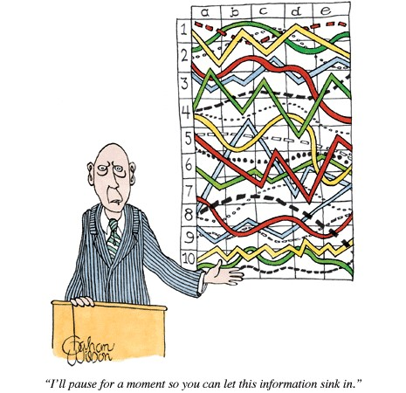
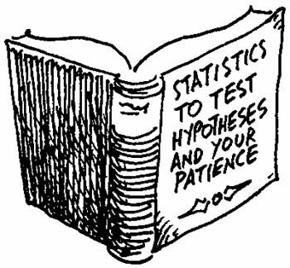
Research is too complicated! Especially
statistics!
4

Slide 7
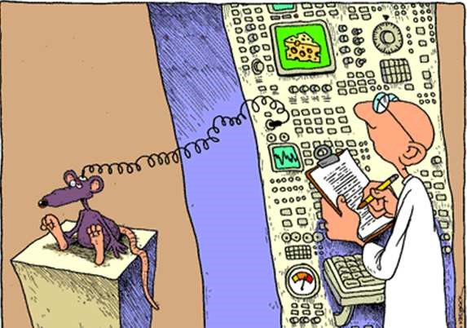
And might some times be irrelevant!!
5

Slide 8
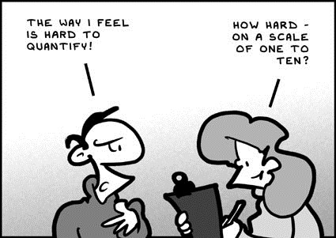
metrics!
Researchers are obsessed with
6

Slide 9
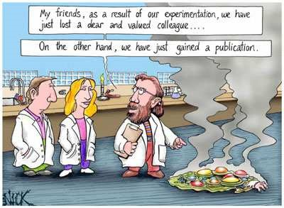
Risky/Opportunistic!
7

Slide 10
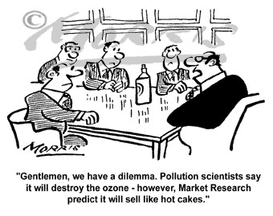
Research supports conflicting agendas
8

Slide 11
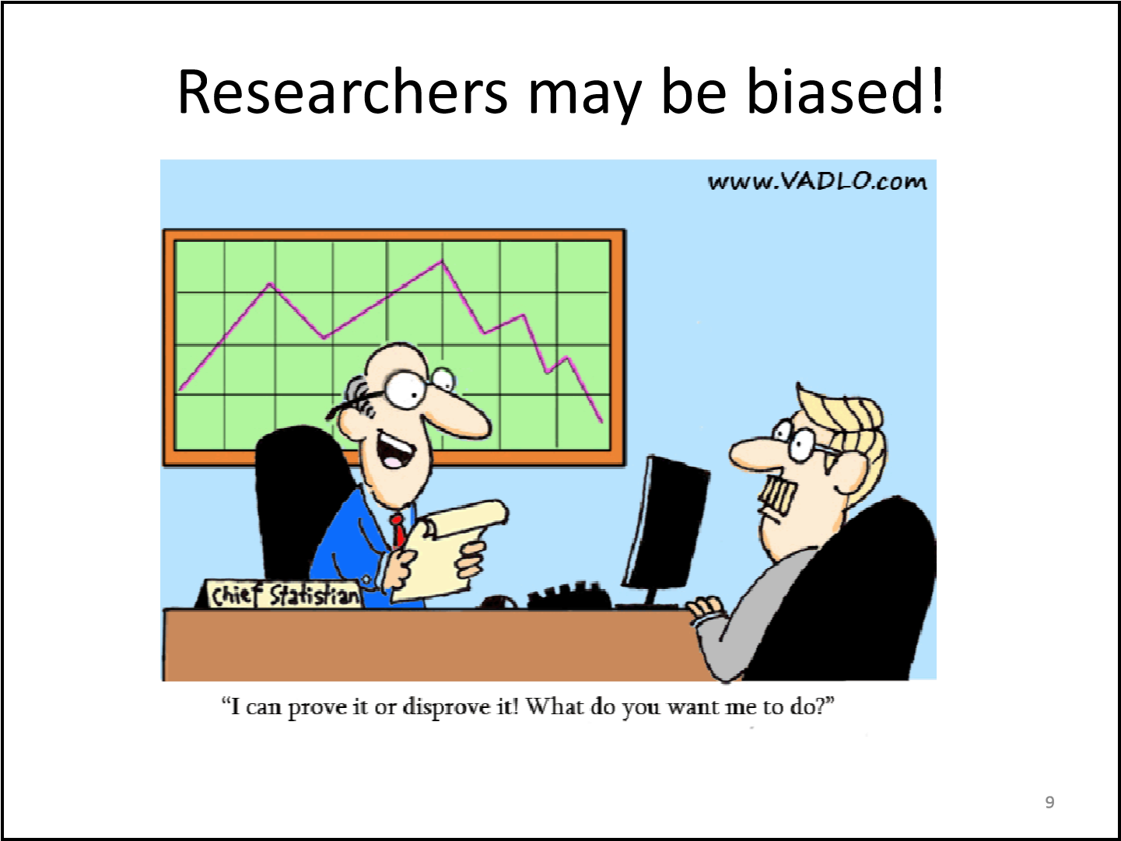

Slide 12
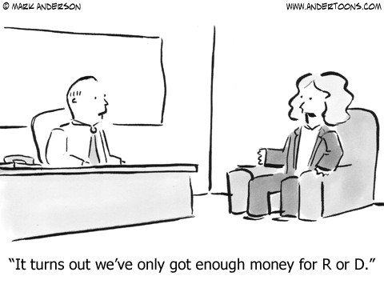
Research is costly $$$
10

Slide 13
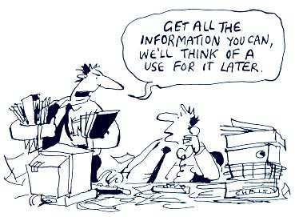
Majority of data collected is never used!
used!
11

Slide 14
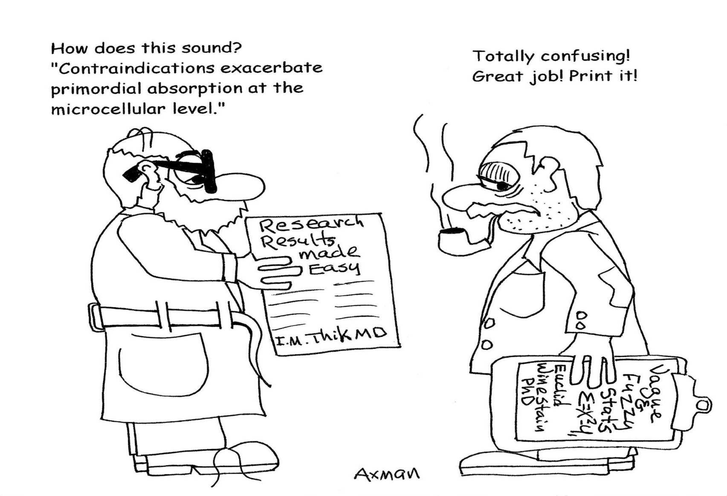
Research findings are too technical to understand/ disseminate understand/ disseminate!!!
understand/ disseminate!!!
12

Slide 15
Research is about creating reliable evidence to
inform practice and policy
It might guide you on what to do

Slide 16
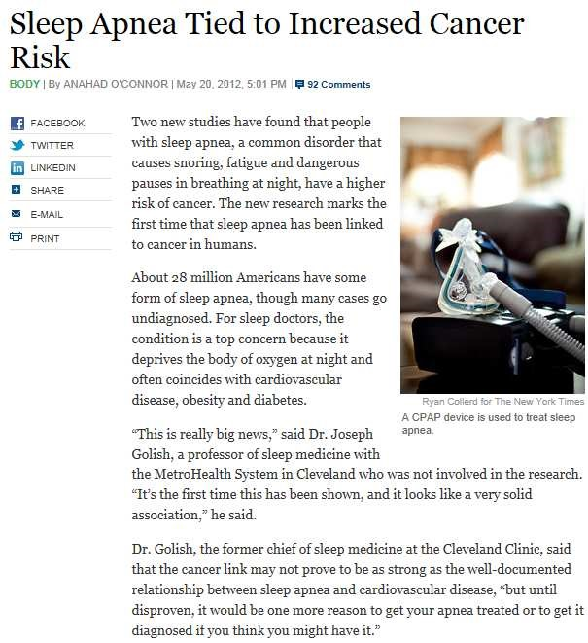
14

Slide 17
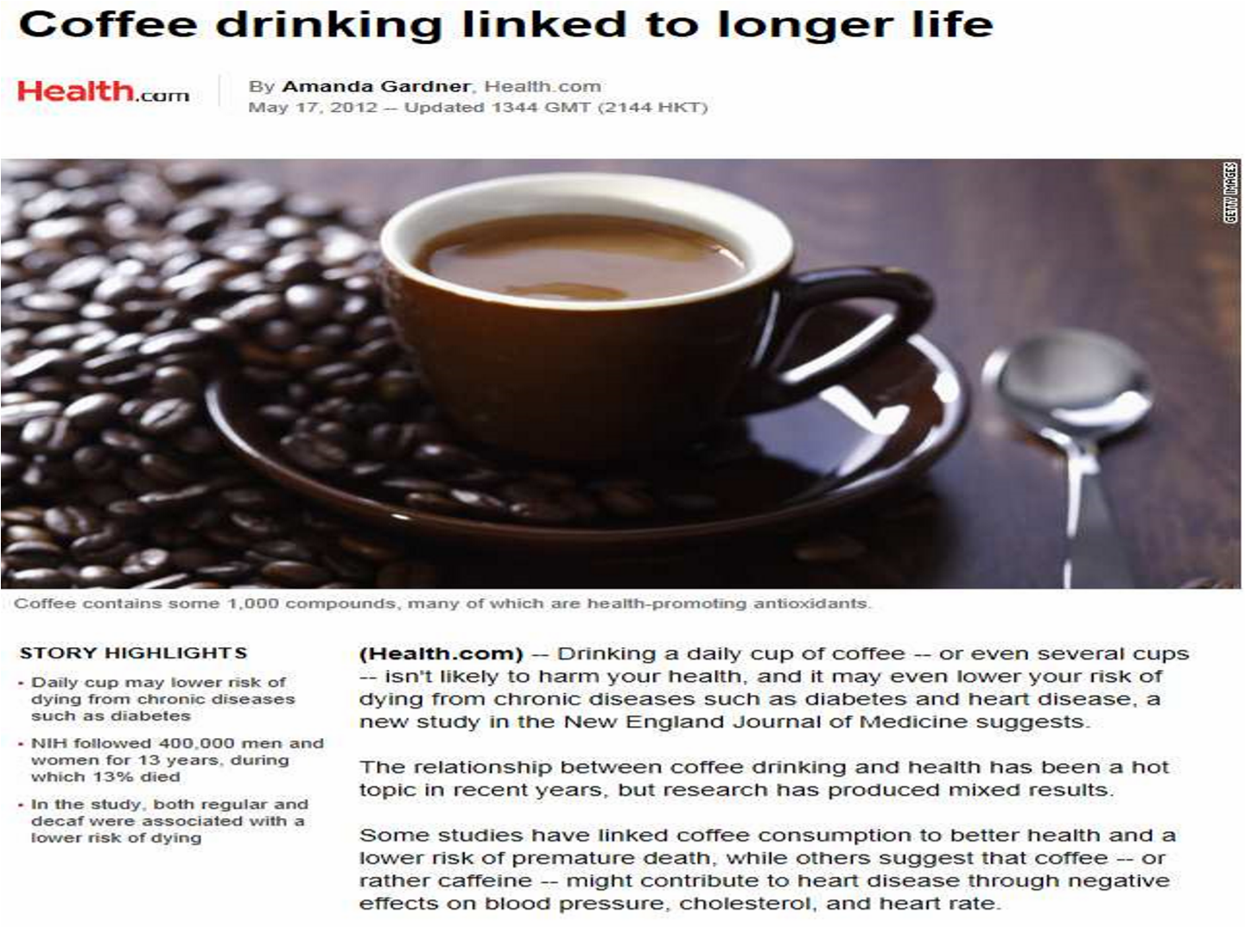
15

Slide 18
Research is about creating reliable evidence to inform practice and policy
It might guide you on what NOT to do

Slide 19
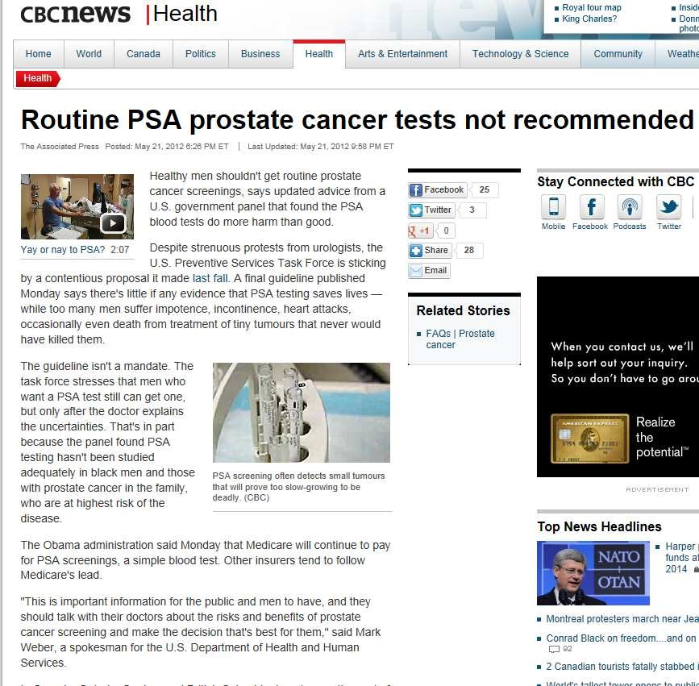
17

Slide 20
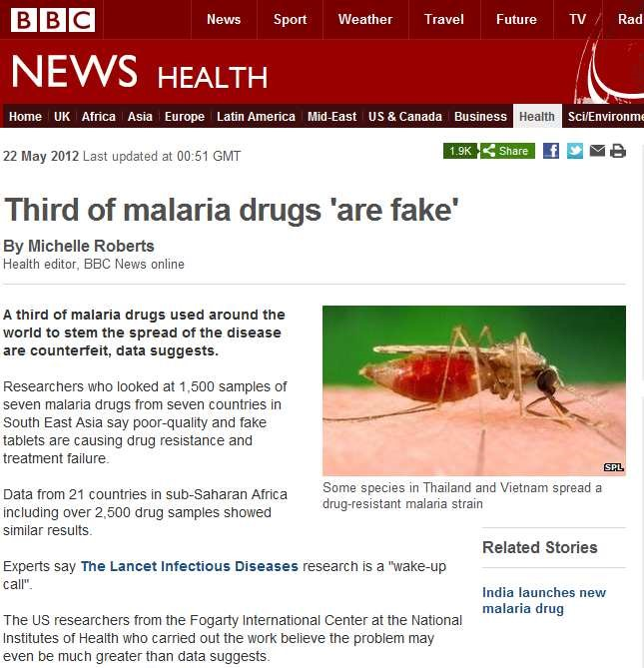
18

Slide 21
Definition for Research
Research is an organized activity with specific objectives on a problem or issue supported by compilation of related data and facts , involving application of relevant and valid tools for data collection and analysis and deriving logically sound inferences based on originality

Slide 22
Good Research Should
Make Sense!
  How do people lives improve after surgery?
Address important and relevant issues
  Digital rectal massage is a cure for hiccups, Annals of Emergency Medicine, August 1988 ☺
  Dog fleas can jump higher than cat fleas, Veterinary Parasitology, 2000 ☺
Offer a new contribution to knowledge
  Unless you like to reinvent the wheel! – Efficiency, effectiveness, ethics, etc.
Be “operationalizable”
Be Doable (do a good reality check)

Slide 23
Approaches to research
Quantitative research: focuses on numbers or quantities. Results are based on numeric analysis and statistics.
Qualitative research: Qualitative research studies are focused on differences in quality, rather than differences in quantity. Results are in words or pictures rather than numbers. Because of the depth of the data collection qualitative studies do not allow for a large number of participants.
Question: Which one provides more valuable information?

Slide 25
Steps in research process
1. Identification and selection of a research problem
2. Review of literature:
  Preliminary review prior to problem selection
  Systematic review after selection
  Preparation of notes
3. Formulation of selected problem
  Definition of the problem
  Conceptual mode
  Delimitation of the study
  Formulations of the objectives of the study and the hypothesis/investigating questions

Slide 26
Steps in research process
4. Operationalization of concepts
  definition of concepts
  construction of indexes/ scales for measuring variables
5. Preparing a research plan
  Statement of the problem
  Objectives of the study
  Hypotheses
  Operational definition of the concepts
  Target population
  Methodology
  Sampling design
  Tools for collection of data
  Plan of analysis
  Time schedule
  Budget

Slide 27
Construction of data collection tools
Identification of data needs
Delineation of data sources
Data collection schedule
Pilot testing
Translation and possible revision

Slide 28
7 .Collection of data
Experimental / field work
Preparing sample frame
Drawing sample of respondents
Collecting data from participants
  Mailing questionnaire
  Collecting specimens
  Administering drug – Etc.

Slide 29
8 .Processing of data
Data entry
Coding
Cleaning and imputation
Transcription
Tabulation
Construction of tables and charts

Slide 30
9 .Analysis of data
Statistical analysis (uni-variate, bi-variate & multi-variate)
Testing hypothesis
Interpretation of findings

Slide 31
10 .Publication & Data Dissemination
Planning report writing work
manuscripts
Fact sheets
Press releases/ conferences

Slide 32
Good Research Could Have a
Significant Impact on the Life of People:
Success Stories

Slide 33
Dr. John Snow Study on Cholera
The father of modern epidemiology
In 1854 John Snow linked water source to cholera in London .
– Snow realized that the water supplied from the companies was polluted with sewage.
A change in water source lead to a reduction in death rates.
Imagine how many lives were saved by Dr.
Snow’s research!

Slide 34
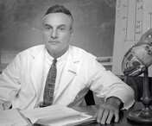
Framingham Heart Study – 1984
Objective to identify CVD risk factors
Prospective cohort study (5209 men & women followed for three decades) Dr. Thomas Dawber
Study led to the identification of the major CVD risk factors –
  high blood pressure, high blood cholesterol, smoking, obesity, diabetes, and physical inactivity
  as well as CVD related factors such as blood triglyceride and HDL cholesterol levels, age, gender, and psychosocial issues.
1200 articles in leading medical journals

Slide 35
The RAND Health Insurance Experiment • An experimental study of healthcare costs, utilization and outcomes in USA: Question: Does free medical care lead to better health than health insurance plans that require the patient to shoulder part of the cost? people randomly assigned to different kinds of plans and followed their behavior, from 1974 to 1982. Concluded that cost sharing reduces both overutilization of health services and the use of appropriately needed medical care The effect of cost sharing on care outcomes was subsequently investigated for a multitude of medical conditions 31

