Slide 1
Cutaneous nerve & Nerve injury of the upper limb
Dr. Ahmed Almusawi
M.B.Ch.B MSc. PhD. Molecular Anatomy

Slide 2
Objectives
Explain the cutaneous innervation of the upper limb
Define the terms of dermatomes and myotomes in addition to locate these terms on upper limb
Explain the nerve injury of the upper limbs according to the site of injury and demonstrate the effect of these injury on motor and sensory function of the upper limbs.

Slide 3
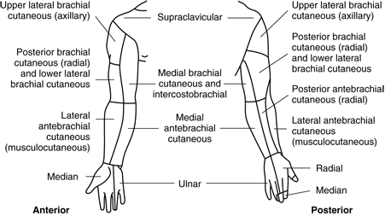
Cutaneous innervation of U.L

Slide 4
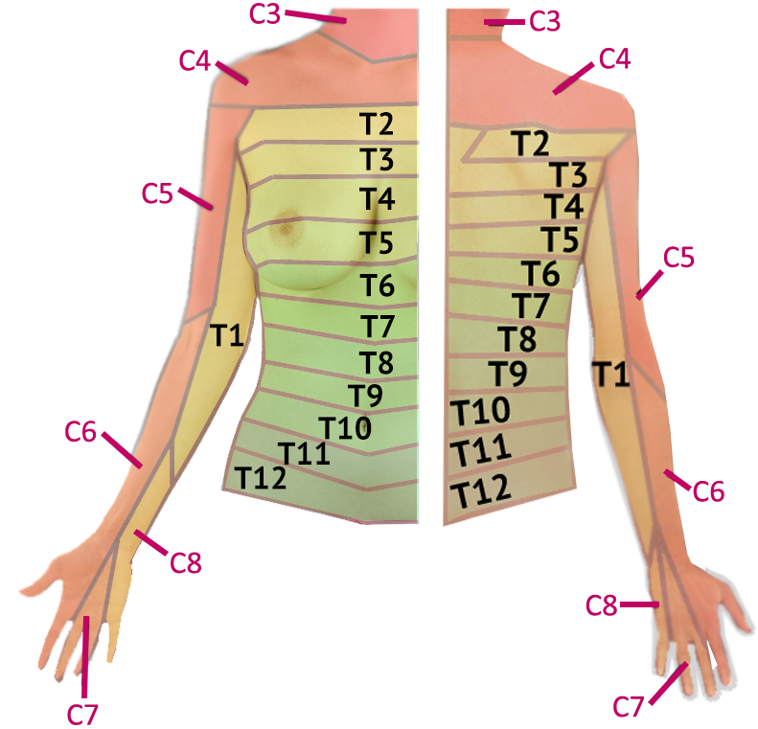
Dermatomes of the U.L

Slide 5
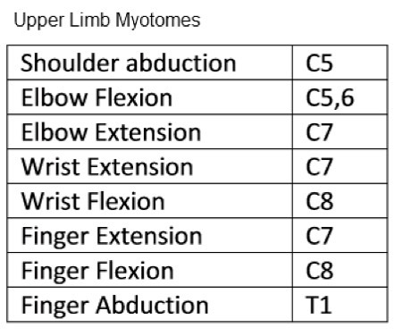
Myotome of the U.L

Slide 6
Nerve injury of U.L
Brachial plexus injury (upper and lower B.P inj)
Long thoracic nerve injury
Axillary nerve injury
Radial nerve injury (proximal, radial groove, superficial and deep branch injury)
Median nerve injury (at the elbow, at the wrist)
Ulnar nerve injury (at the elbow, at the wrist)

Slide 7
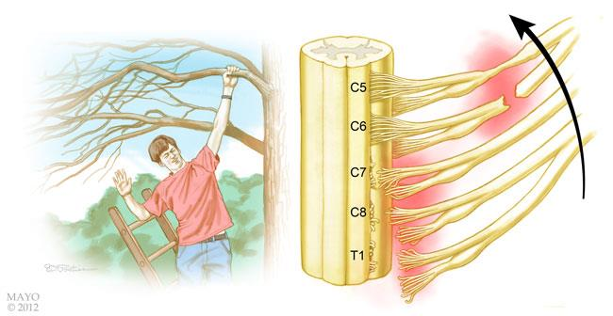
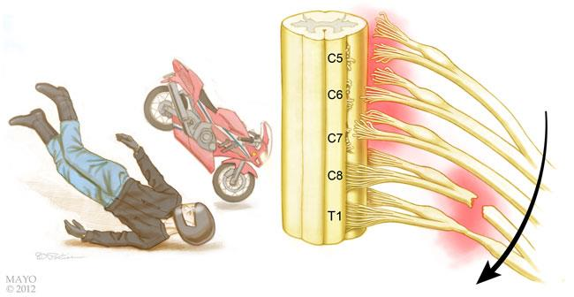
Brachial plexus injury

Slide 8
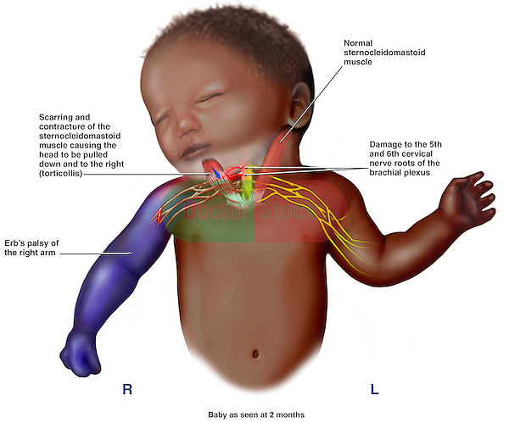
Brachial plexus injury
Mostly C5-6
Suprascapular, subclavius
musculocutaneous nerve of ant comp of the arm
Axillary nerve
Waiters tips

Slide 9
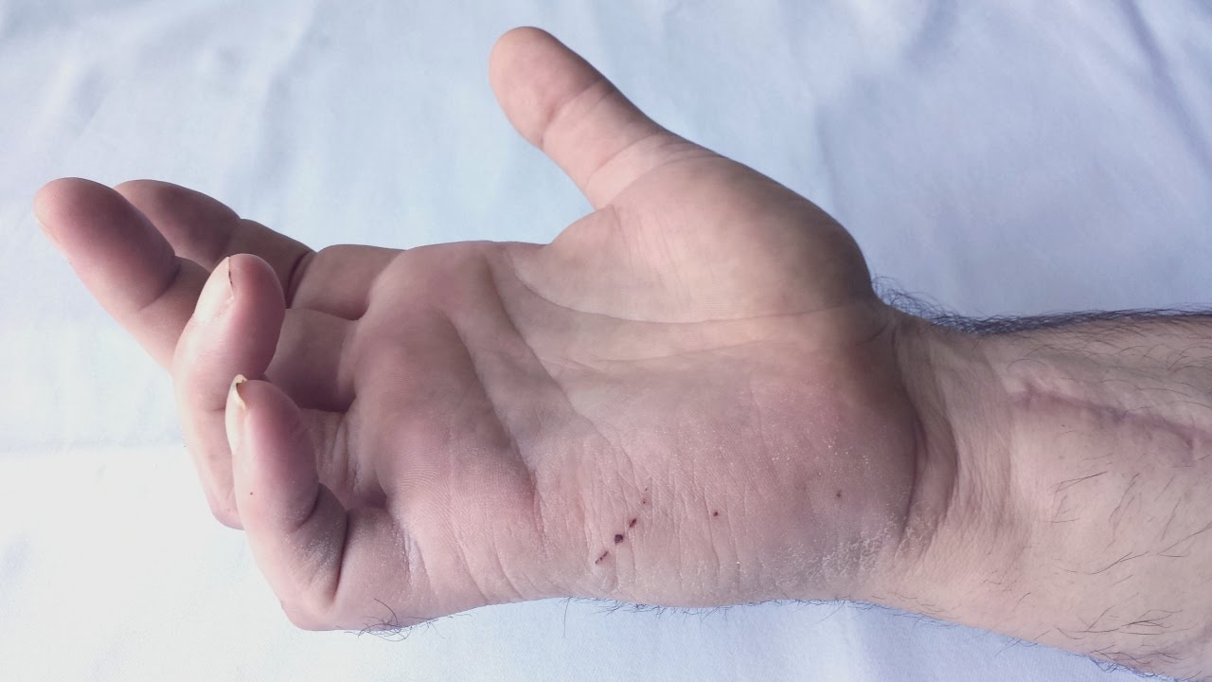
Lower Brachial plexus inj.
Mostly T1
Run in ulnar and median nerve

Slide 10
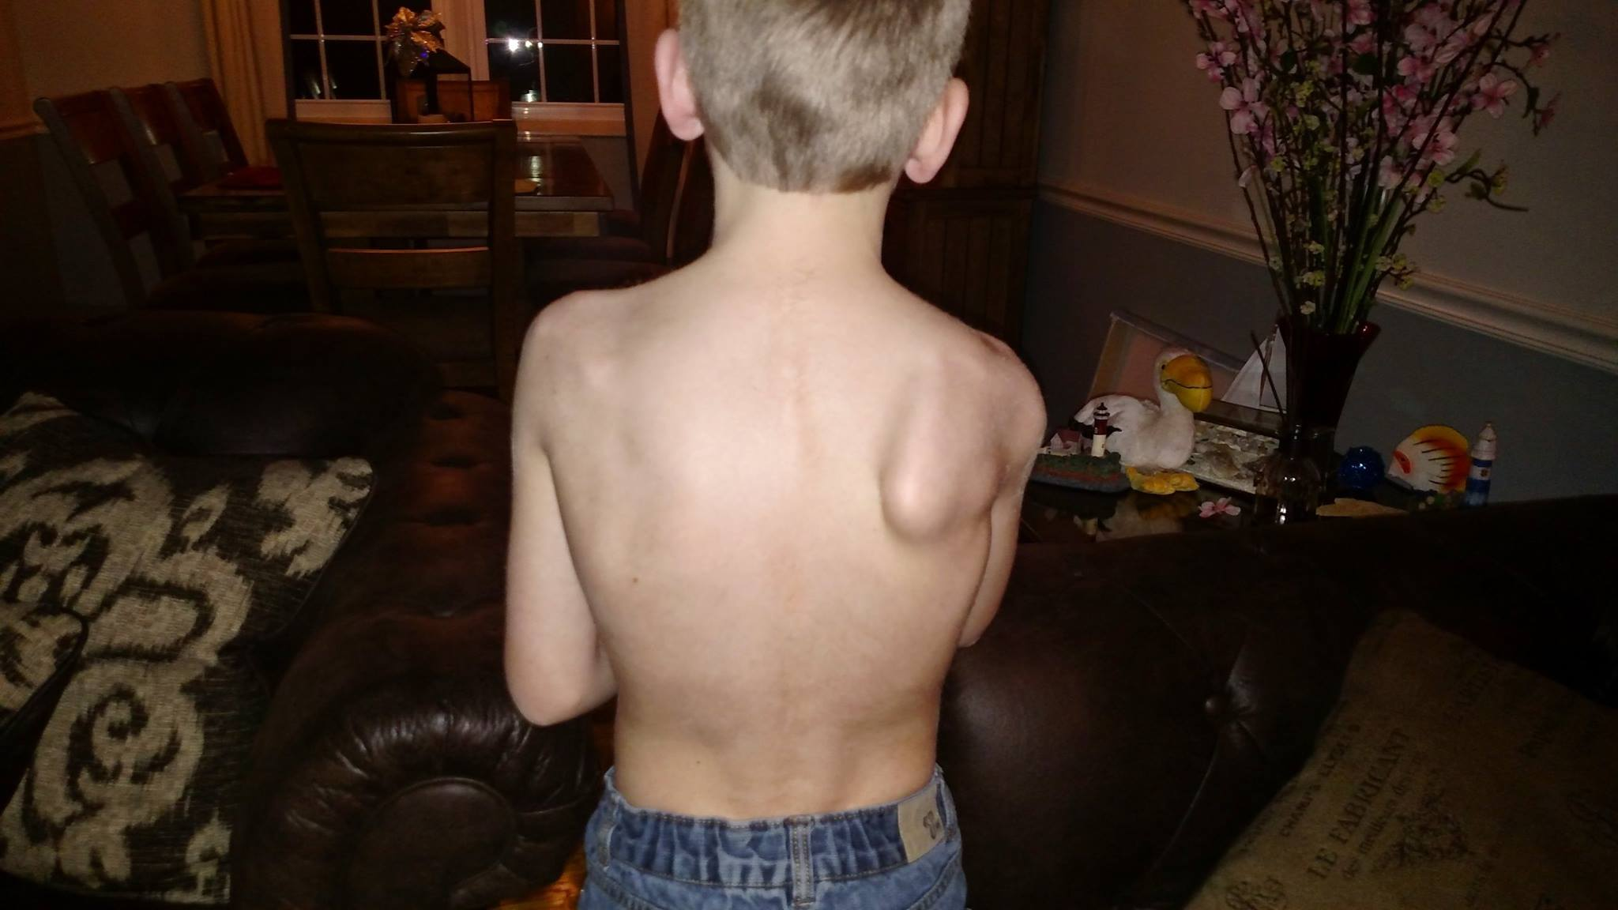
Long thoracic nerve inj.
Trauma to post triangle of neck
Serratus Anterior paralysis
Difficulty in abduction shoulder

Slide 11
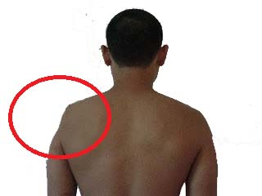
Axillary nerve injury
Failure abduction of shoulder
15-30˚
Lower half of deltoid skin lost

Slide 12
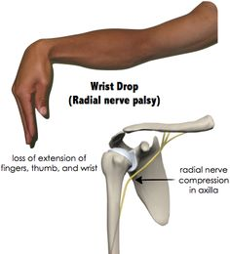
Radial nerve injury
In Axilla by crutch
All extensor are lost
Elbow extension lost
In radial groove
Elbow extension spared
Deep branch injury by head fracture
No wrist drop

Slide 13
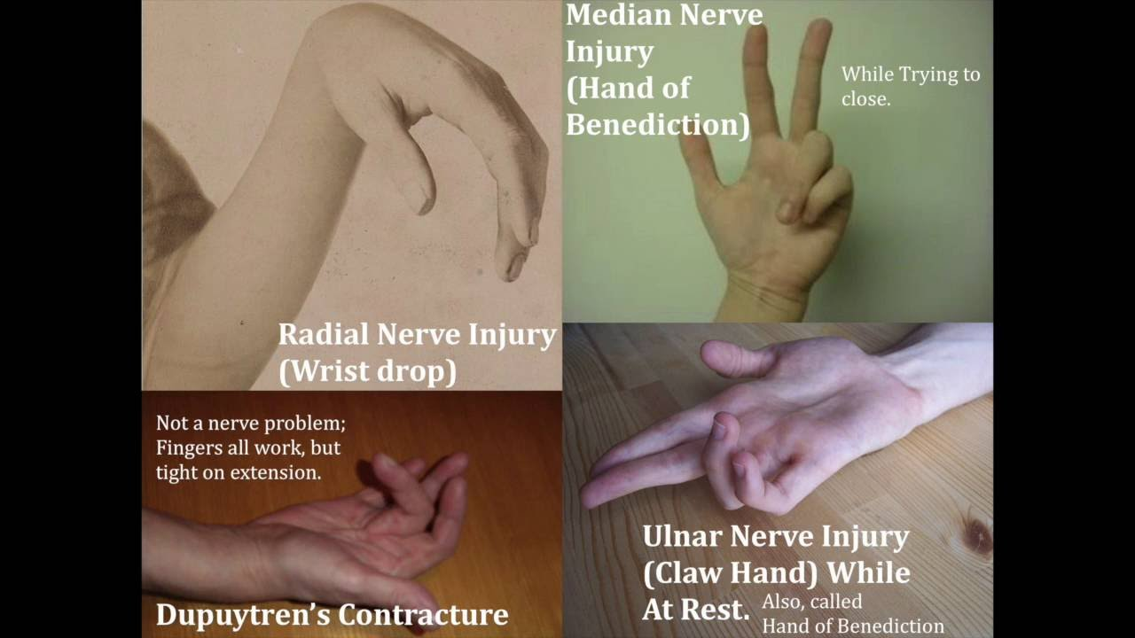
Median nerve injury
By supracondylar fr.
All flexor paralyzed except fl. Carpi uln. And medial two tendon of profundus
Little and ring flexed normally

Slide 14
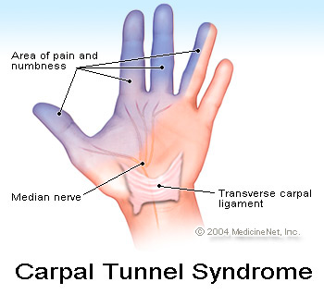
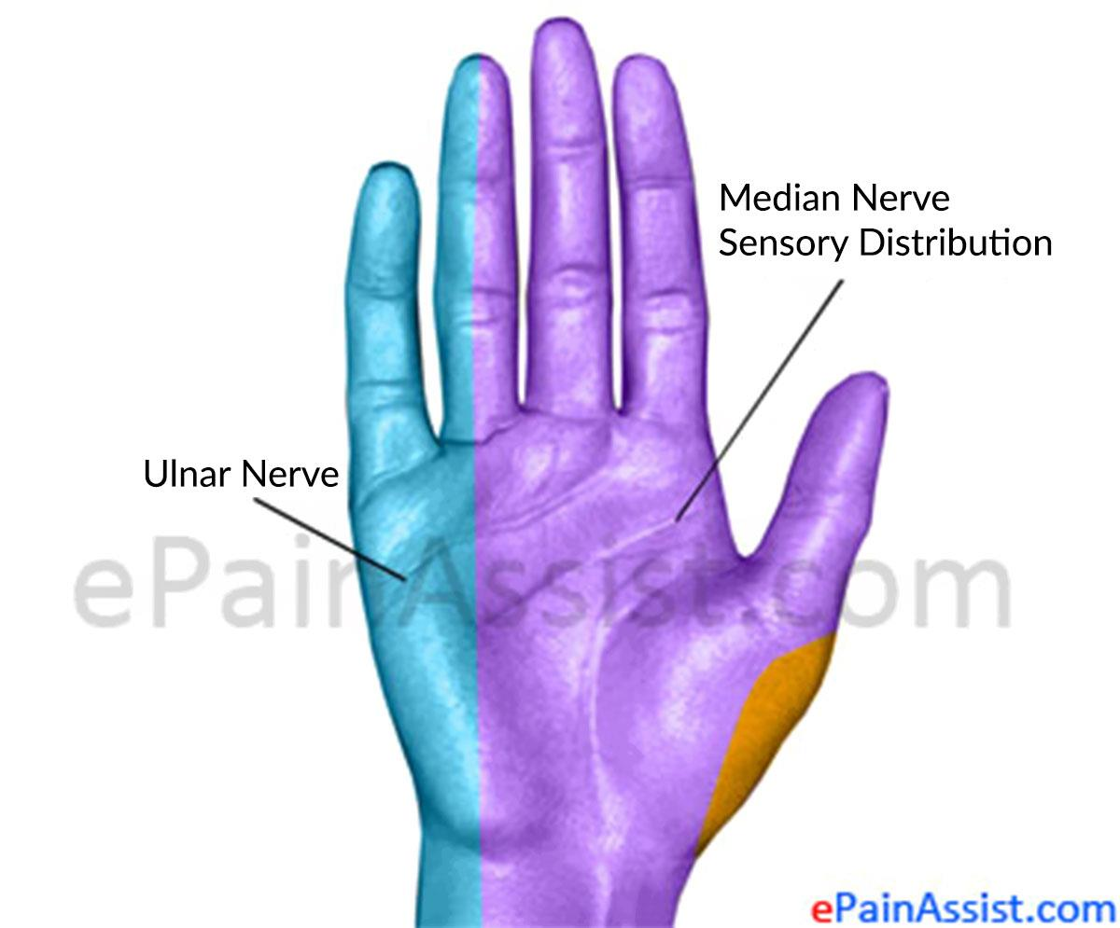
Median nerve injury

Slide 15
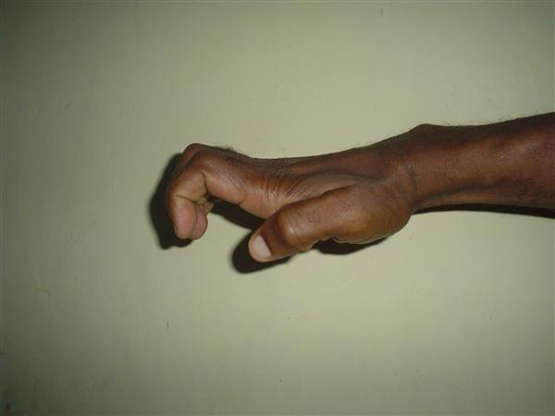
Ulnar nerve injury

Slide 16
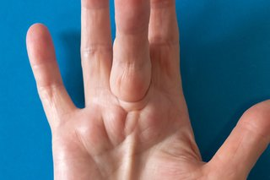
Thank you

