Slide 1
Management of Endometrial Hyperplasia
D Hind Showman

Slide 2
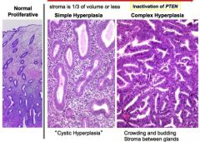
Endometrial hyperplasia is defined as irregular proliferation of the endometrial glands with an increase in the gland to stroma ratio when compared with proliferative endometrium.

Slide 3
Endometrial cancer is the most common gynaecological malignancy in the Western world and endometrial hyperplasia is its precursor
The incidence of endometrial hyperplasia is estimated to be at least three times higher than endometrial cancer and if left untreated it can progress to cancer.

Slide 4
The most common presentation of endometrial hyperplasia is abnormal uterine bleeding this includes
heavy menstrual bleeding
intermenstrual bleeding
irregular bleeding
unscheduled bleeding on hormone replacement therapy (HRT)
postmenopausal bleeding.

Slide 5
What are the risk factors for endometrial hyperplasia?
increased body mass index (BMI) with excessive peripheral conversion of androgens in adipose tissue to estrogen.
anovulation associated with the perimenopause or polycystic ovary syndrome (PCOS).
estrogen-secreting ovarian tumours, e.g. granulosa cell tumours (with up to 40% prevalence of endometrial hyperplasia); and
drug-induced endometrial stimulation, e.g. the use of systemic estrogen replacement therapy or long-term tamoxifen.

Slide 6
How should endometrial hyperplasia be classified?
The widely adopted 1994 WHO classification of endometrial hyperplasia:
(i) simple hyperplasia,
(ii) complex hyperplasia,
(iii) simple hyperplasia with atypia
(iv) complex hyperplasia with atypia. The association of cyto logical atypia with an increased risk of endometrial cancer has been known since
The revised 2014 World Health Organization (WHO) classification is recommended. This separates endometrial hyperplasia into two groups based upon the presence of cytological atypia: i.e. (i) hyperplasia without atypia and (ii) atypical hyperplasia.

Slide 7
What diagnostic and surveillance methods are available for endometrial hyperplasia?
endometrial sampling by outpatient endometrial biopsy. by using miniature outpatient suction devices designed to blindly abrade and/or aspirate endometrial tissue from the uterine cavity or by inpatient endometrial sampling, such as dilatation and curettage performed under general anaesthesia
Despite a negative biopsy result, 2% of women will still have endometrial hyperplasia.

Slide 8
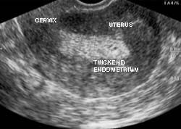
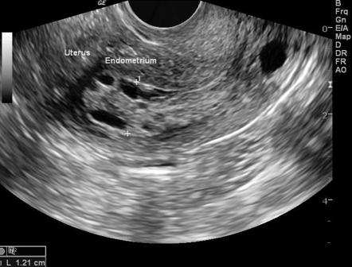
Transvaginal ultrasound may have a role in diagnosing endometrial hyperplasia in pre- and post menopausal women. that detects
an irregularity of the endometrial profile or
an abnormal double layer endometrial thickness measurement would give further reason to perform an endometrial biopsy in women with postmenopausal bleeding.

Slide 9
Systematic reviews have suggested a cut-off of 3 mm or 4 mm for ruling out endometrial cancer and
have shown that the probability of cancer is reduced to less than 1% when the endometrial thickness is less than the cut-off. However, a larger cut-off value has been suggested for women taking HRT or tamoxifen, whether presenting with abnormal uterine bleeding or asymptomatic
PCOS found that no woman with an endometrial thickness of less than 7 mm had endometrial hyperplasia.As a result, the RCOG guidance supports the conclusion that below this cut-off endometrial hyperplasia is unlikely.

Slide 10
Diagnostic hysteroscopy should be considered to facilitate or obtain an endometrial sample, especially where outpatient sampling fails or is non diagnostic
There is insufficient evidence evaluating computerised tomography (CT), diffusion-weighted magnetic resonance imaging (MRI) or biomarkers as aids in the management of endometrial hyperplasia and their use is not routinely recommended.

Slide 11
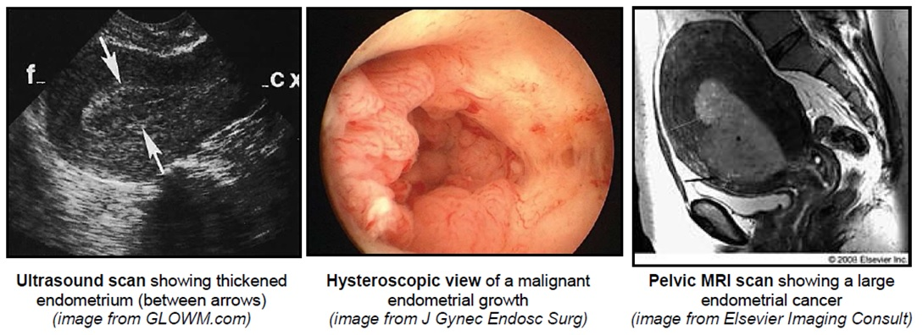

Slide 12
How should endometrial hyperplasia without atypia be managed?
Women should be informed that the risk of endometrial hyperplasia without atypia progressing to endometrial cancer is less than 5% over 20 years and that the majority of cases of endometrial hyperplasia without atypia will regress spontaneously during follow-up

Slide 13
Observation alone with follow-up endometrial biopsies to ensure disease regression
treatment with progestogens has a higher disease regression rate compared with observation alone
Progestogen treatment is indicated in women who fail to regress following observation alone and in symptomatic women with abnormal uterine bleeding.

Slide 14
What should the first-line medical treatment of hyperplasia without atypia be?
The LNG-IUS should be the first-line medical treatment because compared with oral progestogens it has a higher disease regression rate with a more favourable bleeding profile and it is associated with fewer adverse effects.
Continuous progestogens should be used (medroxyprogesterone 10–20 mg/day or norethisterone 10–15 mg/day) for women who decline the LNG-IUS.
Cyclical progestogens should not be used because they are less effective in inducing regression of endometrial hyperplasia without atypia compared with continuous oral progestogens or the LNG-IUS.

Slide 15
What should the duration of treatment and follow-up of hyperplasia without atypia be?
Treatment with oral progestogens or the LNG-IUS should be for a minimum of 6 months in order to induce histological regression of endometrial hyperplasia without atypia.
If adverse effects are tolerable and fertility is not desired, women should be encouraged to retain the LNG-IUS for up to 5 years as this reduces the risk of relapse, especially if it alleviates abnormal uterine bleeding symptoms.

Slide 16
When is surgical management appropriate for women with endometrial hyperplasia without atypia?
Hysterectomy should not be considered as a first-line treatment for hyperplasia without atypia because progestogen therapy induces histological and symptomatic remission in the majority of women and avoids the morbidity associated with major surgery.

Slide 17
Hysterectomy is indicated in women not wanting to preserve their fertility when (i) progression to atypical hyperplasia occurs during follow-up, or (ii) there is no histological regression of hyperplasia despite 12 months of treatment, or (iii) there is relapse of endometrial hyperplasia after completing progestogen treatment, or (iv) there is persistence of bleeding symptoms, or (v) the woman declines to undergo endometrial surveillance or comply with medical treatment.
Postmenopausal women requiring surgical management for endometrial hyperplasia without atypia should be offered a bilateral salpingo-oophorectomy together with the total hysterectomy.

Slide 18
For premenopausal women, the decision to remove the ovaries should be individualised; however, bilateral salpingectomy should be considered as this may reduce the risk of a future ovarian malignancy.
A laparoscopic approach to total hysterectomy is preferable to an abdominal approach as it is associated with a shorter hospital stay, less postoperative pain and quicker recovery.
Endometrial ablation is not recommended for the treatment of endometrial hyperplasia because complete and persistent endometrial destruction cannot be ensured and intrauterine adhesion formation may preclude future endometrial histological surveillance.

Slide 19
What should the initial management of atypical hyperplasia be?
Women with atypical hyperplasia should undergo a total hysterectomy because of the risk of underlying malignancy or progression to cancer.
A laparoscopic approach to total hysterectomy is preferable to an abdominal approach as it is associated with a shorter hospital stay, less postoperative pain and quicker recovery.
There is no benefit from intraoperative frozen section analysis of the endometrium or routine lymph adenectomy.
.

Slide 20
Postmenopausal women with atypical hyperplasia should be offered bilateral salpingo-oophorectomy together with the total hysterectomy
For premenopausal women, the decision to remove the ovaries should be individualised; however, bilateral salpingectomy should be considered as this may reduce the risk of a future ovarian malignancy.
Endometrial ablation is not recommended because complete and persistent endometrial destruction cannot be ensured and intrauterine adhesion formation may preclude endometrial histological surveillance.

Slide 21
How should women with atypical hyperplasia who wish to preserve their fertility or who are not suitable for surgery be managed?
Women wishing to retain their fertility should be counselled about the risks of underlying malignancy and subsequent progression to endometrial cancer. the risk of co-existing ovarian cancer was up to 4%
Pretreatment investigations should aim to rule out invasive endometrial cancer or co-existing ovarian cancer.
First-line treatment with the LNG-IUS should be recommended, with oral progestogens as a second-best alternative . Several hormonal therapies have been used to treat this group of women and these include oral progestogens, the LNG-IUS, aromatase inhibitors and gonadotrophin-releasing hormone agonists.
Once fertility is no longer required, hysterectomy should be offered in view of the high risk of disease relapse.

Slide 22
How should women with atypical hyperplasia not undergoing hysterectomy be followed up?
Routine endometrial surveillance should include endometrial biopsy. Review schedules should be individualised and be responsive to changes in a woman’s clinical condition. Review intervals should be every 3 months until two consecutive negative biopsies are obtained.
In asymptomatic women with a uterus and evidence of histological disease regression, based upon a minimum of two consecutive negative endometrial biopsies, long-term follow-up with endometrial biopsy every 6–12 months is recommended until a hysterectomy is performed.

Slide 23
How should endometrial hyperplasia be managed in women wishing to conceive?
Disease regression should be achieved on at least one endometrial sample before women attempt to conceive.
Women with endometrial hyperplasia who wish to conceive should be referred to a fertility specialist to discuss the options for attempting conception, further assessment and appropriate treatment.
Assisted reproduction may be considered as the live birth rate is higher and it may prevent relapse compared with women who attempt natural conception.
Prior to assisted reproduction, regression of endometrial hyperplasia should be achieved as this is associated with higher implantation and clinical pregnancy rates.

Slide 24
HRT and endometrial hyperplasia
Systemic estrogen-only HRT should not be used in women with a uterus.
All women taking HRT should be encouraged to report any unscheduled vaginal bleeding promptly.
Women with endometrial hyperplasia taking a sequential HRT preparation who wish to continue HRT should be advised to change to continuous progestogen intake using the LNG-IUS or a continuous combined HRT preparation. Subsequent management should be as described in the preceding sections of the guideline.
Women with endometrial hyperplasia taking a continuous combined preparation who wish to continue HRT should have their need to continue HRT reviewed. Discuss the limitations of the available evidence regarding the optimal progestogen regimen in this context. Consider using the LNG-IUS as a source of progestogen replacement.

