Slide 1
Trauma
BY
Dr ALI ADIL

Slide 2
TRAUMA
Trauma is the study of medical problems associated with physical Injury,
including thermal, ionising radiation and chemical but the most common force is the mechanical one.
it is the leading cause of death and disability in the first four decades
of life and is the third most common cause of death overall

Slide 3
Management of trauma
The importance of time:
time is one of the most vital factors that separate patient from death.
Zero time, the person/patient is at their normal baseline.
Then there is some interaction with an external force leading to injury.
The timeline is the progress from time zero to other significant events or deadlines that follow.
Some problems tend to lead to earlier death than others.

Slide 4
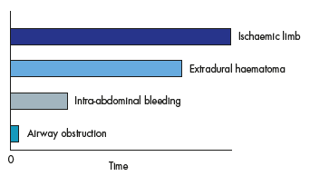
Figure 1: Estimated time from incident to death or irretrievable
damage for various conditions.

Slide 5
Diagnosis time is the time between injury and recognition of the problem.
Response time is the time that elapses between identifying the problem and effective intervention being completed. ( early move)
Our goal is to reduce all these time frames.
ATLS is the most commonly used protocol worldwide in the management of trauma patients , it include:
primary survey→ABCDE.
The primary survey combine the detection and treatment of life-threatening
. problems
. Secondary survey is a head to toe examination, started after finishing the primary survey.

Slide 6
ASSESSMENT AND RESPONSE
The assessment of trauma :
The relationship can be expressed simply as: mechanism + patient = injury
The nature of these components may be quite obvious (overt)
or in some way hidden (covert).
Mechanism :
Blunt or penetrating.
Blast injury
Crush injury
Thermal injury
Penetrating injuries include:
Stab wound e.g knife
Bullet (firearms) which subdivided into:
High velocity e.g machine gun
Low velocity e.g gun or pistol

Slide 7
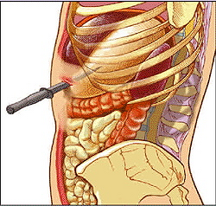
Stab injury
Its predictable
Extent of injury depend on length of knife and its direction

Slide 8
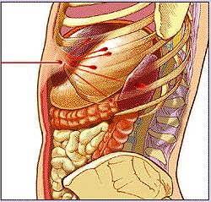
Bullet injury
Non predictable especially high velocity missile
energy increase with velocity.
distance from the weapon is an important factor which determine velocity.

Slide 9
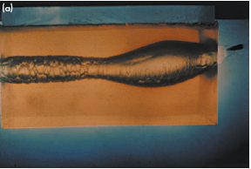
Low velocity missile passing through gelatin block
Low velocity bullet behave like a knife
Direction and distance are very important

Slide 10
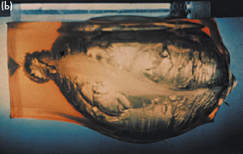
high velocity missile passing through gelatin block
The high-velocity bullet crushes particles of the human body
in its pathway and produces lateral acceleration away from the
point of impact.
So it cause cavitations.

Slide 11
Blunt trauma is divided into
Direct (at site of injury)
Indirect ( away from site of impact) especially in crushing injury.
Motor vehicle accident (MVA) is the most common type.
Ejection from a vehicle is associated with a significantly greater
incidence of severe injury.
The use of seatbelts reduces the risk of death or serious injury for front-seat occupants by approximately 45 per cent.
Risk of seatbelt injuries:
have a four-fold increase in thoracic trauma.
eight-fold increase in intraabdominal trauma.

Slide 12
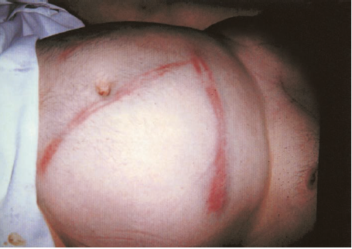
Seatbelt mark after MVA.

Slide 13
Airbag reduce the risk of injury and death by 30% but also has certain risk especially on children.
Patient factors:
It include:
Age
Comorbidities
Drugs taken
Obvious injuries:
Injuries which are visible externally, so they add E ( for exposure) to the ABCDE of ATLS.
e.g penetrating or inhalational injury.

Slide 14
ASSESSMENT AND MANAGEMENT OF THE SERIOUSLY INJURED :
following major trauma there a trimodal death distribution:
Immediate, 50 %of all deaths. No chance of life, mostly caused by sever head or cardiopulmonary injury.
Early, within the first few hours, result from failure of oxygenation of tissues due to airway or breathing or circulation problem.
Late, 20 per cent of deaths. From multiorgan failure or sepsis.
The key to successful work and saving the lives of severely injured patient is by teamwork (multidisciplinary team approach) .

Slide 15
PRIMARY SURVEY AND RESUSCITATION :
ATLS:
A protocol used worldwide in the management of trauma, its divided into:
primary survey: ABCDE system designed for diagnosis and treatment of life threatening injuries it include:
A airway with cervical spine protection
B breathing and ventilation
C circulation haemorrhage control
D disability (neurological status)
E exposure (completely undress the patient).

Slide 16
Airway with cervical spine protection:
Ensuring Airway patency is the most vital step so it’s the first to be assessed, and this can be done by:
Establishing a vocal response from the patient.
clearing the mouth and suctioning. ( blood, foreign bodies)
jaw thrust or chin lift.
nasopharyngeal or Guedel airway
Definitive airway (endotracheal tube) if Glascow coma scale (GSC) ≤ 8.
Tracheostomy if there sever injury to the upper airway.
Any patient with sever head injury should be suspected to have a cervical spine injury until proven otherwise and should be immobilized with a collar.

Slide 17
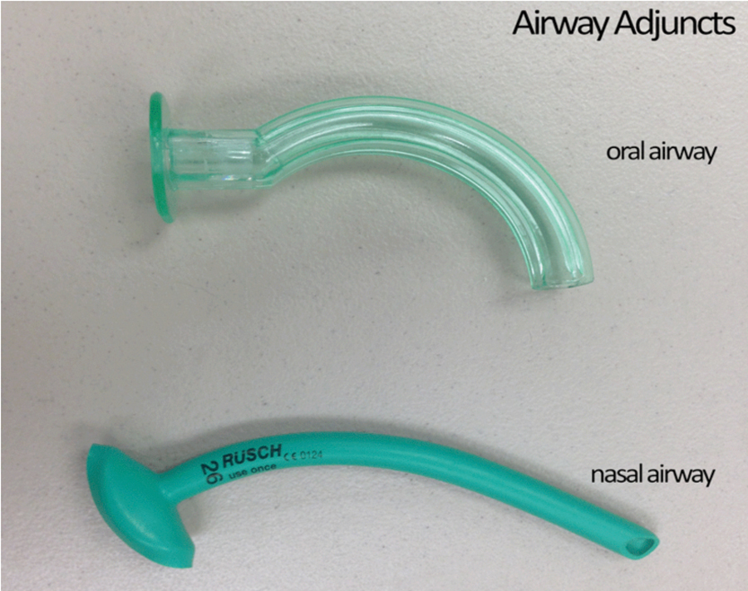

Slide 19
Breathing and ventilation:
After ensuring a patent airway, the chest should assessed by a complete examination to ascertain a good air entry and proper ventilation.
Life threatening chest injuries should be identified at this time and treated, including:
flail chest
Tention pneumothorax
Open pneumothorax (Open sucking wound)
Massive haemothorax
Critical findings which pay attention to sever chest injury:
tracheal deviation
absence of or asymmetry of breath sounds
Hyper resonance or dullness on percussion
Decrease oxygenation despite a patent airway

Slide 20
Circulation and control of bleeding
While emergency team working on A and B other team members will assess three critical clinical observations :
1. Conscious level.
2. Skin colour.
3. Pulse
And perform the following actions:
1. Two large-bore cannulae for intravenous access
2. Withdrawal of blood for hematological investigation
3. Initiation of intravenous fluid, blood or blood substituents
4. Measurement of blood pressure and monitoring of urine output (after introduction of Foleys catheter)
5. Looking for external hemorrhage and control of it if possible.

Slide 21
Disability:
Examination of the neurological system for head injury by:
examination of the pupil for size and reactivity.
GCS.
This should be repeated regularly.
Causes of disturbed level of consciousness other than head injury e.g hypovolemia, hypoglycemia ,alcohol and drug abuse should be identified and treated.
Exposure:
The patient must be fully exposed and examined front and back using a carefully controlled log roll.

Slide 22
Adjuncts to the primary survey
Blood tests – full blood count, urea and electrolytes, clotting
screen, glucose, toxicology, cross-match
ECG, pulse oximetry, arterial blood gas (ABG)
Two wide-bore cannulae for intravenous fluids
Urinary and gastric catheters
Radiographs of the cervical spine, chest and pelvis

Slide 23
SECONDARY SURVEY
Can be done after controlling the life threatening injury (may take place shortly after admission, the following morning on the ward round or sometimes a week later when the patient first regains consciousness).
it’s a head to toe examination or look every where approach.
the goal is to find other injuries.
the history is abbreviated by the ‘AMPLE’ mnemonic:

Slide 24
Secondary survey physical examination :
Head and face, Look for:
penetrating injuries and depressed fractures
Facial wounds
Rhinorrhea and otorrhea.
Ecchymosis, e.g battle sign
2. Neck. Inspect and palpate the cervical spine anteriorly and
posteriorly for haematomas, crepitus, tenderness and evidence of steps on palpation .
3. Chest, as described in primary survey.
4. Neurological examination
5. Abdominal examination,
inspect for bruising, penetrating wound, distention
Palpate for any tenderness, guarding and rigidity.
PR for bleeding, prostate .
6. Extremities. Look for any bleeding or deformity( if so try to align it).

Slide 25
7. Log roll. Its careful turning of the patient to examine the posterior aspect for any tenderness, or signs of injury (palpate the whole length of the vertebral column.
Special group consideration:
Children:
Injury is the leading cause of mortality among children and adolescents. They are more prone to sever injuries due to:
Large surface area compared to Small body mass lead to rapid hypothermia.
Less fat
Immature skeleton
2. Elderly
high mortality from chest injuries
As the heart rate decrease by age or medication there will be masking of hypovolemia.
Brain atrophy protect from contusion.
Osteoporosis and osteoarthritis lead to higher risk of spinal fractures after minor trauma.

Slide 26
3. Pregnancy
The fundamental principles of the ATLS system remain the same.
always pregnancy should be excluded in child bearing age female.
the gravid uterus in 3rd trimester should manually displaced to the left side to relieve pressure on the IVC and increase the venous return.
their increase in intravascular volume in pregnancy so they can tolerate hypovolemia more.

Slide 27
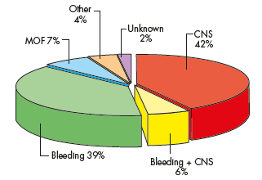
Torso trauma
The torso is generally regarded as the area between the neck and the groin, made up of the thorax and abdomen.
Causes of death in trauma. CNS, central nervous system;
MOF, multiple organ failure

Slide 28
Junctional zones
Neck
Mediastinum: its major vessels and the heart is also an extremely high-risk area for penetrating wounds.
Diaphragm: suspected in lower chest or upper abdominal injuries.
Groin and pelvis: The pelvis contains a large plexus of vessels, both venous and arterial.
Retroperitoneum: difficult to diagnose injuries, the best diagnostic tool is CT scan.
The retroperitoneum is divided into three zones
1 Zone 1 (central): central haematomas should always be
explored, once proximal and distal vascular control has been obtained.
2 Zone 2 (lateral): lateral haematomas are usually renal in
origin and can be managed non-operatively, they may sometimes require angioembolisation..
3 Zone 3 (pelvic): pelvic haematomas are exceptionally difficult
to control and, whenever possible, should not be opened; they should be controlled with packing (intra- or extra peritoneal) and angioembolisation.

Slide 29
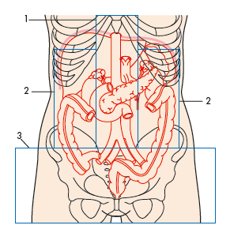

Slide 30
Trauma of chest and abdomen are treated according to ATLS protocol.
Bleeding is the major concern and the most difficult in diagnosis, certain criteria help us to diagnose bleeding which are:
Physiological Increasing respiratory rate
Increasing pulse rate
Falling blood pressure
Rising serum lactate
Anatomical Visible bleeding
injury in close proximity to major vessels
Penetrating injury with a retained missile

Slide 31
THORACIC INJURY
Chest injuries are often life threatening by its on or associated with other organ injury, About 80 per cent of patients with chest injury can be managed nonoperatively.
Investigation of chest injuries
1. Clinical examination:
Inspection: look for any visible injury, bruising, dilated neck veins etc.
Palpation: decrease chest expansion.
Percussion: dullness in haemothorax, hyperresonance in pneumothorax.
Auscultation: decrease air entry in both haemo and pneumothorax.
In massive haemothorax palpate from the back.

Slide 32
2. Chest x-ray
The first choice investigation, so its part of the primary survey.
3. ultrasound: could be used in diagnosis of chest injuries.
4. CT scan: should be done only to stable patient.
5. Chest tube (underwater seal) : can be used as diagnostic and therapeutic.
Management
most patients are treated with resuscitation and drainage of the accumulated blood or air.
.

Slide 33
In blunt injury, most bleeding occurs from the intercostal or internal mammary artey and usually treated conservatively.
The ‘deadly dozen’ threats to life from chest injury.
Immediately life threatening ( treated in primary survey)
Airway obstruction
Tension pneumothorax
Pericardial tamponade
Open pneumothorax
Massive haemothorax
Flail chest
Potentially life threatening ( treated in secondary survey)
Aortic injuries
Tracheobronchial injuries
Myocardial contusion
Rupture of diaphragm
Oesophageal injuries
Pulmonary contusion

Slide 34
Airway obstruction
Early intubation is very important, particularly in cases of neck
.haematoma or possible airway oedema
Tension pneumothorax
develops when a ‘one-way valve’ air leak occurs either from the lung or through the chest wall. Air is sucked into the thoracic cavity without any means of escape.
Clinical features:
The patient is increasingly panicky with tachypnoea
Dyspnea
Distended neck veins
On examination:
Tracheal deviation
hyper-resonance and absent breath sounds
Lung collapse on CXR.
Deviation of mediastinum.

Slide 35
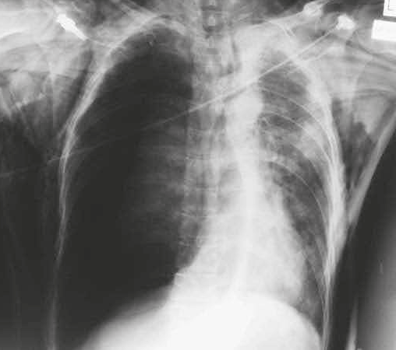
Radiological appearance of a tension pneumothorax.

Slide 36
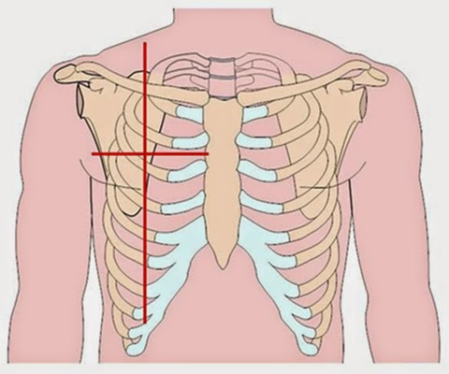
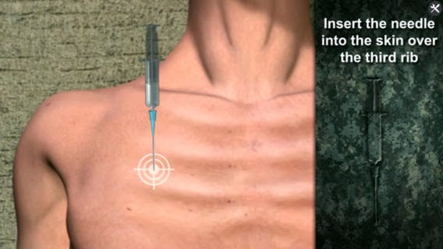
Treatment:
1 .Immediate needle decompression
2. Chest tube insertion

Slide 37
Pericardial tamponade
Its collection of blood in the non distensible pericardium, mostly occur after penetrating injuries.
Clinical features:
Distended neck veins with increase in venous pressure
Hypotension
Muffled heart sounds
Diagnosis:
CXR
Ultrasound
Treatment:
Needle pericardiocentesis
Rapid I.V resuscitation
Definitive surgery

Slide 38
Sucking chest wound:
Accumulation of air in the pleural cavity rather than in the lung, it occurs due to a large open defect (more than 3 cm) in the chest. If non treated properly it will cause a tension pneumothorax.
Treatment:
don’t close the wound
3 sides dressing
Chest tube insertion
D. Physiotherapy and active mobilization should begin as soon as possible
Massive haemothorax::
Accumulation of large amount of blood in chest cavity, usually following blunt chest trauma. Patient may present with signs of shock.
Treatment:
I.V resuscitation
Chest tube
Thoracotomy in certain indications.

Slide 39
Flail chest
three or more ribs fractured in two or more places, following blunt trauma.
there is a paradoxical movement of the loose segment.
Treatment:
O2
Analgesia (including intrapleural if chest tube inserted)
Physiotherapy
Mechanical ventilation in sever cases.

Slide 40
ABDOMINAL INJURY
Patients with abdominal injury are classified into 3 major groups according to their physiological status:
1.Haemodynamically ‘normal’: investigation can be completed before treatment is planned.
2. Haemodynamically ‘stable’: investigation is more limited. It is aimed at establishing whether the patient can be managed non-operatively.
3. Haemodynamically ‘unstable’: here the investigation must be suspended because urgent surgery is required to stop bleeding.
Investigation
1. Clinical examination: finding of tachycardia, tense and tender abdomen are signs of peritoneal irritation by blood or intestinal fluid.
2. Focused abdominal sonar for trauma: is a technique whereby ultrasound (sonar) imaging is used to assess the torso for the presence of free blood, either in the abdominal cavity or in the pericardium.

Slide 41
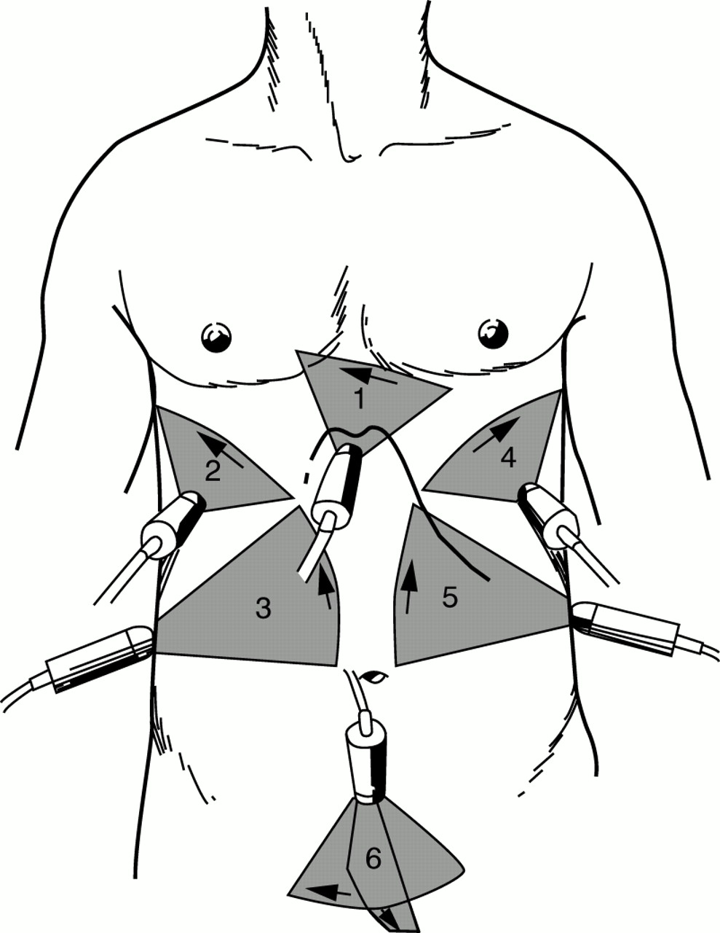
Areas to be examined by fast:
Pericardium
Around liver
right pericolic gutter
Around spleen
Left pericolic gutter
Pelvic cavity

Slide 42
Diagnostic peritoneal lavage
Is a test designed for diagnosis of haemoperitoneum, A cannula is inserted below the umbilicus, directed caudally and posteriorly. The cannula is aspirated for blood (>10 mL is deemed as positive) and, following this, 1000 mL of warmed Ringer’s lactate solution is allowed to run into the abdomen and is
then drained out. The presence of >100 000 red cells/μL or >500 white cells/μL is deemed positive.
Its used alternative to FAST.
Computed tomography
CT with intravenous contrast has become the ‘gold standard’ for the intra-abdominal diagnosis of injury in the stable patient.
It can diagnose blood and individual organ injury, as well as for retroperitoneal injury.

Slide 43
Diagnostic laparoscopy
Used in stable patients with penetrating trauma, to detect or exclude peritoneal penetration and/or diaphragmatic injury, When used in this role DL reduces the non-therapeutic laparotomy rate.
INDIVIDUAL ORGAN INJURY
Liver
Blunt liver trauma occurs as a result of direct injury, the liver as a solid organ is compressed between the impacting object and the vertebrae or ribs.
Most injuries are relatively minor and can be managed non-operatively.
Penetrating trauma to the liver is relatively common.
CT is the investigation of choice in stable patients.

Slide 44
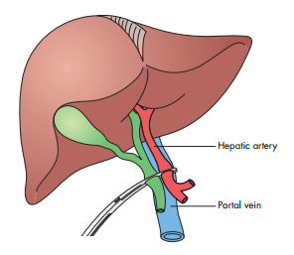
Management
The operative management of liver injuries can be summarized as ‘the four Ps’:
1 push; direct compression
2 Pringle; by Pringle’s manoeuvre, with direct compression of the portal triad, either digitally or using a soft clamp .
3 plug; direct plugging of the penetrating injury.
4 pack. (damage control surgery)
Other treatment modalities including angioembolisation and suturing.

Slide 45
Biliary injuries
Isolated traumatic biliary injuries are rare, occur mainly from penetrating trauma,
and often occur in association with injuries to other nearby structures.
Spleen
Also occurs from penetrating or blunt trauma, Most isolated splenic injuries, especially in children, can be managed nonoperatively.
Indication of surgical treatment:
Presence of other injury
Age >55 years
physiological instability (including sever isolated injury)
Surgical options:
Splenectomy
Splenic repair by suturing or mesh plug
Packing
angioembolisation

Slide 46
Pancreas
Most pancreatic injury occurs as a result of blunt trauma and commonly treated by conservative injury and closed suction drainage.
Surgical treatment options depend on the site of injury:
In the tail so → distal pancreatectomy
In the head or neck → drainage and bypass or damage control procedure with packing and drainage in sever and difficult to manage trauma.
Stomach
Most stomach injuries are caused by penetrating trauma.
Duodenum
It usually associated with pancreatic injuries, surgical options also depend on site of duodenal injury, ranging from direct repair, bypass, drainage to damage control in sever cases.

Slide 47
Small bowel
Small bowel and its mesentery is liable to be ruptured or teared by blunt trauma.
Treatment according to type of trauma, extent of injury and condition of the patient .
It may include one or more of:
Direct repair
Resection and anastomosis
Damage control
Hematoma at mesenteric border should be explored to exclude bowel injury.

Slide 48
Colon
The colon is liable more to penetrating than to blunt trauma
As in small bowel also surgical option depend on
Degree of contamination
Status of the patient
Bowel viability
It include:
Primary repair
Resection and defunctioning stoma
Resection and anastomosis

Slide 49
Rectum
Only 5 per cent of colon injuries involve the rectum and usually result from penetrating injury.
It may result from pelvic fracture and associated with bladder and proximal urethral injury.
Finding of blood on per rectum examination is diagnosing of colorectal injury.
Treatment according to site of injury:
Repair and proximal colostomy if injury of intraperitoneal part.
Proximal colostomy if the injury involve extraperitoneal part.

Slide 50
DAMAGE CONTROL
It’s a limited surgery done to severely injured and physiologically unstable ( shocked patient) who suffered the lethal triad of:
Hypothermia
Coagulopathy
Acidosis
This mode of surgery was originated from naval strategy, whereby a ship which has been damaged may have minimal repairs needed to prevent it from sinking, while definitive repairs wait until it has reached port.
Its designed for :
1 .stopping any active surgical bleeding;
2 .controlling any contamination
Then the abdomen is temporarily closed (opsite sandwich)and the patient is then transferred to the ICU where resuscitation continues to treat the lethal triad.
After stabilization of the patient condition then he transferred back to the theatre for definitive surgery and closure of the abdomen but avoid the ICS.

Slide 51
ABDOMINAL COMPARTMENT SYNDROM
A rise in the intraabdomial pressure
A significant complication of post traumatic abdominal incision closure.
Organ Effect
Renal Increase in renal vascular resistance leading
to a reduction in glomerular filtration rate and
impaired renal function
Cardiovascular Decrease in venous return resulting in decreased
cardiac output because of both a reduction in
preload and an increase in afterload
Respiratory Increased ventilation pressures because of
splinting of the diaphragm, decreased lung
compliance and increased airway pressures
Visceral perfusion Reduction in visceral perfusion
Intracranial effects Severe rises in intracranial pressures

Slide 52
Damage control resuscitation
Minimize emergency resuscitation time
Treatment and monitoring of lethal triad

Slide 53
Indications for damage control surgery
Anatomical
Inability to achieve haemostasis
Complex abdominal injury, e.g. liver and pancreas
Combined vascular, solid and hollow organ injury
Inaccessible major venous injury, e.g. retrohepatic vena cava
Physiological
Temperature <34ºC
pH <7.2
Serum lactate >5 mmol/L (N (normal)
<2.5 mmol/L)
Prothrombin time (PT) >16 s
Partial thromboplastin time (PTT) >60 s
>10 units blood transfused
Systolic blood pressure <90 mmHg for >60 min
Environmental
Operating time >60 min
Inability to approximate the abdominal incision

