Slide 1
Intestinal obstruction 2

Slide 2
Clinical features of strangulation
Sudden sever constant pain
Tenderness and rigidity
Fever
Tachycardia
Other signs of shock
When strangulation occurs in an external hernia, the lump is tense, tender and irreducible and there is no expansile cough impulse. Skin changes with erythema or purplish discolouration are associated with underlying ischaemia.

Slide 3
Clinical features of volvulus
Volvulus of the small intestine
Usually in lower ileum
Primary or secondary
Caecal volvulus
May occur as part of volvulus neonatorum
Usually a clockwise twist.
It is more common in females
Present acutely
The volvulus typically results in the caecum lying in the left upper quadrant

Slide 4
Sigmoid volvulus
Young patients appearing to develop the more acute form
Signs of acute LB obstruction with hiccough and retching
In the elderly, a more chronic form may be seen.

Slide 5
IMAGING
X-ray
Nowadays radiological diagnosis is based on a supine abdominal film
An erect film may subsequently be requested when further doubt exist.
5

Slide 7
Radiological features of obstruction (on plain x-ray)
●● The obstructed small bowel is characterized by straight
segments that are generally central and lie transversely. No/
minimal gas is seen in the colon
●● The jejunum is characterized by its valvulae conniventes,
which completely pass across the width of the bowel and are
regularly spaced, giving a ‘concertina’ or ladder effect
●● Ileum – the distal ileum has been piquantly described by
Wangensteen as featureless
●● Caecum – a distended caecum is shown by a rounded gas
shadow in the right iliac fossa
●● Large bowel, except for the caecum, shows haustral folds,
which, unlike valvulae conniventes, are spaced irregularly, do
not cross the whole diameter of the bowel and do not have
indentations placed opposite one another

Slide 8
In intestinal obstruction, fluid levels appear later than gas shadows as it takes time for gas and fluid to separate
In adults there are 2 normal fluid levels one in the duodenal cap and the other in the terminal ileum.
In children it is difficult to distinguish large from small bowel in the presence of obstruction.
In the small bowel, the number of fluid levels is directly proportional to the degree of obstruction and to its site.
Distal LB obstruction not associated with air fluid levels unless advanced,
High colonic obstruction may do so in the presence of an incompetent ileocaecal valve.
Colonic obstruction is usually associated with a large amount of gas in the caecum.

Slide 10
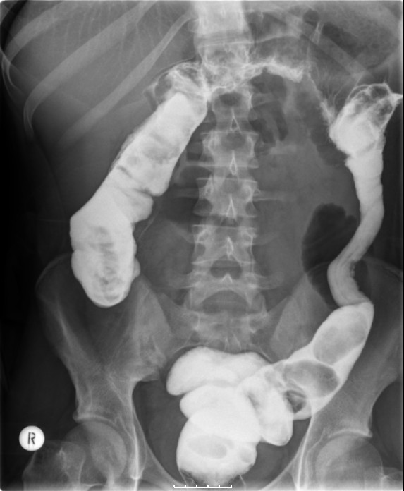
Water soluble contrast
Is considered diagnostic, therapeutic and prognostic.
Barium study is contraindicated in acute obstruction
10

Slide 11
CT SCAN
Widely used nowadays as it has high accuracy in diagnosing I.O and possibly its cause.
The only drawback of CT scan in diagnosis of bowel ischemia.

Slide 12
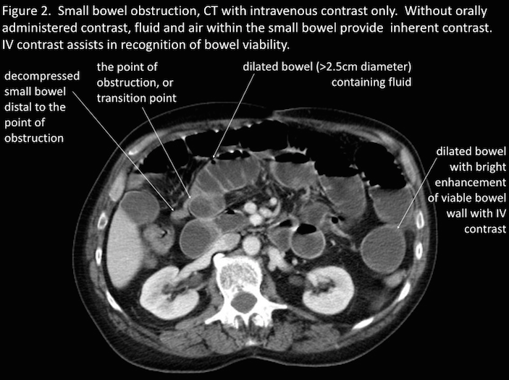

Slide 13
Imaging in intussusception
Plain x-ray:
small or large bowel obstruction
A soft tissue opacity is often visible in children.
absent caecal gas shadow in ileocolic cases
Barium enema:
It shows claw sign

Slide 14
Abdominal ultrasound
It shows the typical doughnut appearance of concentric rings in transverse section.
CT scan
The most sensitive radiological
The characteristic features of CT scan include a ‘target’- or ‘sausage’- shaped soft-tissue mass with a layering effect; mesenteric vessels within the bowel lumen

Slide 15
Imaging in volvulus
Caecal volvulus:
X-RAY:
Caecal dilatation (98–100%),
Single air-fluid level (72–88%),
Small bowel dilatation (42–55%)
absence of gas in distal colon (82–91%
Barium enema:
Absence of barium in the caecum and a bird beak deformity.
CT scanning
The best diagnostic choice
15

Slide 16
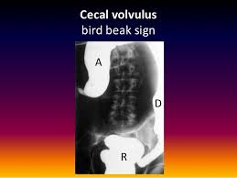

Slide 17
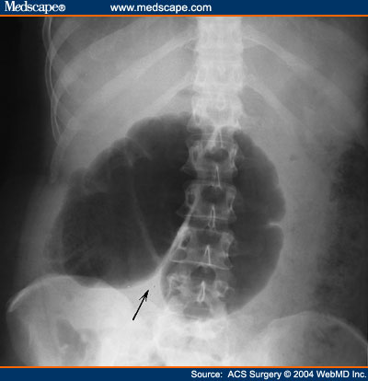

Slide 18
Sigmoid volvulus:
X-ray shows coffee bean sign

Slide 19
TREATMENT OF ACUTE INTESTINAL OBSTRUCTION
Treatment of acute intestinal obstruction
●● Gastrointestinal drainage via a nasogastric tube
●● Fluid and electrolyte replacement using Hartmann’s solution or normal saline.
●● Relief of obstruction
●● Surgical treatment is necessary for most cases of intestinal obstruction but should be delayed until resuscitation is complete, provided there is no sign of strangulation or evidence of closed-loop obstruction.

Slide 20
Surgical treatment
Indications for early surgical intervention
●● Obstructed external hernia
●● Clinical features suspicious of intestinal strangulation
●● Obstruction in a ‘virgin’ abdomen
The classic clinical advice ‘the sun should not both rise and set’ on a case of unrelieved acute intestinal obstruction.
If there is no evidence of ischemia postpone surgery till resuscitation is enough.
Where obstruction is likely to be secondary to adhesions, conservative management may be continued for up to 72 hours in the hope of spontaneous resolution.
20

Slide 21
Principles of surgery (small bowel):
Midline laparotomy incision
deliver the distended small bowel into the wound to have access into the cause of obstruction
Operative decompression by either:
1. Large orogastric tube with gentle milking of SB content into the stomach
2. Savage’s decompressor

Slide 22
Treatment of obstruction depend on the cause
Division of adhesions (enterolysis).
Excision
bypass or proximal decompression
checking bowel viability
if the bowel viability is in doubt, so; wrapped in hot packs for 10 minutes and increase O₂ supply, then check again, if in doubt so resect (if this does not result in short bowel syndrome).

Slide 23
Differentiation between viable and non-viable intestine.
Be aware of Intestinal ischaemia/reperfusion injury following reperfusion of ischaemic bowel with remote lung injury.
In massive infarction, surgical resection is depending on overall general condition, so; in elderly you may leave it but in young age resect with subsequent I.V alimentation and bowel transplantation

Slide 24
When no resection has been undertaken or there are multiple ischaemic areas (mesenteric vascular occlusion), a second-look laparotomy at 24–48 hours may be required.
Small bowel obstruction and strangulation occur in relation to port site hernias in laparoscopic surgery.

Slide 25
Treatment of adhesions
Supportive measures (conservative) usually curative
Close monitoring to exclude development of strangulation and ischemia
If obstruction is not relieved in 24 hours, proceed to surgery, even if you find multiple adhesions, only one is the cause of obstruction, if it really caused by multiple adhesions so sharply dissect all.
Laparoscopic adhesiolysis in the hands of advanced laparoscopic practitioners.
In recurrent cases follow the same principles above
25

Slide 26
Postoperative intestinal obstruction
Early fibrinous postoperative intestinal obstruction is difficult to be differentiated from persistent paralytic ileus, but it usually suspected in a patient who’s bowel function has returned then he develop the obstruction.
Obstruction is usually incomplete and the majority settles with continued conservative management.
Could be diagnosed by CT scan if there was a septic cause (collection).

Slide 27
TREATMENT OF ACUTE LARGE BOWEL OBSTRUCTION
It depend on the
1. Cause of obstruction for example diverticular disease, malignancy and wether it’s curable or not
2. Patient general condition
Surgical options:
Resection and anastomosis
Defunctioning stoma (ileostomy or colostomy)
Resection and stoma (Paul–Mikulicz procedure or Hartmann’s procedure).
Bypass surgery
Self expanding metal stents in irresectable stenosing tumors

Slide 28
Treatment of caecal volvulus
At operation the volvulus is usually found to be ischaemic and needs resection.
If viable:
Detwist the volvulus
Decompress the caecum with needle
Fix the caecum to the lateral abdominal wall (caecopexy) with or without caecostomy.
Recurrence after caecopexy is 40%.

Slide 29
Treatment of sigmoid volvulus
Flexible or rigid sigmoidoscopy and insertion of a flatus tube should be carried out to allow deflation of the gut. The tube should be secured in place with tape for 24 hours and a repeat x-ray taken to ensure that decompression has occurred.
In young patients, an elective sigmoid colectomy is required, the options after resection:
Anastomosis, if possible.
Paul- Mikulicz or Hartmann’s procedure.
No further treatment following successful endoscopic decompression is needed in the elderly as there is high mortality rate.

Slide 30
In recurrent volvulus in elderly, the options are resection or two-point fixation with combined endoscopic/ percutaneous tube insertion.
When the bowel is viable, fixation of the sigmoid colon to the posterior abdominal wall may be a safer manoeuvre in inexperienced hands.
30

Slide 31
CHRONIC LARGE BOWEL OBSTRUCTION
The causes of obstruction may be
Organic:
●● Intraluminal (rare) – faecal impaction;
●● Intrinsic intramural – strictures (Crohn’s disease, ischaemia,
diverticular), anastomotic stenosis;
●● Extrinsic intramural (rare) – metastatic deposits (ovarian), endometriosis, stomal stenosis;

Slide 32
Functional:
●● Hirschsprung’s disease, idiopathic megacolon, pseudoobstruction.
In functional cases, the symptoms may have been present for months or years. Constipation appears first. It is initially relative and then absolute, associated with distension.
Maximum distention in the caecum (RIF)
Pain follows
Lastly vomiting

Slide 33
ADYNAMIC OBSTRUCTION
Paralytic ileus
Definition: failure of transmission of peristaltic waves secondary to neuromuscular failure (i.e. in the myenteric (Auerbach’s) and submucous (Meissner’s) plexuses).
Varieties
The following varieties are recognised:
●● Postoperative: a degree of ileus usually occurs after any abdominal procedure and is self-limiting, with a variable duration of 24–72 hours. Postoperative ileus may be prolonged in the presence of hypoproteinaemia or metabolic abnormality (see below).
●● Infection: intra-abdominal sepsis may give rise to localised or generalised ileus.

Slide 34
●● Reflex ileus: this may occur following fractures of the spine or ribs, retroperitoneal haemorrhage or even the
application of a plaster jacket
●● Metabolic: uraemia and hypokalaemia are the most common contributory factors.

Slide 35
Clinical features
Paralytic ileus takes on a clinical significance if, 72 hours after laparotomy:
●● there has been no return of bowel sounds on auscultation;
●● there has been no passage of flatus.
So the patient present with distention, non colicky pain (pain from the wound from distention), vomiting and negative bowel sounds (silent abdomen).
X-ray shows distended SB and multiple air fluid levels.
35

Slide 36
Treatment:
NG tube
Restriction of oral intake until bowel sounds and the passage of flatus return.
Maintaining Electrolyte balance
Use of enhanced recovery programme with early introduction of fluids and solids.
5. Specific treatment is directed towards the cause, but the following general principles apply:

Slide 37
●● If a primary cause is identified this must be treated.
●● Gastrointestinal distension must be relieved by decompression.
●● Close attention to fluid and electrolyte balance is essential.
●● There is no convincing evidence for the use of prokinetic drugs to treat postoperative adynamic ileus.
●● if paralytic ileus is prolonged CT scanning is the most effective investigation; it will demonstrate any intraabdominal sepsis or mechanical obstruction and therefore guide any requirement for laparotomy.

Slide 38
The indications for surgery in paralytic ileus are:
if it lasts for more than seven days
if bowel activity recommences following surgery and then stops again.
.

Slide 39
Pseudo-obstruction
An obstruction, usually of the colon, that occurs in the absence of a mechanical cause or acute Intra-abdominal disease, it’s a peristalsis with non propulsive manner, so there is a sluggish bowel sounds on auscultation
.
Small intestinal pseudo-obstruction
Either primary (i.e. idiopathic or associated with familial visceral myopathy)
Or secondary.
Presents with recurrent subacute obstruction
Diagnosis by exclusion of organic causes
Treatment by correction of any underlying disorder, Metoclopramide and erythromycin may be of use.

Slide 40
Colonic pseudo-obstruction
May be acute or a chronic form.
The acute one is called Ogilvie’s syndrome, presents as acute large bowel obstruction.
X-ray show evidence of colonic obstruction, with marked caecal distension.
Diagnosis also by exclusion of a mechanical cause by urgent colonoscopy or a single contrast water-soluble barium enema or CT.
40

Slide 41
Treatment :
Correction of the underlying cause, if non useful
Intravenous neostigmine (1 mg intravenously), with a further 1 mg given intravenously within a few minutes if the first dose is ineffective. (ECG monitoring is required and atropine should be available).
If this is non useful then colonoscopic decompression should be performed.
Caecal perforation is a serious complication of acute pseudo-obstruction
It’s diagnosed clinically by RIF tenderness and distention, caecal perforation is more likely if the caecal diameter is14 cm or greater.
Surgery is associated with high morbidity and mortality and should be reserved for those with impending perforation when other treatments have failed or perforation has occurred

Slide 42
Rarely, an endoscopically placed tube colostomy is used as a vent for patients with a chronic unremitting condition.

Slide 43
Thank you

