Slide 1
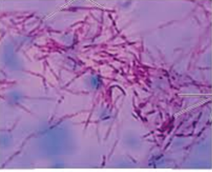
Mycobacterium

Slide 2
Order: Actinomycetails
Family: Myobacteriaceae
Genus: Mycobacterium

Slide 3
Divided into 4 main groups:
Mycobacterium tuberculosis
M. bovis
Atypical mycobacteria
M. leprae

Slide 4
All mycobacteria are intracellular, acid fast bacilli; they are in pairs or in small groups. Sometimes show branching filamentous forms. They are aerobic, non motile, non spore forming non capsulated slow growing forms.

Slide 5
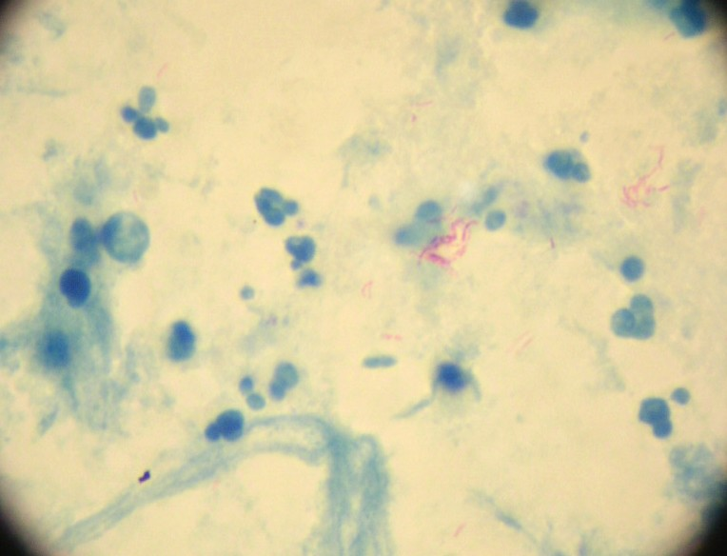
The bacilli appear red in sharp contrast to the blue counter stained background.

Slide 6
Mycobacterium tuberculosis:
They are slender, straight or slightly curved, 2-4 x 0.3-0.5m. in tissues they occur singly or in pairs or in small bundles of parallel bacilli( serpentine cords). While in culture, longer filamentous forms are sometimes seen with swollen or club- shaped forms which indicate the close relation of these organisms to the higher fungi hence they are called mycobacteria(fungus- like bacteria)

Slide 7
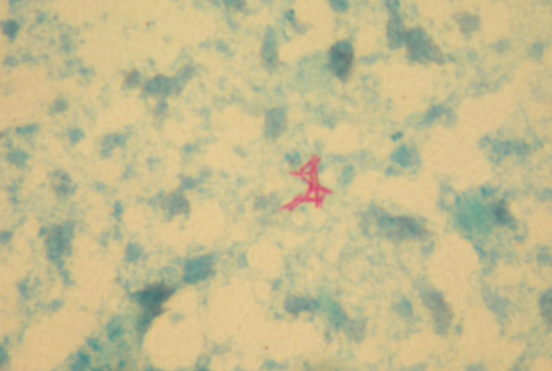
if smear is prepared from culture the bacilli appear short, thick and tend to arranged in a sort of bundles (cord formation).

Slide 8
Stained and recognized by acid fast stain with discoloration by 20-25% H₂SO₄ , or 3% acid + 95%alcohol.
They are slow growing with generation time 12-16 hours, therefore 4-6 weeks required for good growth. They do not grow on ordinary media,

Slide 9
they require special media for growth, such as:-
Lowenstein- Jensen medium: which contain egg yolk, glycerol and malachite green.
Glycerol broth: the organism forms a thick, wrinkled, creamy pellicle on top of the medium if undisturbed. Otherwise, will grow as floccules due to the lipid content of the cell wall.

Slide 10
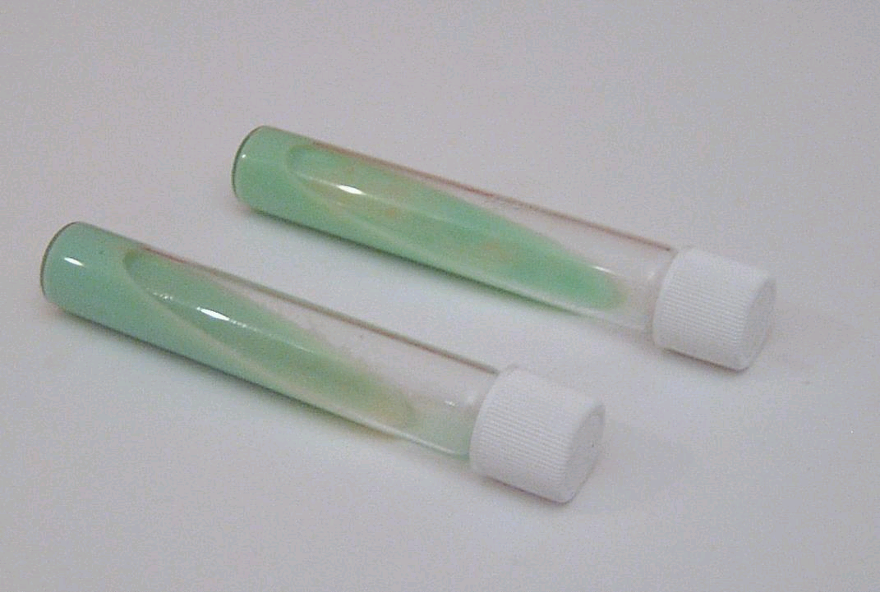
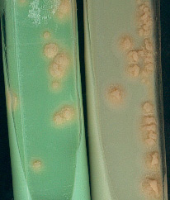
L-J media

Slide 11
*Cord factor: two mycolic acid molecule with one trehalose.
Organism resistance to acid and alkalis.
Organism resistance to antimycobacterial drugs; strain were found to be resistant to isoniazid (isonicotinic acid hydrazide-INH) and also other drugs due to chromosomal mutation because they don’t posses plasmids.

Slide 12
Resistance and survive
if protected from the sun, the bacilli can survive desiccation for weeks or even months and in dried state of sputum or excreta for 6-8 months and in 5% phenol for several hours. The bacilli are killed at 60 C for 15-20 min. and in 2 hours when exposed to
sunlight.
Variation and virulence and the formation of the variant Bacille Calmette- Guerin”(BCG).

Slide 13
In man, tuberculous infection almost exclusively occurs by means of inhalation of a single virulent tubercle bacillus (T.B.) or, at most, few bacilli in a droplet of sputum, or other infected material. Since no mycobacterium produce exotoxins or endotoxins, they can survive and multiply within a cellular vacuole of the phagosome. They can produce a special protein called “exported repetitive protein” which prevents the fusion of the phagosome with the lysosome and form the phagolysosome, therefore it will escape the killing and degradation by the lysosomal contents and lead to
The formation of (Ghon focus or primary focus).

Slide 14
Since the organisms live in the highly oxygenated areas,they will be deposited in bronchoils or the aleveoli, which will be taken by the fixed macrophages where they will start their multiplication intracellularly, and when increase in number, the cell bursts and new phagocytes become infected and repeat the cycle. During this period of 3-4 weeks, sufficient antigen is released to sensitize the host to tuberculoprotien which develops an allergic response.

Slide 15
This lead to an acute inflammatory process followed by central necrosis which appears at the site of the primary focus, which contains large number of organisms. Few bacilli may be carried by phagocyte through the lymphatic channels to the regional lymph nodes, which become enlarged and may caseate. The whole process which is the primary focus , the draining lymph channels, and the enlarged caseous regional lymph nodes produce what is called (the primary complex)

Slide 16
The future course of the case depend on certain factors such as;
The favorable cases, the primary lesion and the involved lymph nodes undergo healing and calcification.
Under unfavorable conditions, progressive lesion may develop and produce miliary tuberculosis, the tuberculous bronchopneumonia, and may involve other organs such as: spleen, liver, brain, kidneys and menings.

Slide 17
Immunity:

Slide 18
The immune response of the human body to the presence of T.B. is indicated by the appearance of agglutinins, precipitins, opsonins and complement fixation antibodies in the serum. These antibodies are found in low titer, and are not used for diagnostic purposes, and none of their antigenic substances are found to be related to virulence, and has no or little effect on the tubercle cells.

Slide 19
Resistance to the organism required by the cell mediated immunity, by T-cell and macrophages. Patient deficient in cellular immunity, such as AIDS patients are at much risk for disseminated tuberculosis. Mutation in the δ- interferon receptor gene is another cause of defective cellular immunity that predispose to severe tuberculosis.

Slide 20
A gene called NRAMP determines the natural resistance to tuberculosis. People who have mutations in this gene have a much higher rate of clinical tuberculosis than those with the normal gene. The NRAMP protein is located in the membrane of the phagosome in macrophages and plays an important role in killing the organism within the phagosome.

Slide 21
Tuberculin test:

Slide 22
Tuberculin test:
Koch’s phenomenon.
Purified protein derivative (PPD) by Seibert.
Tuberculin test is used to investigate infection or previous vaccination with BCG and not necessarily active disease.

Slide 23
The following techniques are employed in tuberculin testing.
The Mantoux test: the dose used is 1-5 tuberculin units (each 1.0 t.u. =0.000028 PPD) is injected intracutaneously and as superficially as possible. Usually into the middle- third of the forearm. The positive reaction appears within 1-2 days showing papule with erythema, or a vesicle may develop in the central part of the indurated area and even with necrosis.

Slide 24
2. The von pirquet test: in this test 2 fine scratches are made not to be too superficial and should not bleed. Tuberculin containing a drop of 1%
adrenaline/ml is rubbed into the scratched area with a glass rod and left to dry for 5 min. positive reaction appear after 72 hours showing an induration of not more than 5 mm. as determined by palpation.

Slide 25
3. The Heaf multiple puncture test: this test requires a special multiple puncture apparatus designed to release 6 needles automatically when the end plate is pressed vertically on the skin.

Slide 26
False positive results:
Histoplasma capsulatum infection
A hot platinum needle is used
Formation of a small hematoma
From a slight skin infection at the site of injection
From bacterial contaminated tuberculin

Slide 27
False negative results:
Old deteriorated tuberculin
Deeper injection
Leakage of tuberculin after injection
Very severe infection such as miliary tuberculosis
During cortisone administration
During measles infection ( lymphocytes become non susceptible to stimulating effect of PPD )
Malignant lymphomas
Sarcoidosis.

Slide 28
Clinical manifestations and chest X-Ray are not enough to give the clear diagnosis without a confirmatory laboratory tests.
Specimens expected to reach the laboratory for acid fast bacilli(AFB) are sputum, urine, CSF, gastric washings, pleural fluid, infected tissues, laryngeal swab, feces and pus.

Slide 29
The laboratory tests may include:
Direct microscopic examination by light and fluorescent microscope; by using the acid fast stain and also using the auramine dye.
Concentration method: by using the NaOH to kill and dissolve all the mucous materials and the bacterial and epithelial cells without affecting the T.B. cells. Then the specimen centrifuged.
Cultural method: by growing the concentrated specimen on the Lowenstein-Jensen medium, or on liquid medium.
Animal inoculation.

Slide 30
M. Tuberculosis is differentiated from other mycobacterium by its production of the niacin and also produces catalase.

Slide 31
Treatment and resistance:
Since the treatment last very long (6-9 months), new resistant strains may emerge. Therefore a multidrug therapy is used such as: isoniazid (INH) + Rifampin + Pyrazinamide. Pyrazinamide is given for two months and the other two are continued for at least 6 months. In immune compromised patients (such as AIDS). Or with disseminated disease, or with INH resistant strains; a fourth drug is added which is ethambutal, and the fourth drug may be given for 9-12 months. Although the treatment lasts for months, the patient sputum became non infectious within 2-3weeks.

Slide 32
INH resistant strain could be detected by using the luciferase enzyme assay; this enzyme is produced by the firefly which produces flashes of light by the help of ATP. If the organism is resistant will produce ATP and hence gives light. If it is sensitive, then it will be damaged and much less light will be produced.

Slide 33
Atypical mycobacteria:
This group of microorganisms resembles M. tuberculosis in certain aspects and differs from it in other aspects. Such as their non pathogenicity to guinea pigs and their spread in the environment. They are classified into four groups according to their rate of growth and pigment production:

Slide 34
Group 1 (photochromagens) produce yellow-orange pigment in light, e.g. M. kansasii (cause lung disease) and M. marinum (cause skin disease).
Group2 (schotochromagens) produce the pigment in dark, e.g. M. scrofulaceum (cause granulomatous cervical adenitis).
Group 3( Nonchromagens) no pigment produced, e.g. M. avium and M. intracellular (produce pulmonary disease in immunocompromised)

Slide 35
Group 4 (Rapid growing Mycobacteria) grow very fast and produce colonies in 7 days, e.g. M. fortuitum and M. chelonei (rarely cause disease or may be in immunocompromised patients) M.Abscessus ( cause chronic lung infections) and M. smegmatis ( non pathogenic) are also rapidly growing mycobacteria.

Slide 36
Thank you

