Slide 1
Vaginal discharge
Dr. Alaa Ibrahim

Slide 2
CAUSES FOR VAGINAL DISCHARGE
• PHYSIOLOGICAL : AGE-DEPENDENT :
1.NEONATE AND INFANT
2.PRE-PUBERTY
3.CHILD BEARING
4.POST MENOPAUSAL
• EXCESSIVE SECRETION :
1.PREGNANCY
2.SEXUAL AROUSA

Slide 3
PATHOLOGICAL
A) NON-INFECTIVE
CHEMICAL IRRITATION
–Antiseptics
bath additives
deodorants,
detergent
spermicides,
douches,
perfumed soaps.
B) FOREIGN BODIES
IUCD,RETAINED MATERIALS,RETAINED TAMPONS

Slide 4
C) INFECTIVE CAUSES
CERVICITIS
1.HERPES GENITALIS
2.MUCOPURULENT CERVICITIS—
a) Gonococcal
b) Non gonococcal- Chlamydia positive and Chlamydia negative

Slide 5
VAGINITIS
1.BACTERIAL VAGINOSIS
2.VAGINAL CANDIDIASIS
3.VAGINAL TRICHOMONIASIS

Slide 6
• CHILD BEARING AGE :
1.Mid cycle stimulation of endo cervical glands by oestrogen
2. EXOGENOUS-Semen of recent ejaculation 3. Mid cycle discharge is sufficient to keep the vagina moist and usually does not stain the under garments.It may be associated with Mittelshmerz or mid cycle unilateral pelvic discomfort.
• POST MENOPAUSAL PERIOD .Most common cause of Abnormal Vaginal discharge is Atropic vulvovaginitis.

Slide 7
How you approach to a diagnosis in patient with a vaginal discharge?

Slide 8
HISTORY:
Source of discharge . Perineal discharge could originate from vagina, cervix, urinary tract and rectum
quantity, duration, colour, consistency and odour.
Symptoms include :
itching or burning . External Dysuria, Dyspareunia Obtain history of the following: • Prior similar episodes
Sexually transmitted infection
Sexual activities
Birth control method
Last menstrual period
Douching practice
Antibiotic use
General medical history
Systemic symptoms such as lower abdominal pain, fever, chills, nausea, and vomiting

Slide 9
PHYSICAL EXAMINATION
1.General examination:
2.Vital signs: temp. , pulse and blood pressure
3.Abdominal exam.: tenderness site, rebound tenderness, guardening, palpable mass and auscultate for bowel sounds.
4.Perineal examination:
1.Appearance of discharge.
2.Erythema and edema of vaginal mucosa, abnormal mass.
3.Speculum examination:

Slide 10
Cusco's bivalve speculum

Slide 11
Bimanual digital examination
using the fingers of the right hand in the vagina steady and elevate the uterus to palpate the uterus by the left hand on the abdomen, the cervix is palpated for hardness or irregularity. The size, shape, position, mobility, and tenderness of the uterus. The adnexae are examined on each side for tenderness or mass

Slide 14
Investigations:
1.General urine exam.
infection
3.Transvaginal sonography to exclude mass or abscess
4.Cervical, rectal and urethral swabs
5. Preparation and Evaluation of Specimen • Collection of specimen • Preparation of specimen slide • Examination of specimen slide – NaCl (wet mount) – KOH (wet mount) • Whiff test
pH levels: Diagnostic Tools:
pH : Nitrazine paper
Wet-mount preparation:
Sample of vaginal secretions is suspended in 0.5 mL of normal saline in a glass tube, and assessed by microscopy.
if any, clue cells which are superficial vaginal epithelial cells with adherent bacteria, usually occur in infection e.gGardnerella vaginalis

Slide 15
Addition of 10 % KOH to the vaginal secretions (the “whiff” test) releases a volatile amines that have fishy like odor produced by anaerobic metabolism, in bacterial vaginosis.
Gram stain :
reveals normal superficial epithelial cells and a predominance of gram-positive rods (lactobacilli).
supplementary tests : vaginal culture, DNA amplification test for Chlamydia.
6. Laparoscopy if PID is suspected
7. Specific tests according to the case such as serology

Slide 16
A women presents with vaginal discharge specially after period and intercourse,
Vaginal swab wad done as microscopic evaluation of a saline "wet prep" of vaginal secretions as shown ?
what is the likely diagnosis?
2.Symptoms and signs?
3.How you treat her?

Slide 17
1.The diagnosis is bacterial vaginosis
2.two- thirds are asymptomatic carriers.
-A fishy vaginal odour, which is particularly noticeable following coitus, and menstruation.
- Vaginal secretions are creamy or gray and thinly coat the vaginal walls.
-Although there is an association with sexual activity, it is not a sexually transmitted

Slide 18
DIAGNOSIS In clinical practice by the presence of three out of four Amsel criteria:
• Thin, homogenous vaginal discharge
• Vaginal pH greater than 4.5
• Positive whiff test (fishy amine odor when 10 percent potassium hydroxide solution is added) • At least 20 percent clue cells (vaginal epithelial cells with borders obscured by adherent coccobacilli on wet-mount preparation or Gram stain

Slide 21
Causative Agent
-Decrease in vaginal lactobacilli is characteristic feature
-Gardnerella vaginalis often present
-As well as numerous anaerobic bacteria
-These bacteria can be present in normal vaginal discharge

Slide 22
Treatment:
1.Oral: metronidazole 500mg bid for 7 days,
or clindamycine 300mg bid for 7 days.
2. Vaginal: metronidazole gel 0.75% bid for 5 days, or clindamycine cream 2% for 7 days.
NO TREATMENT OF SEXUAL PARTNER IS NEEDED because it is not sexually transmited

Slide 23
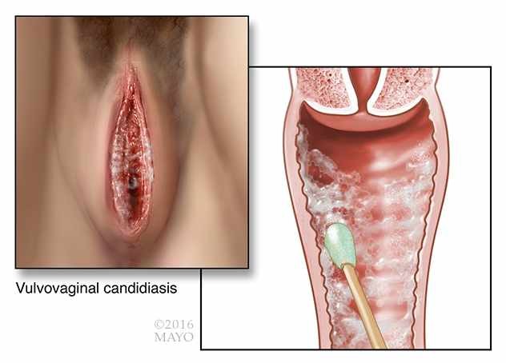
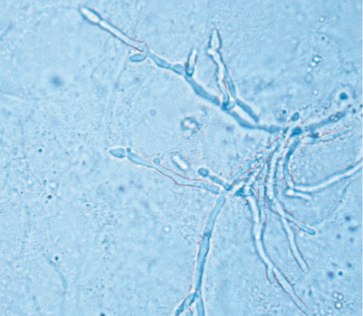
a 26-year-old female presents with thick white vaginal discharge with labial eythema and itching. Microscopic veiw of vaginal discharge revealed the following picture

Slide 24
1.What is the diagnosis?
2.What is the causative agent?
3.How you confirm the diagnosis?
4.How you treat recurrent attaches ?

Slide 25
1.Vulvovaginal candidiasis.
2. Candida albicans
3.Dx:
-The pH of the vagina is usually normal (<4.5).
-The results of saline preparation of the vaginal secretions usually are normal, Fungal elements, Pseudohyphae or hyphae visible on microscopy.
-The whiff test is negative.
-A fungal culture is recommended to confirm the diagnosis.
4. Treatment with fluconazole (150 mg every 3 days for 3 doses), then maintained on a suppressive dose of fluconazole, 150 mg weekly for 6 months. 90% will remain in remission.

Slide 26
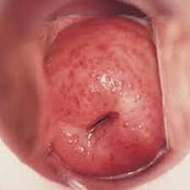
A30 year old women presents with Foul smell vaginal discharge, some times frothy yellowish green in nature, Dysuria, and abdominal discomfort.
-speculum examination revealed the appearance of strawberry cervix due to the presence of punctuate hemorrhages.
What is the diagnosis ?
What dose the wet prepration
reveal?

Slide 27
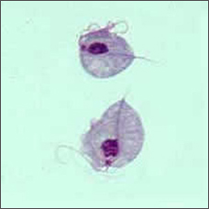
1.Trichomonas Vaginitis.
2.Wet mount test reveals motile trichomonads with typical flagellae, and increased numbers of leukocytes. Clue cells may be present because of the common association with BV.

Slide 28
Awomen presents with mucopurulent discharge associated with dysuria and lower abdominal discomfort.
1.What is the likely diagnosis from the culture?
2.Which type of epithelial cell of genital tract , it affect?
3.complications?

Slide 30
1.The diagnosis is CHLAMYDIA.
2.The columner epithelial cells .
3. Complications:
-Pelvic inflammatory disease.
-Perihepatitis: Fitz-Hugh _Curtis syndrome.
Neonatal conjunctivitis, and pneumonia.
-Reiter's syndrome, reactive arthritis

Slide 31
28-year-old female presents with lower abdominal pain and purulent cervical discharge, her partner reports history of urethritis few days ago.microscopic exam. Of cervical swab showed

Slide 32
What is the diagnosis?
The causative agent is?
The diagnostic tests?
gonorrhoea
Neisseria gonorrhoea endocervicitis
Gram staining-visualization of g-ve intracellular diplococcus( small cotton swab is placed into the endocervical canal ).

Slide 33
What is the neonatal complications?

Slide 34
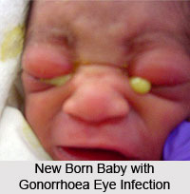
Opthalmia neonatorum
Gonococcal conjunctivitis of the newborn
Acquired from infected birth canal , Prevented with silver nitrate or erythromycin withn1 hour of birth.

Slide 36
Causative Agent
Treponema pallidum
Motile spirochete
Cannot be cultivated in laboratory
Darkfield microscopy used for identification
Symptoms
Occurs in numerous forms
Easily confused with other diseases
Manifestation occurs in three stages
Primary stage
Secondary stage
Tertiary stage

Slide 37
Primary stage
Occurs about 3 weeks post infection
Characterized by a painless red ulcer
Ulcer called a hard chancre
Chancre appears at the site of infection
Usually on the genitalia
Local lymph nodes become enlarged
Spontaneous healing of chancre

Slide 38
Microscopic views of Treponema pallidum. With dark-field microscopy, spirochetes appear as motile, bright corkscrews against a black background

Slide 39
Vulvar syphilitic chancre, painless ulcer commonest site is the cervix

Slide 40
Photograph of a woman with multiple keratotic papules on her palms (arrows). With secondary syphilis, disseminated papulosquamous eruptions may be seen on the palms, soles, or trunk

Slide 41
Granuloma inguinale, Photomicrograph of a mononuclear cell containing Donovan bodies

Slide 42
Photograph of the "groove sign" seen with lymphogranuloma venereum. Enlarged lymph nodes matted together on either side of the inguinal ligament create this characteristic groove

Slide 44
1.What is the daignosis ?
2.What is the most common organism?

Slide 45
Pathogens Causing Suppurative Cervicitis
Neisseria gonorrhoeae
Chlamydia trachomatis

Slide 46
The diagnosis should be PID if they have uterine tenderness, adnexal tenderness, or cervical motion tenderness. One or more of the following enhances diagnostic specificity: (1) oral temperature >38.3°C (101.6°F), (2) mucopurulent cervical or vaginal discharge, (3) abundant WBCs on saline microscopy of cervical secretions, (4) elevated erythrocyte sedimentation rate (ESR) or C-reactive protein (CRP), and (5) presence of cervical N gonorrhoeae or C trachomatis

Slide 47
Presenting symptoms may include lower abdominal and/or pelvic pain, yellow vaginal discharge, menorrhagia, fever, chills, anorexia, nausea, vomiting, diarrhea, dysmenorrhea, and dyspareunia. Patients also may have infective urinary symptoms. Unfortunately, there is no single symptom or symptom associated with a physical finding that is specific for this diagnosis. Accordingly, other possible sources of acute pelvic pain should be considered

Slide 48
In women with acute PID, leukorrhea or mucopurulent endocervicitis is common and is diagnosed microscopically. In women suspected of having acute PID, endocervical testing for both N gonorrhoeae and C trachomatis should be performed

Slide 49
During bimanual pelvic examination, women with acute pelvic inflammatory disease will usually have pelvic organ tenderness. Cervical motion tenderness (CMT) is typically elicited by quickly displacing the cervix laterally with examining vaginal fingers. If a woman has pelvic peritonitis secondary to bacteria and purulent debris that has exuded from the fallopian tubes, this rapid peritoneal movement usually causes a marked pain response. Tapping the cul-de-sac with examining finger(s) will give the examiner similar information. This maneuver usually causes a patient significantly less pain because less inflamed peritoneum is involved.

Slide 50
Abdominal peritonitis may be identified by deep probing and quick release of a hand placed on the abdomen. Alternatively, an examining hand may be positioned with a palm against a woman's mid-abdomen and gently and quickly moved back and forth (shake). This will identify abdominal peritonitis, often with less patient discomfort. In women with PID and peritonitis, usually only the lower abdomen is involved. If all quadrants are involved, suspicion of a ruptured tubo-ovarian abscess should be heightened

Slide 51
Laparoscopy
Tubal serosal hyperemia, tubal wall edema, and purulent exudate issuing from the fimbriated ends of the fallopian tubes and pooling in the cul-de-sac confirm this diagnosis

Slide 52
vaginal sonography may be used to identify tubo-ovarian abscess or exclude other pathology as the pain source. If sonography does not lead to a clear diagnosis, computed-tomography (CT) scanning may be indicate

Slide 53
Polymorphonuclear leukocytes on the endometrial surface correlate with acute endometritis, whereas plasma cells in the endometrium are found with chronic endometritis

Slide 57
Thank you

