Slide 1
Blood ,its products and transfusion
By Dr.Mustafa Usama
General and laparoscopic, endoscopic surgeon

Slide 2
Learning objects :
To understand blood and its products .
Indication of blood transfusion.with guide line for massive transfusion.
Blood group and cross matching .ABO and Rheuses system .
Complications of blood transfusion.
Management of coagulopathy . DIC

Slide 3
Blood and blood products.
The whole blood :Whole blood is now rarely available in civilian practice as it is an inefficient use of the limited resource. However, whole blood transfusion has significant advantages over packed cells as it is coagulation factor rich and, if fresh, more metabolically active than stored blood.
Packed red cells
Each unit is approximately 330 mL and has a haematocrit of 50–70 per cent. Packed cells are stored in a SAG-M solution (saline–adenine–glucose–mannitol) to increase shelf life to 5 weeks at 2–6°C.

Slide 4
Fresh-frozen plasma (FFP) is rich in coagulation factors and is
removed from fresh blood and stored at −40 to −50°C with a two-year shelf life. It is the first-line therapy in the treatment of coagulopathic haemorrhage (see below under Management of
coagulopathy). Rhesus D-positive FFP may be given to a rhesus
D-negative woman.

Slide 5
Cryoprecipitate
Cryoprecipitate is a supernatant precipitate of FFP and is rich in factor VIII and fibrinogen. It is stored at −30°C with a two year
shelf life. It is given in low fibrinogen states or factor VIII deficiency.
.

Slide 6
Platelets :
Platelets are supplied as a pooled platelet concentrate and contain about 250 × 109/L. Platelets are stored on a special agitator at 20–24°C and have a shelf life of only 5 days. Platelet transfusions are given to patients with thrombocytopenia or with platelet dysfunction who are bleeding or undergoing surgery.
Asprin .clpodigril ??vasopressin with continuous platelets infusion.

Slide 7
Prothrombin complex concentrates
Prothrombin complex concentrates (PCC) are highly purified
concentrates prepared from pooled plasma. They contain factorsII, IX and X. Factor VII may be included or produced separately.It is indicated for the emergency reversal of anticoagulant (warfarin)therapy in uncontrolled haemorrhage.

Slide 8
Autologous blood:
Collection up to 3 weeks
During same surgery , they collect blood and washed and then re transfuse.

Slide 9
Indication of blood transfusion
acute blood loss, to replace circulating volume and maintain oxygen delivery.
perioperative anaemia, to ensure adequate oxygen delivery during the perioperative phase.
• symptomatic chronic anaemia, without haemorrhage or impending surgery.

Slide 10
Perioperative transfusion criteria
Indication | Hemoglobin level g/dl
Probably will benefit from transfusion | <6
Transfusion unlikely to be of benefit in the absence of bleeding or impending surgery | 6-8
No indication for transfusion in the absence of other risk factors. | >8

Slide 11
Blood group and cross matching
Frequency (%) | Antibodies | Antigens | Genotype | Phenotype
46 | AntiA,anti B | O | OO | O
42 | Anti B | A | AA or AO | A
9 | Anti A | B | BB or BO | B
3 | None | AB | AB | AB
ABO system

Slide 12
Rhesus system
85% RH +ve
15% RH –ve
Aquired during delivery RH-ve mother
Next prenancy antibodies cross placenta and cause haemolytic aneamia and hydrop fetalis .

Slide 13
Complication of blood transfusion
Complications from a single transfusion include:
• incompatibility haemolytic transfusion reaction
• febrile transfusion reaction(non-haemolytic ,leukocyte induce)
• allergic reaction
• infection : bacterial infection (usually due to faulty storage),hepatitis HIV, malaria.
• air embolism
• thrombophlebitis
• transfusion-related acute lung injury (usually from FFP).(TRALI).IT is syndrome of transfusion of plasma part of blood .non cardiogenic pulmonary oedema .

Slide 14
Transfusion –associated circulatory overload :(TACO)
It can occur with rapid infusion of blood, plasma expanders, and crystalloids, particularly in older patients with underlying heart disease. Central venous pressure monitoring should be considered.

Slide 15
Complications from massive transfusion
• coagulopathy
• hypocalcaemia
• hyperkalaemia
• hypokalaemia
• hypothermia

Slide 16
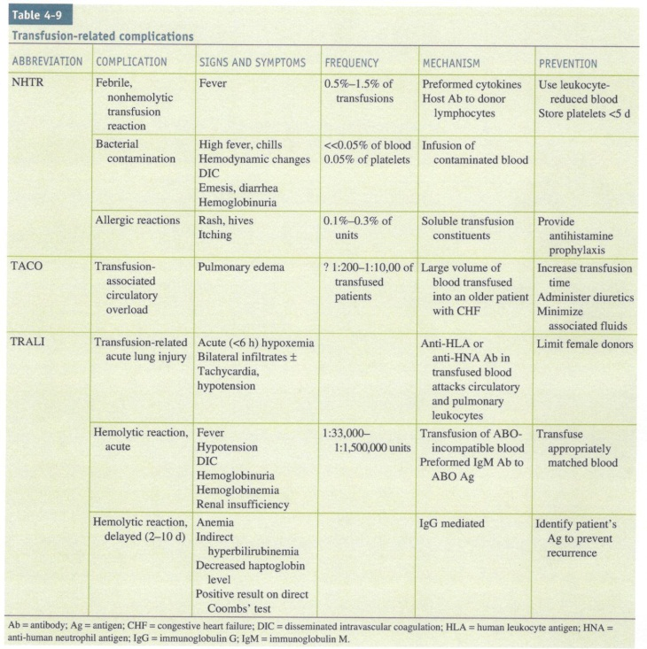

Slide 17
The modern practice of ‘safe’ massive blood transfusion consists of:
• replacing and maintaining blood volume by RBC packs: use stored blood less than 14 days old
• haemostatic resuscitation by administering a 1:1:1 ratio (equal parts PRBCs, FFP and platelets); replaced volume maintaining hemostasis based on the coagulation screen (platelet count, thrombin time and
prothrombin time).

Slide 18
• maintaining oxygen-carrying capacity: ensure PCV >20 or Hb >80›g/L (repeat hematological testing)
• keeping the patient warm: heating coils on the blood circuit, heated blanket, etc.
• correcting or avoiding metabolic complications
• maintaining a normal plasma protein concentration: avoid excessive
crystalloid infusions and monitor the plasma albumin level.

Slide 19
Management of coagulopathy
• FFP if prothrombin time (PT) or partial thromboplastin time (PTT) >1.5 times normal.
• cryoprecipitate if fibrinogen <0.8 g/L
• platelets if platelet count <50 × 109/mL.

Slide 20
DIC
DIC is
an acquired syndrome characterized by systemic activation of
coagulation pathways that result in excessive thrombin generation
and the diffuse formation of microthrombi.
This disturbance ultimately leads to consumption and depletion of platelets and coagulation factors with the resultant classic picture of diffuse
Bleeding..

Slide 21
injuries resulting in embolization of materials such as brain matter, bone marrow, or amniotic fluid can act as potent thromboplastins that activate the DIC .
Additional etiologies include malignancy, organ injury (such as severe pancreatitis), liver failure, certain vascular abnormalities (such as large aneurysms), snake bites, illicit drugs, transfusion reactions, transplant rejection, and sepsis

Slide 22
Diagnosis :
Depend on inciting etiology with associated thrombocytopenia,
prolongation of the prothrombin time, a low fibrinogen level, and
elevated fibrin markers (FDPs, D-dimer, soluble fibrin monomers).
Treatment :If there is active bleeding, hemostatic factors should be replaced with FFP, which is usuall ysufficient to correct the hypofibrinogenemia, although
cryoprecipitate, fibrinogen concentrates, or platelet concentrates may also be needed.

Slide 23
Thank you for your lessening

