Slide 1
Laparoscopic ,robotic ,minimal invasive surgery
Dr MUSTAFA USAMA
GENERAL LAPARASCOPIC ENDOSCOPIC SURGGEON .

Slide 2
Objectives
A-To understand the principal of minimal invasive surgery in different surgical specialties(Advantages and disadvantages).
C- to list the application of MIS in different specialties.
D-Laparascopy regarding general surgery.application,advantages,disadvantages.contraindication.
D-Principal of robotic surgery .

Slide 3
Minimal access surgery is a marriage of modern technology and surgical innovation that aims to accomplish surgical therapeutic goals with minimal somatic and psychological trauma.
This type of surgery has reduced wound access trauma, as well as being less disfiguring than conventional techniques. With increasing experience, it offers cost-effectiveness both to health services and to employers by shortening operating times, shortening hospital stays and allowing faster recuperation.

Slide 4
MIS advantages and disadvantages
As opposed to large incisions, you will only need some small cuts with MIS.
There is less trauma to your nerves, tissues, and muscles.
You will experience less bleeding.
After recovery, you will have less scarring.
Your organs will undergo less trauma.
You won’t need the same amount of narcotics because the pain is significantly less.
Your hospital stay is cut by more than half the time.
It is less taxing on your overall immune system.

Slide 5
MIS
Minimally invasive surgery requires specialized high-end medical equipment.
Surgeons need specialized training.
The equipment used with MIS is more expensive.
There are various procedures, especially the most recent surgeries, that may take longer.

Slide 6
Types of endo-surgery flexible OGD
Diagnostic
Unexplained anemia (usually along with a colonoscopy)
Upper gastrointestinal bleeding as evidenced by hematemesis or melena
Persistent dyspepsia in patients over the age of 45 years
Heartburn and chronic acid reflux – this can lead to a precancerous lesion called Barrett's esophagus
Persistent vomiting
Dysphagia – difficulty in swallowing
Odynophagia – painful swallowing
Persistent nausea
IBD (inflammatory bowel diseases)
Therapeutic
Treatment (banding/sclerotherapy) of esophageal varices
Injection therapy (e.g. epinephrine in bleeding lesions)
Cutting off of larger pieces of tissue with a snare device (e.g. polyps, endoscopic mucosal resection)
Application of cautery to tissues
Removal of foreign bodies (e.g. food) that have been ingested
Tamponade of bleeding esophageal varices with a balloon
Application of photodynamic therapy for treatment of esophageal malignancies
Endoscopic drainage of pancreatic pseudocyst
Tightening the lower esophageal sphincter
Dilating or stenting of stenosis or achalasia
Percutaneous endoscopic gastrostomy (feeding tube placement)
Endoscopic retrograde cholangiopancreatography (ERCP) combines EGD with fluoroscopy
Endoscopic ultrasound (EUS) combines EGD with 5–12 MHz ultrasound imaging

Slide 7
END-surgery and gastroenterology

Slide 8
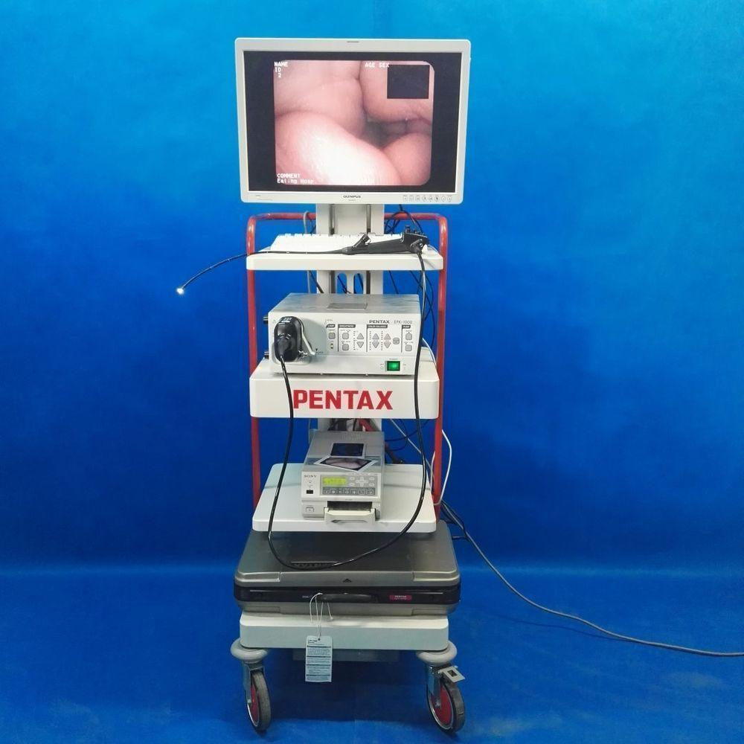

Slide 9
Colonoscopy

Slide 10
Indications
• Suspected inflammatory bowel disease
• Chronic diarrhoea
• Altered bowel habit
• Rectal bleeding or iron deficiency anaemia
• Assessment of abnormal CT colonogram or barium enema
• Colorectal cancer screening
• Colorectal adenoma and carcinoma follow-up
• Therapeutic procedures, including endoscopic resection,
dilatation of strictures, laser, stent insertion and argon
plasma coagulation

Slide 11
Hysteroscopy
indication Dx & TX
Asherman's syndrome
Endometrial polyp. Polypectomy
Abnormal uterine bleeding
Adenomyosis
Endometrial ablation
Myomectomy for uterine fibroids
Mullerian malformations
Evacuation of retained products of conception
IUDs

Slide 12
Hysteroscopy

Slide 13
Arthroscopy

Slide 15
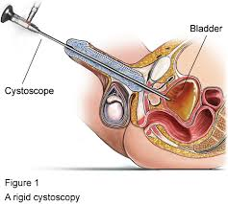
When is a cystoscopy needed? Endo-urology
Frequent urinary tract infections (UTIs)
Hematuria, or blood in the urine
Urinary frequency, or urinating more than 8 times a day
Urinary urgency, or the sudden, strong urge to urinate
Urinary retention, or when the bladder does not empty completely
Urinary incontinence, or urine leakage
Pain or burning before, during, or after urination
Abnormal cells found in a urine sample

Slide 16
Laparoscopic urology

Slide 17
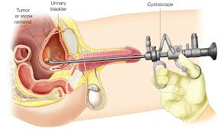

Slide 18
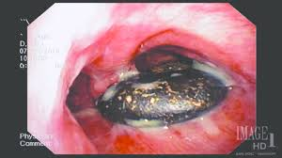
Rigid and fibro optic bronchoscopy

Slide 19
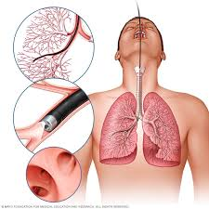
VATS

Slide 20
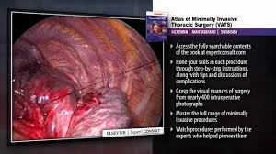
VATS

Slide 21
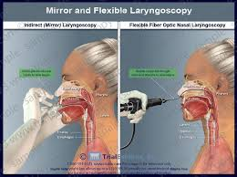
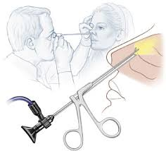
ENT FESS. Indirect laryngoscopy

Slide 22
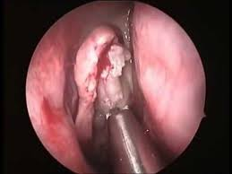

Slide 23
Endoscopic laminectomy.Enodocopic discectomy

Slide 24
Endoscopic basal skull surgery

Slide 26
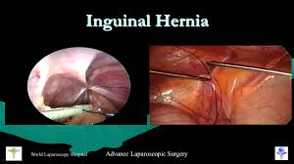
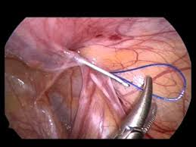
Pediatric Laparoscopy
Appendectomy
Hernia
Undescended testis
Cholecystectomy

Slide 27
Laparoscopy in general surgery
Laparoscopy is a surgical procedure that involves insertion of a narrow telescope-like instrument through a small incision in the belly button.
• This allows visualization of the abdominal and pelvic organs.

Slide 28
Advantages of minimal access surgery
Decrease in wound size
Reduction in wound infection, dehiscence, bleeding,
herniation and nerve entrapment
Decrease in wound pain
Improved mobility
Decreased wound trauma
Decreased heat loss
Improved vision

Slide 29
Limitations of minimal access surgery
Reliance on remote vision and operating
Loss of tactile feedback
Dependence on hand–eye coordination
Difficulty with haemostasis
Reliance on new techniques
Extraction of large specimens

Slide 30
Contraindications
Severe cardiopulmonary diseases
• Generalised peritonitis
• Intestinal obstruction
• Significant hemoperitoneum
• Extensive peritoneal adhesions
• Large pelvic tumour
• Obesity
• Pregnancy >16 wks

Slide 32
• laparoscopic cholecystectomy
• laparoscopic inguinal hernia repair
• laparoscopic antireflux surgery
• laparoscopic appendicectomy
• laparoscopic bariatric surgery
• laparoscopic colectomy/anterior resection
• laparoscopic upper gastrointestinal (GI) surgery incisional).

Slide 33
Other elective laparoscopic or minimally invasive procedures
that are becoming more widely utilised in certain specialist centres
include:
• colectomy;
• gastrectomy
• splenectomy;
• nephrectomy;
• adrenalectomy;
• prostatectomy;
• thyroid and parathyroid surgery;
• aortic aneurysm surgery;
• single-vessel coronary artery bypass surgery;
• video-assisted thorascopic surgery (VATS);
• laparoscopic hernia surgery (inguinal, femoral, paraumbilical,

Slide 36
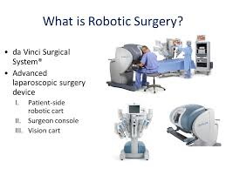

Slide 37
Difference Between Robotic-Assisted and Standard Laparoscopy

Slide 38
Disadvantage of Robotic surgery

Slide 39
THANK YOU FOR YOUR
ATTENSION

