Slide 1

Practical No. 8
Antibiotic susceptibility testing

Slide 2
The method of testing most frequently used is the standardized paper disk agar diffusion method, also known as the Kirby-Bauer method.
A number of small sterile filter disk of uniform size that have each been impregnated with an antibiotic in defined concentration are placed on the surface of an agar plate previously seeded with a standard amount of the organism to be tested.

Slide 3
Antibiotics Susceptibility testing:
Antibiotics susceptibility testing of the isolated pathogen can indicate specifically which drug are most effective in suppressing or destroying it.
Antibiotics susceptibility testing can give a great assistance the physician in selecting effective antibiotics drugs for specific chemotherapy of infections disease.

Slide 4
Diffusion methods
Kirby-Bauer method or disk diffusion antibiotic sensitivity testing:
Small filter paper disks containing antibiotics are placed onto a plate upon which bacteria are growing. The antibiotic diffuses from the disk into the agar . If the bacteria are sensitive to the antibiotic, a clear ring, or zone of inhibition, is seen around the disk indicating poor growth. Using special comparators that interpret the diameter of the zones of inhibition, consequently the organism can be described as resistant, intermediate, or sensitive. Tables are used to determine the breakpoint for each drug.

Slide 5
The zone of inhibition around the antibiotic disk is influenced by the:
(1) type of growth medium
(2) its cation content
(3) the antimicrobial concentration in the disk
(4) inoculum concentration
(5) temperature of incubation
(6) atmosphere of incubation .
N.T: Antibiotic disk may be single disks or strips of multiple antibiotic disks.

Slide 6
When the disks are in firm contact with the agar, their antibiotics diffuse into the surrounding medium and there come in contact with the multiplying organisms. The plates are incubated at 35ºc for 18-24 hours.
After incubation, the plates are examined for the presence of zones of inhibition of bacterial growth (clear rings) around the antibacterial disks.
If there is no inhibition, the organism is reported as resistant (R) to the antibiotic in the disks.
If there is inhibit a zone of inhibition surrounding the antibiotic disk, the organism is not susceptible (s) to the drug being tested.

Slide 7
Kirby-Bauer method for determining drug susceptibility
Bacteria spread on surface of agar plate
12 disks, each with different antimicrobial drug, placed on agar plate
Incubated- drugs diffuse outward and kill susceptible bacteria
Zone of inhibition around each disk
Compare size of zone to chart

Slide 8
Agar disk diffusion method procedure:
from a prepared bacterial suspension, dip a swab and seed the surface of an agar plate with the swab then rotate the plate through a 45º angle and streak the whole surface again, then rotate the plate another 90º and streak once more. Discard the swab in disinfectant.
Dip the tips of a forceps in 70% alcohol, flame rapidly and allow cooling.
Pick up an antibiotic disc with the forceps and place it on the agar surface, press the disk gently using the tips of the forceps.
Repeat with eight different antibiotic disks; make sure they are separated evenly from each other.
Invert plates and incubate at 37ºC overnight.

Slide 9
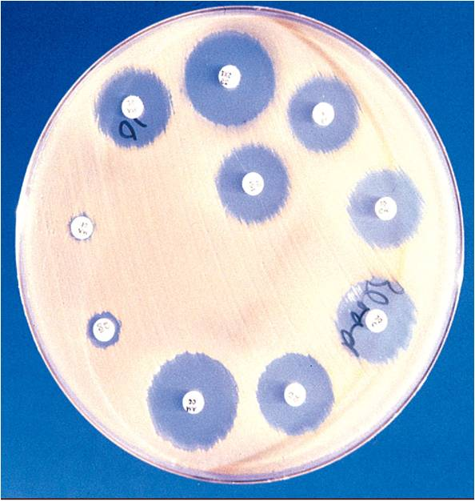

Slide 10
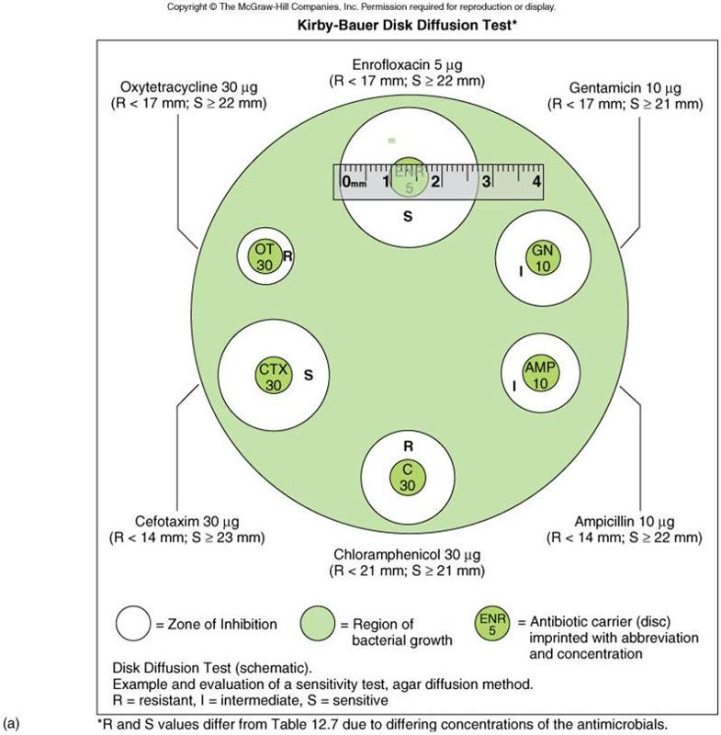

Slide 11
The diameter for size with values listed in a standared chart. Table (1):
Antibiotics | Disk Concentration | Diameter of zone of inhibition (mm)
 |  | Resistant | Intermediate | susceptible
Ampicillin* | 10ug | 1.1 or less | 12-13 | 14 or more
Cephalothin | 30ug | 14 or less | 15-17 | 18 or more
Chloramphenicol | 30ug | 12 or less | 13-17 | 18 or more
Genamicin | 10ug | 12 or less | 13-14 | 15 or more
Pencillin** | 10U | 20 or less | 21-28 | 29 or more
Polymyxin B | 300U | 8 or less | 8-11 | 12 or more
Sulfonamide | 300ug | 12 or less | 13-16 | 17 or more
Tetracycline | 30ug | 14 or less | 15-18 | 19 or more
* Zone sizes appropriate only when testing Gram-negative enteric organisms
** Zone sizes appropriate only when testing staphylococci.

Slide 12
The Epsilometer test (usually abbreviated Etest) is a laboratory test used to determine whether or not a bacterium is susceptible to an antibiotic. The Etest is basically an agar diffusion method. The Etest utilises a rectangular strip that has been impregnated with the drug to be studied. A lawn of bacteria is inoculated onto the surface an agar plate and the Etest strip is laid on top; the drug diffuses out into the agar, producing an exponential gradient of the drug to be tested. There is an exponential scale printed on the strip. After 24 hours of incubation, an elliptical zone of inhibition is produced and the point at which the ellipse meets the strip gives a reading for the (MIC) of the drug.

Slide 13
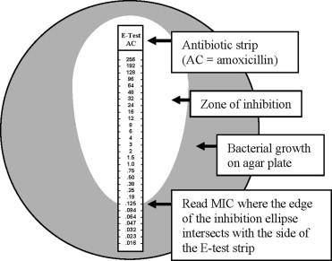

Slide 14
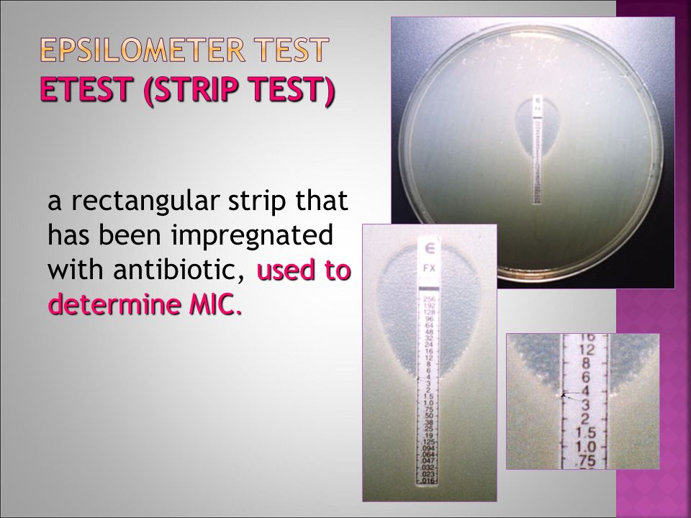

Slide 15
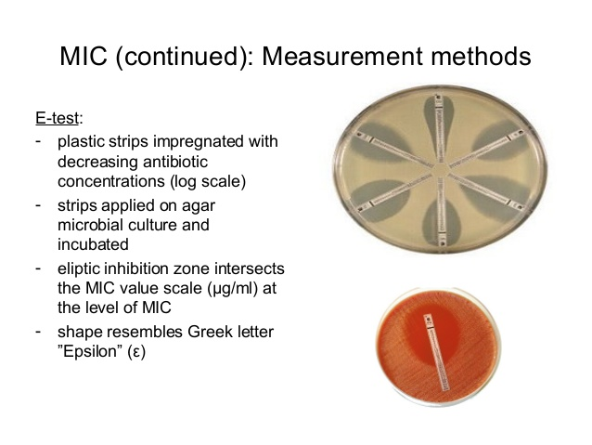

Slide 16
when two antimicrobial agents act at the same time on the same microbial population, the effect may be either
indifference. 1+1= 1
addition. 1+1=2
synergism. 1+1= 3
antagonism 1+1= 1/2

Slide 17
MIC (Minimum inhibitory concentration):
MIC is the lowest concentration of an antimicrobial that will inhibit the visible growth of a microorganism after incubation.
It is important in diagnostic laboratories to confirm resistance of micro organism to an antimicrobial agent.
Also to monitor the activity of new antimicrobial.

Slide 18
Determinatrdion of MIC
* Broth Tube Dilution method:
- This test is the standard method for determining levels of resistance to an antibiotic.
Serial dilutions of the antibiotic are made in a liquid medium which is inoculated with a standardized number of organisms and incubated for a 24 hours.
The lowest concentration (highest dilution) of antibiotic preventing appearance of turbidity is the (MIC). At this dilution the antibiotic is bacterio static.
The minimal bactericidal concentration (MBC) determined by sub culturing the contents of the tubes onto antibiotic-free solid medium and examining for bacterial growth.

Slide 19
Procedure of (MIC):
  Number sterile capped test tubes 1 through 9. All of the following steps are carried out using aseptic technique.
  Add 2.0 ml of tetracycline solution (100 ug/ml) to the first tube. Add 1.0 ml of sterile broth to all other tubes.
  Transfer 1.0 ml from the first tube to the second tube.
  Using a separate pipette, mix the contents of this tube and transfer 1.0 ml to the third tube.
  Continue dilutions in this manner to tube number 8, being certain to change pipettes between tubes to prevent carryover of antibiotic on the external surface of the pipette.
  Remove 1.0 ml from tube 8 and discard it. The ninth tube, which serves as a control, receives no tetracycline.
  Suspend to an appropriate turbidity several colonies of the culture to be tested in 5.0 ml of Mueller-Hinton broth to give a slightly turbid suspension.
  Dilute this suspension by aseptically pipetting 0.2 ml of the suspension into 40 ml of Mueller-Hinton broth.
  Add 1.0 ml of the diluted culture suspension to each of the tubes. The final concentration of tetracycline is now one-half of the original concentration in each tube.
  Incubate all tubes at 35ºC overnight.
  Examine tubes for visible signs of bacterial growth. The highest dilution without growth is the minimal inhibitory concentration (MIC).

Slide 20
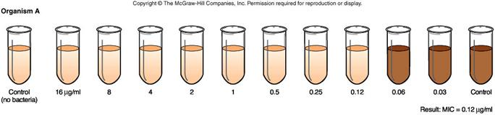

Slide 21
Thank you

