Slide 1
Practical No. 7
Sterilization and Disinfection
Department of Microbiology
College of Medicine

Slide 2
Sterilization:
Is the killing or removal of all micro-organisims, including bacterial spores, which are highly resistant.
e.g.:
Sterilization by autoclave (121ºc , 15Klb).
Ethyl oxide gas for surgical instruments.
Filtration for intravenous solution.
Classification of sterilization agents:
1- Physical agents: a- heat
b- filtration
c- radiation
2- Chemical agents:

Slide 3
1- Physical agents:
A- Heat: Most effective cause it effectively stops cellular activates by coagulate proteins or oxidize cell components.
Types of sterilization by heat:
Dry heat
Red heat ( Direct flame): for rapid and repeated sterilization e.g.: Loop, Forceps by using Bunzen burner.
Hot air: By using oven. e.g.: glass ware, metal instrument (left in a hot air oven on a temperature of 160-180ºc for one hour).
Incineration: by using electrically heated or gas- fired incineration filled with forced air blower units. e.g.: solid dressings, pathological material, animal caresses and bedding.

Slide 4
Flaming

Slide 5
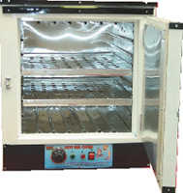
- Hot air oven: Temperature of 160 °C for 1 hour is employed. Hot air oven is the best method for sterilizing dry glassware, forceps, scalpels...other steel & dental &surgical instruments, powders, fat, greases.
Hot air oven

Slide 6
Glassware

Slide 8
Moist heat :
- Pasteurization: Use 63ºc at 30 minutes. Milk born-disease are killed by this process. e.g.: Brucella, Salmonella, and tubercle. Sporing Bacteria are not killed.
- Boiling water: A temperature at 100ºc will kill all non-sporing or vegetative organism within 10 minutes.
Most spore will be killed in 30minutes in this temperature, but some spores will resist boiling for several hours.
2% of sodium carbonate increase the disinfecting power of the water.

Slide 9
This method is suitable for infected instruments or small pieces of infected glassware:
Tyndallization: Sterilization by intermittent steaming.
Steam under pressure: The steam is placed under pressure in an autoclave.
Bacteriological media, surgical instruments are sterilized in the auto clave at 121ºc (15 Ibs) for 15 minutes.

Slide 10
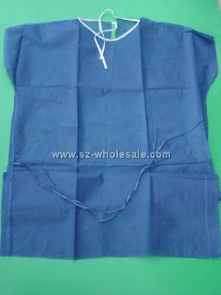
c- At a temperature above 100°C: steam under increased pressure this is called (Autoclaving). This is the usual method of sterilizing bacteriological media, surgical instruments, towels, dressing, gloves,..etc The minimum values required for sterilization in an efficient autoclave are 15 lb/inch² 121 °C 15 minutes.
Surgical dress

Slide 11
Surgical instruments

Slide 12
Autoclave

Slide 13
B- Filtration: The material must pass through special bacterial filters which hold back any bacteria present. e.g.: Sera, Plasma, Vitamins and antibiotic solutions.
Filters are made of unglazed porcelain, mandler….
C- Radiation: Sterilization of large amount of pre-packed disposable items.
By Ultra – violet rays.
e.g.: Plastic syringes and Catheters

Slide 14
Sterilization

Slide 15
hospital rooms by UV light

Slide 16
Foley catheter: sterilized by ionizing radiation

Slide 17
sterilized by ionizing radiation

Slide 18
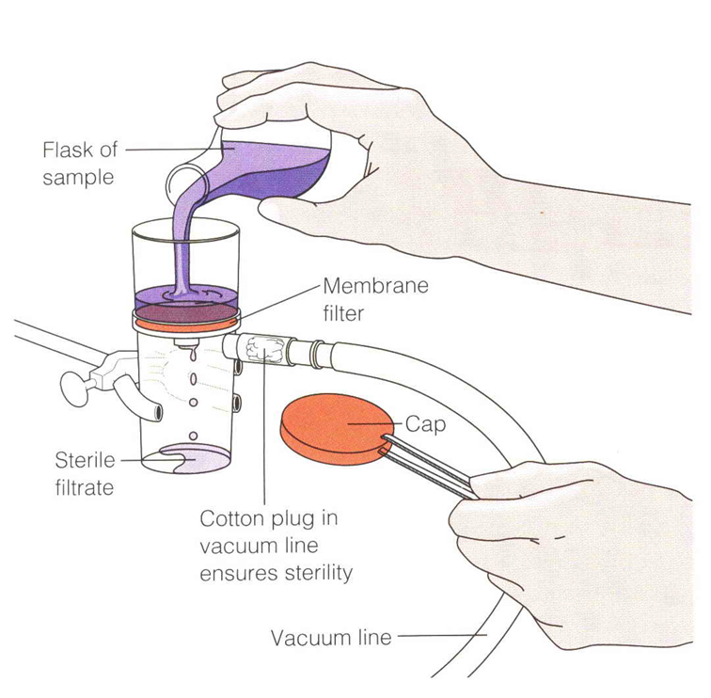
FILTRATION
To render fluids, including bacterial culture, free from bacteria by passing them through special filters, e.g Seitz filter. This method is used in sterilizing liquids that would be damaged by heat such as serum, vaccines, antibiotic solutions, sugars, toxins, …etc.

Slide 19
Experiment:
Materials Provided:
1-Nutrient Broth (4 tubes to each group)
2-Sterile forceps
3-Sterile paper strips
4-Broth culture of E. coli and B. subtilis

Slide 20
Procedure:
a- Contaminate 4 strips by dipping them into one of the cultures supplied.
b- Place one strip in a broth bottle, labeled ''Control''.
c- Place a second strip into a broth bottle and hold in boiling water bath for 15 min.
d- Place a third strip into a broth bottle and autoclave at 15 atm. pressure for 15 minutes.
e- Place the fourth strip into 70% alcohol, leave for 15 minutes shake off the alcohol and drop the strip into a broth bottle.
f- Label all bottles (or tubes) with organism and treatment.
g- Incubate them at 37ºС for overnight.
h- Record the results.

Slide 21
2- Chemical Agents:
Alchohols, Ethyl alcohol, Isopropyl alcohol (70%): Antiseptic to sterilize thermometer and skin before injection.
Phenols: Sterilization of surgical instruments, bathroom, hospital floor.
Heavy Metal Ions: (Metallis salt), (Mercury; Silver nitrate). Use as preservation for sera or viral vaccine.
Oxidizing agent: H₂O₂ for contaminated wound
Halogens : Chlorine and hypo chlorite to disinfect the swimming pools and water supplies.

Slide 22
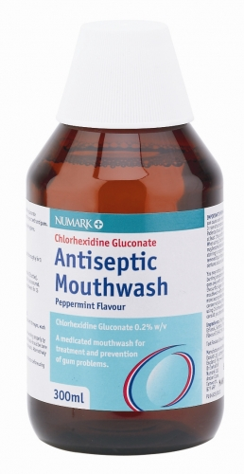
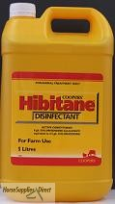
Sterilization
Chlorhexidine agents

Slide 23
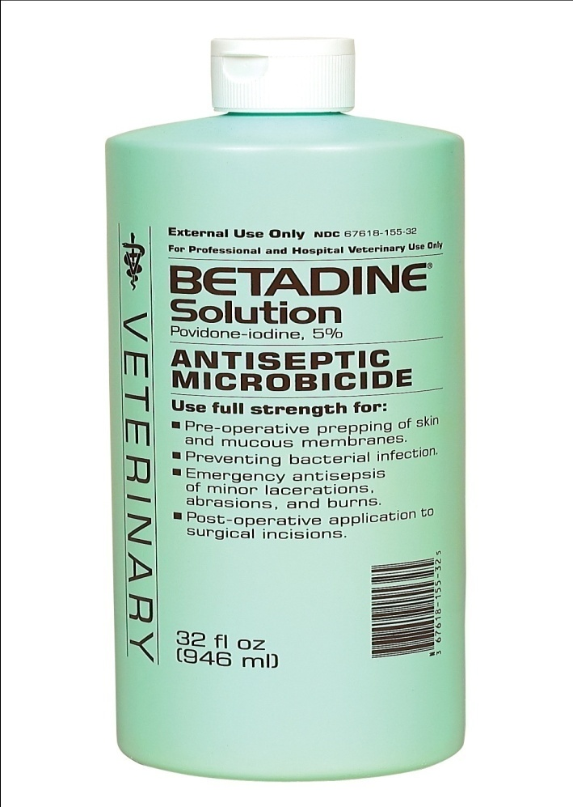
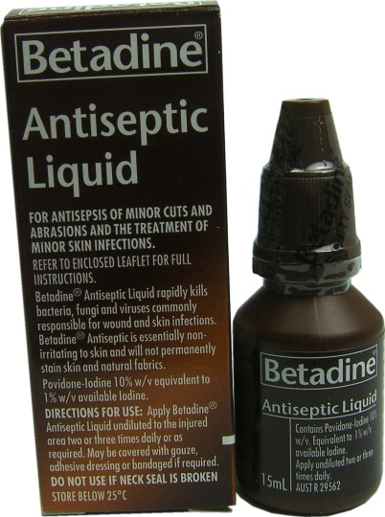
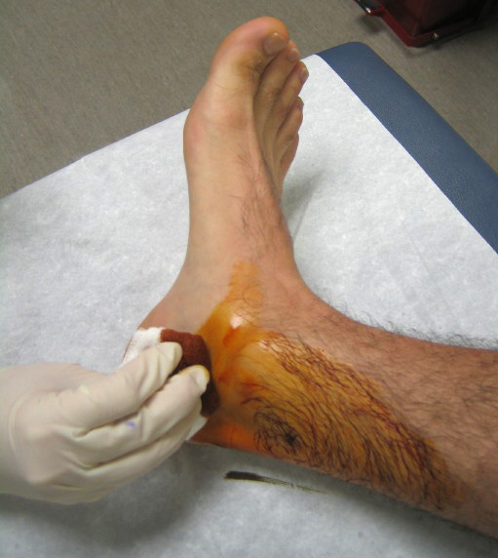
* Iodine (Betadine): used in surgery to sterileize skin pre-operation

Slide 24
Akalyting Agents:
Formaldehyde: for instruments, Lab, and Clothing, books
Ethylene oxide: for heat sensitive objects plastic petri dishes, tubs, syringes….
Detergents: Soaps, quaternary compounds

Slide 25
Experiment:
Materials Provided:
Tubes of nutrient broth
Sterile, empty tubes
Sterile, 10-ml pipettes (cotton plugged)
Sterile, 1.0-ml pipettes (cotton plugged)
1.0 per cent phenol, 2.0 per cent phenol
Absolute alcohol, 70 per cent alcohol
3.0 per cent hydrogen peroxide
1.0 per cent Lysol, 5 per cent Lysol
Tincture of iodine
Antiseptic mouthwash
24-hour nutrient broth culture of Escherichia coli
Three-to-six-day-old culture of Bacillus subtilis

Slide 26
Procedures:
1- Select one of the chemical agents. Draw 5.0ml of the solution into a sterile test tube.
2- To the 5ml of disinfectant, add 0.5ml of the E. coli culture. Gently shake the tube to distribute the organisms uniformly. Note the time.
3- At intervals of 2, 5, and 10 minutes, transfer one loop full of the disinfectant-culture mixture to a tube of fresh nutrient broth. Label each broth tube with the name of the organism, the disinfectant, its concentration, and the time of exposure (for example, E. coli, 1 percent phenol, 2 minutes).
4- Using the same concentration of the same disinfectant, repeat procedures 1 to 3 with the culture of
B. subtilis.
5- Inoculate a tube of nutrient broth directly from the E. coli culture and another from the B. subtilis culture. Label each tube with the name of the organism and the word ''Control''.
6- Incubate all tubes at 35ºС for 48 hours.
7- Record your results.

Slide 27
Thank You

