Slide 1
ENT Endoscopy
Assis. Professor
Dr Haider Alsarhan

Slide 2
Endoscopy of the nose
Rigid endoscope
Usually called sinoscope
Length 170 mm
Width 4 mm and 2.7 mm
Angles 0 , 30 ,45 and 70
Diagnostic and operative

Slide 3
Endoscopy of the nose
Diagnostic
Identify the 3 turninates
Identity the 3 meatuses
Full identification of the oseo meatal complex of the middle meatus
Examination of the postnasal space

Slide 4
Endoscopy of the nose
Surgical
Endoscopic sinus surgery for chronic sinusitis
Endoscopic polypoctomy
Endoscopic biopsy
Endoscopic tumor resection

Slide 5
Endoscopy of the nose

Slide 6
Endoscopy of the nose
Degree of vision

Slide 7
Endoscopy of the ear
Rigid endoscope
Usually called otoscope
Length 50 mm and 100 mm
Width 4 mm , 2.7 mm and 1.3 mm
Angles 0 , 30 and 70
Diagnostic and operative

Slide 8
Endoscopy of the ear
Rigid endoscope
Usually called otoscope
Length 50 mm and 100 mm
Width 4 mm , 2.7 mm and 1.3 mm
Angles 0 , 30 and 70
Diagnostic and operative

Slide 9
Endoscopy of the ear
Diagnostic
Identification of the tympanic membrane
Identification of the tympanic membrane perforation
Identification of the tympanic portion of the cholesteatoma

Slide 10
Endoscopy of the ear
Operative
Myringotomy
Gromate placement
Endoscopic resection of cholesteatoma
Endoscopic myringoplasty (repair of TM perforation)

Slide 11
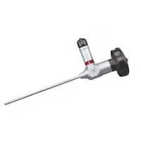
Endoscopy of the ear

Slide 12
Endoscopy of the larynx
Rigid endoscope
Usually called Laryngoscope
Length 170mm and 180mm
Width 6mm , 7mm and 8 mm
Angles 90 and 70
Diagnostic only

Slide 13
Endoscopy of the larynx
Diagnostic
Identification of the larynx and hypopharynx

Slide 14
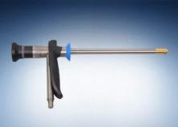
Endoscopy of the larynx

Slide 15
Endoscopy of the larynx
Direct endoscope
Operative only

Slide 16
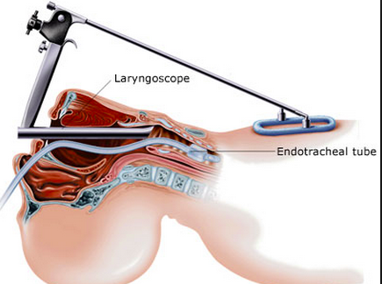
Endoscopy of the larynx

Slide 17
Endoscopy of the Nose and the Throat
Flexible Nasopharyngoscope
Diagnostic for the nose , parynx and the larynx

Slide 18
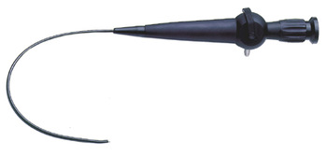
Endoscopy of the Nose and the Throat

