Slide 1
T.M Joint and M. of mastication
Clinical Anatomy of second year

Slide 2
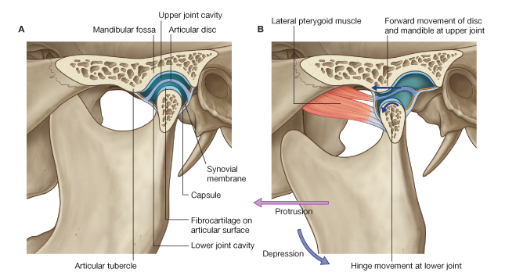
T.M joint

Slide 3
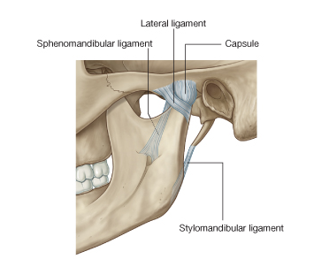
Joint ligaments

Slide 4
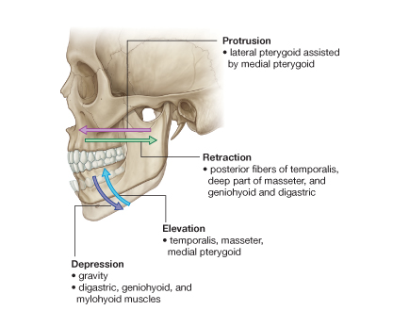
T.M Joint Movement

Slide 5
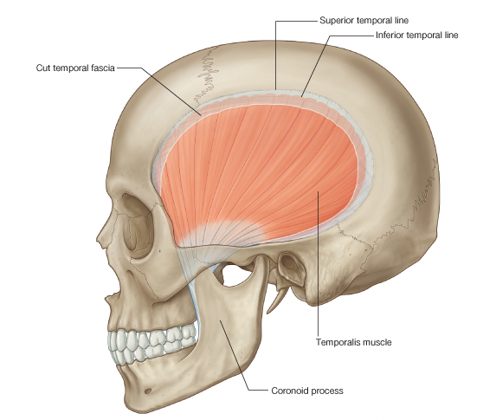
Muscles of Mastication

Slide 6
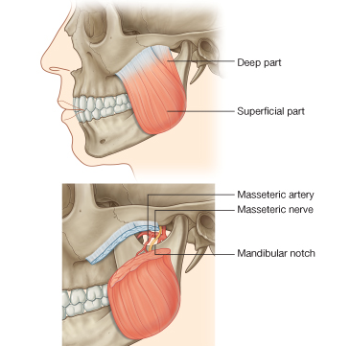
Masseter Muscle

Slide 7
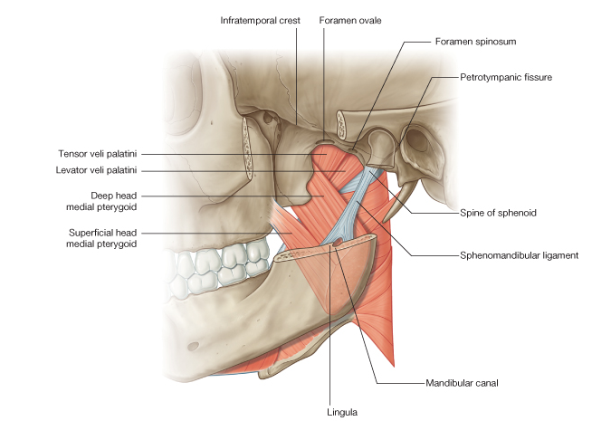
Medial pterygoid muscle

Slide 8
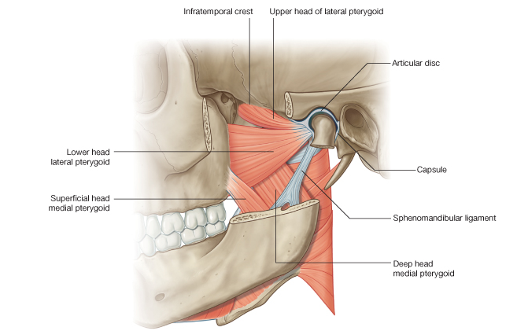
Lateral pterygoid Muscle

