Slide 1
The EAR
Clinical Anatomy of second year

Slide 2
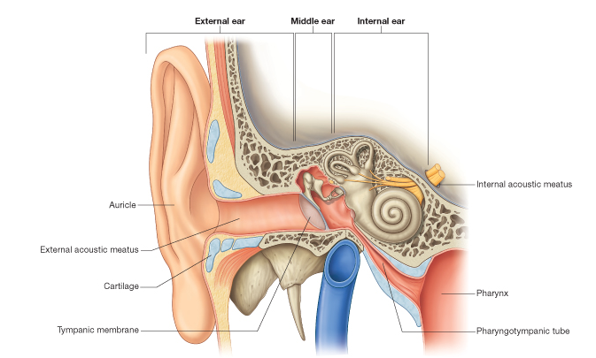
The EAR

Slide 3
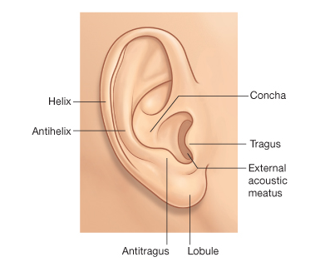
External EAR- The Auricle

Slide 4
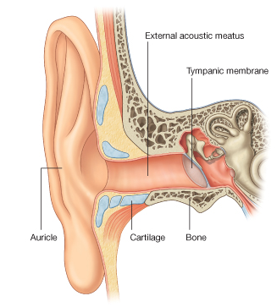
External Auditory Meatus

Slide 5
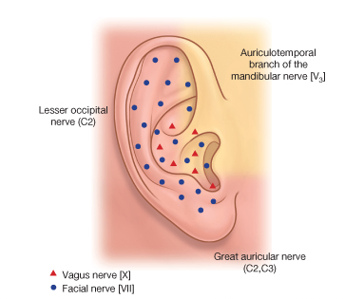
Innervation and Blood Supply

Slide 6
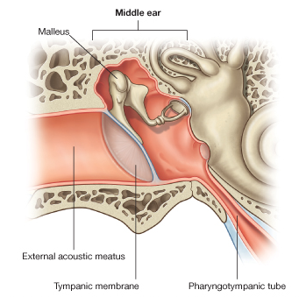
Tympanic Membrane

Slide 7
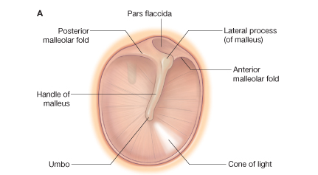
Tympanic membrane Diagram

Slide 8
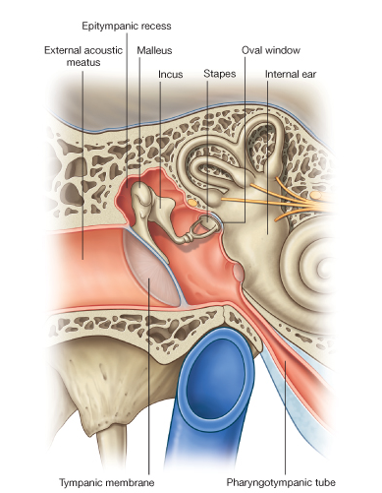
Middle Ear

Slide 9
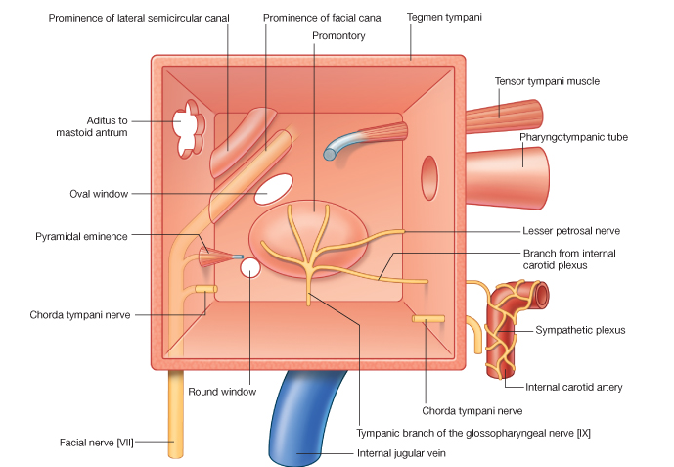
Boundaries of Middle Ear

Slide 10
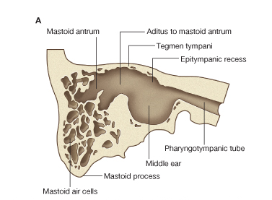
Mastoid Ear sinus

Slide 11
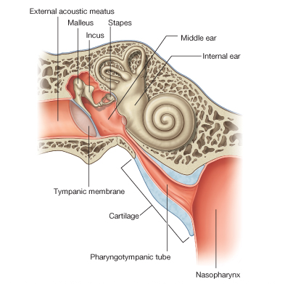
Pharyngotympanic Tube

Slide 12
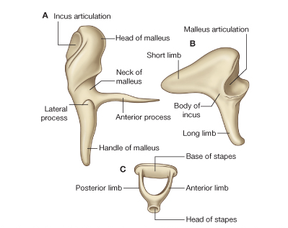
Auditory Ossicles

Slide 13
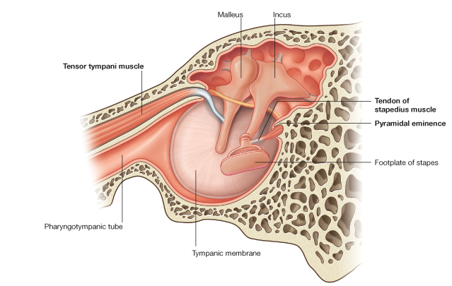
Middle Ear Muscles

Slide 14
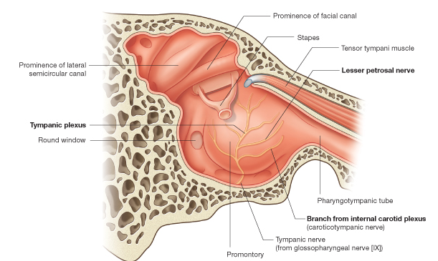
Middle ear innervation

Slide 15
Best wishes
Thank you

