Slide 1
Pterygopalatine fossa
Clinical Anatomy of second year

Slide 2
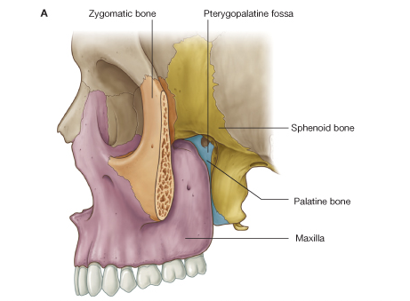
Pterygopalatine fossa

Slide 3
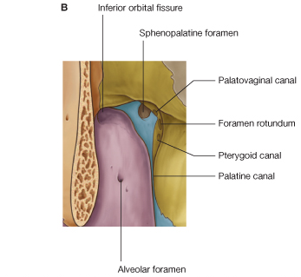
Foramina

Slide 4
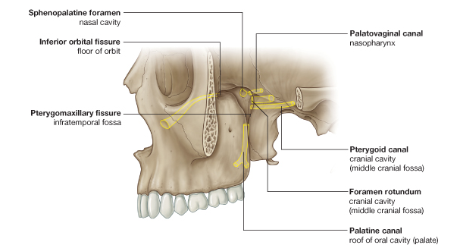
Foramina and fissures

Slide 5
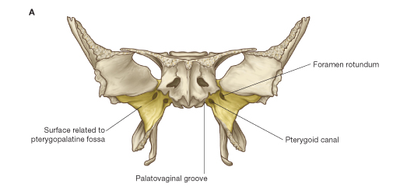
Bony frame work

Slide 6
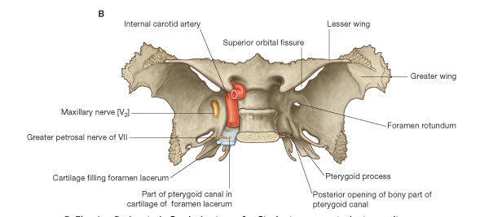
Contents of foramina of sphenoid

Slide 7
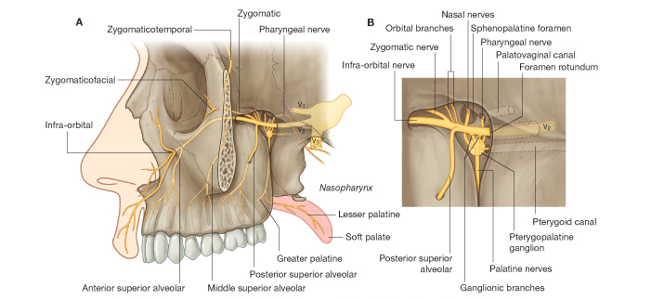
Maxillary nerve and its branches

Slide 8
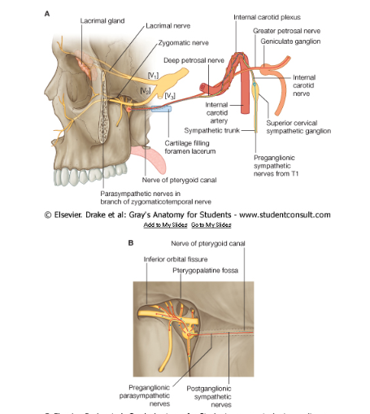
Nerve of pterygoid canal

Slide 9
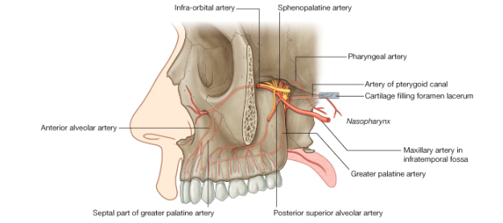
Branches of maxillary artery

Slide 10
Thank you

