Slide 1
Temporal & infratemporal fossa
Clinical Anatomy of second year
Dr. Ahmed Almusawi

Slide 2
Objectives
Describe the anatomy of temporal and infratemporal fossa
explaining the bony framework of these fossa
describing the contents of each fossae including the nerves, blood vessels and muscles

Slide 3
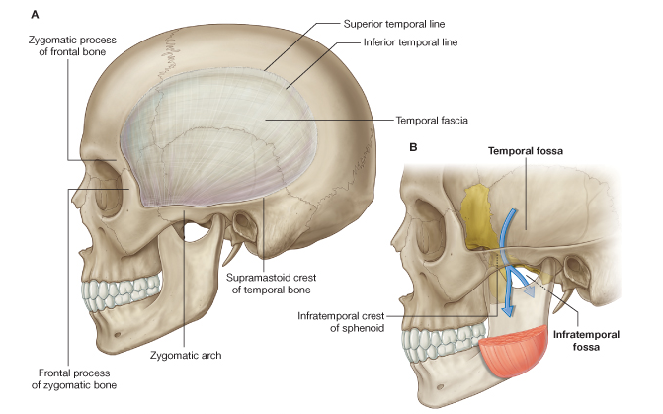
Temporal & Infratemporal fossa

Slide 4
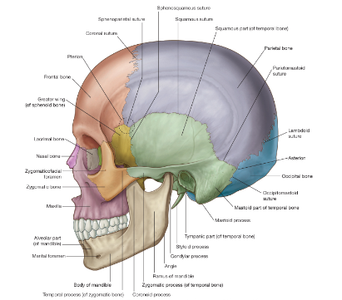
Bony framework

Slide 5
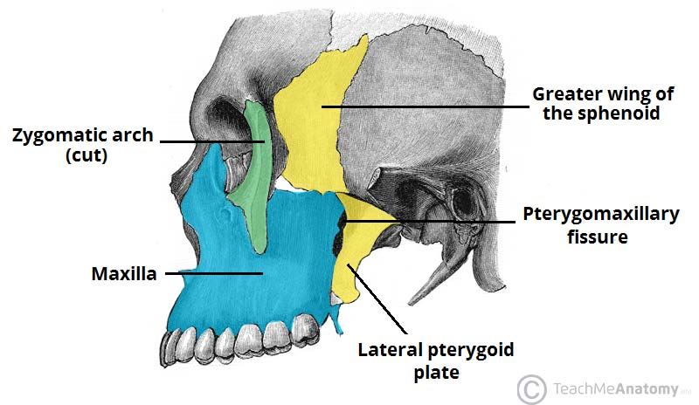
Bony framework

Slide 6
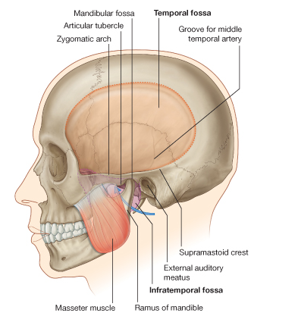
Temporal fossa

Slide 7
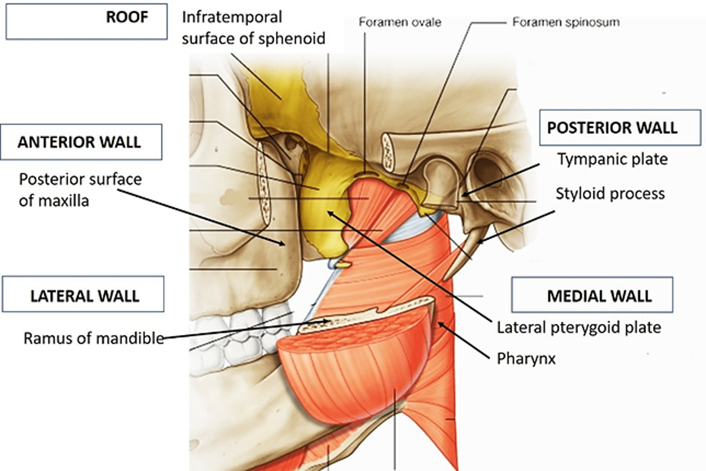

Slide 8
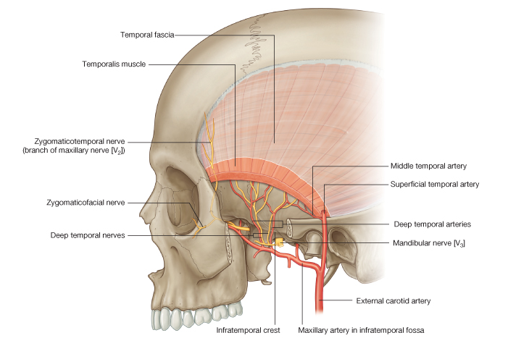
Contents of temporal fossa

Slide 9
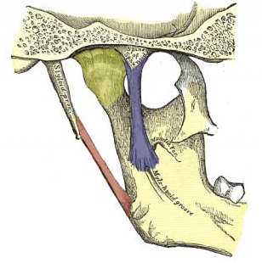
Contents of infratemporal fossa 1. sphenomandibular ligament

Slide 10
2. Med & lat. Pterygoid muscles

Slide 11
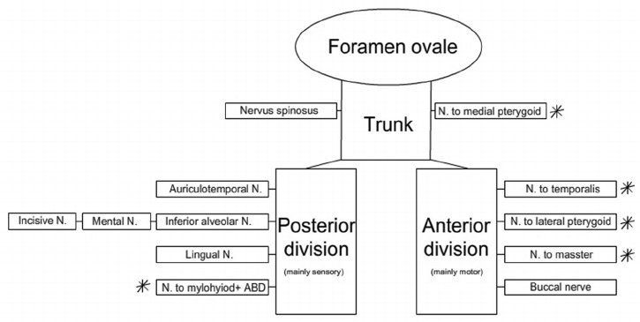
3. Mandibular nerve

Slide 12
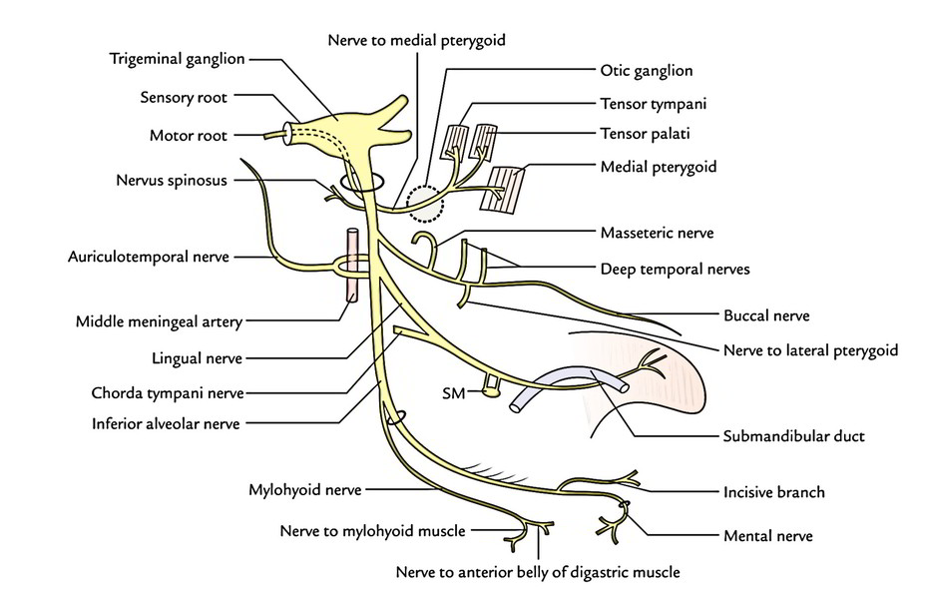
Mandibular nerve

Slide 13
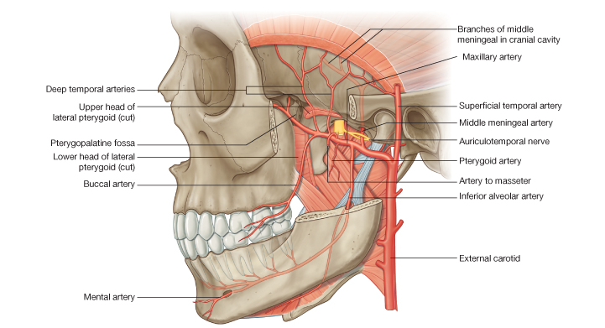
4. Maxillary artery

Slide 14
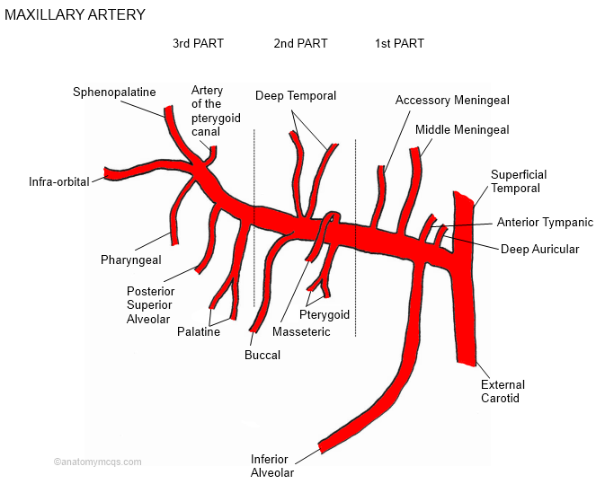
Maxillary art. branches

Slide 15
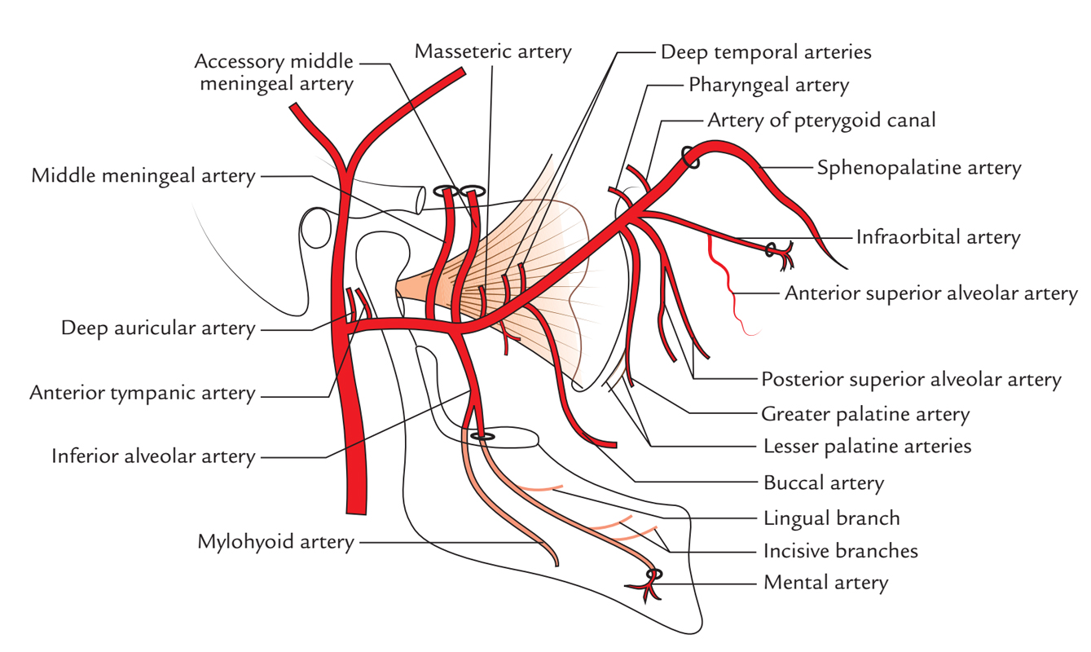

Slide 16
Thank you

