Slide 1
The SCALP
Clinical Anatomy of second year
Dr. Ahmed Almusawi
M.B.Ch.B, MSc, PhD Human Anatomy

Slide 2
OBJECTIVES
Explain the anatomy of the scalp
and naming the individual layers of it
in addition to explain the innervation, blood supply and lymphatics of the scalp
with some clinical notes about some scalp condition

Slide 3
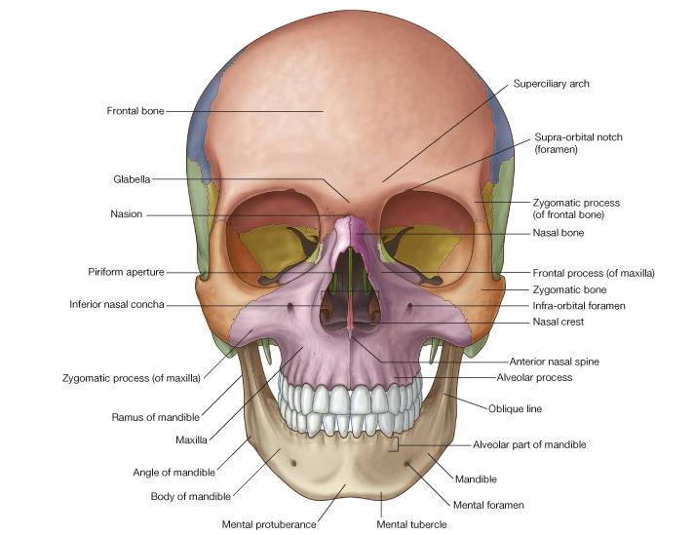
Anterior view

Slide 4
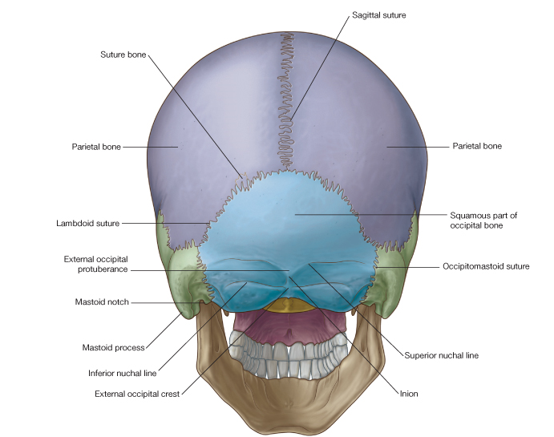
Posterior view

Slide 5
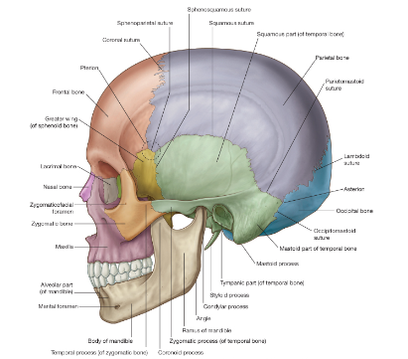
Lateral view

Slide 6
Quiz
blow on the head lead to black eye

Slide 7
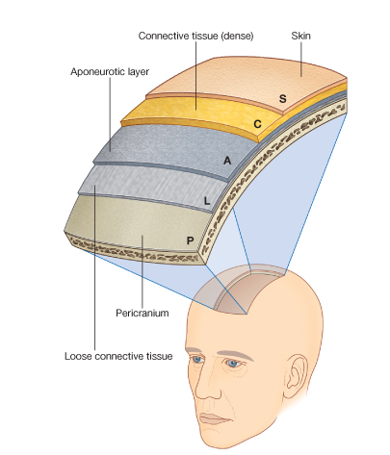
SCALP

Slide 8
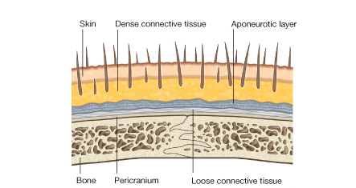
LAYERS

Slide 9
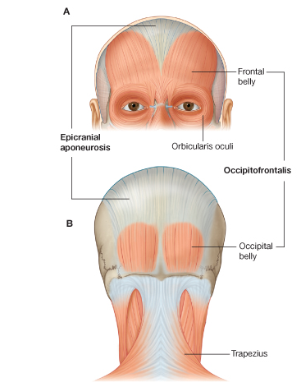
OCCIPTOFRONTALIS

Slide 10
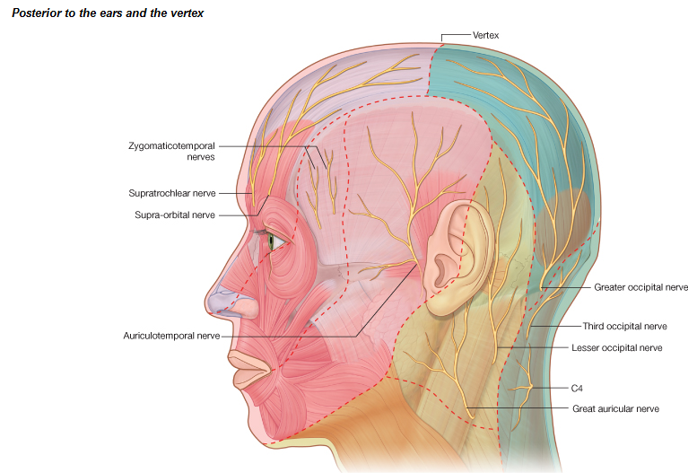
INNERVATIONS

Slide 11
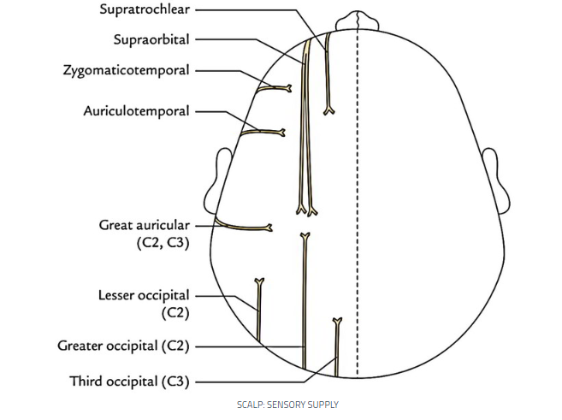
Sensory innervation of scalp

Slide 12
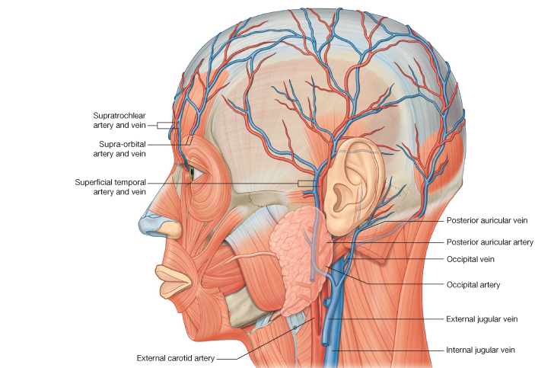
BLOOD SUPPLY

Slide 13
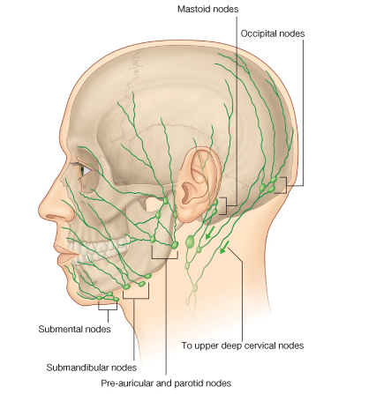
LYMPHATICS

Slide 14
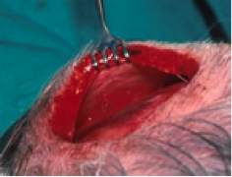
SCALP CONDITIONS 1. LACERATION

Slide 15
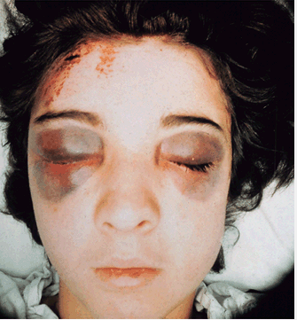
2. ECCYMOSIS

Slide 16
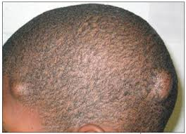
3. Sebaceous Cysts

Slide 17
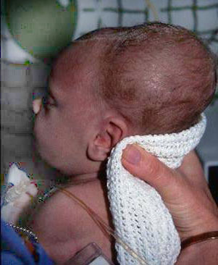
4. CEPHALOHAEMATOMAS

