Slide 1
haemopoiesis

Slide 2
Haematopoiesis: the process of production of new blood cells (RBC, WBC, Platelet) from the stem cells
Erythropoiesis: the process of new RBC production.

Slide 3
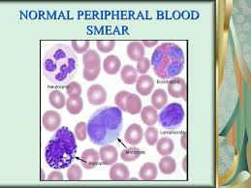

Slide 4
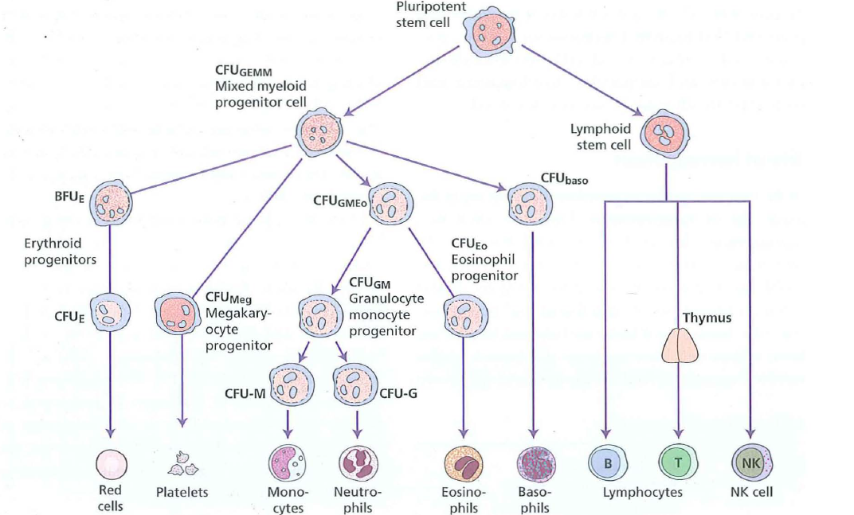

Slide 5
Haemopoietic stem and progenitor cells
Haemopoiesis starts with a pluripotential stem
cell that can give rise to the separate cell lineages
This haemopoietic stem cell is rare, perhaps 1 in
every 20 million nucleated cells in bone marrow.
has the appearance of a small or medium-sized lymphocyte
Although its exact phenotype is unknown, on
immunological testing it is CD34+ CD38-
Cell differentiation occurs from the stem cell via the committed haemopoietic progenitors which are restricted in their developmental potential

Slide 6
Hemopoiesis starts in the yolk sac.
After the 12th week of gestation, the liver & spleen become the main sites.
The bone marrow becomes active from week 20 onwards & it is the only site in the postnatal life.

Slide 7
During the first 3 years of life active bone marrow is found in all bones.
Later; the active (red) marrow will be replaced gradually by yellow (fatty) marrow.
in adults, the red marrow is confined to the axial skeleton: sternum, ribs, cranium, vertebrae & pelvis.
However, increased demand will result in expansion of the red marrow into the yellow marrow & to extramedullary sites (liver & spleen).

Slide 8
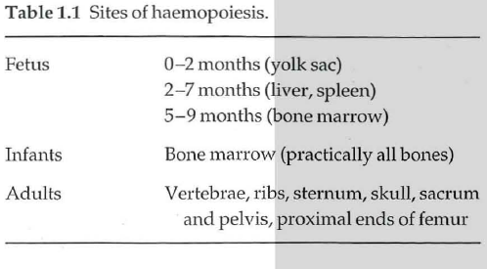

Slide 9
Bone marrow stroma
The bone marrow forms a suitable environment for stem cell survival, growth and development.
It is composed of stromal cells and a microvascular network
The stromal cells include :
adipocytes,
Fibroblasts
endothelial cells
macrophages
they secrete extracellular molecules such as :
collagen,
glycoproteins (fibronectin and thrombospondin)
and glycosaminoglycans (hyaluronic acid and
chondroitin derivatives)
to form an extracellular matrix.
In addition, stromal cells secrete
Several growth factors necessary for stem cell survival.

Slide 10
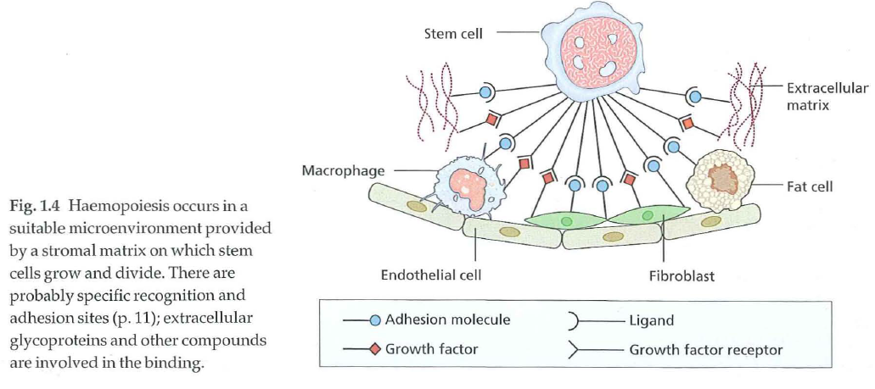

Slide 11
Mesenchymal stem cells are thought to be critical
in stromal cell formation.
Stem cells are able to traffic around the body and
are found in peripheral blood in low numbers.
In order to exit the bone marrow, cells must cross
the blood vessel endothelium and this process of
mobilization is enhanced by administration of
cytokines such as granulocyte colony-stimulating factor (G-CSF) or granulocyte-macrophage colony stimulating
factor (GM-CSF)
The reverse process of stem cell homing appears to depend on a chemokine gradient in which the stromal derived
factor (SDF-l) is critical.

Slide 12
Several interactions maintain stem cell viability and production in the stroma including stem cell factor
(SCF) and Jagged proteins expressed on stroma and
their respective receptors c-Kit and Notch expressed
on stem cell.
Stem cell plasticity
There is some evidence that adult stem cells in
different organs are pluripotent and can generate
various types of tissue
Studies in patients and animals who have received haemopoietic stem cell transplants have suggested that donor cells may contribute to tissues such as neurons,
liver and muscle.

Slide 13
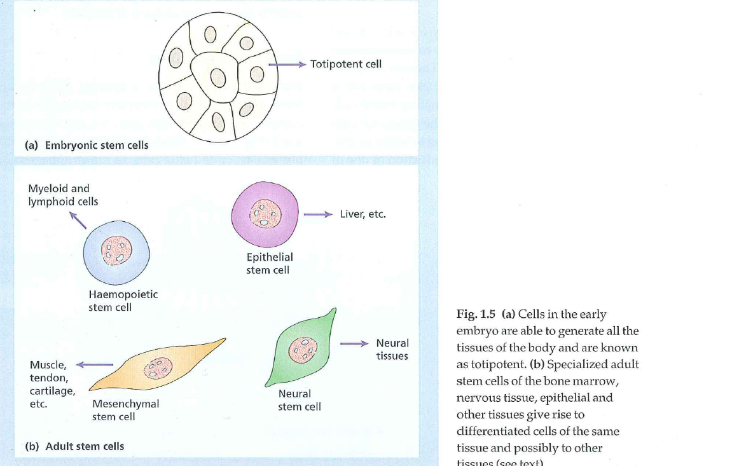

Slide 14
The regulation of haemopoiesis
Haemopoiesis starts with stem cell division in
which one cell replaces the stem cell (self-renewal)
and the other is committed to differentiation.
These early committed progenitors express low levels of
transcription factors that may commit them to discrete
cell lineages.
Which cell lineage is selected for differentiation may depend both on chance and on the external signals received by progenitor cells.
Several transcription factors that regulate differentiation:
PU.1 commits cells to the myeloid lineage
GATA-1 has an essential role in erythropoietic and megakaryocytic differentiation.

Slide 15
Haemopoietic growth factors
The haemopoietic growth factors are glycoprotein
hormones that regulate the proliferation and differentiation of haemopoietic progenitor cells and the function of mature blood cells.
They may act locally at the site where they are produced by cell-cell contact or circulate in plasma.
They also bind to the extracellular matrix to form niches to which stem and progenitor cells adhere.
The growth factors may cause cell proliferation but can also stimulate differentiation, maturation, prevent apoptosis and affect the function of mature cells

Slide 16
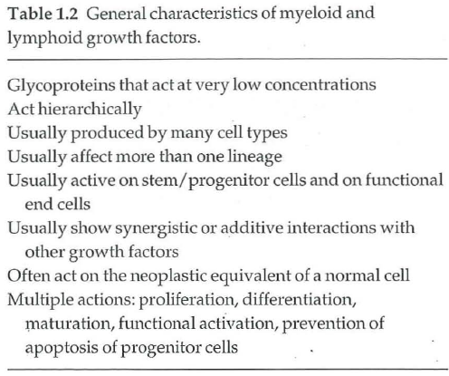

Slide 17
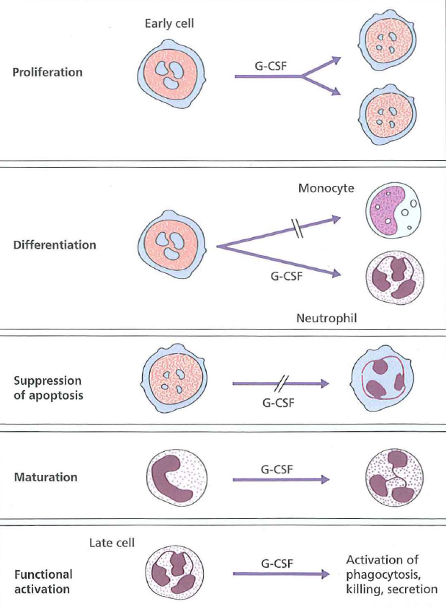

Slide 18
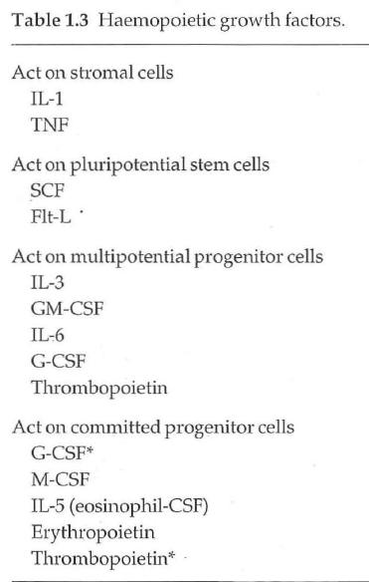

Slide 19
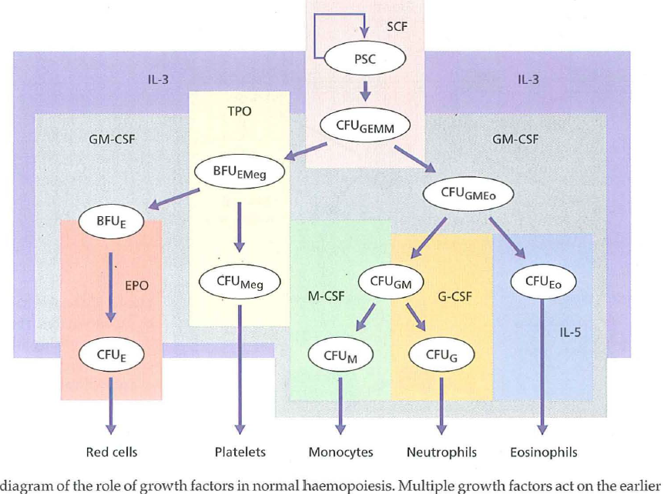

Slide 20
The biological effects of growth factors are mediated
through specific receptors on target cells.
Many receptors (e.g. erythropoietin (epa) receptor (R), GMCSF-
R) are from the haematopoietin receptor superfamily
which dimerize after binding their ligand.
Dimerization of the receptor leads to activation of a complex series of intracellular signal transduction pathways of which the three major ones are :
JAK (The Janus associated kinase) /STAT(signal transducer
and activator of transcription)
mitogen activated protein (MAP) kinase
the phosphatidylinositol 3 (PI3) kinase pathways .

Slide 21
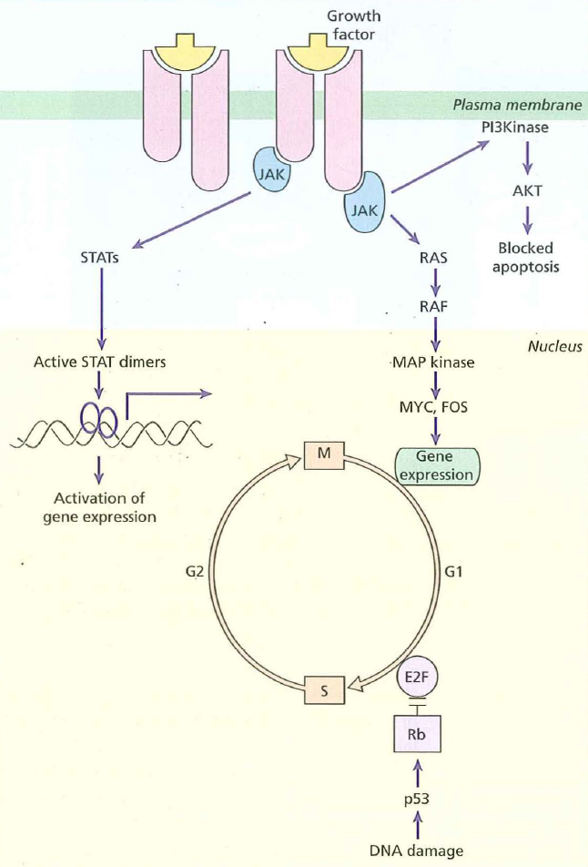

Slide 22
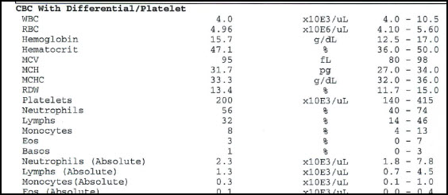
Full Blood Count:
This term refers to a group of tests that performed simultaneously on a blood sample to assess whether there is any hematological abnormality.

Slide 23
