Slide 1
Aplastic anaemia and bone marrow failure

Slide 2
Pancytopenia
Pancytopenia is a reduction in the blood count of all the major
cell lines – red cells, white cells and platelets. It has several causes
which can be broadly divided into
decreased bone marrow production or increased peripheral destruction

Slide 3
Causes of pancytopenia.
Decreased bone marrow function
Aplasia (reduction of haemopoietic stem cells)
Acute leukaemia, myelodysplasia, myeloma
Infiltration with lymphoma, solid tumours, tuberculosis
Megaloblastic anaemia
Paroxysmal nocturnal haemoglobinuria
Myelofibrosis
Haemophagocytic syndrome
Increased peripheral destruction
Splenomegaly

Slide 4
Aplastic anaemia
Aplastic (hypoplastic) anaemia is defined as pancytopenia
resulting from hypoplasia of the bone marrow
It is classified into
primary (congenital or acquired) or
secondary

Slide 5
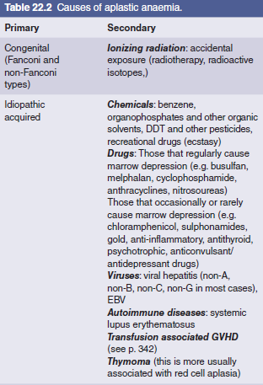

Slide 6
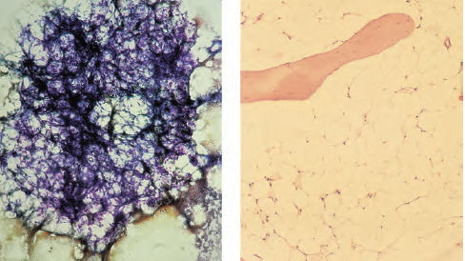

Slide 7
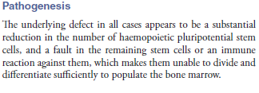

Slide 8
Congenital: Fanconi anaemia (FA)
The Fanconi type has an autosomal recessive pattern of inheritance
and is often associated with growth retardation and congenital defects of the skeleton (e.g. microcephaly, absent radii or thumbs), of the renal tract (e.g. pelvic or horseshoe kidney)
or skin (areas of hyper‐ and hypopigmentation);
sometimes there is learning disability

Slide 9
The syndrome is genetically
heterogeneous with 16 different genes involved: FANC
A–Q. FANCD1 is identical to BRCA2, the breast cancer susceptibility gene.
The proteins coded for by these genes cooperate
in a common cellular pathway which results in ubiquitination
of FANCD2, which protects cells against genetic damage.
Cells
from FA patients show an abnormally high frequency of spontaneous chromosomal breakage and
the diagnostic test is
elevated breakage after incubation of peripheral blood lymphocytes with
the DNA cross‐linking agent diepoxybutane (DEB test).

Slide 10
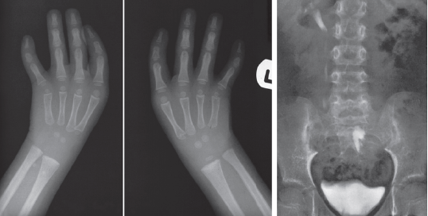

Slide 11
Dyskeratosis congenita (DC)
is a rare sex‐linked disorder
with nail and skin atrophy and a high risk of pulmonary fibrosis, cirrhosis, osteoporosis and cancer.
It is associated
with mutations in the DKC1 (dyskerin) or TERC (telomerase reverse transcriptase RNA template) involved in the maintenance
of telomere length.

Slide 12
The usual age of presentation of FA is 3–14 years. Approximately
10% of patients develop acute myeloid leukaemia. Treatment
is usually with androgens and/or SCT.
The blood count
usually improves with androgens but side‐effects, especially in children, are distressing (virilization and liver abnormalities);
remission rarely lasts more than 2 years.
SCT may cure the patient.
Because of the sensitivity of the patient’s cells to DNA
damage, conditioning regimes are mild and irradiation avoided.

Slide 13
Other inherited bone marrow failure syndromes include
Diamond–Blackfan anaemia (DBA),
Schwachman–Diamond syndrome (SDS)
severe congenital neutropenia
amegakaryocytic thrombocytopenia and
thrombocytopenia with absent radii .
In DC, DBA and SDS there are genetic defects in ribosomal biosynthesis
and function

Slide 14
Idiopathic acquired aplastic anaemia
This is the most common type of aplastic anaemia, accounting for at
least two‐thirds of acquired case.
In most cases haemopoietic tissue is the target of an autoimmune process dominated by oligoclonal expression of cytotoxic CD8+ T cells.
Clonal haemopoiesis with somatic mutations of genes such as PIGA, ASXLI and DNMT3A,
presumably arising by selection in a failed marrow, occur in about
50% of cases.
The disease must be distinguished from a late onset
of a congenital form of aplastic anaemia and from hypoplastic
myelodysplasia.. Mutations of the telomere repair complex and
short telomeres may be present, apparently as acquired abnormalities.
The favourable responses to antilymphocyte globulin (ALG)
and ciclosporin support the concept of an autoimmune disorder

Slide 15
Secondary causes
Aplastic anaemia may be caused by direct damage to the haemopoietic
marrow by radiation or cytotoxic drugs. The antimetabolite
drugs (e.g. methotrexate) and mitotic inhibitors (e.g. daunorubicin)
cause only temporary aplasia but the alkylating agents,
particularly busulfan, may cause chronic aplasia closely resembling
the chronic idiopathic disease. Some individuals develop aplastic
anaemia as a rare idiosyncratic side‐effect of drugs such as chloramphenicol
or gold (Table 22.2). They may also develop the disease
during or within a few months of viral hepatitis (most frequently
negative for all known hepatitis viruses). Because the incidence of
marrow toxicity is particularly high for chloramphenicol, this drug
should be reserved for treatment of infections that are life‐threatening
and for which it is the optimum antibiotic (e.g. typhoid).
Chemicals such as benzene may be implicated and, rarely, aplastic
anaemia may be the presenting feature of acute lymphoblastic or
myeloid leukaemia, especially in childhood. Myelodysplasia (see
Chapter 16) may also present with a hypoplastic marrow

Slide 16
Clinical features
The onset is at any age with peak incidences around 10–25
and over 60 years.
It is more frequent in Asia, e.g. China, than Europe.
It can be insidious or acute with symptoms and
signs resulting from anaemia, neutropenia or thrombocytopenia.
Bruising, bleeding gums, epistaxes and menorrhagia
are the most frequent haemorrhagic manifestations and the
usual presenting features ,often with symptoms of
anaemia. Retinal haemorrhage may impair vision. Infections,
particularly of the mouth and throat, are common and generalized
infections are frequently life threatening.
The lymph nodes, liver and spleen are not enlarged.

Slide 17
Laboratory findings
In aplastic anaemia, there must be at least two of the following:
1 Anaemia (haemoglobin <100 g/L). This is normochromic, normocytic or macrocytic (mean cell volume (MCV) often 95–110 fL).
The reticulocyte count is usually extremely low in relation to the degree of anaemia.
2 Neutrophil count <1.5 × 109/L.
3 Platelet count <50 × 109/L.
4 Severe cases show neutrophils <0.5 × 109/L and platelets
<20 × 109/L, reticulocytes <20 × 109/L and marrow cellularity
<25%.Very severe cases show neutrophils <0.2 × 109/L.
5 There are no abnormal cells in the peripheral blood.
6 The bone marrow shows hypoplasia, with loss of haemopoietic
tissue and replacement by fat which comprises over
75% of the marrow.
Trephine biopsy may show patchy cellular
areas in a hypocellular background. The main cells
present are lymphocytes and plasma cells; megakaryocytes
in particular are severely reduced or absent.
7 Cytogenetic and, more recently, molecular analysis is performed
to exclude inherited forms and myelodysplasia

Slide 18
Diagnosis
The disease must be distinguished from other causes of pancytopenia
Paroxysmal nocturnal haemoglobinuria (PNH) must be
excluded by flow cytometry testing of red cells for CD55 and
CD59.
In older patients, hypoplastic myelodysplasia may
show similar appearances. Abnormalities of the blood cells
and clonal cytogenetic or molecular changes suggest myelodysplasia.
Some patients diagnosed as having aplastic anaemia
develop PNH, myelodysplasia or acute myeloid leukaemia in
subsequent years. This may occur even in patients who have
responded well to immunosuppressive therapy.
Large granular lymphocytic leukaemia may also be associated
with pancytopenia and a hypoplastic marrow.

Slide 19
Treatment
This is best carried out in a specialized centre.
:General
supportive care with blood transfusions, platelet concentrates, and treatment and prevention of infection.
All blood products should
be leucodepleted, to reduce the risk of alloimmunization, and
irradiated, to prevent grafting of live donor lymphocytes. An
antifibrinolytic agent (e.g. tranexamic acid) may be used to
reduce haemorrhage in patients with severe prolonged thrombocytopenia.
Granulocyte transfusions are rarely used, but may
be given to patients with severe bacterial or fungal infections
not responding to antibiotics. Oral antibacterial and antifungal
drugs may be used to reduce infections.

Slide 20
Specific
This must be tailored to the severity of the illness as well as the
age of the patient and availability of stem cell donors. Severe
cases have a high mortality in the first 6–12 months unless
they respond to specific therapy. Less severe cases may have an
acute transient course or a chronic course with ultimate recovery,
although the platelet count often remains subnormal for
many years. Relapses, sometimes severe and occasionally fatal,
may also occur and rarely the disease transforms into myelodysplasia,
acute leukaemia or PNH

Slide 21
specific treatments are
1 Antithymocyte globulin.
2 Ciclosporin .
3 Alemtuzumab (anti‐CD 52 antibody)..
4 Eltrombopag .
5 Androgens
6 Stem cell transplantation
7 Haemopoietic growth factors Granulocyte colony‐stimulating
8 Iron chelation therapy

