Slide 1
Gynecological examination
Dr. Zeena Helmi

Slide 2
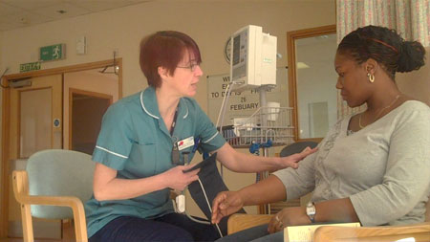
How to perform Sim's speculum exam.
1. Patient's verbal consent, explain to the patient what are you going to do. A female assistant should be present for intimate exam.

Slide 3
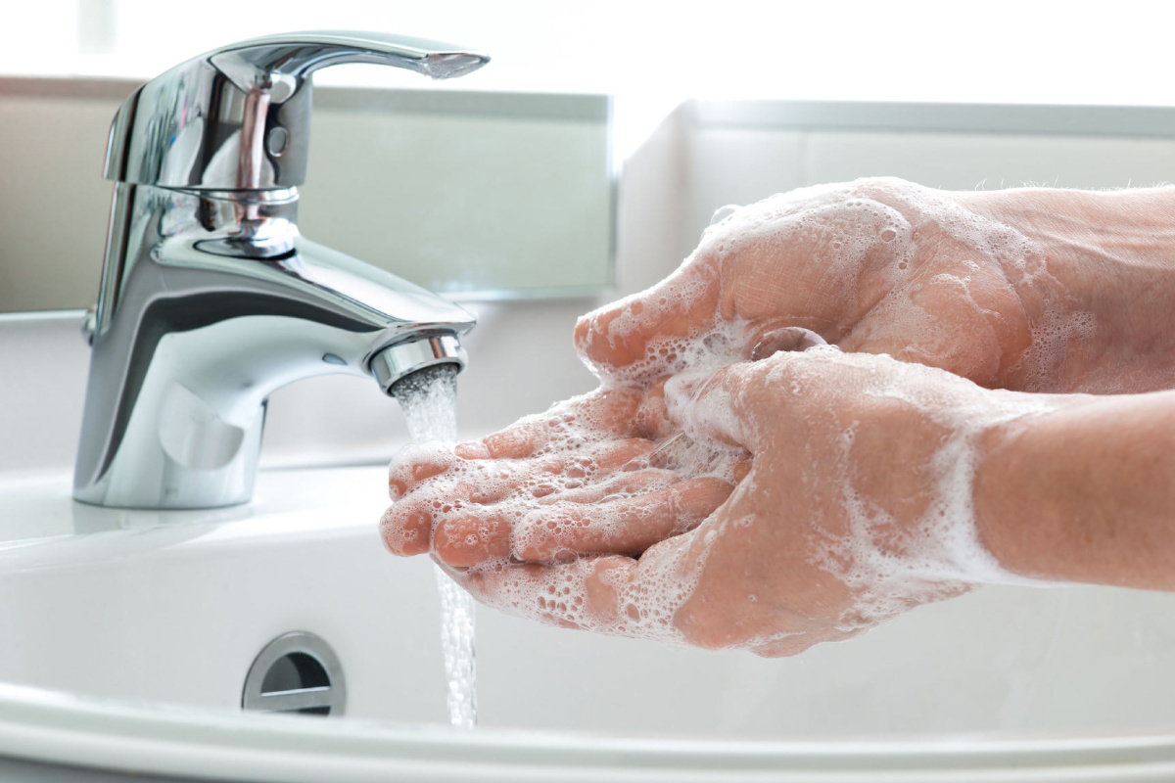
2. Wash hands, wear gloves and use sterile speculum after warming it.

Slide 4
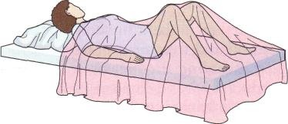
3. The patient's external genitalia examined under good light in dorsal position with hips flexed and abducted and knees flexed.

Slide 5
4. The left lateral position is used for prolapsed and for inspection of vaginal walls.
5. The patient is asked to strain down to detect any prolapse and to cough to see stress incontinence
6. The speculum is removed

Slide 7
How to perform Cusco's bivalve speculum exam.
1. Patient's verbal consent, explain to the patient what are you going to do. A female assistant should be present for intimate exam.
2. Wash hands, wear gloves and use sterile speculum after warming it.
3. The patient's external genitalia examined under good light in dorsal position with hips flexed and abducted and knees flexed.

Slide 9
4. Cusco's bivalve speculum is inserted while closed in oblique direction with the lock directed posteriorly then opened to visualize the cervix and fix the screw
5. After complete the exam. Loose the screw, close the speculum and remove it.

Slide 10
How to perform a high vaginal swab
1. Patient's verbal consent, explain to the patient what are you going to do. A female assistant should be present for intimate exam.
2. Wash hands, wear gloves and use sterile speculum after warming it.
3. The patient's external genitalia examined under good light in dorsal position with hips flexed and abducted and knees flexed.

Slide 11
4. Cusco's bivalve speculum is inserted while closed in oblique direction with the lock directed posteriorly then opened to visualize the cervix and fix the screw
5.the swab is introduced into the posterior vaginal fornix then closed, labeled and sent to the lab.
6. After complete the exam. Loose the screw, close the speculum and remove it.

Slide 14
How to perform a pap smear
1. The smear should be done while the patient is not menstruating, at 10 to 20 days after the 1st day of the last menstrual period.
2. For 2 days before the test there should be no intercourse, no vaginal douching, spermicidal preparation or medication.
3. Patient's verbal consent, explain to the patient what are you going to do. A female assistant should be present for intimate exam.

Slide 15
4. Wash hands, wear gloves and use sterile speculum after warming it.
5. The patient's external genitalia examined under good light in dorsal position with hips flexed and abducted and knees flexed.
6. Cusco's bivalve speculum is inserted while closed in oblique direction with the lock directed posteriorly then opened to visualize the cervix and fix the screw

Slide 18
7. The Ayre's spatula is inserted into the SCJ rotate it through 360 degrees, avoid too much and too little force, then spread the cells on a glass slide, put it in a fixative, label it and send it to the lab.

Slide 20
8. Use the endocervical brush through introducing it into the cervical canal, rotate it and collect the cells on a paper or a slide and put it in the fixative.
9. After complete the exam. Loose the screw, close the speculum and remove it.

Slide 21
Thank you

