Slide 1
Urinary Tract Infection
Dr.Zeena Helmi

Slide 2
Urinary tract infection are the most common bacterial infections during pregnancy.
asymptomatic bacteriuria is the most common, symptomatic infection includes cystitis, or it may involve the renal calyces, pelvis, and parenchyma—pyelonephritis.
Organisms that cause urinary infections are those from the normal perineal flora. Approximately 90 percent of Escherichia coli

Slide 3
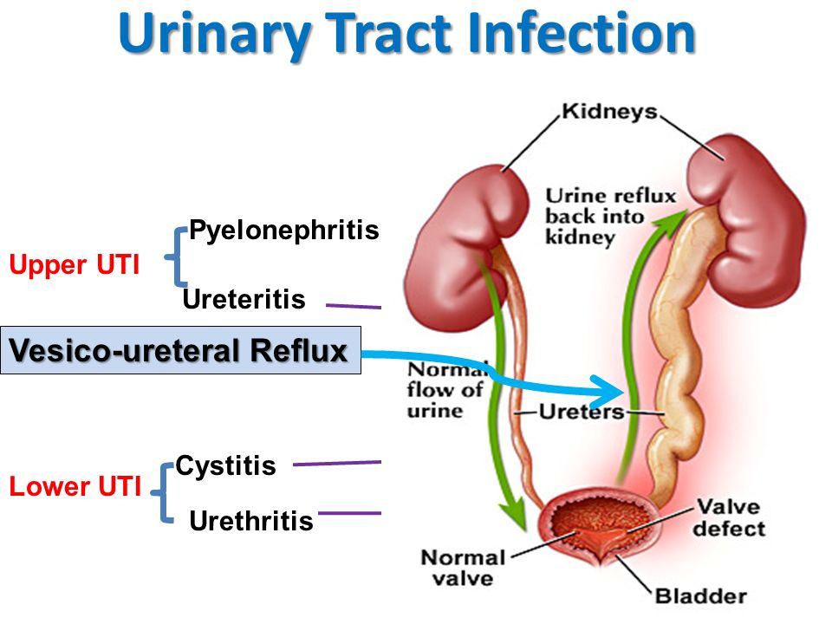

Slide 4
Asymptomatic Bacteriuria
is refers to persistent, actively multiplying bacteria within the urinary tract in asymptomatic women.
Bacteriuria is typically present at the first prenatal visit. An initial positive urine culture result prompts treatment, after which, fewer than 1 percent of women develop a urinary tract infection. A clean-voided specimen containing more than 100,000 organisms/mL is diagnostic.

Slide 5
Significance
If asymptomatic bacteriuria is not treated, approximately 25 percent of infected women will develop symptomatic infection during pregnancy. Eradication of bacteriuria with antimicrobial agents prevents most of these.
Treatment
Bacteriuria responds to empirical treatment with any of several antimicrobial regimens

Slide 6
treatment
Single-dose treatment
Amoxicillin, 3 g
Ampicillin, 2 g
Cephalosporin, 2 g
Nitrofurantoin, 200 mg

Slide 7
3-day course
Amoxicillin, 500 mg three times daily
Ampicillin, 250 mg four times daily
Cephalosporin, 250 mg four times daily
Nitrofurantoin, 50 to 100 mg four times daily or
100 mg twice daily

Slide 8
Cystitis and Urethritis
Cystitis is characterized by dysuria, urgency, and frequency, but with few associated systemic findings. Pyuria and bacteriuria are usually found. Microscopic hematuria is common, and occasionally there is gross hematuria from hemorrhagic cystitis . Although cystitis is usually uncomplicated, the upper urinary tract may become involved by ascending infection. Almost 40 percent of pregnant women with acute pyelonephritis have preceding symptoms of lower tract infection.

Slide 9
Women with cystitis respond readily to any of several regimens. Most of the three-day regimens are usually 90-percent efective ..
Lower urinary tract symptoms with pyuria accompanied by a sterile urine culture may be from urethritis caused by Chlamydia trachomatis. Mucopurulent cervicitis usually coexists, and azithromycin therapy is efective.

Slide 10
Acute Pyelonephritis
Renal infection is the most common serious medical complication of pregnancy
Clinical findings:
1-Renal infection develops more frequently in the second trimester, and nulliparity and young age are associated risk factors
Pyelonephritis is unilateral and right-sided in more than half of cases,
there is usually a rather abrupt onset with fever, shaking chills,

Slide 11
aching pain in one or both lumbar regions.
Anorexia, nausea, and vomiting may worsen dehydration.
Tenderness usually can be elicited by percussion in one or both costovertebral angles.

Slide 12
Investigation
urinary sediment contains many leukocytes, frequently in clumps, and numerous bacteria.
Bacteremia is demonstrated in 15 to 20 percent of these women. E coli is isolated from urine or blood in 70 to 80 percent of infections, Klebsiella pneumoniae in 3 to 5 percent, Enterobacter or Proteus species in 3 to 5 percent, and gram-positive organisms, including group B Streptococcus and S aureus, in up to 10 percent of cases
Plasma creatinine is monitored because early studies reported that 20 percent of pregnant women developed renal dysfunction.

Slide 13
DDx:
labour
chorioamnionitis
appendicitis
placental abruption
infarcted leiomyoma.

Slide 14
complications
1-Uterine activity from endotoxin is common and is related to fever severity
2-Varying degrees of respiratory insufficiency from endotoxin-induced alveolar injury are manifest in up to 10 percent of women and may result in frank pulmonary edema

Slide 15
3-Endotoxin-induced hemolysis is common, and approximately a third of patients with pyelonephritis develop anemia . With recovery, hemoglobin regeneration is normal because acute infection does not affect erythropoietin production
4-Plasma creatinine is monitored because 20 percent of pregnant women developed renal dysfunction.

Slide 16
Management
1-Admission to hospital
2- Intravenous hydration to ensure adequate urinary output is the cornerstone of treatment
3- Antimicrobial therapy usually is empirical, and ampicillin plus gentamicin; cefazolin or ceftriaxone
4- High fever should be lowered with a cooling blanket or acetaminophen. is especially important in early pregnancy because of possible teratogenic effects of hyperthermia

Slide 17
5-Obtain urine and blood cultures
6-Evaluate hemogram, serum creatinine, and electrolytes
7-Monitor vital signs frequently
8-Obtain chest radiograph if there is dyspnea or tachypnea

Slide 18
9-Repeat hematology and chemistry studies in 48 hours
10-Change to oral antimicrobials when afebrile
11-Discharge when afebrile 24 hours, consider antimicrobial therapy for 7 to 10 days
12-Repeat urine culture 1 to 2 weeks after antimicrobial therapy completed

Slide 19
With persistent spiking fever or lack of clinical improvement by 48 to 72 hours, urinary tract obstruction or another complication or both are considered. Renal sonography is recommended to search for obstruction manifest by abnormal ureteral or pyelocaliceal dilatation

Slide 20
If stones are strongly suspected patient should be send for
1-a renal sonographic examination ,
2-a plain abdominal radiograph (will identify nearly 90 percent.)
3-MR imaging may disclose the cause of persistent infection

Slide 21
Obstruction relief is important, and one method is ¹ cystoscopic placement of a double-J ureteral stent
² percutaneous nephrostomy
³ surgical removal of stones may be required in some women

Slide 22
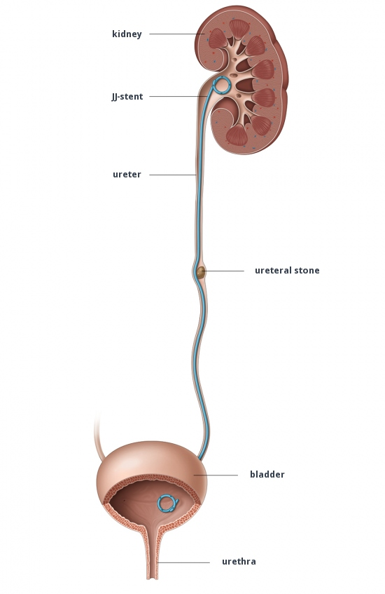

Slide 23
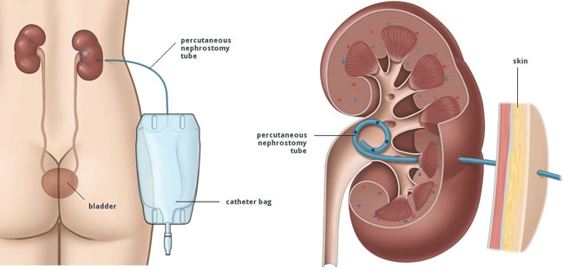

Slide 24
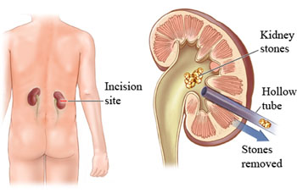

Slide 25
for recurrence infection : nitrofurantoin, 100 mg orally at bedtime given for the remainder of the pregnancy, reduces bacteriuria recurrence

Slide 26
Quiz
Patint G1P0 gestational age is 20 week presented with loin pain fever and chills

