Slide 1
Otolaryngology
Rhinology
Sinonasal Tumours
A. Proffesor Dr Haider W. Alsarhan

Slide 2
Classification:
Both benign and malignant groups can be classified into epithelial, non epithelial, odontogenic, and fibro-osseous tumours.
Benign.
Epithelial (papilloma, adenoma and inverted papilloma).
Non-epithelial (fibroma, haemangioma, nasal glioma, Schwannoma, chondroma, haemangiopericytoma, chordoma, meningioma and osteoma).
Malignant.
Epithelial (squamous cell carcinoma, adenocarcinoma, anaplastic carcinoma, transitional cell carcinoma, malignant melanoma, salivary gland malignancy in particular adenoid cystic carcinoma and olfactory neuroblastoma.
Non-epithelial (fibrosarcoma, angiosarcoma, chondrosarcoma, rhabdomyo-sarcoma, and osteogenic sarcomas).

Slide 3
Staging
The UICC staging is as follows:
Tx Primary tumour cannot be assessed.
T0 No evidence of primary disease.
Tis Carcinoma in situ.

Slide 4
Maxillary sinus:
T1 Tumour limited to the antral mucosa with no erosion or destruction of bone.
T2 Tumour causing bone erosion or destruction, except for the posterior wall, including extension into the hard palate and/or middle meatus.
T3 Tumour invades any of the following: bone of posterior wall of maxillary sinus, subcutaneous tissues, skin of cheek, floor of medial wall of orbit.
T4 Tumour invades orbital contents beyond the floor or medial wall including apex and/or any of the following: cribriform plate, base of skull, nasopharynx, sphenoid sinus, frontal sinus.

Slide 5
Ethmoid sinus:
T1 Tumour confined to ethmoid with or without bone erosion.
T2 Tumour extends into nasal cavity.
T3 Tumour extends to anterior orbit and/or maxillary sinus.
T4 Tumour with intracranial extension, orbital extension including apex, involving sphenoid and/or frontal sinus and/or skin of nose.

Slide 6
Clinical features:
In its earliest stages these tumours cause no symptoms. Blood-stained nasal discharge and increasing unilateral nasal obstruction should raise suspicion.
Late features are sadly often the presenting features and include:
• Unilateral facial swelling.
• Swelling or ulceration of the gums or palate.
• Epiphora, owing to involvement of the nasolacrimal duct.
• Proptosis and diplopia, due to involvement of the fl oor of the orbit.
• Pain – commonly in the cheek, but may be referred to the ear, head or jaw
• Metastatic neck nodes

Slide 7
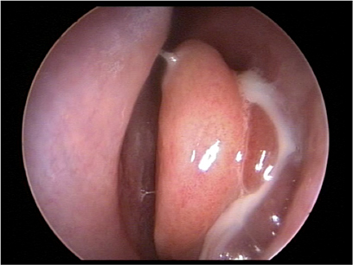

Slide 8
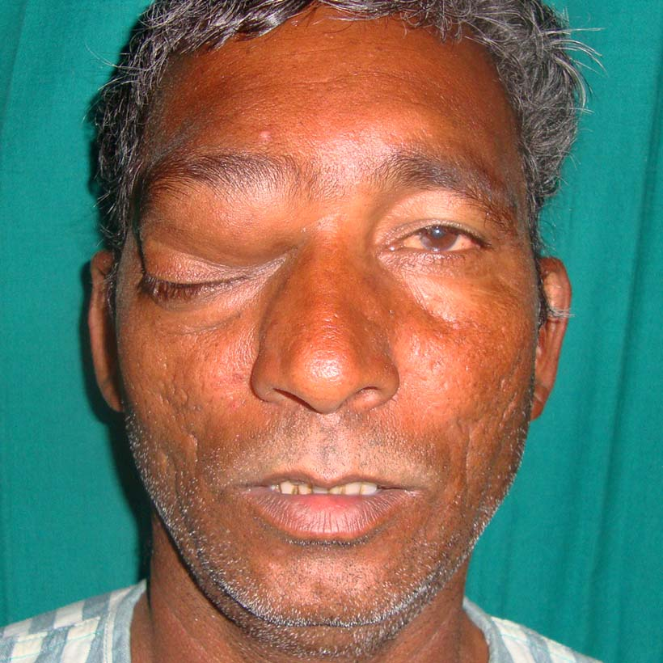

Slide 9
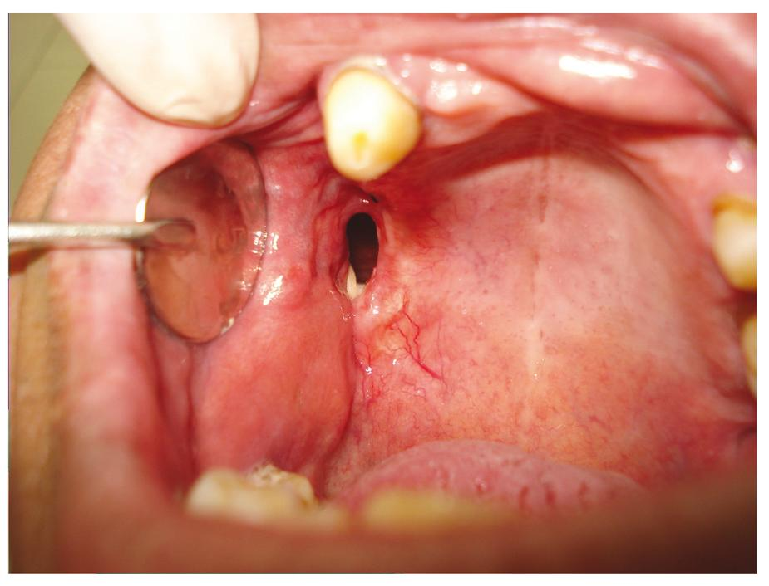

Slide 10
Investigations:
A high definition CT scan on both bone and soft tissue windows is the ideal to show soft tissue and bone involvement. A T2 weighted or STIR sequence MRI scan may distinguish tumour from inflammation, retained secretions and fat.

Slide 11
Treatment
Inverted Papiloma :
Inspite of high recurrence rate , endoscopic resection is better than open resection , close fellow up and observation is needed after surgery
Malignant tumors :
Lateral rhinotomy for tumour limited to the lateral nasal wall, nasal cavity and ethmoid.
(b) Total maxillectomy. For antral carcinoma.
(c) Craniofacial resection is indicated when the cribriform plate is involved or breached.
Adjuvant radiotherapy may be indicated depending on tissue margins
Close fellow up each 3 month after treatment by enddoscopic examination , CT scan and MRI is highly needed
Overall a five-year survival of 40-50%

