Slide 1
College of medicine Almustansiriyah University
Department of Surgery
ENT Unit
ENT – Throat Instruments
Dr Haider Alsarhan

Slide 2
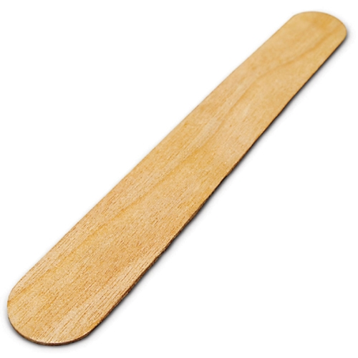
ENT – Throat instruments
Wooden tongue depressor
To perform the test of visualization of the oropharynx

Slide 3
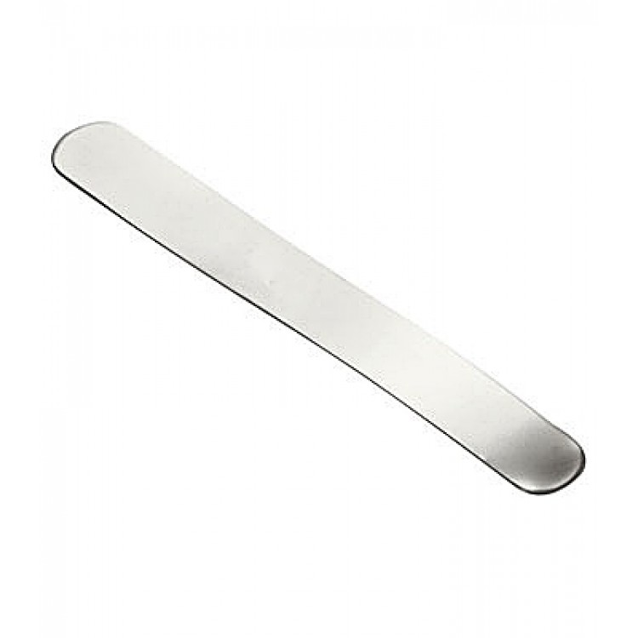
ENT – Throat instruments
Metallic tongue depressor
To perform the test of visualization of the oropharynx

Slide 4
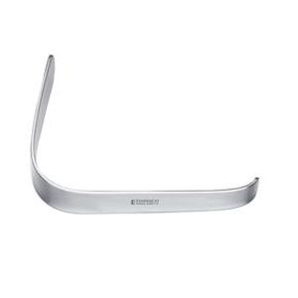
ENT – Throat instruments
Lack’s tongue depressor
To perform the test of visualization of the oropharynx
To perform minor surgical procedures

Slide 5
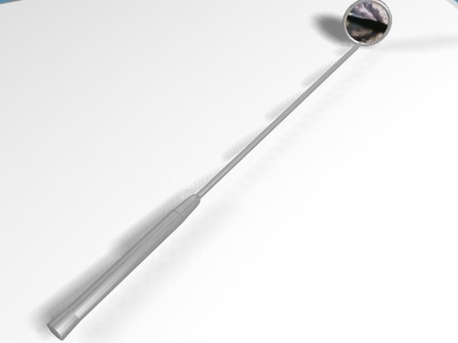
ENT – Throat instruments
Laryngeal mirror
To perform the test of Indirect Laryngoscopy

Slide 6
ENT – Throat instruments
Rigid Laryngoscope
Detailed visualization of the Larynx and hypopharynx
Recording photos and videos for documentation when attached to digital camera

Slide 7
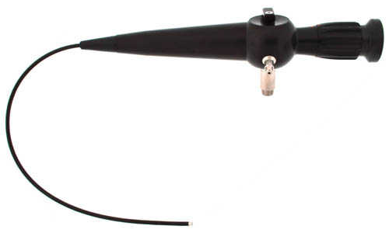
ENT – Throat instruments
Flexible Pharyngo-laryngoscope
Detailed visualization of the Larynx and the pharynx
Recording photos and videos for documentation when attached to digital camera

