Slide 1
College of medicine Almustansiriyah University
Department of Surgery
ENT Unit
ENT – Nose Instruments
Dr Haider Alsarhan

Slide 2
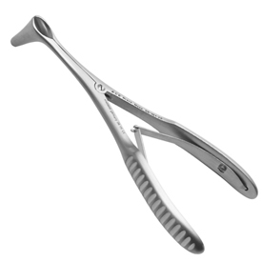
ENT – Nose instruments
Killian nasal speculum
To perform the test of anterior rhinoscopy and visualize the anterior part of the nasal septum , inferior and some times the middle turbinate

Slide 3
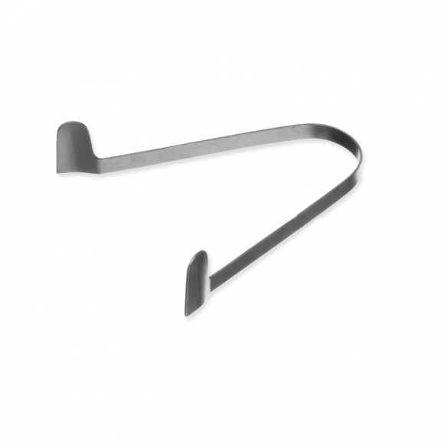
ENT – Nose instruments
Thedicum nasal speculum
To perform the test of anterior rhinoscopy and visualize the anterior part of the nasal septum , inferior and some times the middle turbinate

Slide 4
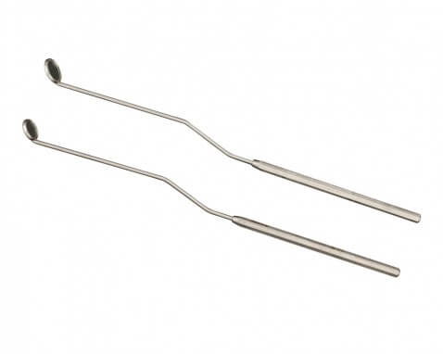
ENT – Nose instruments
Post nasal mirror
To perform the test of Posterior rhinoscopy and visualize the posterior part of the nasal septum , inferior and some times the middle turbinate
Note: this instrument also used in the ear and the throat

Slide 5
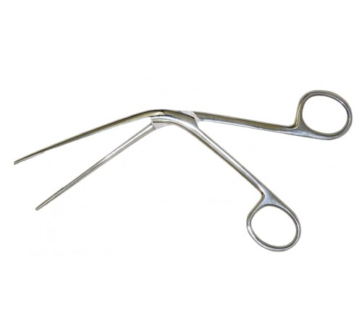
ENT – Nose instruments
Tilley nasal forceps
To perform anterior packing
To remove nasal pack
To remove foreign body
Note : it have another uses in the throat

Slide 6
ENT – Nose instruments
Tilley Lichwitz trocar and canula
To perform Antral wash out

Slide 7
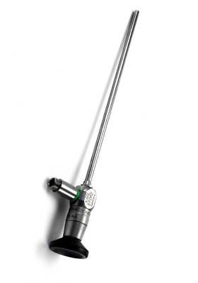
ENT – Nose instruments
Rigid sinoscope
Detailed visualization of the nasal cavity and sinus meatuses
Recording photos and videos for documentation when attached to digital camera

