Slide 1
College of medicine Almustansiriyah University
Department of Surgery
ENT Unit
ENT - Ear Instruments
Dr Haider Alsarhan

Slide 2
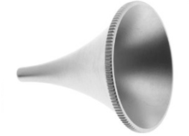
ENT – Ear instruments
Ear speculum
Visualization of the external ear canal and tympanic membrane when possible

Slide 3
ENT – Ear instruments
Ear speculum
Visualization of the external ear canal and tympanic membrane when possible

Slide 4
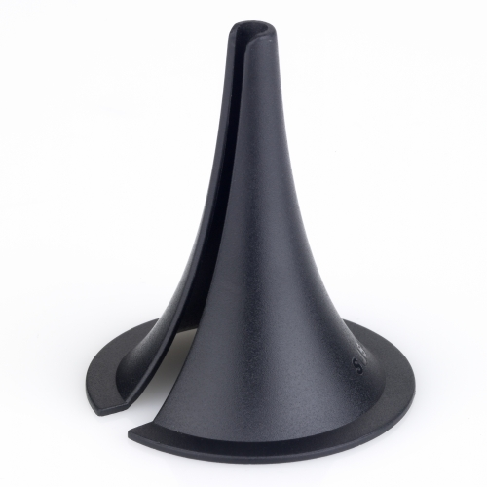
ENT – Ear instruments
Ear speculum with slit
To perform surgical procedures
Like Myrengotomy

Slide 5
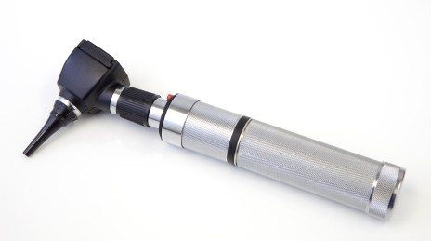
ENT – Ear instruments
Auroscope
Detailed visualization of the tympanic membrane

Slide 6
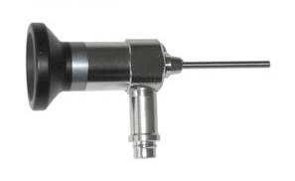
ENT – Ear instruments
Rigid otoscope
Detailed visualization of the tympanic membrane
Recording photos and videos for documentation when attached to digital camera

Slide 7
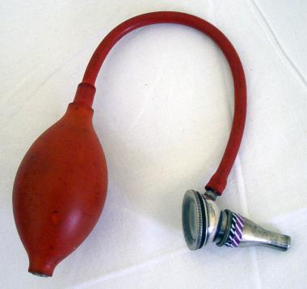
ENT – Ear instruments
Siegle Pneumatic Aural speculum
Magnification
Differentiation between retraction and perforation
Identify fistula sign
Suction
Induction of powder material

Slide 8
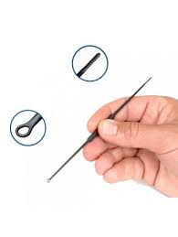
ENT – Ear instruments
Jobson Horne Probe
Serrated end
Dry mopping
Wet mopping
Ring end
Removal of hard wax
Removal of foreign body
Note : it has another uses in the nose

Slide 9
ENT – Ear instruments
Ear Hook
Removal of hard wax
Removal of foreign body

Slide 10
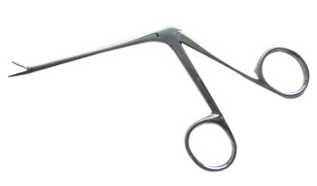
ENT – Ear instruments
Crocodile
Removal of hard wax
Removal of foreign body

Slide 11
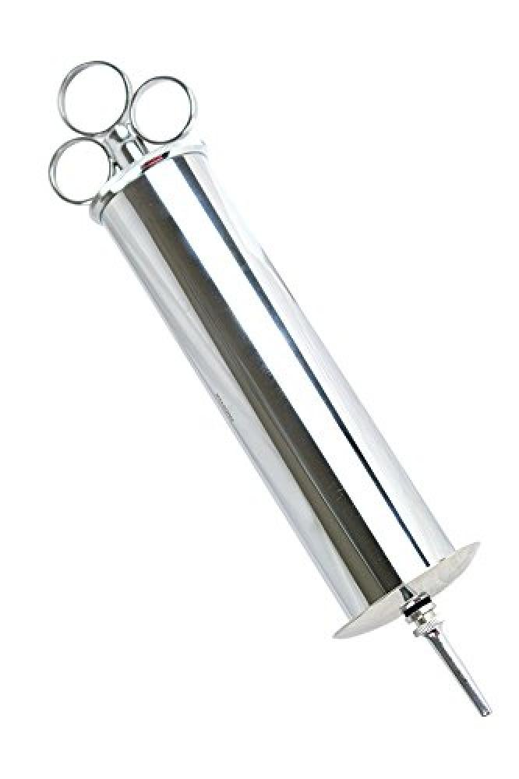
ENT – Ear instruments
Ear Syringe
Removal of soft wax
Removal of foreign body

Slide 12
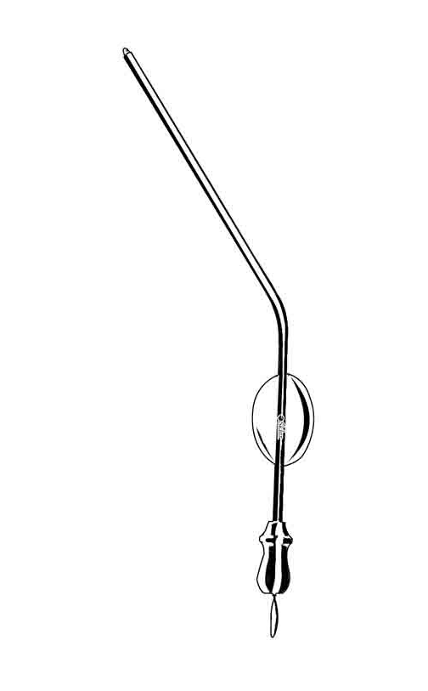
ENT – Ear instruments
Suctioendn
Removal of soft wax
Removal of foreign body

