Slide 1
College of medicine Almustansiriyah University
Department of Surgery
ENT Unit
ENT – Pure Tone Audiogram
Dr Haider Alsarhan

Slide 2
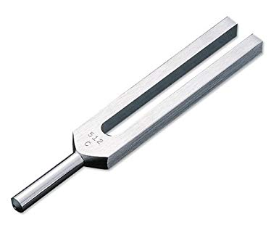
ENT – Hearing
Tuning fork
Should be 512 Hz

Slide 3
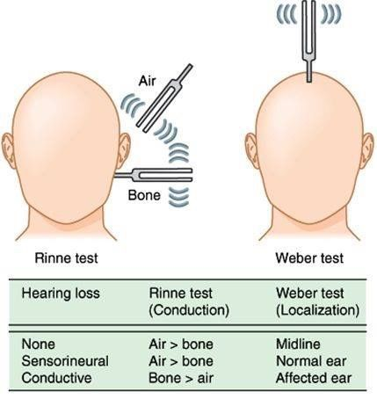
ENT – Hearing

Slide 4
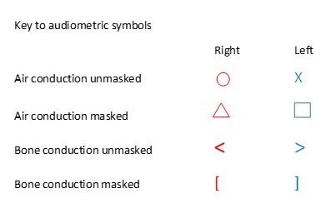
ENT – Hearing

Slide 5
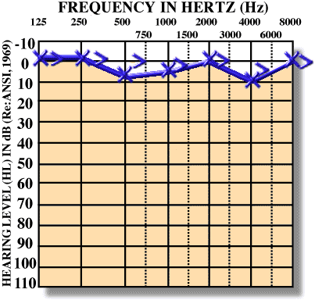
ENT – Hearing

Slide 6
ENT – Hearing

Slide 7
ENT – Hearing

Slide 8
ENT – Hearing

