Slide 1
College of medicine Almustansiriyah University
Department of Surgery
ENT Unit
ENT – Diagrams
Dr Haider Alsarhan

Slide 2
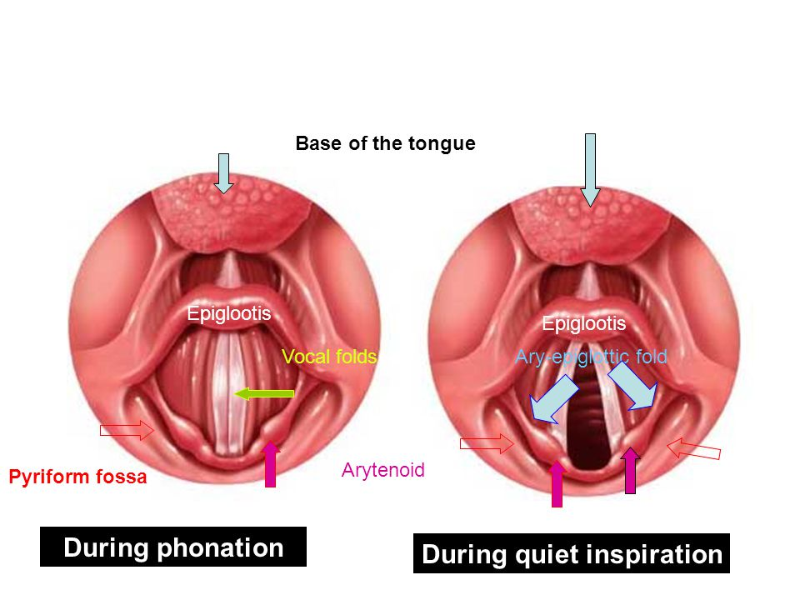
ENT – Diagrams

Slide 3
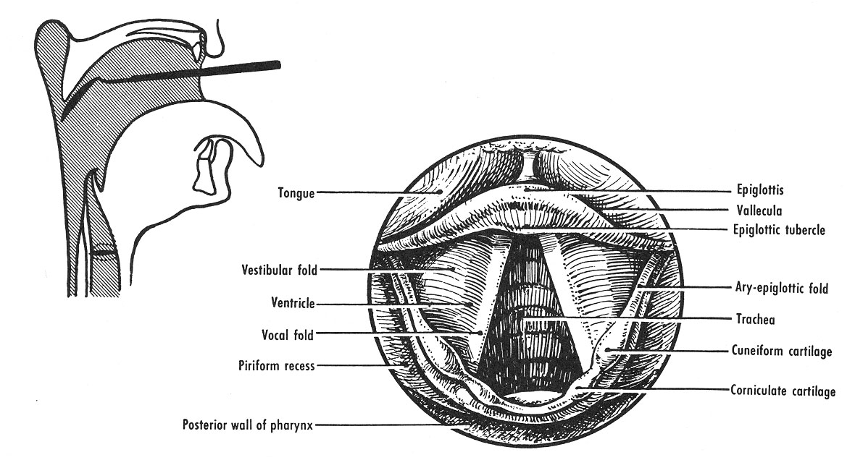
ENT – Diagrams

Slide 4
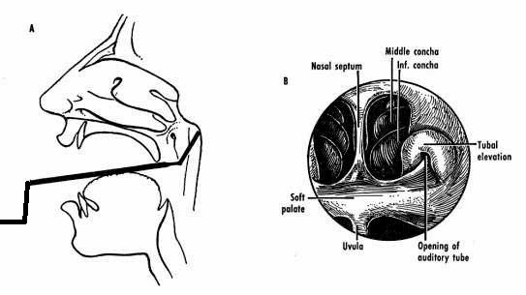
ENT – Diagrams

Slide 5
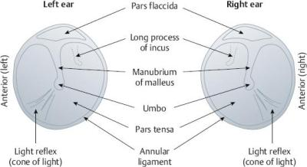
ENT – Diagrams

Slide 6
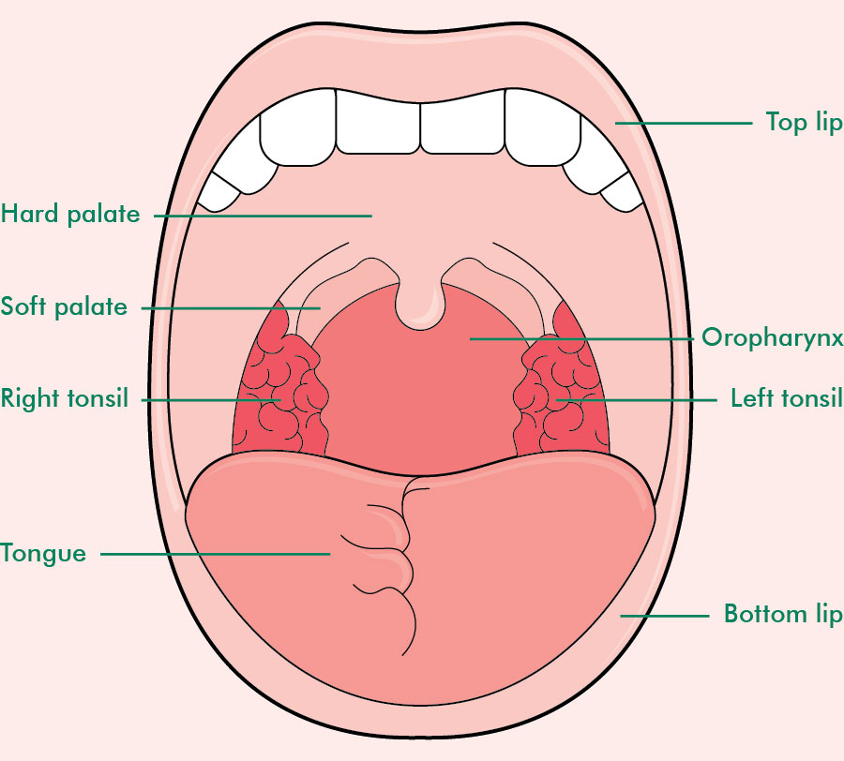
ENT – Diagrams

