Slide 1



Slide 2
Prolonged labour
Dr ban hadi

Slide 3
Abnormal labour :
by the end of this lecture, 4th year student should be able to
Define dystocia
Summarize the important points in history and examination to reach the diagnosis
Predict the management option for different case presentations
Determine the type of dystocia by different partograph's patterns

Slide 4
Abnormal labour :
Labour becomes abnormal when there is:
1.Poor progress (as evidenced by a delay in cervical dilatation or descent of the presenting part)
2.The fetus shows signs of compromise.
3.There is a fetal malpresentation
4.A multiple gestation
5.A uterine scar
6.Labour has been induced

Slide 5
Risk factors for abnormal labour
Small woman
• Big baby
• Dysfunctional uterine activity
• Malpresentation
• Malposition
• Early membrane rupture
• Soft-tissue/pelvic malformation

Slide 6
Progress in labour is dependent on
The power, i.e. the efficiency of uterine contractions
The passenger (fetal size, presentation and position).
The passages (the uterus, cervix and bony pelvis).

Slide 7
Poor progress in the first stage of labour
Poor progress in labour has been defined as cervical dilatation of less than 2 cm in 4 hours, usually associated with failure of descent and rotation of the fetal head
Divided into:
Primary and secondary arrest

Slide 8
Poor progress in the second stage of labour
Delay in 2nd stage is diagnosed if delivery is not imminent after 2 hours in a nulliparous labour and 1 hour for a parous woman. With epidural use the birth of the baby is expected to take place within 3 hours of the start of the second stage in nulliparous women, and 2 hours in parous women.

Slide 9
Causes of poor progress in labour
A. Dysfunctional uterine activity
B. Abnormal fetal size, presentation and position
C. Abnormalities of the birth canal (the ‘passages’)
.

Slide 10
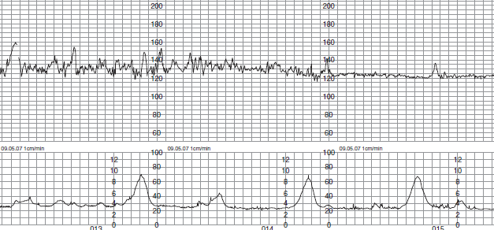
A. Dysfunctional uterine activity

Slide 11
How would you assess uterine activity?
1.By clinical examination
2. By using external uterine tocography
3. Intrauterine pressure catheters .

Slide 12
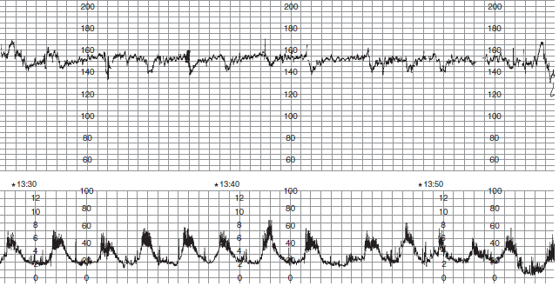
Efficient uterine contractions: 4-5 cont.\10min. Each lasting 40-50 sec.

Slide 13

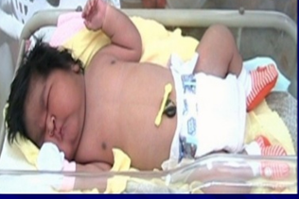
B.Abnormal fetal size, presentation and position
fetal macrosomia:

Slide 14
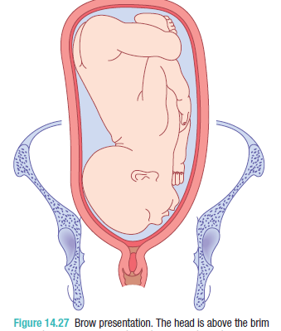
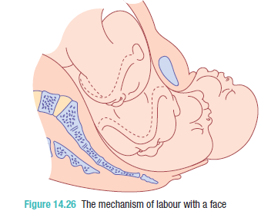
B.Abnormal fetal size, presentation and position
fetal malpresentation:

Slide 15
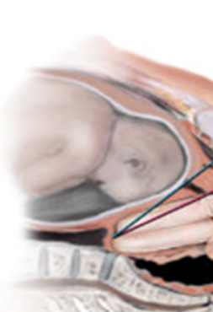

Slide 16
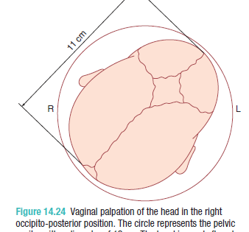
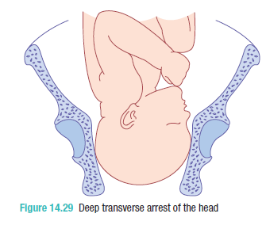
B.Abnormal fetal size, presentation and position
fetal malposition:

Slide 17
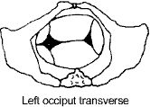
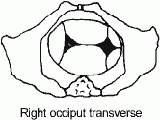
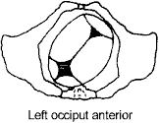
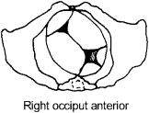
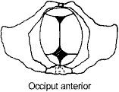
Occiput transverse positions
Fetal position
Occiput anterior positions

Slide 18
C.Abnormalities of the birth canal (the ‘passages’)
The bony pelvis may cause delay in the progress of labour as in android pelvis.
Abnormalities of the uterus and cervix can also delay labour. fibroid in the lower uterine segment
‘cervical dystocia’, a term used to describe a non-compliant cervix , usually as a result of a previous cone biopsy.

Slide 19
Cephalopelvic disproportion:
Cephalopelvic disproportion (CPD) implies anatomical disproportion between the fetal head and maternal pelvis

Slide 20
Causes of CPD: It can be due to
A large head
A small pelvis
A combination of the two
previous fracture or metabolic bone disease.
Rarely, a fetal anomaly like hydrocephaly
Malposition like OP

Slide 21
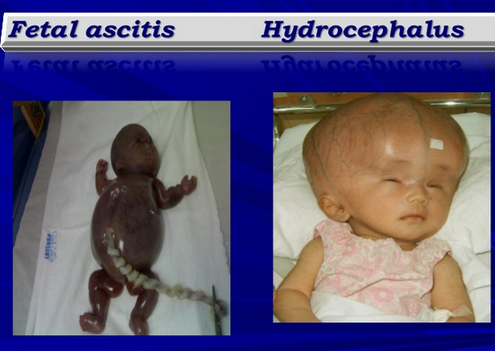
Causes of CPD
Fetal abnormality
Notes:
A 6- to 10-cm
longitudinal incision is made just proximal to the tip of the greater
trochanter. To accommodate distal locking, the surgical field must
include the distal femur.

Slide 22
Diagnosis of Cephalopelvic disproportion:
1 progress is slow or actually arrests despite efficient uterine contractions
2 the fetal head is not engaged
3 vaginal examination shows severe moulding and caput formation
4 the head is poorly applied to the cervix
5 hematuria

Slide 23
Management of prolonged labour:
A. Diagnosis:
Partograph will diagnose long labour before obstructed labour develops

Slide 24
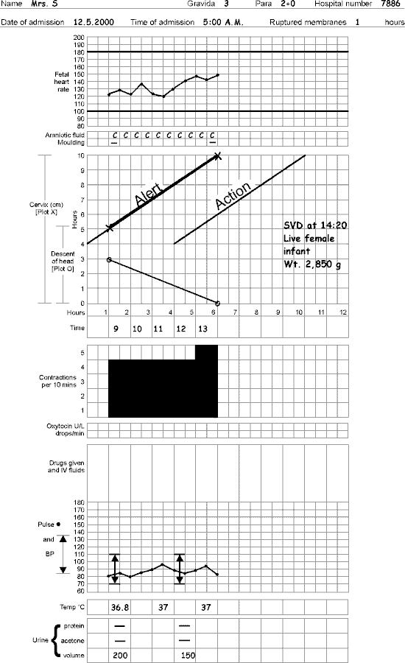
Components of the partograph
Part 1 : fetal condition ( at top )
Part 11 : progress of labour ( at middle )
Part 111 : maternal condition ( at bottom )

Slide 25
history should include:
- Age, parity
- Duration of labour, partograph abnormality, duration of ruptured membranes (amount and colour of liquore)
- Duration of bearing down
- Antenatal records and complications
- Previous prolonged labour, fetal death, instrumental delivery and caesarean sections

Slide 26
Examination:
General exam. Features of maternal distress: exhaustion, ketosis, dehydration, tachycardia, fever and scanty urine.

Slide 27
Abdominal exam :
Frequency and intensity of uterine contractions
Presentation, engagement, estimated fetal weight
The retraction ring (bandl's ring) is seen and felt between the tonically contracted upper segment of the uterus and the distended, tender and stretched lower segment which is the site of uterine rupture.

Slide 28
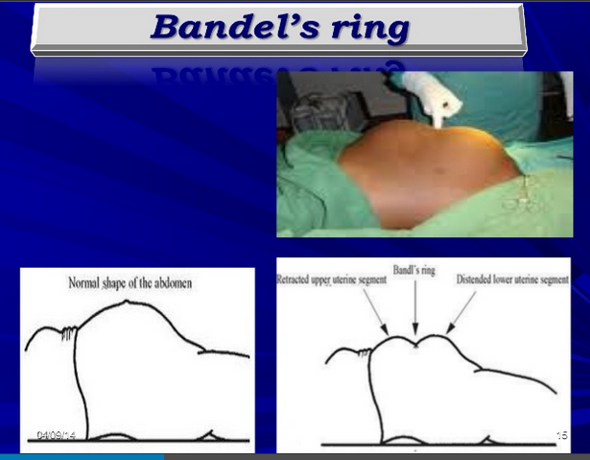
Abdominal exam.:

Slide 29
Examination:
- fetal heart auscultation for possible fetal compromise
- Vaginal exam. dry hot vagina, cervical dilatation, fetal presentation and position, station, excessive caput and moulding.

Slide 30
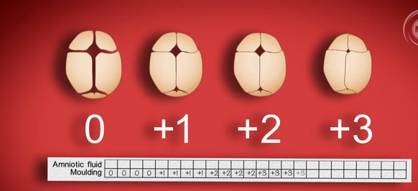

Slide 31
B. Treatment: Treatment of poor progress in the 1st stage of labour
1. Good hydration, adequate pain relief, empty bladder, cross match blood and emotional support
2. When poor progress in labour is suspected it is usual to recommend repeat vaginal examination 2, rather than 4, hours after the last exam. and plot on partograph

Slide 32
3. If delay is confirmed, the woman should be offered artificial rupture of membranes (ARM)
if there is still poor progress in a further 2 hours; use an oxytocin infusion to augment the contractions. The infusion is commenced at a slow rate initially, and increased carefully every 30 minutes. Continuous EFM is necessary as excessively frequent and augmented contractions may cause fetal compromise

Slide 33
4. Women can be offered an epidural anaesthesia
5. If progress fails to occur despite 4–6 hours of augmentation with oxytocin, a Caesarean section will usually be recommended
6. Active management of third stage of labour because of risk of PPH

Slide 34
Treatment of poor progress in the 2nd stage of labour
Rehydration and intravenous oxytocin for inefficient uterine cont.
Instrumental birth can be considered for prolonged second stage
Caesarean delivery if the Instrumental birth attempt is unsuccessful, or if elements of obstructed labour present
Episiotomy for a resistant perinium

Slide 35
Treatment of CPD
1. Oxytocin can be given carefully to a primigravida with mild to moderate CPD as long as the cardiotocography is reactive. Relative disproportion may be overcomed if the malposition is corrected (i.e. conversion to a flexed OA position).
2. Oxytocin must never be used in a multiparous woman where CPD is suspected
3. A Caesarean section is indicated in cases of CPD with elements of obstructed labour

Slide 36
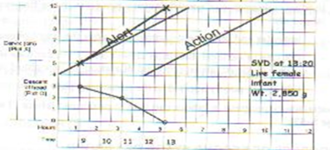
Patterns of abnormal progress in labour
The main aim of partograph is the early diagnosis of prolonged labour before the complicatins of obstructed labour develop.
Normal labour progress should be at or to the left of the alert line of partograph

Slide 37
1. Prolonged latent phase
when the latent phase is longer than the arbitrary time limits (20 hrs in nulliparous and 14 hrs in multiparous women). It is more common in primiparous women and probably results from a delay in the chemical processes that occur within the cervix

Slide 38
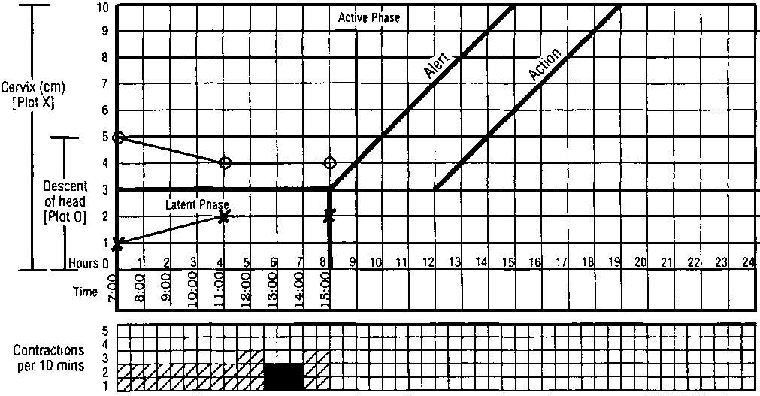
Prolonged latent phase

Slide 39
Management:
It is best managed away from the labour suite with simple
analgesics, mobilization and reassurance.
However, intervention in the form of ARM or oxytocin infusion will increase the likelihood of poor progress later in the labour and the need for Caesarean birth

Slide 40
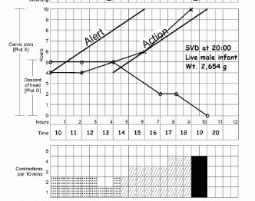
2. Primary dysfunctional labour
<2 cm cervical dilatation/4 hours :

Slide 41
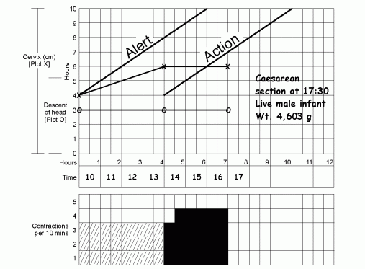
3. Secondary arrest of cervical dilatation
progress in the active phase of first stage is initially good but then slows, or stops
altogether, typically after 7 cm dilatation. :

Slide 42
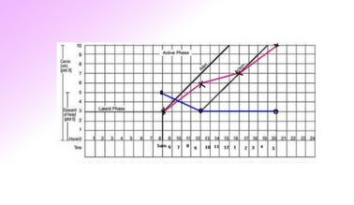
4.Arrest of descent of presenting part:
the descent of the presenting part stops :

Slide 43
Abnormalities of the partogram

Slide 44
Complications of prolonged labour:
Maternal :maternal exhaustion and dehydration, rupture of uterus, increased operative intervention, maternal injury, shock, postpartum hemorrhage, puerperal sepsis and maternal death
Late maternal complications: urinary fistula and infertility

Slide 45
Fetal
birth asphyxia, acidosis, intracranial hemorrhage, meconium aspiration, fetal trauma, death and neonatal infection
Late fetal complications: cerebral palsy and mental retardation

Slide 46


Thank you

