Slide 1
Urinary incontinence
Dr Ban Hadi
2018

Slide 2
Objectives: by the end of this lecture, the 5th year student should be able to:
Define urinary incontinence
Summarize the types of urinary incontinence
Differentiate between its types by history taking
Demonstrate on menniquene the examination of a case with urinary incontinence
Predict the management option for different case presentations
Text books Gynecology by ten teachers 20th ed. And dewhurts

Slide 3
What is incontinence?
Urinary incontinence is defined as the involuntary loss of urine that is objectively demonstrable and is a social or hygienic problem
The prevalence increases with age, with approximately 5 % of women below 44 years of age being affected, rising to 20 % of those older than 65 years

Slide 4
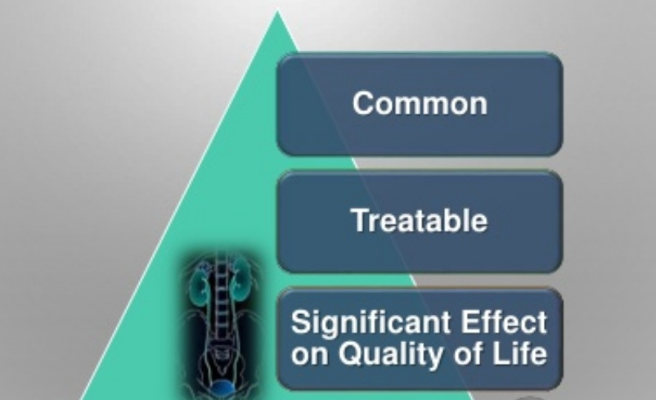
Urinary incontinence

Slide 5
Common symptoms associated with incontinence
• Stress incontinence is a symptom and a sign and means loss of urine on physical effort. It is not a diagnosis
• Urgency means a sudden desire to void.
• Urge incontinence is an involuntary loss of urine associated with a strong desire to void.

Slide 6
• Overflow incontinence occurs without any detrusor activity when the bladder is over-distended.
• Frequency is defined as the passing of urine seven or more times a day, or being awoken from sleep more than once a night to void

Slide 7
Classification of incontinence
Urethral causes
• Urethral sphincter incompetence (urodynamic stress incontinence)
• Detrusor over-activity or the unstable bladder - this is either neuropathic or non-neuropathy
• Retention with overflow
• Congenital causes: Epispadias
• Miscellaneous
Extra-urethral causes
• Congenital causes
• Fistula

Slide 8
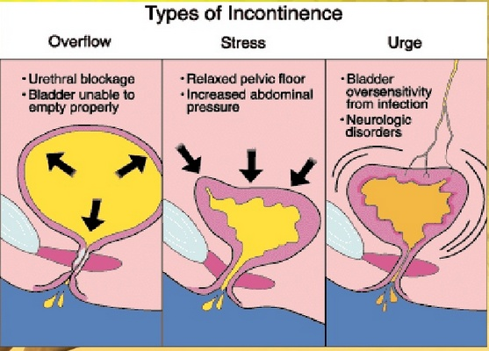
Stress 50%, urge 20%,mixed 30%

Slide 9
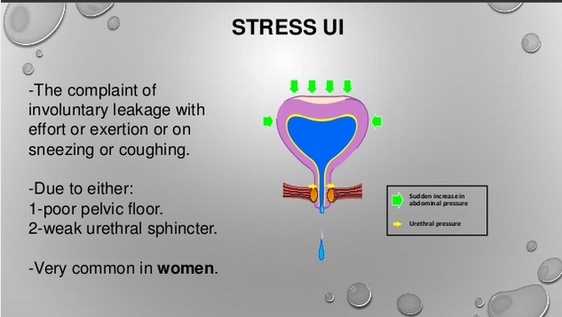

Slide 10
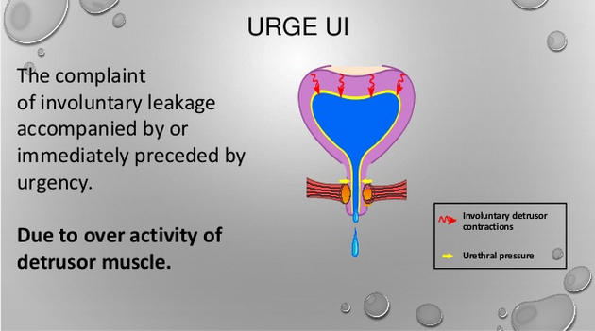

Slide 11
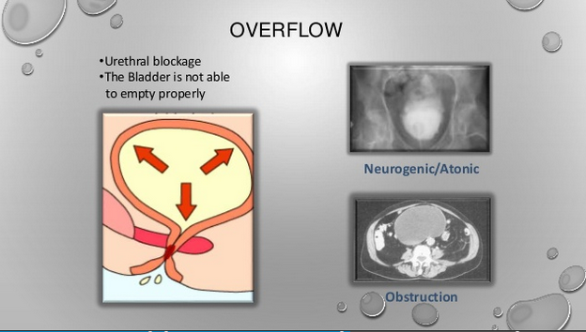

Slide 12
Urodynamic stress incontinence USI:
is noted during filling cystometry, and is defined as the involuntary leakage of urine during increased abdominal pressure in the absence of a detrusor contraction

Slide 13
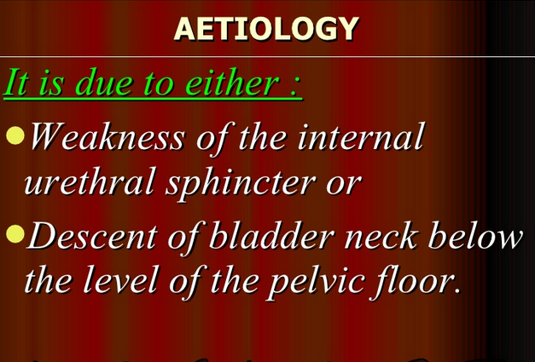

Slide 14
Risk Factors for stress Urinary Incontinence
Multiparity (particularly vaginal births).
• Forceps delivery*.
• Perineal trauma.
• Long labour*.
• Epidural analgesia.
• Birthweight >4 kg.
• Increasing age.
• Postmenopause.
• Obesity studies have shown that significant weight loss among obese women is associated with major improvements in urinary leakage symptoms.
• Connective tissue disease.
• Chronic cough (e.g. bronchiectasis or chronic obstructive pulmonary disease).
• Doxazocin (alpha-adrenergic antagonist) for hypertension causes relaxation of the urethral sphincter*.

Slide 15
Diagnosis:
History: risk factors and symptoms, risk factors as cough, constipation, high parity and difficult deliveries
Stress incontinence is the usual symptom, but urgency,frequency and urge incontinence may be present.
The patient may present with symptoms of prolapse.
The severity of symptoms vary from mild cases where incontinence occurs with heavy exercise such as lifting heavy weight to severe cases where incontinence develops simply on changing position.

Slide 16
Examination
Cough test: stress incontinence may be demonstrated when the patient coughs.
Vaginal examination should assess for prolapse, atrophy, fistula and pelvic masses

Slide 17
Q Tip test:
A sterile swab stick is inserted into the bladder cavity. As the patient strains in continent women the angle between the horizon and the swab should not exceed 30 degree. While women with stress incontinence the angle may reach up to 60 degree.

Slide 18
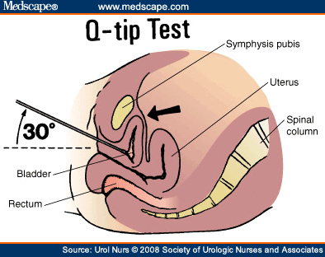

Slide 19
Investigations
1-Mid-stream specimen of urine: to exclude infection
2-Frequency/volume chart: (urinary or bladder diary) provides an objective assessment of a patient’s fluid input and urine output

Slide 20
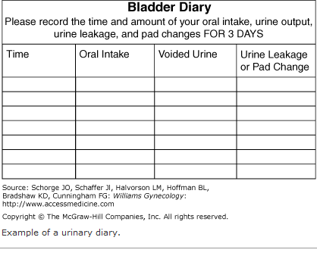

Slide 21
3-Pad test: by measuring the weight gain of a perineal sanitary towel
4-Uroflowmetry : is the measurement of urine flow rate. A flow rate < 15mL \ s on more than one occasion is considered abnormal in female

Slide 22
5-Cystometry
involves the measurement of the pressure volume relationship of the bladder. It measures the abdominal pressure, intravesical pressure and detrusor pressure

Slide 23
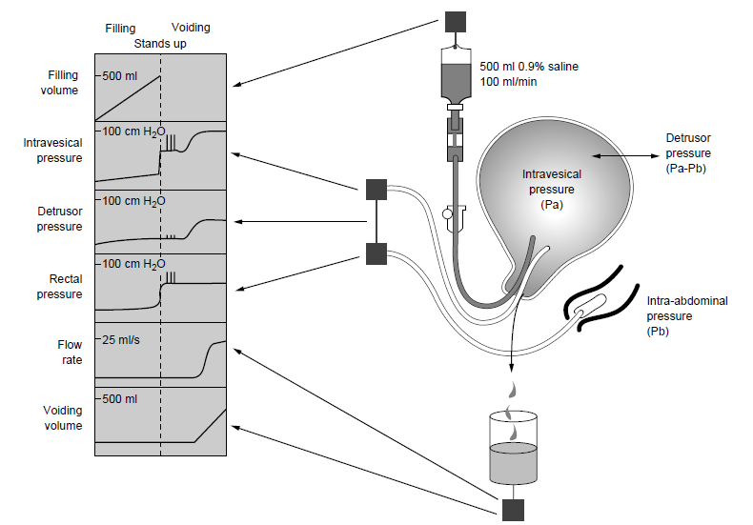

Slide 24
The following are parameters of normal bladder function.
• Residual urine of < 50 mL.
• First desire to void between 150 and 200 mL.
• Capacity between 400 and 600 mL.
• Detrusor pressure rise of < 15 cmH₂0 during filling and standing.
• Absence of systolic detrusor contractions.
• No leakage on coughing.
• A voiding detrusor pressure rise of < 70 cmH20 with a peak flow rate of > 15 mLis for a volume > 150 mL

Slide 25
6- other investigations in selected cases like: Videocystourethrography, Urethral pressure profilometry, Cystourethroscopy, Ultrasound and IVU usually performed when there is hematuria, recurrent UTI, fistula, urgency and dysurea

Slide 26
Treatment of Urodynamic stress incontinence:
A. Non surgical:
: Simple measures
Treatment of urinary tract infection
Restriction of fluid intake
Reduce caffeine intake
Modifying medication(e.g. diuretics)
Treating chronic cough and constipation play an important role in the management of most types of urinary incontinence.

Slide 27
Prevention
Shortening the second stage of delivery and reducing traumatic delivery may result in fewer women developing stress incontinence. The benefits of hormone replacement therapy have not been substantiated. The role of pelvic floor exercises either before or during pregnancy needs to be evaluated.

Slide 28
Conservative treatment is indicated when
1- The incontinence is mild,
2- The patient is medically unfit for surgery or
3-The patient does not wish to undergo an operation
4- Women who have not yet completed their families.
5- It may also be useful prior to surgery in case of a long waiting list

Slide 29
1- Non pharmacological
1- Pelvic floor muscle training : Also known as Kegel exercises, PFMT entails voluntary contraction of the levator ani muscles. As with any muscle building, exercise sets should be performed numerous times during the day, with some reporting up to 50 or 60 times each day. The aim is to enhance the tone of levator ani muscle. 40 -60 % of cases improve with this exercise

Slide 30
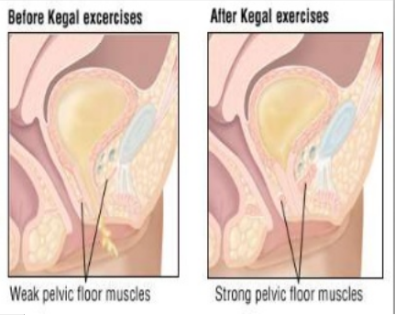

Slide 31


Slide 32
2-Perineometry
A perineometer is a cylindrical vaginal device which can
be used to assess the strength of pelvic floor contractions
It can be used to help an individual to contract her pelvic floor muscles appropriately and is also useful in detecting improvement following pelvic floor exercises.

Slide 33
3-Weighted vaginal cones
These are currently available as sets of five or three all of the same shape and size but of increasing weight (20–90 g)

Slide 34
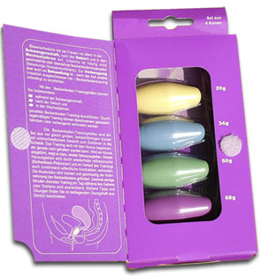

Slide 35
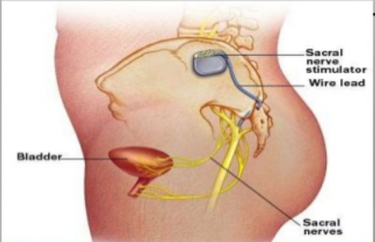
4-Maximal electrical stimulation

Slide 36
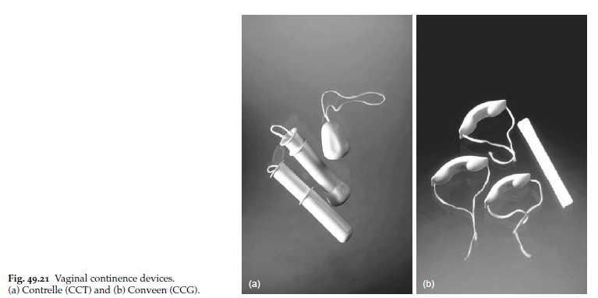
5-Vaginal devices may be useful for use during exercise on a short term basis.

Slide 37
2 –Pharmacological
1-Duloxetine
2-α1-adrenoceptor agonists, oestrogens and tricyclic antidepressants have all been used for the treatment of stress incontinence

Slide 38
B. Surgical treatment of Urodynamic stress incontinence
Aim of surgery:
to provide suburethral support; restoration of the proximal urethra and bladder
neck to the zone of intra-abdominal pressure transmission; to increase urethral resistance;

Slide 39
1-Vaginal procedures:
Retropubic tape procedures TVT (tension free vaginal tape) the most popular surgical treatment for stress incontinence. In this operation a synthetic inert tape is inserted through vaginal incision and passed bellow the urethra by trocar and attached to the anterior abdominal wall.
Complications include bladder and urethral injury, stricture and retention of urine

Slide 40
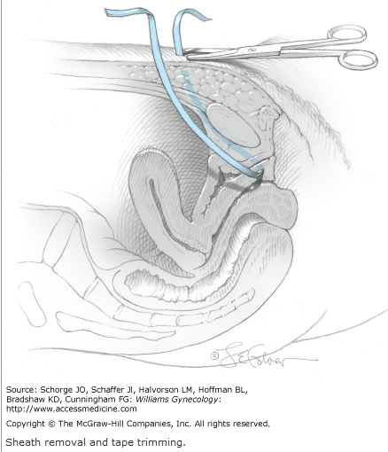
TVT

Slide 41
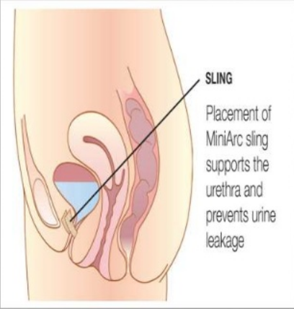

Slide 42
Transobturator tape procedures TOT:
In this operation a tape is inserted through vaginal incision and passed bellow the urethra through the lower part of obturator membrane into the medial aspect of thigh. It requires special needle. This operation is widely used now days.
Complications: hemorrhage, infection and the patient may have chronic pelvic pain

Slide 43
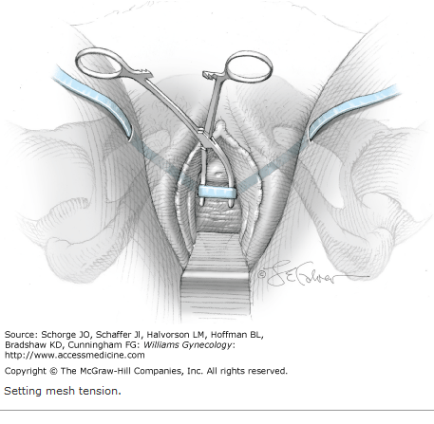
TOT

Slide 44
Anterior colporrhaphy:
is still performed for stress incontinence. Although it is usually the best operation for a cystourethrocele, the cure rates for urodynamic stress incontinence are poor compared to suprapubic procedures. The success rate is about 60%

Slide 45
Urethral bulking agents:
are minimally invasive surgical procedures for the treatment of urodynamic stress incontinence and may be useful in the elderly and those women who have undergone previous operations and have a fixed, scarred fibrosed urethra.

Slide 46
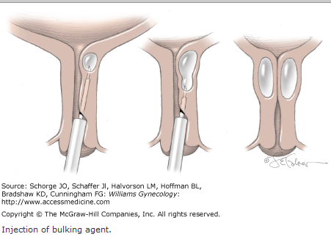

Slide 47
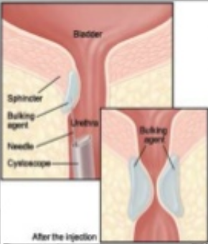

Slide 48
2-Abdominal: performed through an abdominal incision
Burch colposuspension: In this operation the Para urethral tissues are sutured to the ipsilateral iliopectineal ligament to elevate the bladder base. The success rate is over 90%.

Slide 49
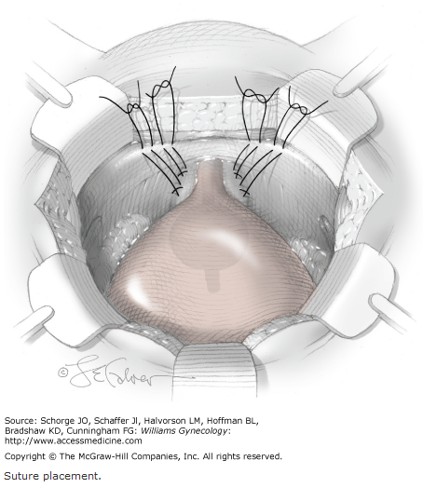

Slide 50
Marshall–Marchetti–Krantz procedure:
is a suprapubic operation in which the paraurethral tissue at the level of the bladder neck is sutured to the periostium and/or perichondrium of the posterior aspect of the pubic symphysis. It is less popular due to the risk of periostitis.

Slide 51
3-Laparoscopic colposuspension
4- Complex
Artificial sphincter May be employed when conventional surgery fails. This is implantable and consists of a fluid-filled inflatable cuff which is surgically placed around the bladder neck.

Slide 52
Detrusor overactivity DO:
previously called detrusor instability, is a urodynamic observation characterized by involuntary detrusor contractions during the filling phase which may be spontaneous or provoked (such as drinking or changing position).
This is primarily a disease of unknown cause in which the bladder contracts strongly to expel the minimum amount of urine which is normally tolerated by normal balder, and there is excessive cholinergic stimulation of the detrusor muscle.

Slide 53
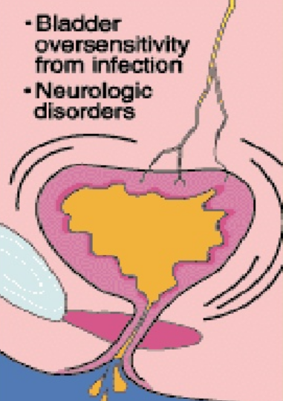

Slide 54
Risk factors for detrusor overactivity
• Childhood bedwetting.
• Obesity.
• Smoking.
• Previous hysterectomy.
• Previous continence surgery

Slide 55
Clinical presentation
The combination of symptoms of urgency, frequency and nocturia is termed the overactive bladder (OAB).
When detrusor contractions observed during cystometry the diagnosis of detrusor overactivity is established.
In most of the cases physical examination reveals nothing; However; mass, prolapse and atrophy should be excluded and cough test is performed to exclude USI.
Neurological exam as bladder hyper reflexia may be the earliest sigh of multiple sclerosis.
Investigations: same as USI

Slide 56
Treatment
Bladder retraining Instruct to void every 1.5 h during the day; she must not void between these times, she must wait or be incontinent. Increase voiding interval by half an hour when initial goal achieved, and continue with 2-hourly voiding and so on.

Slide 57
Drug therapy
Imipramine: is a tricyclic antidepressant drug which has also anticholinergic properties. In a dose of 25 mg for 3 months up to 90 % of women get improvement
Tolterodine is a competitive muscarinic receptor antagonist with relative functional selectivity for bladder muscarinic receptors.
Oxybutynin is anticholinergic drug which has special affinity to the detrusor muscle. It is much superior to imipramine.

Slide 58
Desmopressin is a synthetic vasopressin analogue. It has strong antidiuretic effects without altering blood pressure.
Intravesical therapy intravesical administration of Botulinum toxin may offer an alternative to surgery in those women with intractable detrusor overactivity
Neuromodulation Stimulation of the dorsal sacral nerve has been developed for use in patients with both idiopathic and neurogenic detrusor overactivity

Slide 59
Surgery
1-Clam cystoplasty
2-detrusor myectomy
3-urinary diversion

Slide 60
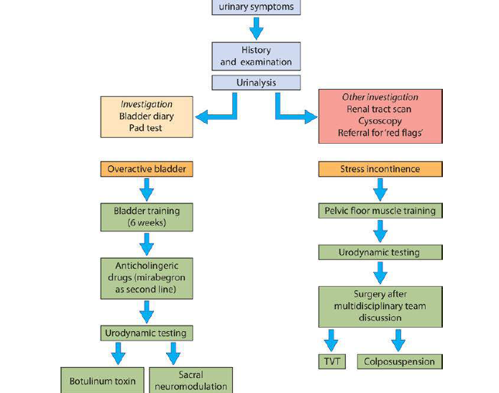

Slide 61
Retention with overflow
Insidious failure of bladder emptying may lead to chronic retention and finally, when normal voiding is ineffective, to overflow incontinence
Symptoms
Symptoms include poor stream, incomplete bladder emptying and straining to void, together with overflow stress incontinence. Often there will be recurrent urinary tract infection. Cystometry is usually required to make the diagnosis, and bladder ultrasonography or intravenous urogram may be necessary to investigate the state of the upper urinary tract to exclude reflux.

Slide 62
EMQ
A Urodynamic assessment.
B Urgent flexible cystoscopy.
C Renal tract ultrasound.
D Insertion of midurethral tape.
E Immediate release oyxbutynin.
F Topical oestrogen.
G Oral antibiotics.
H Botulinum toxin injection.
I Duloxetine.
1 Immediate management of a 73-year-old woman with frequency, urgency and haematuria.
2 Management of a 38-year-old woman with symptoms of only stress incontinence who has
completed a course of pelvic floor exercises without improvement.
3 Should be performed after failed conservative and/or medical management before second-line
treatments for incontinence.
4 First-line drug treatment for OAB.

Slide 63
ANSWERS
1B Because of the haematuria, cystoscopy is required to exclude a malignancy.
2D It is reasonable to insert a midurethral tape without further investigations in this situation,
because there are no symptoms of mixed incontinence.
3A Urodynamic assessment will exclude a picture of mixed incontinence, which is necessary before
more invasive treatment.
4E Immediate release oxybutynin will effectively treat overactive bladder symptoms and no further
investigations are required before treatment

Slide 64
Choose the single best answer.
A 45 year old woman attends outpatients complaining of a 3-year history of stress incontinence, urgency and urge incontinence. She leaks urine about four times a day, has to wear sanitary pads all the time and rarely travels due to the urgency and need to pass urine 8 or 9 times during the day.
Examination reveals her to be of normal BMI, with a weak pelvic floor muscle strength.
What would be the recommended first line of management?
A Commence the patient on an oral anticholinergic medication for 8 weeks.
B Arrange urodynamic assessment to define the underlying cause of her problems.
C Arrange a 6–8 week course of supervised pelvic floor exercises and bladder retraining.
D Admit the patient for a cystoscopy.
E Test the urine for infection and treat with antibiotics.

Slide 65
C Pelvic floor strengthening exercises will improve up to 50% of stress incontinence problems and may avoid the need to treat urge incontinence with anticholinergics

Slide 66

Thank you

