Slide 1
Bariatric and metabolic surgery
Dr.MUSTAFA USAMA
GENERAL ,LAPARASCOPIC,ENDOSCOPIC SURGEON

Slide 2
objectives
1- definition and classification of obesity,risk of obesity
2-to whom bariatric surgery indicated??,contraindication of bariatric surgery .
3- type of Bariatric surgery
4-comon operations and important complications
5- multidisplinary team and preoperative preparation
6-postoprtaive care

Slide 3
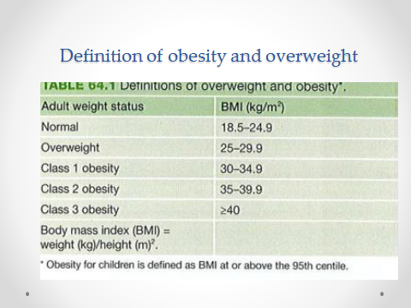

Slide 4
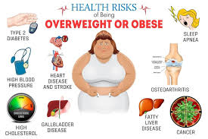

Slide 5
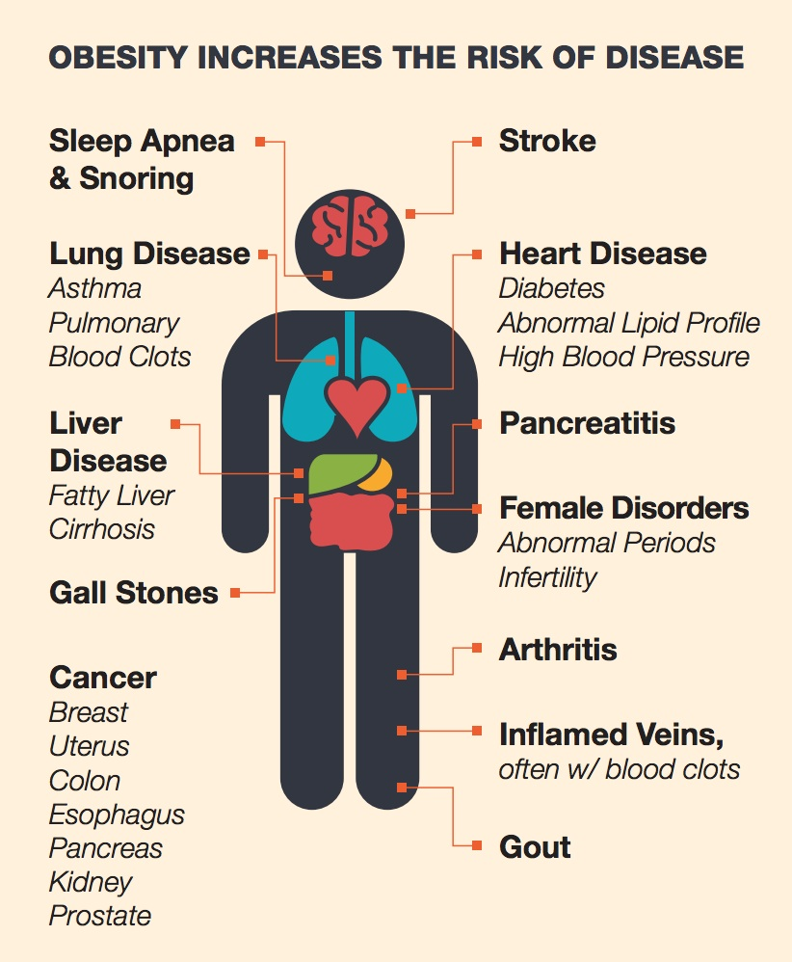


Slide 6
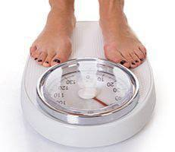

Slide 7
Bariatric and metabolic surgery

Slide 8
Effect of bariatric surgery on comorbid medical conditions
% Improved | % Resolved | Condition
85.4 | 76.8 | Diabetes
78.5 | 61.7 | Hypertension
85.7 | 83.6 | Sleep apnea
96.9 | 70.0 | Hyperlipidemia

Slide 9
Indications for bariatric surgery
Patient must have:
1. Body mass index ≥40 kg/m2 with or without comorbid medical conditions associated with obesity
2. Body mass index 35–40 kg/m2 with comorbid medical conditions In addition, it is expected that the patient:
3. Has failed attempt at medically supervised diet
4. Be psychiatrically stable.

Slide 10
Potential contraindications for bariatric surgery
1. Severe medical disease making anesthesia or surgery
prohibitively risky (American Society of Anesthesiologists
class IV)
2. Mentally incompetent to understand procedure
3. Inability or unwillingness to change lifestyle
postoperatively
4. Drug, alcohol, or other addiction
5. Active problem of bulimia or other eating disorder
6. Psychologically unstable
7. Non ambulatory status
8. Unsupportive home environment

Slide 11
Types of commonly performed bariatric operations
Primarily Restrictive
Laparoscopic adjustable gastric banding (LAGB)
Sleeve gastrectomy (SG)
Primarily Malabsorptive
Biliopancreatic diversion (BPD)
Duodenal switch (DS)
Combination:
Roux-en-Y gastric bypass (RYGB)
Other
Mini gastric By Pass.
SADI-S
Gastric plication
Other endoscopic gastric balloon.

Slide 12
Laparoscopic gastric banding

Slide 13
Ports for sleeve gastrectomy

Slide 15
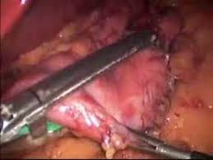

Slide 16
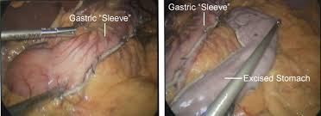

Slide 17
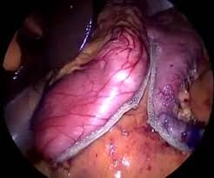
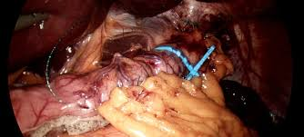
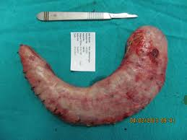

Slide 18
LGBP

Slide 19
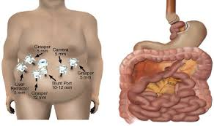
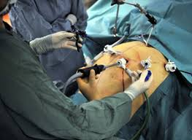
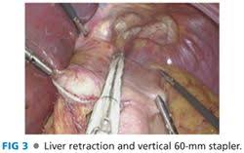
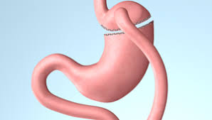
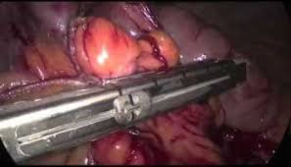

Slide 20
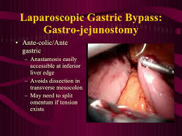
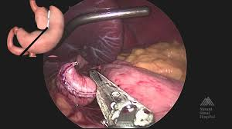

Slide 21
BPD with DS

Slide 22
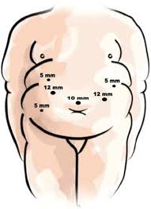
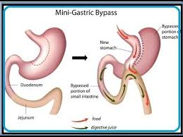

Slide 23
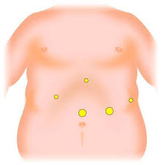
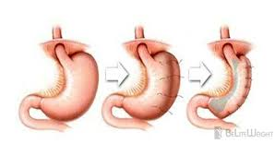
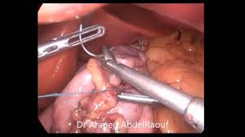
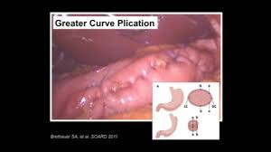
Gastric plication

Slide 24
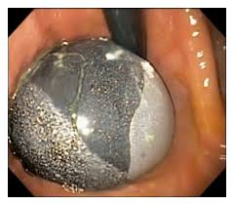
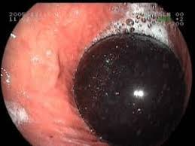
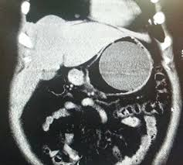
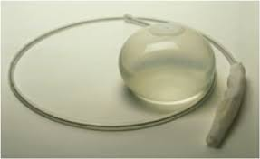

Slide 29
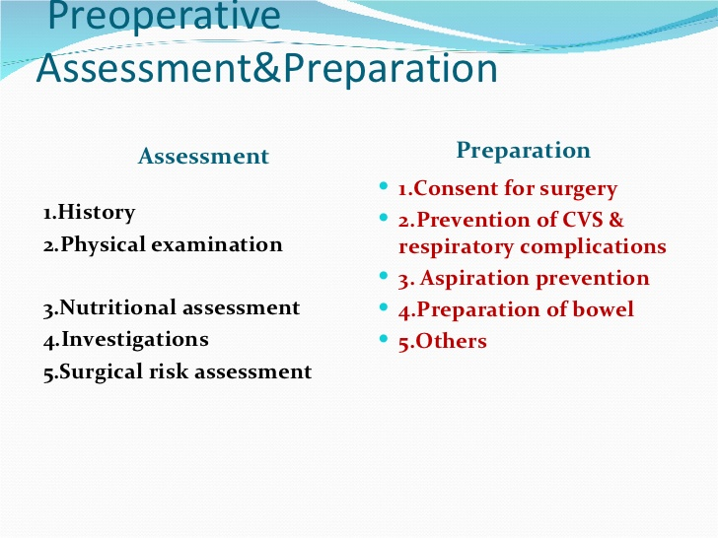

Slide 30
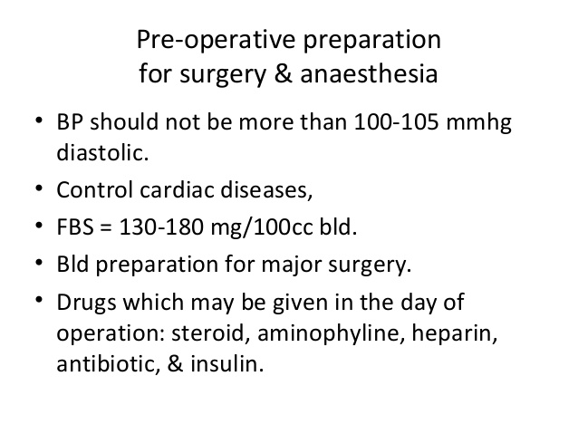

Slide 31
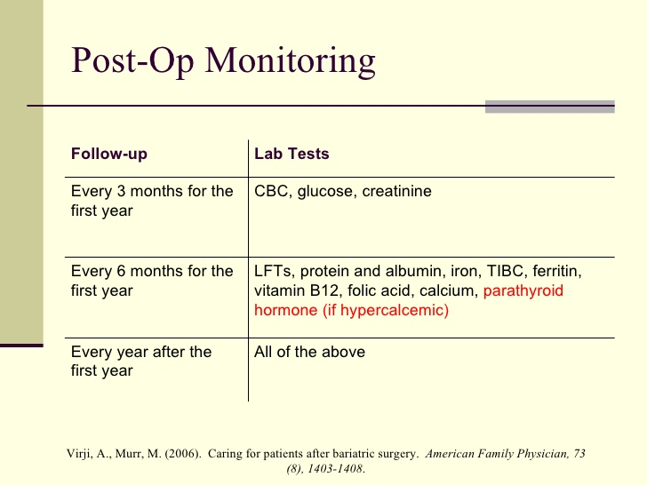

Slide 32
THANK YOU FOR YOUR ATTENSION

