Slide 1
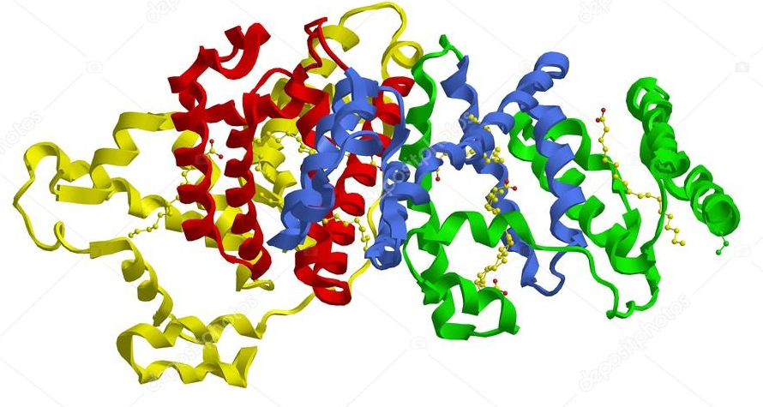
Color Test For Proteins
And Amino Acids.

Slide 2
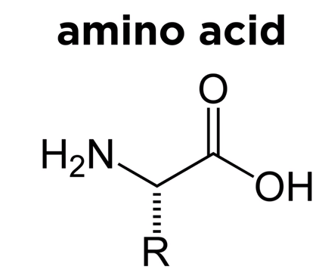
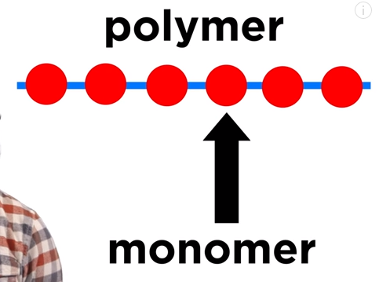
Proteins :
Proteins are polymer or macromolecules, the building units or monomer of which are the α-amino acids. An -amino acid contains a carboxyl group and amino group, both of which are attached to the α-carbon atom of the amino acid fig(1).
fig(1): Proteins and monomer α-amino acid structures.

Slide 3
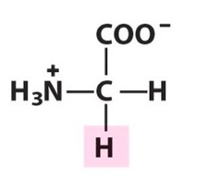
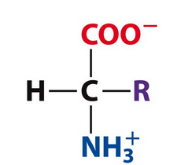
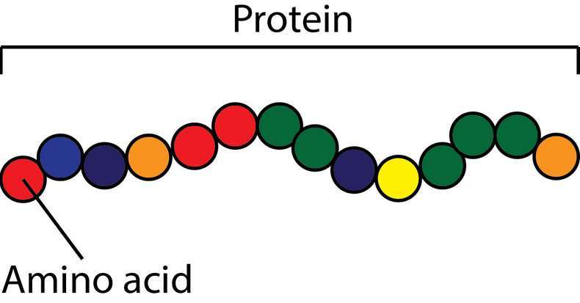
Beta amino acids and Gama amino acids also occur in nature but not as a component of proteins. With exception of Glycine all α – amino acids are asymmetric, i.e. Four different groups are bounded to the α – carbon atom occur optically active . Also α – amino acids can be L isomers or D isomers. In nature proteins of higher organism, only the L isomers of one or more of approximately 20 amino acids are present.
Glycine
all α – amino acids asymmetric

Slide 4
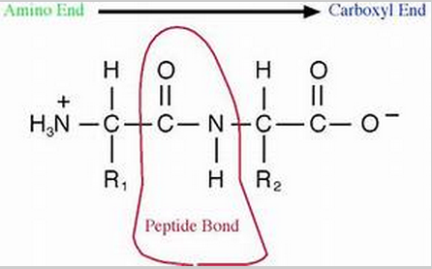
When an amino group and carboxyl group of two amino acid molecules combine the resulting bond is called a peptide bond, and the constituent of amino acids are termed amino acid residue linked by peptide bonds. Peptides of more than ten amino acids are termed Polypeptides. With the increase in molecular weight the proteins will form.

Slide 5
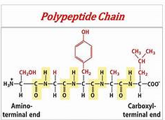
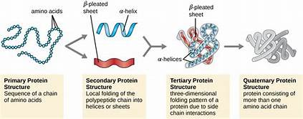
The dividing line between large Polypeptides and small proteins is usually taken to be between MW 8000 and 10000 KD.

Slide 6
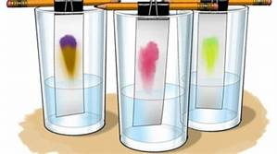
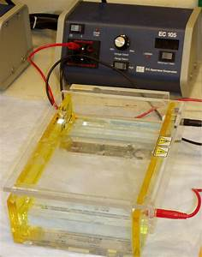
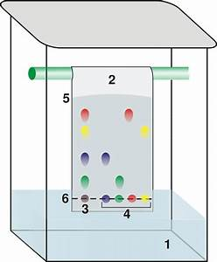
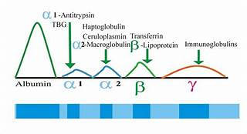
Proteins & amino acids can be analyzed qualitatively and quantitatively.
Different proteins & amino acids may be separated by chromatography or electrophoresis before individual testing.
Chromatography
Electrophoresis

Slide 7
Principle of the color tests:-
①- Biuret Test:
Compounds react containing two or more peptide bond with Cu(II) ions in alkaline solution to form a purple (pink to violet) color. The color is due to coordination complex formation or chelation of the Cu (II) ions & the carbonyl oxygen & amid nitrogen atom of the peptide bond. At least two peptide bonds (tri-peptide) are required for a positive test. The name of this test comes from the compound biuret, which due to structural similarity to peptide bonds also gives a typically positive reaction.

Slide 8
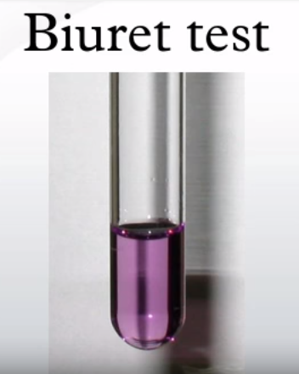
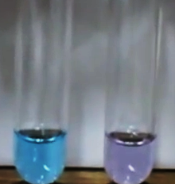
NH₂
C=O
∆
2(NH₂)₂ C=O → → → NH + NH₃
(NaOH+CuSO₄) C=O
NH₂
Biuret coordination complex

Slide 9
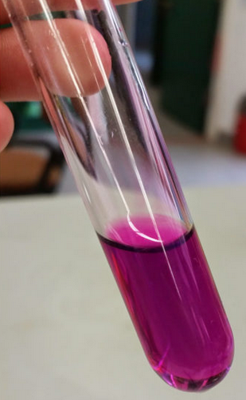
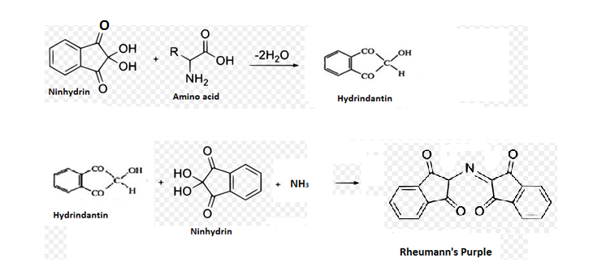

② Ninhydrin
Its the powerful oxidizing agent. It causes oxidative decarboxylation of α – amino acids, producing carbon dioxide CO₂, ammonia (NH₃), and an aldehyde. i.e., Amino acids, on heating with ninhydrin, are oxidatively decarboxylated, Reduced ninhydrin then reacts with the liberated ammonia and a blue or purple colored complex is produced. A blue or purple color appears, if proteins, peptides or amino acids are present.
A stain obtained after a thumbprint
is treated with ninhydrin.

Slide 10
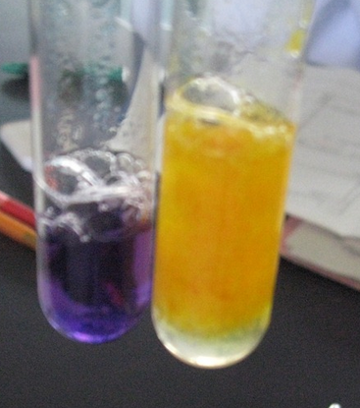
The reaction depends on presence of free amino group so proline and hydroxyproline which lack of free amino group yield yellow color with ninhydrin. Peptides and proteins owing to their free terminal amino groups yield a positive test.
positive test.
positive test and proline as yellow solution negative test.

Slide 11
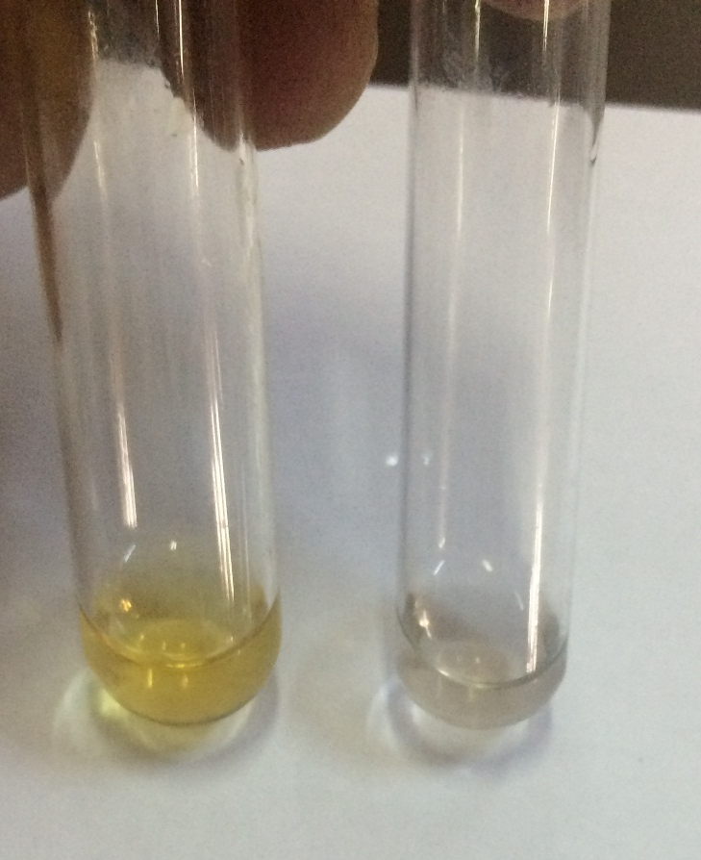
③The xanthoproteic reaction:
Nitration of the aromatic ring of an amino acid by hot concentrated nitric acid produce a yellow color so Tyrosine and Tryptophan give a positive test.
Under the condition of the test, Phenylalanine doesn’t produce the color. However, if one adds a small amount of concentrated sulfuric acid together with the nitric acid one will obtain a positive result (colorless solution).

Slide 12
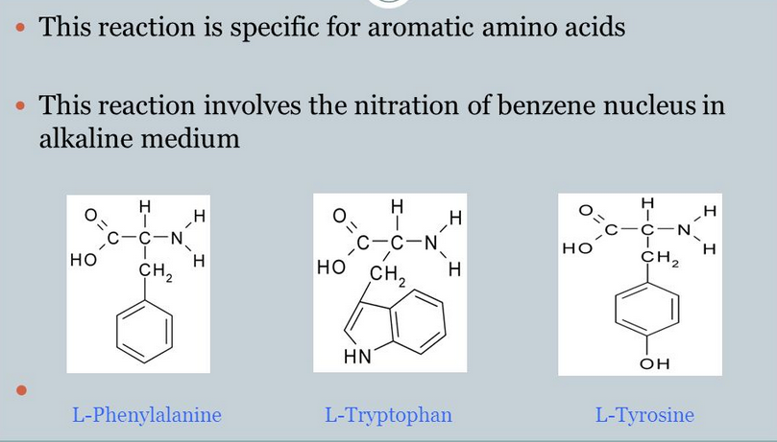
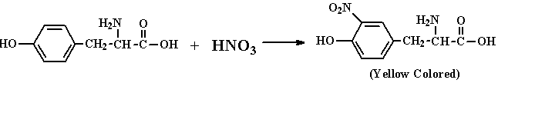
The xanthoproteic reaction

Slide 13
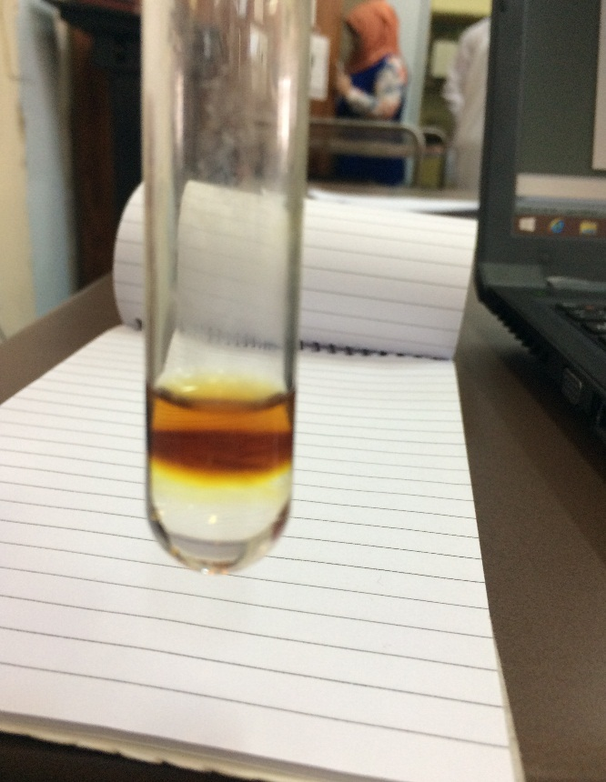
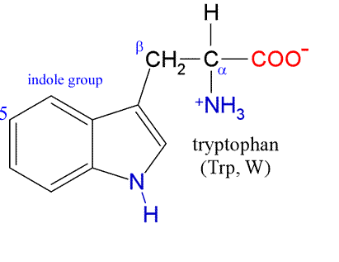
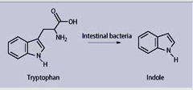
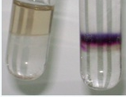
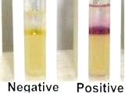
④Hopkins Cole test :
Tryptophan, due to its indole ring condenses with the aldehyde glyoxlic acid (CHO-COOH) in presence of concentrated H₂SO₄ to produce a purple to blue color.
Indole Ring

Slide 14
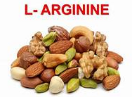
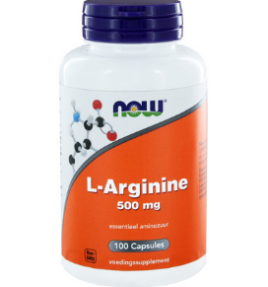
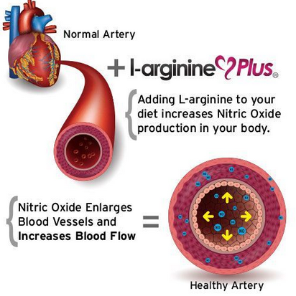
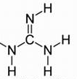
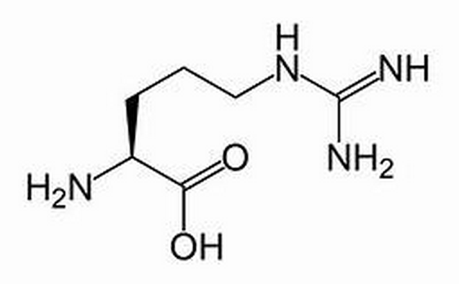
⑤The Sakaguchi test:
The only amino acid containing the Guanidine group is and this reacts with α – Naphthol and an oxidizing agent such as bromine to give a red color.
The guanidine group

Slide 15
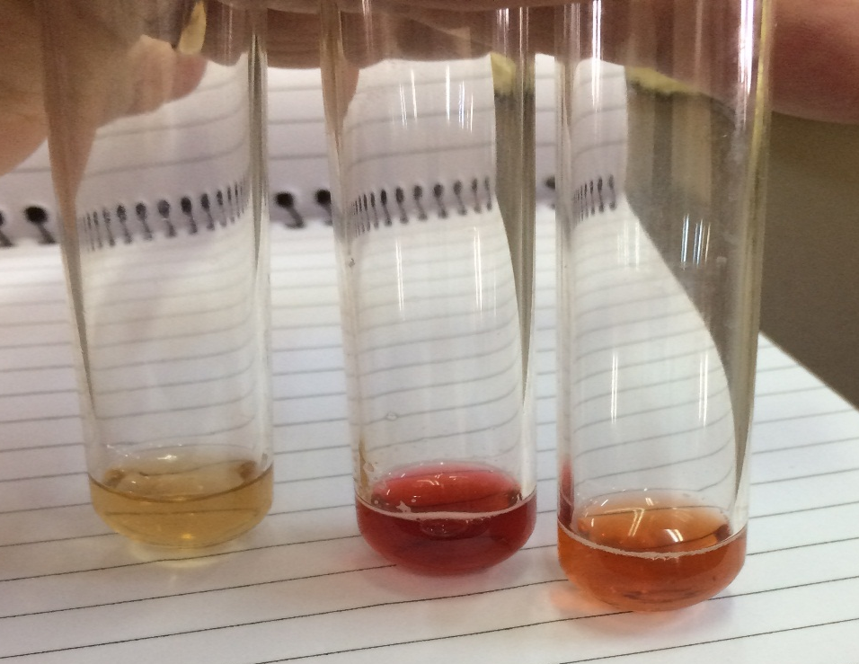
⑤The Sakaguchi test:
The only amino acid containing the Guanidine group is and this reacts with α – Naphthol and an oxidizing agent such as bromine to give a red color.
Arg. (red solution), Gelatin & Albumen (red solutions) are positive the other samples are negative results.

