Slide 1

Nutrition (also called nourishment or aliment) is the provision, to cells and organisms, of the materials necessary (in the form of food) to support life.
Many common health problems can be prevented or alleviated with a healthy diet.
Aside from not smoking, the most important determinants of good health are what we eat and how active we are.

Slide 2
Dietitians are health professionals who specialize in human nutrition, meal planning, economics, and preparation.
They are trained to provide safe, evidence-based dietary advice and management to individuals (in health and disease).
Clinical nutritionists are health professionals who focus more specifically on the role of nutrition in chronic disease, including possible prevention or remediation by addressing nutritional deficiencies before resorting to drugs.
A poor diet can have an injurious impact on health, causing deficiency diseases such as scurvy and health-threatening conditions like obesity and metabolic syndrome and such common chronic systemic diseases as cardiovascular disease, diabetes, and osteoporosis.

Slide 3
The human body contains chemical compounds, such as water, carbohydrates (sugar, starch, and fiber), amino acids (in proteins), fatty acids (in lipids), and nucleic acids (DNA and RNA).
These compounds in turn consist of elements such as carbon, hydrogen, oxygen, nitrogen, phosphorus, calcium, iron, zinc, magnesium, manganese, and so on.
All of these chemical compounds and elements occur in various forms and combinations (e.g. hormones, vitamins, phospholipids, hydroxyapatite), both in the human body and in the plant and animal organisms that humans eat.

Slide 4
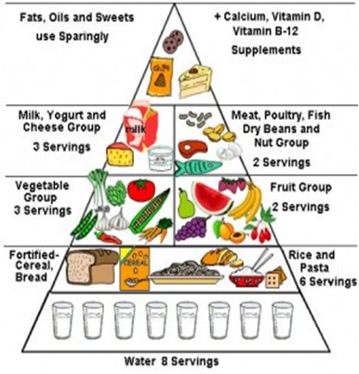

Slide 5
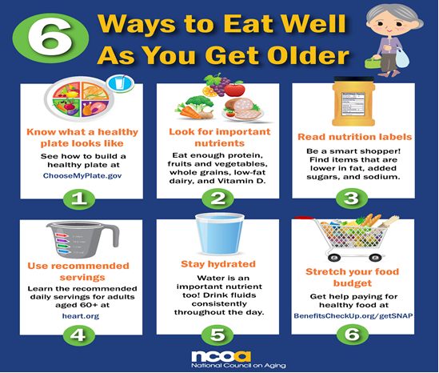

Slide 6
Nutrients
There are six major classes of nutrients: carbohydrates, fats, minerals, protein, vitamins, and water.
These nutrient classes can be categorized as either macronutrients (needed in relatively large amounts) or micronutrients (needed in smaller quantities). The macronutrients include carbohydrates (including fiber), fats, protein, and water. The micronutrients are minerals and vitamins.
The macronutrients (excluding fiber and water) provide structural material (amino acids from which proteins are built, and lipids from which cell membranes and some signaling molecules are built) and energy. Some of the structural material can be used to generate energy internally, and in either case it is measured in Joules or kilocalories.

Slide 7
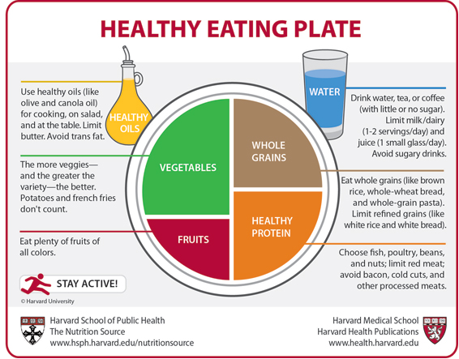

Slide 8
The aim of nutritional science:
1-To define the complete set of nutrients required in diet
2-The optimal amount of each nutrient.
3-Combination or food that meets these requirements.
4-To determine the variation of how these requirements vary in normal life cycle.
5-Nutritional factors affect and affected by illness, injury and treatment.
There are four disorders arising from dietary causes, which are widespread in our world today:
1-Protein - calorie malnutrition.
2-Obesity.
3-Starvation.
4-Secondary starvation (insufficient food intake)

Slide 9
Factors which affect specific req. of individual:
4-Weight 1-Heigh. 2-Sex. 3-Climate.
5-Physical activity level 6-Age-development stage.
7-Pregnancy.
The nutrient content of a food depends on:
1-Genetic strain 2-Growing location
3-Soil 4-Handling
5-Storage 6-Cooking
No single food contains adequate amount of all essential nutrients.

Slide 10
Energy Requirements of a normal person
While calculating the energy requirements, we have to consider the energy required for:
1-Maintenance of basal metabolic rate(BMR).
2-Specific dynamic action or thermogenic effect of food.
3-Extra energy expenditure for physical activities.

Slide 11
Resting Metabolic Rate(RMR)
Is the measure of energy required to maintain life or vital functions. The subject is awake and non –fasting , it is approximately about 3% higher than the BMR.
BMR is measured directly by the heat evolved or indirectly by the volume of oxygen consumed and carbon dioxide evolved per unit time.
Factors affecting BMR:
1-Age. 2-Sex. 3-Tempreture.
4-Fever. 5-Thyroid Hormones.
Since BMR is affected by body surface area, it is usually expressed in Kilocalories per hour / square meter of body surface.

Slide 12
Physical Activity
The energy requirements would depend on the occupation, physical activity and lifestyle of the individual.
The activity level may be divided into 3 groups-Sedentary, Moderate and Heavy.
Requirement for energy during pregnancy is + 300 kcal/ day, and during lactation is + 500 kcal/day in addition to the basic requirements.
In the diet proximate principles are carbohydrates, fats and proteins. Moreover, required amounts of minerals and vitamins are also to be

Slide 13
Activity | Energy required in kcal / hour
Eating | 28
Writing | 30
Driving a car | 63
Typing at high speed | 100
Walking | 140
Cycling(speed 2 km/h) | 175
Running | 490
Swimming (3.5 km / hour) | 550

