Slide 1
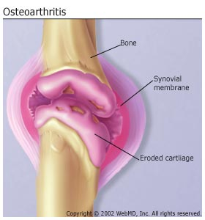
OSTEOARTHRITIS
Osteoarthritis (OA) is a chronic disorder of synovial joints in which there is progressive softening and disintegration of articular cartilage accompanied by new growth of cartilage and bone at the joint margins (osteophytes), cyst formation and sclerosis in the subchondral bone, mild synovitis and capsular fibrosis.

Slide 2
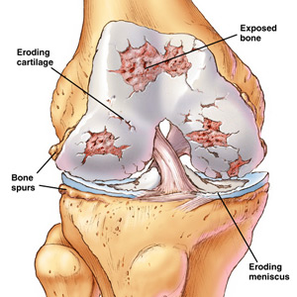
OA

Slide 3
Classification of OA
It is defined as primary when no cause is obvious, and secondary when it follows a demonstrable abnormality.

Slide 4
NOTE
It is also not a purely degenerative disorder, and the term ‘degenerative arthritis’ – which is often used as a
synonym for OA – is a misnomer. Osteoarthritis is a dynamic phenomenon

Slide 5
Aiteology
The most obvious feature of OA is that it increases in frequency with age. This does not mean that it is an expression of senescence; it simply show that OA takes many years to develop.
OA results from a disparity between the stress
applied to articular cartilage and the ability of the cartilage to withstand that stress. This could be due to one or a combination of two processes:
(1)weakening of the articular cartilage (possibly due to
genetic defects in type II collagen or to enzymatic
activity in certain infl ammatory disorders such as
rheumatoid disease).
(2) increased mechanical stress in some part of the articular surface.

Slide 6
Pathology
progressive cartilage destruction.
subarticular cyst formation, with
sclerosis of the surrounding bone.
osteophyte formation.
(5) capsular fibrosis.

Slide 7
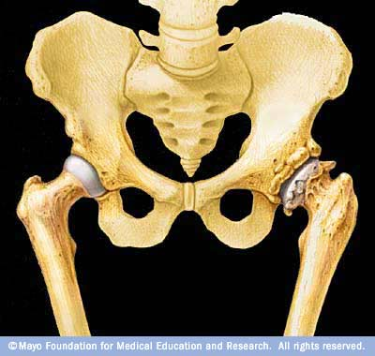
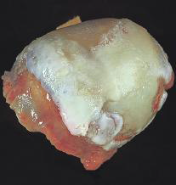
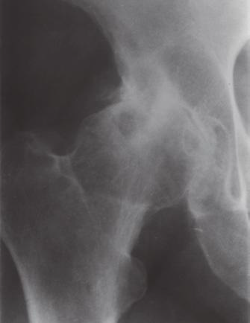
Pathology of AO

Slide 8
Risk factors
■■ Joint dysplasia: disorders such as congenital acetabular dysplasia, Perthes’ disease and slipped upper femoral epiphysis presage a greater than normal risk of OA in later life. Minor degrees of dysplasia are often asymptomatic and are spotted only later in life when OA starts to develop.
■■ Trauma: fractures involving the articular surface are obvious precursors of secondary OA; so too are lesser injuries which result in joint instability.
Occupation: there is good evidence of an association between OA and certain occupations which cause repetitive stress, for example OA of the knees in workers engaged in continuous knee-bending activities.
Family history: women whose mothers had generalized OA are more likely to develop the same condition. The particular trait responsible for this is not known.

Slide 9
Factors that increase risk of osteoarthritis include:
· Older age. Osteoarthritis typically occurs in older adults. People under 40 rarely experience osteoarthritis.
· Sex. Women are more likely to develop osteoarthritis, though it isn't clear why.
· Bone deformities. Some people are born with malformed joints or defective cartilage, which can increase the risk of osteoarthritis.
· Joint injuries. Injuries, such as those that occur when playing sports or from an accident, may increase the risk of osteoarthritis.
· Obesity. Carrying more body weight places more stress on weight-bearing joints, such as knees. But obesity has also been linked to an increased risk of osteoarthritis in the hands, as well.
· Other diseases that affect the bones and joints. Bone and joint diseases that increase the risk of osteoarthritis include gout, rheumatoid arthritis, Paget's disease of bone and septic arthritis.

Slide 10
Clinical features
1- Patients usually present after middle age, although it is likely that cartilage changes start 10 or even 20 years before that. Sometimes – especially in younger patients – there is a history of some preceding joint disorder or injury.
2- In some cases symptoms are confined to one or two large joints; in others (especially elderly women) multiple joints are affected, including the distal interphalangeal joints of the hand(Heberden’s nodes) (polyarticular OA).
3-Pain starts insidiously and increases slowly over months or years. It is aggravated by exertion and relieved by rest, although with time relief is less and less complete. Stiffness, characteristically, is worst after periods of rest.
4- Typically symptoms follow an intermittent course, with periods of remission sometimes lasting for months.
5-Swelling(effusion), deformity(varus), tenderness, crepitus on movement, loss of mobility and muscle wasting are features of advanced disease. Ultimately the joint may become unstable.

Slide 11
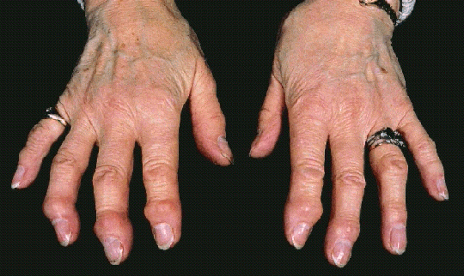
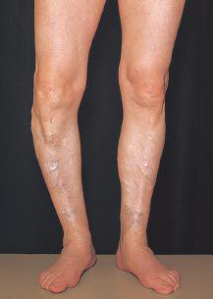
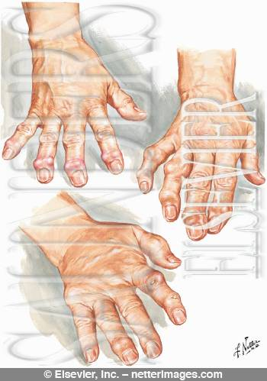
Clinical features

Slide 12
Clinical variants of OA
Monarticular and pauciarticular OA:
In its ‘classic’ form, OA presents with pain
and dysfunction in one or two of the large weight-bearing joints like hip or knee joints.
Polyarticular (generalized) OA
This is far and away the most common form of OA, though most of the patients never consult an orthopaedic surgeon. The typical patient is a middle-aged woman who presents with pain, swelling and stiffness of the distal finger joints (Heberden’s nodes)
OA in unusual sites:
OA is uncommon in the shoulder, elbow, wrist and ankle. If any of these joints is affected one should suspect a previous abnormality – congenital or traumatic.

Slide 13
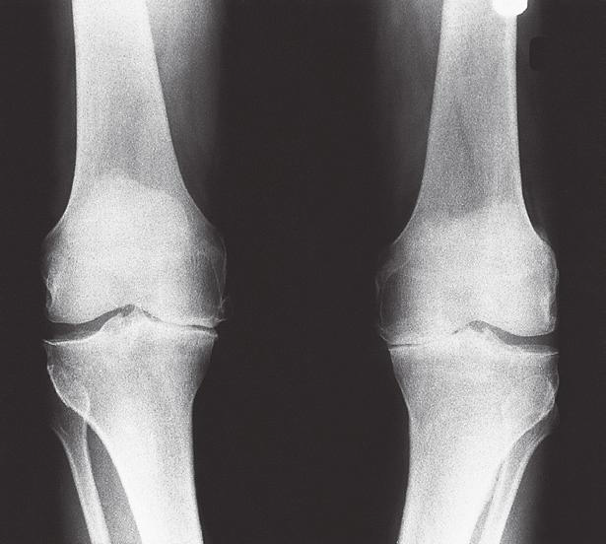
X-rays
(1) narrowing of the joint ‘space’, due to cartilage depletion;
(2) subarticular cyst formation and sclerosis;
(3)osteophyte formation.
Initially the first two featuresare restricted to the major loadbearing part of the joint, but in late cases the entire joint is affected.
(4) deformity (varus) in
Severe cases.

Slide 14
Treatment
A-Early
There are three principles in the treatment of early OA:
(1) relieve pain;
(2) increase movement;
(3) reduce load.

Slide 15
1-Pain relief is achieved by analgesics and nonsteroidal anti-inflammatory drugs (NSAIDs),Rest periods and modification of activities may also be necessary.
2- Joint mobility can often be improved by
physiotherapy; even a small increase in range and
power will reduce pain and improve function.
3-Load reduction can be achieved by using a walking stick, wearing soft-soled shoes, avoiding prolonged, stressful activity and by weight reduction

Slide 16
B-Intermediate
If symptoms increase despite conservative treatment, some form of operative treatment may be needed. This will usually be a ‘holding’ procedure, especially in younger patients who are not yet ready for a joint replacement.
For OA of the knee, joint debridement (removal of interfering osteophytes, cartilage tags and loose bodies) can be performed arthroscopically. For both the hip and the knee, realignment osteotomy used to be popular.

Slide 17
C-Late
Joint replacement, is now the procedure of choice for OA in patients with severe symptoms, marked loss of function and significant restriction of daily activities.
For OA of the hip and knee in middle-aged and older patients, total joint replacement by modern techniques promises improvement lasting for 15 years or longer, but techniques are improving year by year

Slide 18
However, joint replacement operations are highly dependent on technical skills, implant design, appropriate instrumentation and postoperative care – requirements that cannot always be met, or may not be cost-effective, in all parts of the world.

Slide 19
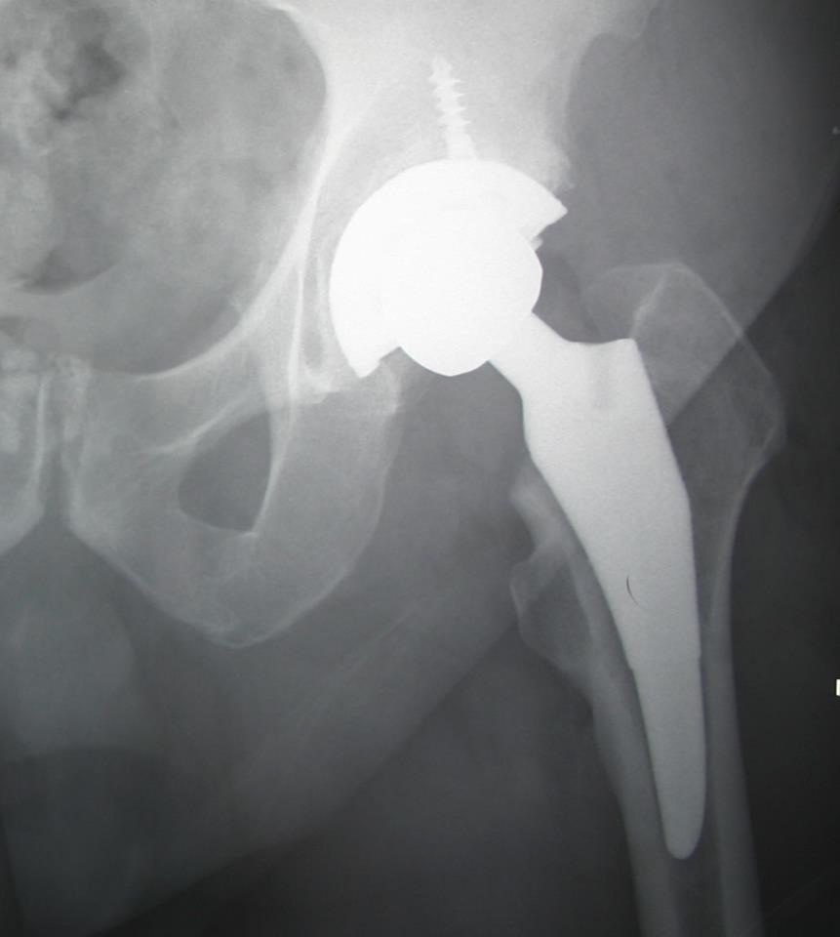
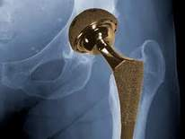
THA

Slide 20
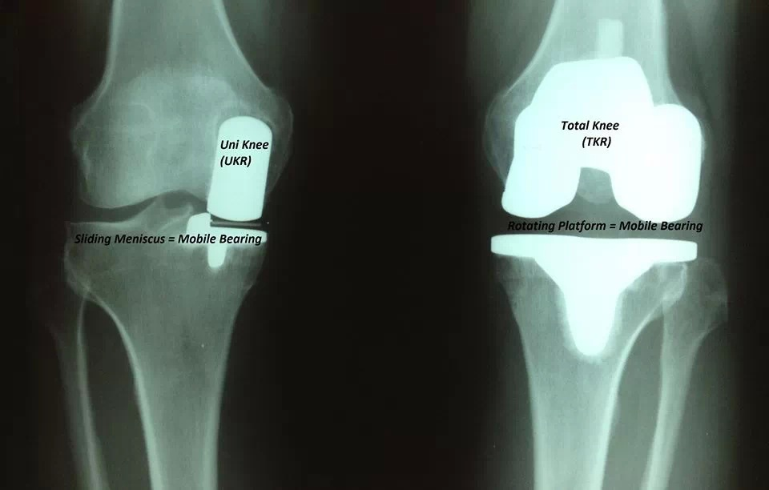
TKA

Slide 21
Neuropathic arthritis (Charcot’s disease)
Neuropathic arthritis is a rapidly progressive
degeneration in a joint which lacks position sense
and protective pain sensation. In the lower limb it is
associated with tabes dorsalis, cauda equinalesions,
peripheral neuropathies (especially diabetic) and
congenital indifference to pain; in the upper limbs
it is usually due to syringomyelia.

Slide 22
Pathology
The joint disorder is a rapidly progressive form
of OA. There is marked destruction of articular
cartilage and the underlying bone, and microscopic
spicules of bone become embedded in the
synovium. Ligaments and capsule are lax and at the
joint periphery there is florid new bone formation.

Slide 23
Clinical features
The patient complains of instability, swelling and
deformity; the symptoms may progress rapidly. The
appearance of the joint suggests that movement
would be agonising and yet it is often painless. The
paradox is diagnostic. Swelling and deformity are marked, yet there is no warmth or tenderness. Fluid is greatly increased and bits of bone can be felt everywhere. All movements are increased and the joint is unstable, yet painless.

Slide 24
X-rays
The joint may be subluxated or dislocated; gross bone destruction is obvious and there are irregular calcified masses in the capsule.

Slide 26
Treatment
The underlying condition may need treatment, but the affected joints cannot recover. They should, if possible, be stabilized by external splintage (e.g. a calliper). Operation is not advised.

