Slide 1
Amoebiasis
(Amoebic dysentery)
Presented by Abhinay Bhugoo

Slide 2
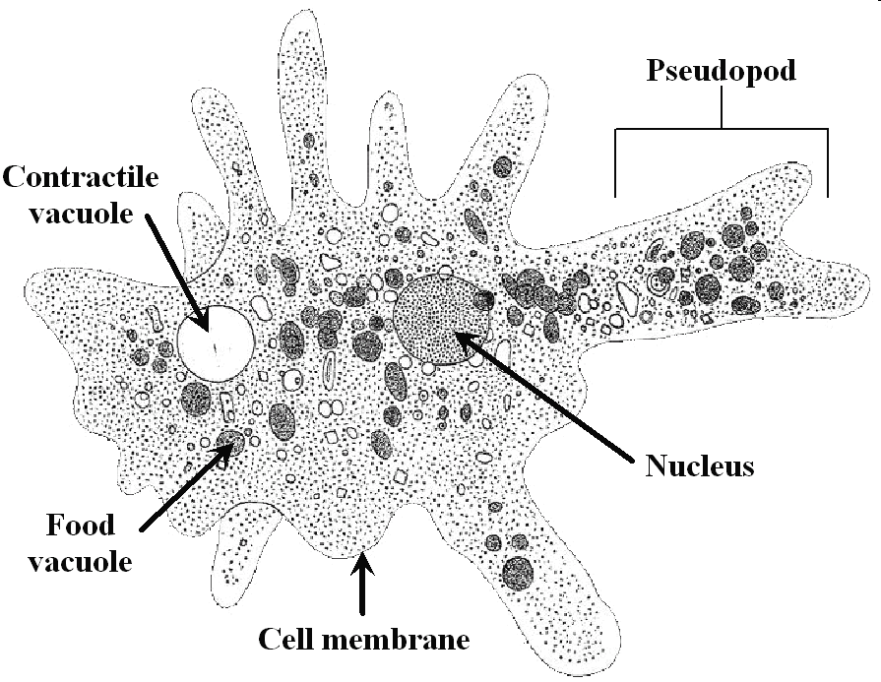
Causative agent:
Entamoeba histolytica

Slide 3
Amoebiasis
“Harbouring of protozoa E. histolytica
inside the body with or without disease”
  only 10% of infected develop disease
  two types of infection
    Extra-intestinal
    Intestinal- mild to fulminant

Slide 4
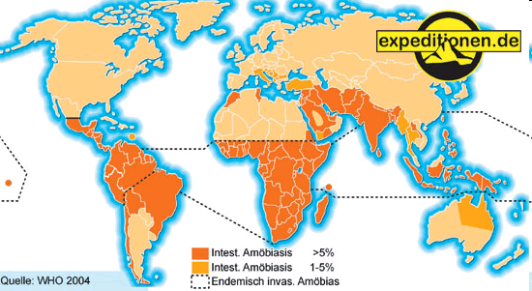
Trends of Amoebiasis

Slide 5
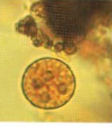
Epidemiological determinants
Entamoeba histolytica
      7 zymodemes pathogenic
      two forms –
        trophozoite (vegetative)-fragile
        cyst -this is the infective stage
        -survives for weeks if appropr. envi
        -infective dose can be a single cyst
      source of infection is a case or carrier
      -1.5*10⁷ cysts per day
      reservoir is only human –several years
      resistant to chlorine in normal conc.
      readily killed by freezing or heating(55°C)

Slide 6
Incubation period:
Period of communicability:
3 days in severe infection; several months in sub-acute and chronic form. In average case vary from 3-4 weeks.
For duration of the illness.

Slide 7
Modes of Transmission
    Faeco-oral route
      - contaminated water and food
      - direct hand to mouth
    Agency of flies, cockroaches, rats, etc.
    Sexual contact via oral-rectal contact

Slide 8


Slide 9
Host Factor Contributions
Several factors contribute to influence infection
1 Stress
2 Malnutrition
3 Alcoholism
4 Corticosteroid therapy
5 Immunodeficiency
6 Alteration of Bacterial flora

Slide 10
Risk factors
People in developing countries that have poor sanitary conditions
Immigrants from developing countries
Travellers to developing countries
People who live in institutions that have poor sanitary conditions
HIV-positive patients
homosexuals

Slide 11
Clinical features
intestinal
Extra intestinal
Asymptomatic carriers
Amoebic colitis
Fulminant colitis
Amoeboma
Liver
Lung
Brain
Skin

Slide 12
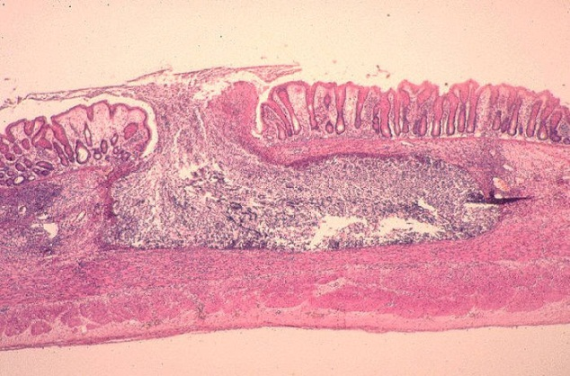
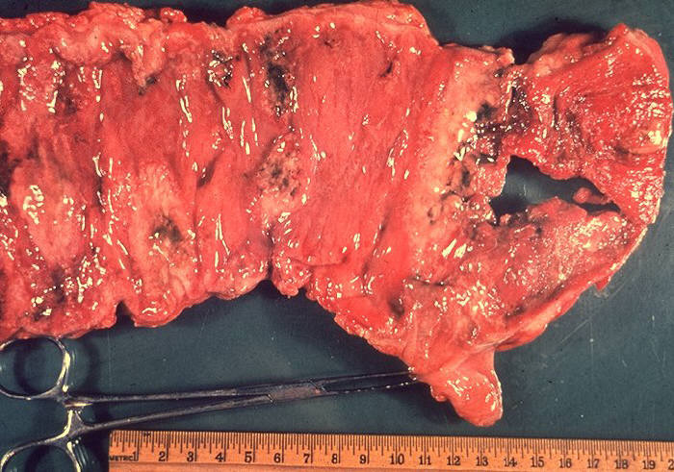
Asymptomatic carriers (non invasive form)
- 90% without symptoms
- does not damage lumen
Invasive forms:
Amoebic colitis
- flask shaped ulcers superficial or deep
- abd pain, diarrhoea, blood, fever
-
Fulminant colitis - <0.5%
- severely ill with high fever
- intestinal bleeding
- perforation
- paralytic ileus

Slide 13
Amoeboma
- 1% of cases
- inflammatory thickening of intestinal wall
- palpable mass with trophozoites
Symptoms of amoebic colitis
Symptoms Percentage
Diarrhea 100
Dysentery 99
Abdominal pain 85
Fever 68
Dehydration 5
Length of symptoms 2 to 4 weeks

Slide 14
Symptom | Bacillary dysentery | Amoebic dysentery
Onset | Acute | Gradual
General Condition | Poor | Normal
Fever | High grade | Little fever (adult)
Tenesmus | Severe | Moderate
Dehydration | Frequent | Little dehydration (adult)
Faeces | No trophozoites | Trophozoites present
Culture | Positive | Negative

Slide 15
Extra-intestinal
Amoebic liver abscess
    via portal system
    5% of invasive disease
    10 times more common in men
Pleuropulmonary
  - direct spread from liver abcess (10%)
  - haematogenous spread
Brain
  - abrupt onset & rapid progression
  - death in 12-72 hrs

Slide 16
Virulence factors
Trophozoites of E.histolytica interact with host through a series of steps:
Adhesion of target cell, phagocytosis and cytopathic effect
E.histolytica induces both Humoral and cell mediated immune responses.
Virulence factors – In many circumstances lumen dwelling Amoeba may be asymptomatic
Causes disease only when invade the Intestine
Virulence is associated with secretion of Cysteine proteniase which assists the organism in digesting the extracellular matrix and invading tissues

Slide 17
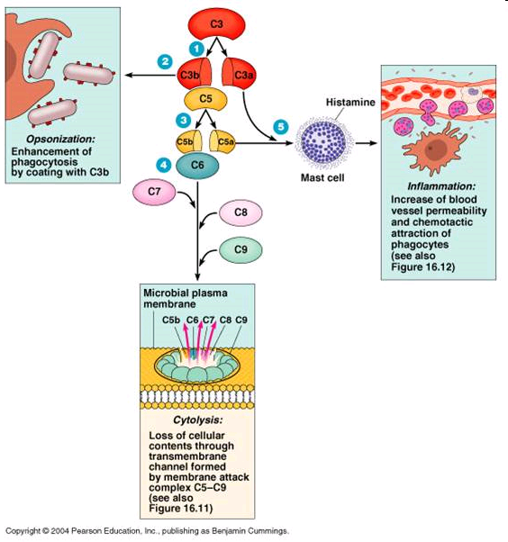
Cysteine proteinase - Complement factor C3
It is observed Cysteine proteinase produced by invasive strains of E.histolytica inactivates the complement factor C3 and are thus resistant to Complement mediated lysis.

Slide 18
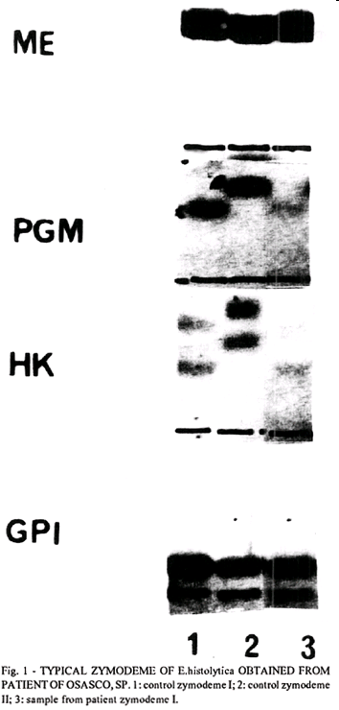
Zymodeme
Zymodeme:Populations of parasites with identical isoenzymes.
Based on Electrophoretic mobility E.histolytica strains are classified into 22 Zymodemes
However only 9 are invasive

Slide 19
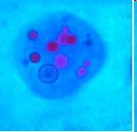
Invasive x Noninvasive strains
The invasive and non invasive strains may appear identical may represent two distinct species
1 Invasive strain – E.histolytica
2 Non invasive strains reclassified as E.dispar.

Slide 20
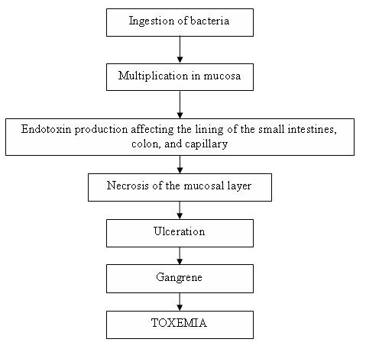
pathogenesis

Slide 21
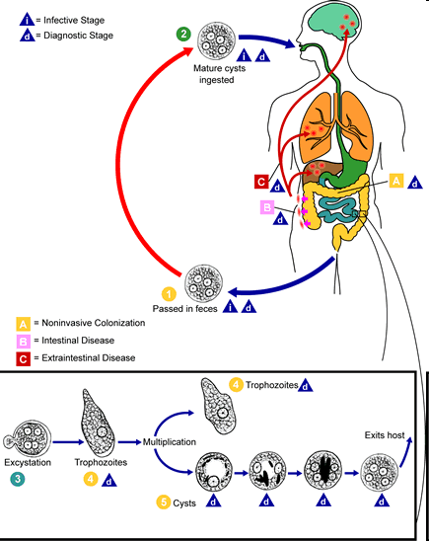

Slide 22
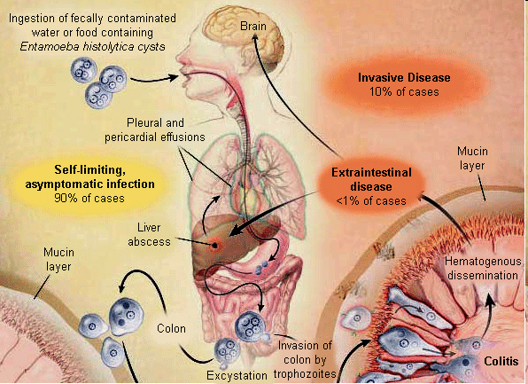

Slide 23
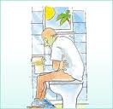

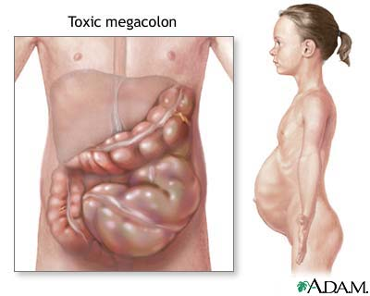
Clinical manifestation
A. Acute amoebic dysentery
Slight attack of diarrhea, altered with periods of constipation and often accompanied by tenesmus.
Diarrhea, watery and foul-smelling stools often containing blood-streaked mucus.
Nausea, flatulence and abdominal distension, and tenderness in the right iliac region over the colon.

Slide 24

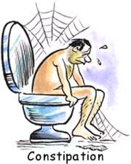
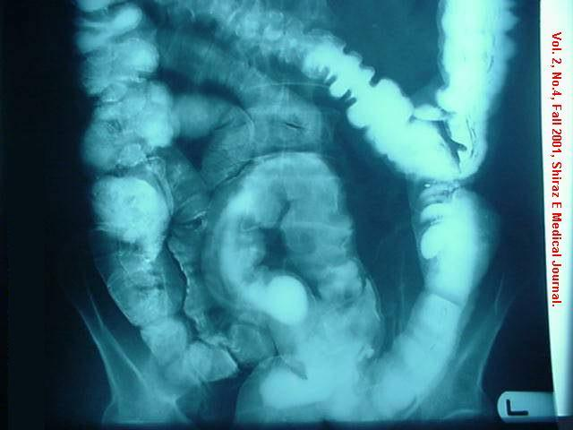

B. Chronic amoebic dysentery
Attack of dysentery lasting for several days, usually succeeded by constipation.
Tenesmus accompanied by the desire to defecate.
Anorexia, weight loss and weakness.
Liver maybe enlarged.
The stools at first are semi-fluid but soon become watery, blood, and mucoid.
Vague abdominal distress, flatulence, constipation or irregularity of the bowel.
Mild anorexia, constant fatigue and lassitude
Abdomen lost its elasticity when picked---up between fingers.
On sigmoidoscopy, scattered ulceration with yellowish and erythematous border.
Gangrenous type of stool

Slide 25
Diagnosis
    M/E immediately before cooling
    - fresh mucus or rectal ulcer swab
    - colourless motile trophozoites with RBC
    - quadrinucleated cysts
    Serology –IHA, ELISA
    - usually negative in intestinal

Slide 26
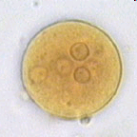
Quadrinucleated cyst

Slide 27
Treatment
- symptomatic cases
- asymptomatic in non-endemic areas
- asymptomatic if food handlers
 | Drug
 | Metronidazole | Tinidazole | Iodoquinol | Diloxanide furoate
Acts on | Kills trophozoites in intestine & tissue | Kills trophozoites in intestine & tissue | Luminal- Eradicate cysts | Luminal- Eradicate cysts
Dose | 500-750 mg PO tid x 5-10 days | 600 mg bd PO x 5 days | 650 mg PO tid x10days | 500 mg PO tid x10days

Slide 28
Prevention & Control
Primary prevention
- Safe excreta disposal
- Safe water supply
- Hygiene
- Health education
Secondary
- Early diagnosis
- Treatment

Slide 29
Primary prevention
Sanitation Water Food hygiene H edu.
-excreta -protect -protect food -long
-wash hands -sand filter -acetic acid term
-latrines -boiling -detergent
-food handlers
examine
treat
educate

