Slide 1
Vitamin B₁₂, vitamin B12 or vitamin B-12, also called cobalamin, is a water soluble vitamin with a key role in the normal functioning of the brain and nervous system, and for the formation of blood. It is one of the eight B vitamins.
A common synthetic form of the vitamin, cyanocobalamin, does not occur in nature, but is used in many pharmaceuticals and supplements, and as a food additive, because of its stability and lower cost.

Slide 3
Medical uses
Vitamin B₁₂, is used to treat vitamin B₁₂ deficiency, cyanide poisoning, and hereditary deficiency of transcobalamin II. It is also given as part of the schilling test for detecting pernicious anemia.
For cyanide poisoning, large amount may be given intravenously, and sometimes in combination with sodium thiosulfate. The mechanism of action is straightforward: the hydroxycobalamin hydroxide ligand is displaced by the toxic cyanide ion, and the resulting harmless B₁₂ complex is excreted in urine.
High vitamin B₁₂ level in elderly individuals may protect against brain atrophy or shrinkage, associated with Alzheimer's disease and impaired cognitive function.

Slide 4
Cyanocobalamin is one such "vitamer" in this B complex, the cyanocobalamin form of B₁₂ is easy to crystallize and is not sensitive to air-oxidation, it is typically used as a form of B₁₂ for food additives and in many common multivitamins.
All cyanocobalamin is vitamin B₁₂, but not all vitamin B₁₂ is cyanocobalamin. Pure cyanocoblamin possesses the deep pink colour associated with most octahedral cobalt(II) complexes and the crystals are well formed and easily grown up to milimetre size.

Slide 5
Hydroxocobalamin is another form of B₁₂ commonly encountered in pharmacology, but which is not normally present in the human body. Hydroxocobalamin is sometimes denonoted B_{12a}. This form of B₁₂ is the form produced by bacteria.
It is supplied typically in water solution for injection. Hydroxocobalamin is thought to be converted to the active enzymic forms of B₁₂ more easily than cyanocobalamin.

Slide 6
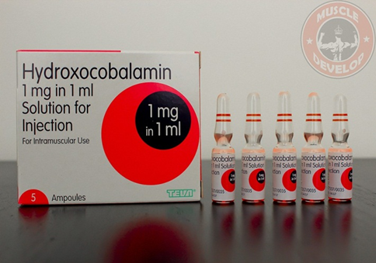
Hydroxycobalamine (B12a) is superior as :
1-It is more active in enzyme systems.
2-It is retained longer in the body when given orally.
Hence,B12a is more useful for theraptic administration of B 12a by mouth.

Slide 8
Absorption
Vitamin B12 is absorbed from ileum,for its proper absorption it requires:
Presence of HCL, and Intrinsic factor(IF) of Castle, a constituent of normal gastric juice.
Mechanism of absorption, it has been shown that two binding proteins are required:
Cobalophilin: a binding protein secreted in the saliva.
Intrinsic factor(IF) : a glycoprotein secreted by parietal cells of gastric mucosa.
1-Gastric acid(HCL) and pepsin release the Vit B12 from protein binding in food and make it available to bind to salivary protein,cobalophilin.
2-In the duodenum, cobalophilin is hydrolyzed, releasing the vitamin for binding to Intrinsic factor (IF).

Slide 11
In supplements, B12 is not bound to protein, and therefore does not need digestive enzymes or stomach acid to be detached from a protein. Stomach acid is needed to dissolve some B12 tablets, especially if not chewed.
There is some preliminary evidence that unbound B12, especially when combined with an absorption enhancer, can be directly absorbed through the membranes under the tongue at higher rates than through passive diffusion in the digestive tract.

Slide 13
Transport in blood
Vitamin B12 is transported in blood in association with specific proteins named Transcobalamine I and Transcobalamine II and III.
Physiologically Transcobalamine II is more important.

Slide 16
Biological Active Forms of B12
Biologically active forms are cobamide coenzymes act as coenzyme with various enzymes.
Deficiency
May be due to dietary factors, gastric factors as in post gastrostomy and in strict vegetarians .
If absorption is prevented by lack of intrinsic factor it will cause pernicious anemia.
Megaloblastic anemia appears due to B₁₂ deficiency

Slide 17
Clinical Symptoms of vitamin B ₁₂ deficiency:
1-Cardiovascular- increased risk of stroke or heart attack.
2-Psychiatric-
a- Irratability and overall personality change.
b-Mild memory impairment,,occasional dementia.
c-Psyhosis.
d-Depression.
3-Hematologic- a-Megaloblastic anemia.
b-Pancytopenia.

