Slide 1

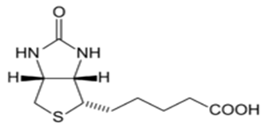
Biotin, also known as vitamin H or coenzyme R, is
a water-soluble B-vitamin (vitamin B₇).

Slide 2
Biotin plays a vital role in:
• 1-Helping the body metabolize proteins, fats and carbohydrates.
• 2-Helping the body process glucose.
• 3-It also contributes towards healthy nails, skin and hair.
It is therefore found in many cosmetic and health products for the skin and hair.

Slide 3
Sources of biotin
Biotin is consumed from a wide range of food sources in the diet, but few are particularly rich sources. Foods with relatively high biotin content include
Egg yolk (raw). Egg white reduces egg yolk's biotin effectiveness in the body. People who consume just egg white for many years without biotin supplementation have a slight risk of not getting enough vitamin B7.
Liver, Peanuts,Yeast,Bread, whole-wheat,Cheese, cheddar,Pork,Salmon,Avocado,Raspberries and Cauliflower (raw).

Slide 4
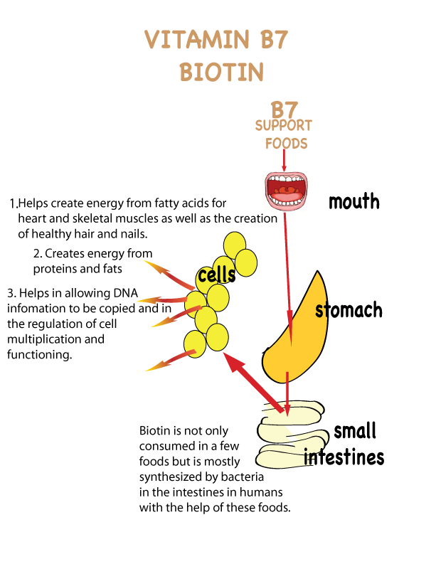

Slide 5
Deficiency
Biotin deficiency is relatively rare and mild, and can be addressed with supplementation. Such deficiency can be caused by the consumption of raw egg whites (eating two or more uncooked egg whites daily for several months has caused biotin deficiency that is serious enough to produce symptoms), which contain high levels of the protein avidin, which binds biotin strongly.
Avidin denaturates upon heating (cooking), while the biotin remains intact.

Slide 6
People who are at an increased risk for vitamin B7 biotin deficiency include those with the following:
1-long-term use of certain anti-seizure medications
prolonged antibiotic use
2-intestinal malabsorption issues or serious digestive disorders like Chron’s disease, celiac disease, or leaky gut syndrome.
There isn’t a good laboratory test for detecting biotin deficiency, so this condition is usually identified by its symptoms.
Requirement increase in:
1-Pregnancy and Lactation.
2-Oral antibiotic therapy for prolonged periods.

