Slide 1

Vitamin B₆ is a water-soluble vitamin and is part of the vitamin B complex group. Several forms of the vitamin are known, but pyridoxal phosphate (PLP) is the active form and is a cofactor in many reactions of amino acid metabolism, including transamination, deamination, and decarboxylation. PLP also is necessary for the enzymatic reaction governing the release of glucose from glycogen.

Slide 2
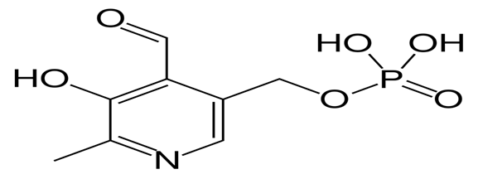

Slide 3
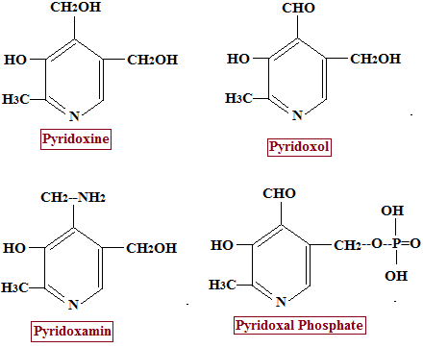

Slide 4
Forms
Seven forms of this vitamin are known:
Pyridoxine (PN), the form that is most commonly given as vitamin B₆ supplement
Pyridoxine 5'-phosphate (PNP)
Pyridoxal (PL)
Pyridoxal 5'-phosphate (PLP), the metabolically active form (sold as 'P-5-P' vitamin supplement)
Pyridoxamine (PM)
Pyridoxamine 5'-phosphate (PMP)
4-Pyridoxic acid (PA), the catabolite which is excreted in the urine
Pyridoxine is the form used in vitamin supplements because it is the least expensive to produce commercially.

Slide 5
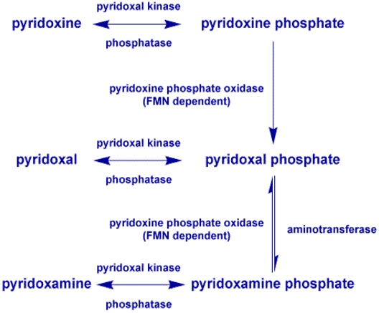

Slide 6
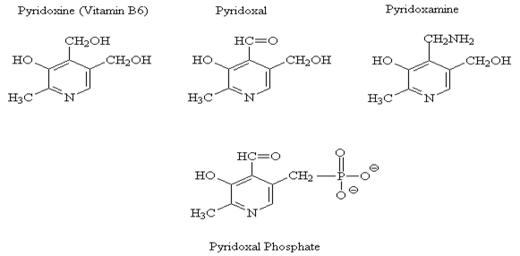
Forms

Slide 7
Biological Active Forms
The biological active forms of the vitamin are the phosphorylated derivatives: (Pyridoxal-PO4 and Pyridoxamine-PO4)
Phosphorylation involves the hydroxymethyl group-CH2OH at position 5 in the pyridine ring.

Slide 8
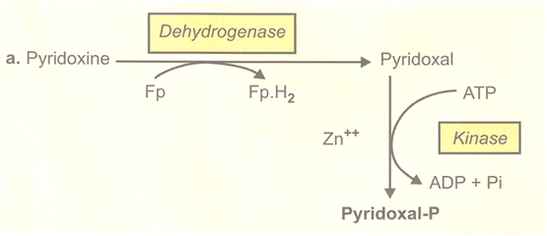
Formation of pyridoxal-P
a- Pyridoxine to Pyridoxal-P.

Slide 9
-
Alternatively, Pyridoxine first undergoes phosphorylation with the help of ATP-dependent Kinase to produce Pyridoxal-P and then oxidized by FP-dehydrogenase.
Biosynthesis
Vitamin B6 can be formed by many micro-organisms and probably also by plants. Human beings cannot synthesize the vitamin, hence has to be provided in the diet.
Intestinal bacteria can synthesize the vitamin.

Slide 10
Metabolism
Absorption
Dietary vitamin B6 is ready to absorption by the intestine.
Vitamin B₆ is absorbed in the jejunum and ileum via passive diffusion.
The absorption of pyridoxal phosphate and pyridoxamine phosphate involves their dephosphorylation catalyzed by a membrane-bound alkaline phosphatase.
Those products and non-phosphorylated Vitamers in the digestive tract are absorbed by diffusion.
The trapped pyridoxine and pyridoxamine are oxidized to Pyridoxal phosphate in the tissue.

Slide 11
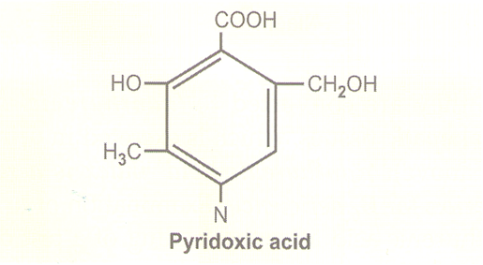
Excretion
Pyridoxal and Pyridoxamine are excreted in urine in small amounts 0.5to o.7 mg daily.
Major urinary metabolite:inactive form 4-pyridoxic acid.
It a useful clinical marker to assess the vitamin B₆ status of an individual

Slide 12
Food sources
Good sources include meats, whole grain products, vegetables, nuts and bananas.
Cooking, storage and processing losses of vitamin B₆ vary and in some foods may be more than 50%, depending on the form of vitamin present in the food. Plant foods lose the least during processing, as they contain mostly pyridoxine, which is far more stable than the Pyridoxal or pyridoxamine found in animal foods.
Freezing and canning are other food processing methods that result in the loss of vitamin B₆ in foods.

Slide 13
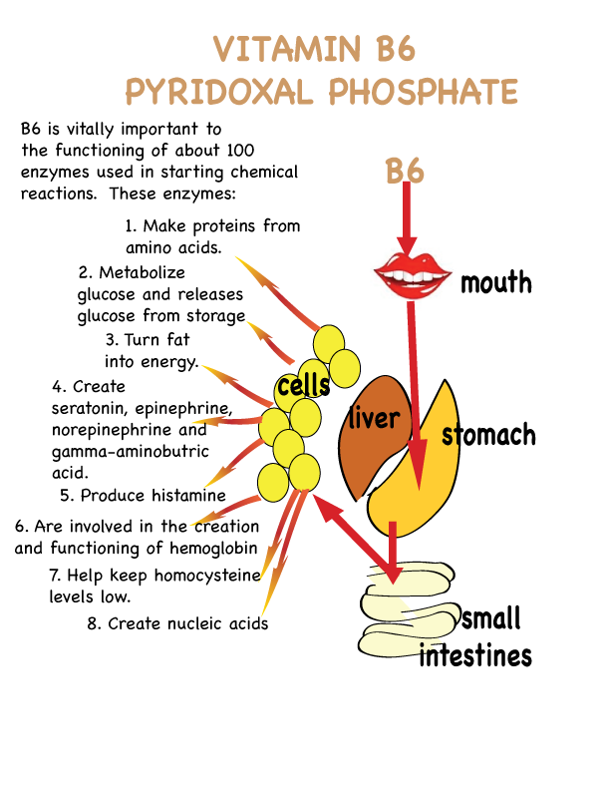

Slide 14
Functions
Pyridoxal phosphate, the metabolically active form of vitamin B₆, the liver is the site for vitamin B₆ metabolism.
The primary role of vitamin B₆ is to act as a coenzyme to many other enzymes in the body that are involved predominantly in metabolism.
1) Protein, carbohydrate, and fat synthesis and breakdown.
2) The synthesis of neurotransmitters (which are important for nerve function).
3) The synthesis of histamine (which is involved in the allergic immune response).
4) Hemoglobin synthesis and function (which carries oxygen to tissues and carbon dioxide to the lungs).
5) Gene expression (which involves which proteins are made in the body).

Slide 15
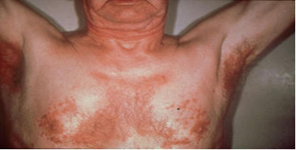
Deficiencies
The classic clinical syndrome for B₆ deficiency is a seborrhoeic dermatitis-like eruption, atrophic glossitis with ulceration, angular cheilitis, conjunctivitis, intertrigo, and neurologic symptoms of somnolence, confusion,
and neuropathy

Slide 16
Clinical assessment of vitamin B₆
The three biochemical tests most widely used are:
1-The activation coefficient for the erythrocyte enzyme aspartate aminotransferase.
2-Plasma pyridoxal phosphate (PLP) concentrations.
3-The urinary excretion of vitamin B₆ degradation products, specifically urinary pyridoxic acid.
Of these, plasma PLP is probably the best single measure, because it reflects tissue stores. When plasma pyridoxal phosphate is less than 10nmol/L, it is indicative of vitamin B₆ deficiency. Urinary 4-pyridoxic acid is also an indicator of vitamin B₆ deficiency; a level of less than 3.0 mmol/day is suggestive of vitamin B₆ deficiency.

