Slide 1
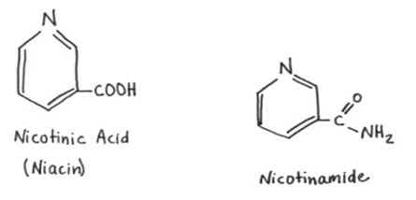
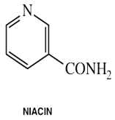
Vitamin B3
Niacin and niacinamide are forms of Vitamin B3,(water soluble vitamin) an organic compound with the formula C6H5NO2.It extremely stable to heat, light, acid, alkali, and oxidation.

Slide 4
Niacin is a precursor to NAD+/NADH and NADP+/NADPH, which play essential metabolic roles in living cells. Niacin is involved in both DNA repair, and the production of steroid hormones in the adrenal gland.
Niacin is a unique vitamin since it can be synthesized from tryptophan, one of the essential amino-acids. It takes 60 g of tryptophan to make 1 g of niacin provided that the intestinal flora is healthy and the diet contains sufficient amounts of vitamins B2, B6 and proteins.
For these reasons, niacin's recommended intake is expressed as niacin equivalents (NE). 1 niacin equivalents (NE) = 1 mg of niacin or 60 mg of tryptophan.

Slide 5
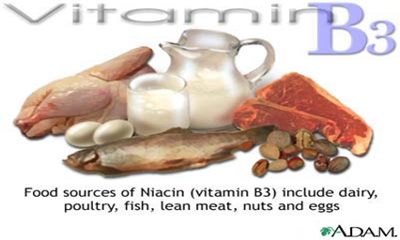
Food sources
Niacin is found in variety of foods, including liver, chicken, beef, fish, cereal, peanuts and legumes.

Slide 6
Biosynthesis and chemical synthesis
The liver can synthesize niacin from the essential amino acid tryptophan, requiring 60 mg of tryptophan to make one mg of niacin.
The 5-membered aromatic heterocycle of tryptophan is cleaved and rearranged with the alpha amino group of tryptophan into the 6-membered aromatic heterocycle of niacin.

Slide 8
Biological Active Forms
Two such nucleotide active forms are known:
1-Nicotinamide adenine dinucleotide (NAD+)
The compound contains:
* One molecule of nicotinamide.
*Two molecules of D-ribose.
*Two molecules of phosphoric acid, and
*One molecule of adenine.
2-Nicotinamide adenine dinucleotide phosphate (NADP)
This compound differs from NAD+ in that it contains an additional molecule of phosphoric acid attached to 2-position of D-ribose attached to N-9 of Adenine. The reduced form of either coenzymes is designated by the prefix dihydro-nicotinamide adenine dinucleotide (NADH).

Slide 16
Function
1-Important part of energy production.
2-Help maintain muscle tone in the GI tract.
3-Involved in the production of sex and stress hormones.
4-Helps improve circulation.
5-Helped in cholesterol production ,and can help lower LDL cholesterol.
6-Required for DNA production.
7-Involved in blood sugar regulation.

Slide 18
Lipid-modifying effects
Niacin blocks the breakdown of fats in adipose tissue.
These fats are used to build very-low-density lipoproteins (VLDL) in the liver, which are precursors of low-density lipoprotein (LDL) or "bad" cholesterol.
Because niacin blocks the breakdown of fats, it causes a decrease in free fatty acids in the blood and, as a consequence, decreases the secretion of VLDL and cholesterol by the liver.
By lowering VLDL levels, niacin also increases the level of high-density lipoprotein (HDL) ,therefore it is sometimes prescribed for people with low HDL, who are also at high risk of a heart attack.

Slide 19
Having a low HDL level by itself is a risk factor for developing heart disease.

Slide 20
Deficiency
Niacin deficiency is sometimes seen in developed countries, and it is usually apparent in conditions of poverty, malnutrition, and chronic alcoholism.
Mild niacin deficiency has been shown to slow metabolism, causing decreased tolerance to cold

Slide 21
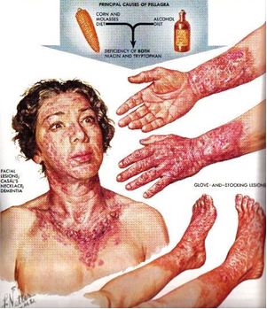

Slide 22
Pellagra
Pellagra is a vitamin deficiency disease most commonly caused by a chronic lack of niacin (vitamin B₃) in the diet. It can be caused by decreased intake of niacin or tryptophan, and possibly by excessive intake of leucine. It may also result from alterations in protein metabolism in disorders such as carcinoid syndrome. A deficiency of the amino acid lysine can lead to a deficiency of niacin, as well.
Alterations in protein metabolism may also produce pellagra-like symptoms. An example is carcinoid syndrome, a disease in which carcinoid tumors produce excessive serotonin. In normal patients, only one percent of dietary tryptophan is converted to serotonin; however, in patients with carcinoid syndrome, this value may increase to 70%. The diversion of tryptophan to making serotonin in patients with metastatic tumors can result in tryptophan deficiency.

Slide 23
Toxicity
Pharmacological doses of niacin (1.5 - 6 g per day) occasionally lead to side effects that can include dermatological conditions such as skin flushing and itching, dry skin, and skin rashes including eczema exacerbation. These symptoms are generally related to niacin's role as the rate limiting cofactor in the histidine decarboxylase enzyme which converts l-histidine into histamine.
Although high doses of niacin may elevate blood sugar, thereby worsening diabetes mellitus.

Slide 24
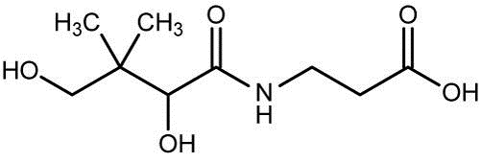
Vitamin B5
Vitamin B₅, or Pantothenic acid, also called pantothenate, is a water-soluble vitamin .It is the only linear vitamin in structure.
Pantothenic acid is the amide between pantoic acid and β-alanine.

Slide 25
However, freezing may lead to a loss of much of the pantothenic acid content. Whole grains are also a good source.
In commercial supplement products, vitamin B5 is available as D-pantothenic acid and as the synthetic products dexpanthenol (converted in the body to pantothenic acid) or calcium pantothenate. Pantothenic acid is frequently used in combination with other B vitamins in vitamin B complex formulations.
Only the dextrorotatory (D) isomer of pantothenic acid possesses biologic activity. The levorotatory (L) form may antagonize the effects of the dextrorotatory isomer.

Slide 26
Biological role
Only the dextrorotatory (D) isomer of pantothenic acid possesses biologic activity.
Pantothenic acid is used in the synthesis of coenzyme A (CoA). Coenzyme A may act as an acyl group carrier to form acetyl-CoA.
CoA is important in energy metabolism for pyruvate to enter the tricarboxylic acid cycle (TCA cycle) as acetyl-CoA.
For α-ketoglutarate to be transformed to succinyl-CoA in the cycle. CoA is also important in the biosynthesis of many important compounds such as fatty acids, cholesterol, and acetylcholine.
Approximately 85% of pantothenic acid (PA) is found in many foods as CoA, which is an essential constituent, or Acyl Carrier Protein (ACP), an important component in both fatty acid and polyketide biosynthesis.

Slide 28
Function
1-Coenzyme A
Pantothenic acid is a component of coenzyme A (CoA), an essential coenzyme in a variety of reactions that sustain life.
CoA is required for chemical reactions that generate energy from food (fat, carbohydrates, and proteins).
The synthesis of essential fats, cholesterol, and steroid hormones requires CoA, as does the synthesis of the neurotransmitter, acetylcholine.
Heme, a component of hemoglobin, requires a CoA-containing compound for its synthesis.
Coenzyme A was named for its role in acetylation reactions. Most acetylated proteins in the body have been modified by the addition of an acetate group that was donated by CoA. Protein acetylation affects the 3-dimensional structure of proteins, potentially altering their function.

Slide 29
2-Acyl-carrier protein
The acyl-carrier protein requires pantothenic acid in the form of 4'-phosphopantetheine for its activity as an enzyme.
Both CoA and the acyl-carrier protein are required for the synthesis of fatty acids. Fatty acids are a component of some lipids, which are fat molecules essential for normal physiological function.
Among these essential fats are sphingolipids, which are a component of the myelin sheath that enhances nerve transmission.

Slide 30
Absorption
When found in foods, most pantothenic acid is in the form of CoA or acyl carrier protein (ACP). For the intestinal cells to absorb this vitamin, it must be converted into free pantothenic acid. Within the lumen of the intestine, CoA and ACP are hydrolyzed into 4'-phosphopantetheine. The 4'-phosphopantetheine is then dephosphorylated into pantetheine.
Pantetheinase, an intestinal enzyme, then hydrolyzes pantetheine into free pantothenic acid.
Free pantothenic acid is absorbed into intestinal cells via a saturable, sodium-dependent active transport system. At high levels of intake, when this mechanism is saturated, some pantothenic acid may also be absorbed via passive diffusion.

Slide 31
What does Pantothenic acid do for us?
Coenzyme A is vital to synthesize or create:
1. Essential fats:
Essential fats are necessary to the proper functioning of skin, hair, brain cells, nerve protection and transmission
2. Cholesterol:
Cholesterol is imperative to the bodies survival.
3. Steroid hormones:
Steroid hormones are steroids that act as hormones but are fat soluble and can cross through the cell membrane to help create energy in the mitochondria (the inner cell).
4. The neurotransmitter acetylcholine:
When we move the neurotransmitter acetylcholine activates our muscles. When our hearts beat acetylcholine is involved
5. The hormone melatonin:
When we get sleepy and fall asleep at about the same time each night it is the chemical called melatonin that induces this sleep.
6. The part of hemoglobin called heme:
When we bleed we see the dark red colour of the iron rich part of our blood called heme.
7. It also helps the liver metabolize and deal with drugs and toxins.

Slide 33
Deficiency
Pantothenic acid deficiency is exceptionally rare and has not been thoroughly studied. In the few cases where deficiency has been seen (victims of starvation and limited volunteer trials), nearly all symptoms can be reversed with the return of pantothenic acid.
There is impaired energy production, due to low CoA levels, which could cause symptoms of irritability, fatigue, and apathy.
Acetylcholine synthesis is also impaired; therefore, neurological symptoms can also appear in deficiency; they include numbness,and muscle cramps.
Deficiency in pantothenic acid can also cause hypoglycemia, or an increased sensitivity to insulin. Insulin receptors are acylated with palmitic acid when they do not want to bind with insulin. Therefore, more insulin will bind to receptors when acylation decreases, causing hypoglycemia.

