Slide 1

The vitamin B-complex refers to all of the known essential water-soluble vitamins except for vitamin C.
Each member of the B-complex has a unique structure and performs unique functions in the human body, and often coexists in the same foods. Vitamins B1, B2, B3, and biotin participate in different aspects of energy production, vitamin B6 is essential for amino acid metabolism, and vitamin B12 and folic acid facilitate steps required for cell division.
However, contrary to popular belief, no functions require all B-complex vitamins simultaneously.

Slide 2
The Vitamins B-complex are family due to :
1-They are found together in the same food.
2-Do similar work in the body, maintain healthy skin and muscles tone enhance immune and nervous system functions and promote cell growth and divisions.
3-Symptoms of one vitamins deficiency may be undistinguishable from others.

Slide 3
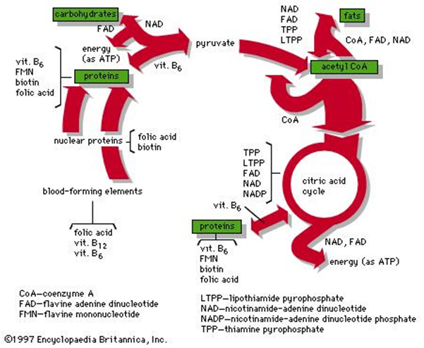

Slide 4
Thiamine (vitamin B₁)
Thiamine or vitamin B₁, named as the "thio-vitamine" ("sulfur-containing vitamin") is a water-soluble vitamin of the B complex.
We need vitamin B1 so that the body can use carbohydrates as energy - it is essential for glucose metabolism.
Vitamin B1 also plays a key role in nerve, muscle and heart function.
Mammals, including humans cannot synthesize thiamine so it has to be obtained from diet via intestinal absorption. Absorption of vitamin B1 involves a specialized pH-dependent, Na⁺- independent carrier mediated mechanism. In order to become a coenzyme thiamine has to acquire a pyrophosphate group.

Slide 6
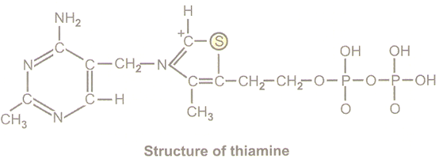
Thiamine is a colorless compound with a chemical formula C₁₂H₁₇N₄OS. Its structure contains an amino pyrimidine ring and a thiazole ring with methyl and hydroxyethyl side chains linked by methylene bridge.
.

Slide 7
*The primary function of B-1 is to help the body convert food to energy.
When we eat, the body breaks food down for fuel use. The body's primary fuel source is glucose, which we get from carbohydrate foods.
B-1 helps the body turn carbohydrates into glucose for fuel.
B-1, along with the other B vitamins, also helps the body metabolize fats and protein.
*Helps keep the liver, skin, hair and eyes healthy.

Slide 8
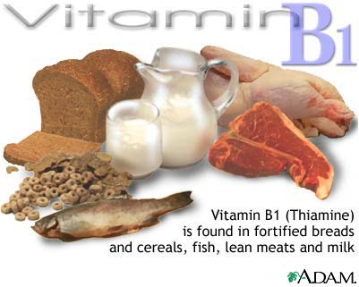

Slide 9
Absorption
Thiamine is released by the action of phosphatase and pyrophosphates in the upper small intestine.
At low concentrations, the process is carrier-mediated, and, at higher concentrations, absorption occurs via passive diffusion.
Active transport is greatest in the jejunum and ileum. The cells of the intestinal mucosa have thiamine pyrophosphokinase activity.
The majority of thiamine present in the intestine is in the pyrophosphorylated form .
The uptake of thiamine by the mucosal cell is likely coupled in some way to its phosphorylation/dephosphorylation.

Slide 10
Bound to serum proteins
The majority of thiamine in serum is bound to proteins, mainly albumin. Approximately 90% of total thiamine in blood is in erythrocytes.
A specific binding protein called thiamine-binding protein (TBP).
Cellular uptake
Uptake of thiamine by cells of the blood and other tissues occurs via active transport and passive diffusion.
The brain requires a much greater amount of thiamine than in other cells of the body.
About 80% of intracellular thiamine is phosphorylated and most is bound to proteins. In some tissues, thiamine uptake and secretion appears to be mediated by a soluble thiamine transporter that is dependent on Na⁺ and a transcellular proton gradient.

Slide 11
Tissue distribution
Human storage of thiamine is about 25 to 30 mg, with the greatest concentrations in skeletal muscle, heart, brain, liver, and kidneys.
ThMP and free (unphosphorylated) thiamine is present in plasma, milk, cerebrospinal fluid, and, it is presumed, all extracellular fluids.
Thiamine contents in human tissues are less than those of other species.
Excretion
Thiamine and its acid metabolites (2-methyl-4-amino-5-pyrimidine carboxylic acid, 4-methyl-thiazole-5-acetic acid, and thiamine acetic acid) are excreted principally in the urine.

Slide 12
Thiamine phosphate derivatives and function
Thiamine is mainly the transport form of the vitamin, while the active forms are phosphorylated thiamine derivatives. There are five known natural thiamine phosphate derivatives: thiamine monophosphate (ThMP),
thiamine diphosphate (ThDP), also sometimes called thiamine pyrophosphate (TPP),
thiamine triphosphate (ThTP), and the recently discovered adenosine thiamine triphosphate (AThTP), and adenosine thiamine diphosphate (AThDP).

Slide 13
Thiamine diphosphate
Thiamin pyrophosphate plays a key role in the production of energy from food by acting as a coenzyme for four important enzymes.
  The synthesis of thiamine diphosphate (ThDP), also known as thiamine pyrophosphate (TPP) or cocarboxylase, is catalyzed by an enzyme called thiamine diphosphokinase according to the reaction
  Thiamine + ATP → ThDP + AMP (EC 2.7.6.2).
  ThDP is a coenzyme for several enzymes that catalyze the transfer of two-carbon units and in particular the dehydrogenation(decarboxylation and subsequent conjugation with coenzyme A) of 2-oxoacids (alpha-keto acids).

Slide 14
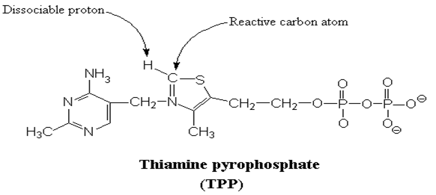

Slide 15
The enzymes transketolase, pyruvate dehydrogenase (PDH), and 2-oxoglutarate dehydrogenase (OGDH) are all important in carbohydrate metabolism.
The cytosolic enzyme transketolase is a key player in the pentose phosphate pathway, a major route for the biosynthesis of the pentose sugars deoxyribose and ribose.
PDH links glycolysis to the citric acid cycle, while the reaction catalyzed by OGDH is a rate-limiting step in the citric acid cycle. In the nervous system, PDH is also involved in the production of acetylcholine, a neurotransmitter, and for myelin synthesis.

Slide 16
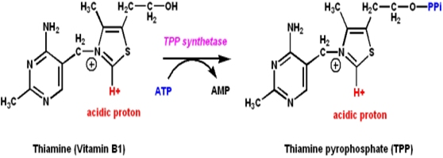
Thiamine is the precursor of thiamine pyrophosphate (TPP):

Slide 17
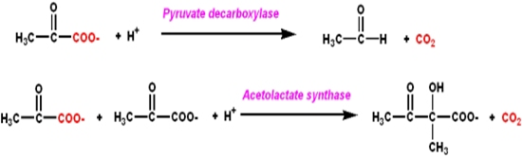
It catalyzes the synthesis or cleavage of bonds to carbonyl carbons

Slide 18
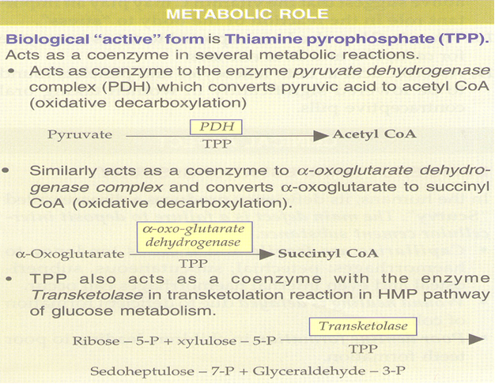

Slide 19
Deficiency
Thiamine derivatives and thiamine-dependent enzymes are present in all cells of the body, thus a thiamine deficiency would seem to adversely affect all of the organ systems. However, the nervous system is particularly sensitive to thiamine deficiency, because of its dependence on oxidative metabolism.
Thiamine deficiency commonly presents subacutely and can lead to metabolic coma and death. A lack of thiamine can be caused by malnutrition, a diet high in thiaminase-rich foods (raw freshwater fish, raw shellfish, ferns) and/or foods high in anti-thiamine factors (tea, coffee, betel nuts) and by grossly impaired nutritional status associated with chronic diseases, such as alcoholism, gastrointestinal diseases, HIV-AIDS, and persistent vomiting.
Well-known syndromes caused by thiamine deficiency include beriberi, Wernicke-Korsakoff syndrome, and optic neuropathy.

Slide 20
Beriberi
Beriberi is a disorder of nervous system which is actually cause by the deficiency of the thiamine in the diet of the individual, thiamine is basically found in the membranes of neurons and it is involved in the break down of the energy molecules such as glucose.
Beriberi may be found in people whose diet consists mainly of polished white rice, which is very low in thiamine
It can also be seen in chronic alcoholics, Arsenic poisoning causes alterations in cellular metabolism resulting in blockage of thiamine use which results in thiamine deficiency without any dietary shortfall.

Slide 21
Three major forms of the of beriberi
1-Dry beriberi :affecting distal more than proximal limb segments and causing calf muscle tenderness.
2-Wet beriberi :is associated with mental confusion, muscular atrophy, edema, tachycardia, cardiomegaly, and congestive heart failure in addition to peripheral neuropathy.
3-Infantile beriberi :occurs in infants breast-fed by thiamin-deficient mothers (who may show no sign of thiamine deficiency).

Slide 22
Assay for Thiamine Deficiency:
The measurement of erythrocyte (red blood cell) transketolase activity.
Red blood cells, which lack mitochondria, have no alternative means of generating NADPH save the pentose phosphate pathway. Also, NADPH is required to reduce glutathione in order to maintain the normal structure of red blood cell and maintain hemoglobin in the ferrous state. Therefore, the pentose phosphate pathway is essential in red blood cells. Transketolase is a thiamine pyrophosphate-requiring enzyme, which catalyzes reactions in the pentose phosphate pathway. So the level of transketolase activity in the red blood cell is a reliable diagnostic indicator of thiamine status.

