Slide 1
Immunology
Cancer and the Immune System
Refif S. Al-Shawk (PhD)
Lec. 7

Slide 2
Cancer is altered self cells that have escaped normal growth regulating mechanisms.
These cells give rise to clones of cells that can expand to a considerable size, producing a tumor, or neoplasm.
If it does not invade the healthy surrounding tissue it is called benign.
A tumor that continues to grow and becomes progressively invasive is malignant

Slide 3
Mutation of cells caused by various physical agents (UV light & ionizing irradiation). Chemical agents (alkylating agents) or other inducers
These chemical & physical agents that induce tu are called carcinogen, of which, if it induces 2 separate tu at different sites in the same patient → the tu Ag are distinct, so, the immune response to one tu does not protect against other tu. I.e. they were highly specific.
In contrast, in virally induced tu , the tu express tu Ag that, were shared by all tu induced by the same virus, even if in different site, i.e. there is cross-reaction, while, tu cell induced by different viruses do not cross-react.

Slide 4
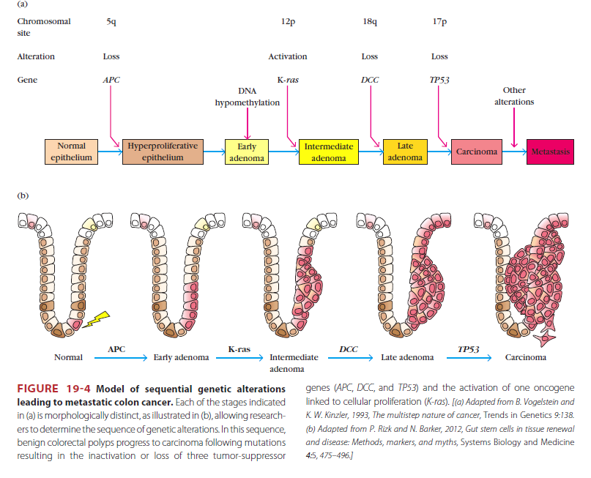

Slide 5
TUMOR ANTIGENS
The classification of tumor antigens was based on their patterns of expression:
Antigens that are expressed on tumor cells but not on normal cells are called tumor specific antigens; some of these antigens are unique to individual tumors, whereas others are shared among tumors of the same type.
Tumor antigens that are also expressed on normal cells are called tumor-associated antigens; in most cases, these antigens are normal cellular constituents whose expression is aberrant or dysregulated in tumors.

Slide 6
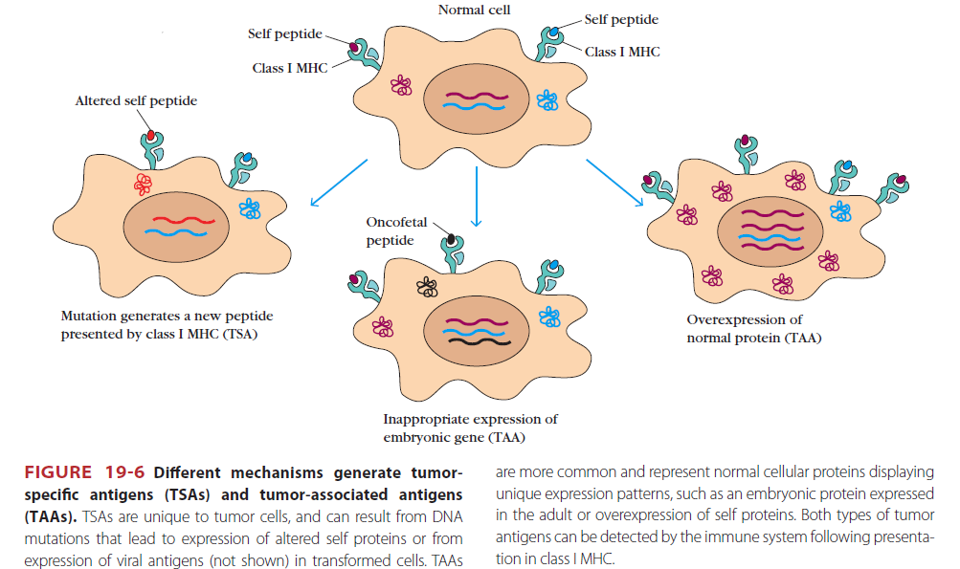

Slide 7
Tumor Ag:
Tu specific transformation Ag (TSTA), which, is unique to tu cell & not found in normal cell.
Tu associated transplantation Ag (TATA), which is not unique to tu but, may be protein that expressed on normal cell also, which are:
1. Oncofetal Ag as, * Alpha-fetoprotein (AFP), that is normally present only during fetal life so, if it ↑ in adult life, it indicate liver cancer.
* Carcinoembryonic Ag (CEA) which, if ↑ in adult so, indicate colorectal carcinoma.
2. Over expression of normal Ag, as growth factor & growth factor receptor.

Slide 8
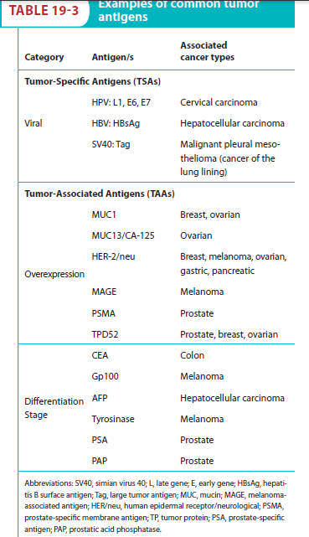

Slide 9
IMMUNE RESPONSES TO TUMORS
Adaptive immune responses, mainly mediated by T cells, have been shown to control the development and progression of malignant tumors.
HOW??

Slide 10
1- T Lymphocytes
The principal mechanism of adaptive immune protection against tumors is killing of tumor cells by CD8+ CTLs.
→CD8+ T cell responses specific for tumor antigens may require cross-presentation of the tumor antigens by dendritic cells.
→CD4+ cells may play a role in anti-tumor immune responses by providing cytokines for differentiation of naive CD8+ T cells into effector and memory CTLs.
→ helper T cells specific for tumor antigens secrete cytokines, such as TNF and IFN-γ, that can increase tumor cell class I MHC expression and sensitivity to lysis by CTLs. IFN-γ may also activate macrophages to kill tumor cells.

Slide 11
2- Antibodies
→Antibodies may kill tumor cells by activating complement or by antibody-dependent cell-mediated cytotoxicity, in which Fc receptor–bearing macrophages or NK cells mediate the killing.
→Others called blocking Ab, enhance tumor growth by blocking recognition of tumor Ag by the host.
→Antibodies specific for tumor cell antigens are used for diagnosis, and the antigens are potential targets for antibody therapy.

Slide 12
3- Natural Killer (NK) Cells
NK cells kill many types of tumor cells,
→especially cells that have reduced class I MHC expression giving NK cells stimulatory signals (some tumors lose expression of class I MHC molecules, makes the tumors good targets for NK cells.)
→express ligands for NK cell–activating receptors.
→NK cells can be targeted to IgG antibody–coated tumor cells by Fc receptors.
→The tumoricidal capacity of NK cells is increased by cytokines, including interferon-γ (IFN-γ), IL-15, and IL-12, and the anti-tumor effects of these cytokines are partly attributable to stimulation of NK cell activity.
→IL-2–activated NK cells, called lymphokine-activated killer (LAK) cells, are derived by culture of peripheral blood cells or tumor-infiltrating lymphocytes from tumor patients with high doses of IL-2.

Slide 13
4- Macrophages
Macrophages are capable of both inhibiting and promoting the growth and spread of cancers, depending on their activation state. possible mechanism for macrophages activation include recognition of damage-associated molecular patterns (DAMP) from dying tumor cells by macrophage TLRs and other innate immune receptors, and activation of macrophages by IFN-γ produced by tumor-specific T cells.

Slide 14
5- The Role of Cytokines
→IFN-γ. This cytokine can exert direct anti-tumor effects on transformed cells, including enhanced class I MHC expression, making neoplastic cells better targets for CD8+ T cell recognition and destruction.
→The cytokine IL-12 has ability to enhance anti-tumor immunity by driving the development to T-cell pathways: this cytokine encourages DCs to activate strong TH1 and CTL responses.
→The cytokine TNF-α was named for its anticancer activity. When it was injected into tumor-bearing animals, it induced hemorrhage and necrosis of the tumor.

Slide 15
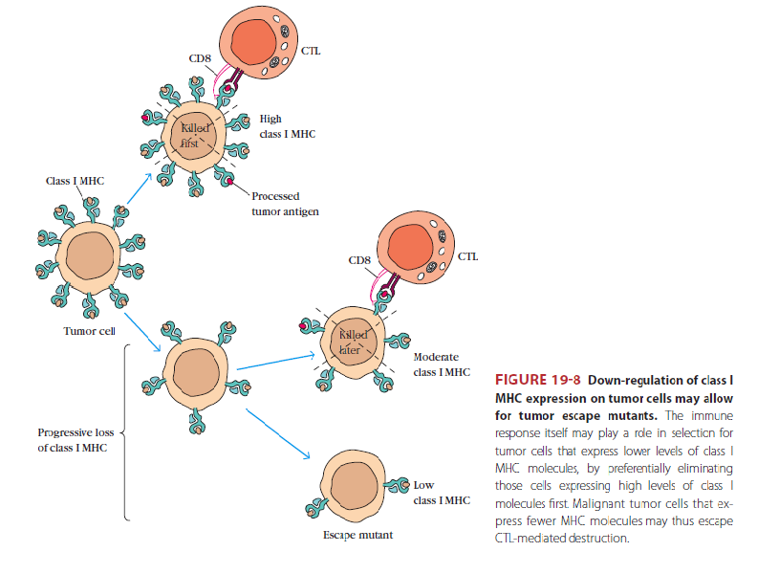
Tumor evasion of the immune system:
Escaping Immune Recognition by Loss of Antigen Expression:
Immune responses to tumor cells impart selective pressures that result in the survival and outgrowth of variant tumor cells with reduced immunogenicity, a process that has been called tumor immunoediting. -loss of tumor-specific antigens- class I MHC expression may be downregulated on tumor cells so that they cannot be recognized by CTLs.

Slide 16
Active Inhibition of Immune Responses:
a) Tumors may engage inhibitory mechanisms that suppress immune responses. T- cell responses to some tumors are inhibited by the involvement of CTLA-4 one of the inhibitory pathways in T cells . A possible reason for this role of CTLA-4 is that tumor antigens are presented by APCs in the absence of strong innate immunity and thus with low levels of B7 costimulators. These low levels may be enough to engage the high-affinity receptor CTLA-4.
b) Secreted products of tumor cells may suppress anti-tumor immune responses. An example of an immunosuppressive tumor product is TGF-β, which is secreted in large quantities by many tumors and inhibits the proliferation and effector functions of lymphocytes and macrophages

Slide 17
c) Regulatory T cells may suppress T cell responses to tumors. A numbers of regulatory T cells are increased in tumor-bearing individuals, and these cells can be found in the cellular infiltrates in certain tumors.
d) Tumor-associated macrophages may promote tumor growth and invasiveness by altering the tissue microenvironment and by suppressing T cell responses.*These macrophages have an phenotype secrete mediators, such as IL-10 and prostaglandin E2, that impair T cell activation and effector functions.
*Conversely, tumor-associated macrophages also secrete factors that promote angiogenesis, such as TGF-β, which may enhance tumor growth.

Slide 18
Ab can modulate tu Ag of which, certain tu specific Ag have been observed to disappear from the surface of tu cell in the presence of serum Ab & then re-appear after the Ab is no longer present. This is called Agic modulation.

Slide 19
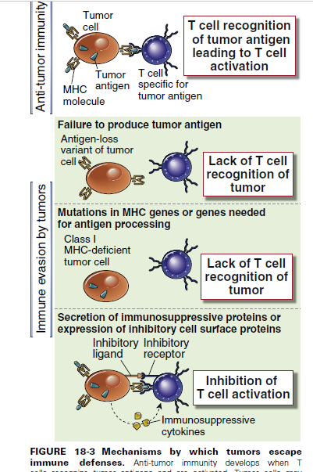

Slide 20
Cancer immunotherapy:
Approach of treatment is to augment natural defense mechanisms by:
Manipulation of co-stimulatory signal through providing signal necessary for activation of CTL precursor.
Enhancement of APC activity as for e.g. culture of dendritic cell (from peripheral blood ) in the presence of GM-CSF, TNF-α & IL-4. All these 3 cytokines induce the generation of large number of dendritic cell.

Slide 21
Cytokines therapy as,
A. IFN will ↑ class I MHC.
B. TNF- α & β which, have direct anti tu activity
C. IL-2: (in high concentration) will activate one type of NK cell called LAK cell( lymphocyte activated killer cell), which are activated NK cell with TCR that kill tu cell & not normal cell.
So, Lymphocyte + IL-2 → LAK → tu cell destruction.
Also the tu contain specific lymphocyte that have been infiltrated the tu & have antitu response. These are called TILs (tu-infiltrating lymphocyte).
As well, IL-1, 2, 4, 5, 12. GM-CSF. All augment immune response against tu. But the difficulty is that all have S.E

Slide 22
Monoclonal Ab as:
1. Anti growth factor receptor e.g, anti HER-2 for breast cancer.
2. Anti to tu specific Ag, that is coupled with radio-isotopes, which is called guided missile therapy.
3. Also the use of what is called immunotoxin (diphtheria toxin ).
4. BCG vaccine used to boost tu immunity by activating macrophage & ↑ the expression of various cytokine.

Slide 23
Tu vaccine:
aim is to focus the cellular arm of immune system against the tu – associated Ag that, exist in the body. So if immune system recognizes this Ag, it will act against it.
So tu Ag + cell contain MHC I (dendritic cell) → Hybrid → immunogen.
The advantage of this is that, the hybrid cell has the Ag presenting capability of a dendritic cell but, also contains the Ag from the patient’s tu cell, then dendritic cell process tu Ag & present it to immune system of the patient.

Slide 24
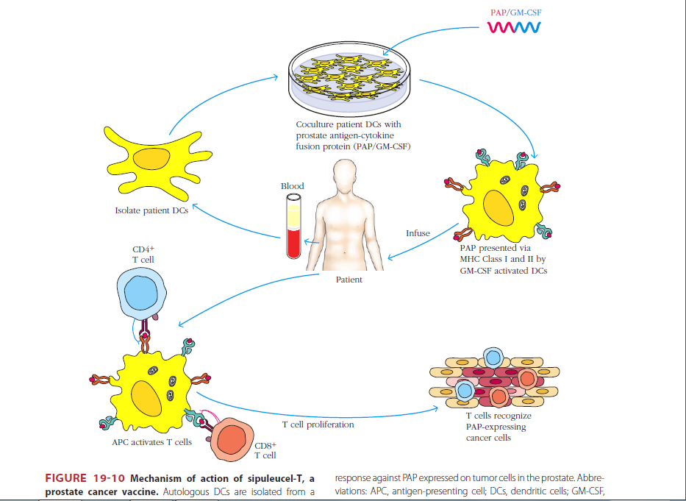

Slide 25
