Slide 1
Is a water soluble vitamin and easily destroyed by heat, alkali and storage .In the process of cooking,70% of vitamin C is lost.
The vitamin is easily oxidized to form dehydroascorbic acid (DHAA), and thus oxidation is readily reversible. Vitamin C is a generic name for all compounds that exhibit the same biologic activity as AA. Consequently, the term includes both AA and DHAA. The structure formula of vitamin C(Ascorbic acid) closely resembles that of carbohydrates.

Slide 2
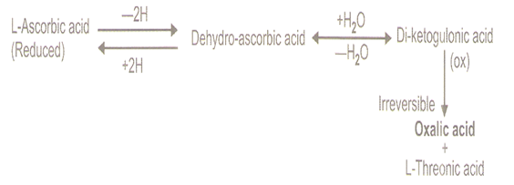

Slide 4
The name vitamin C always refers to the L-enantiomer of ascorbic acid and its oxidized forms.
The opposite D-enantiomer called D-ascorbate has equal antioxidant power, but is not found in nature, and has no physiological significance.
Ascorbic acid is a weak sugar acid structurally related to glucose.
In biological systems, ascorbic acid can be found only at low pH, but in neutral solutions above pH 5 is predominantly found in the ionized form, ascorbate.

Slide 6
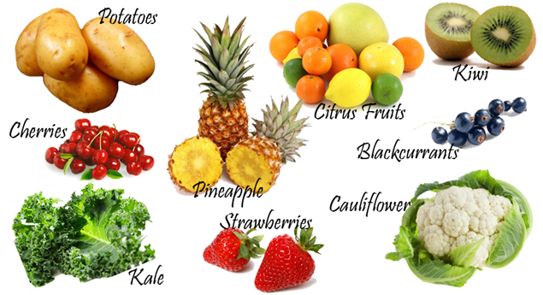
Sources

Slide 7
Biological significance
The biological role of ascorbate is to act as a reducing agent, donating electrons to various enzymatic and a few non-enzymatic reactions. The one- and two-electron oxidized forms of vitamin C, semidehydroascorbic acid and dehydroascorbic acid, respectively, can be reduced in the body by glutathione and NADPH dependent enzymatic mechanisms.
The presence of glutathione in cells and extracellular fluids helps maintain ascorbate in a reduced state.

Slide 8
Absorption, transport, and excretion
Ascorbic acid is absorbed in the body by both active transport and simple diffusion.
Sodium-Dependent Active Transport—Sodium-Ascorbate Co-Transporters (SVCTs) and Hexose transporters (GLUTs)—are the two transporters required for absorption.
SVCT1 andSVCT2 import the reduced form of ascorbate across plasma membrane.
GLUT1 and GLUT3 are the two glucose transporters, and transfer only the dehydroascorbic acid form of Vitamin C. Although dehydroascorbic acid is absorbed in higher rate than ascorbate, the amount of dehydroascorbic acid found in plasma and tissues under normal conditions is low, as cells rapidly reduce dehydroascorbic acid to ascorbate. Thus, SVCTs appear to be the predominant system for vitamin C transport in the body.

Slide 10
Function of vitamin C
1-Reverible oxidation –reduction.
It can change between ascorbic acid and dehydroascorbic acid.
2-Hydroxylation of prolin and lysine.
Ascorbic acid is necessary for the post-translation hydroxylation of prolin and lysine residues,hydroxyprolin and hydroxylysin are essential for the formation of cross links in the collagen.

Slide 12
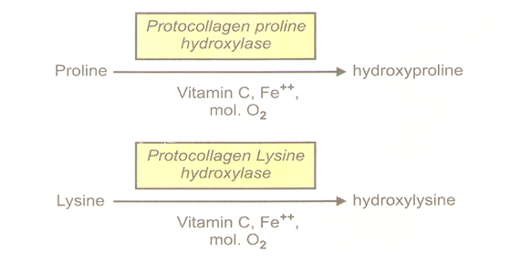
The role of Vitamin C in Collagen synthesis

Slide 14
Function of vitamin C
1-Reverible oxidation –reduction.
2-Hydroxylation of prolin and lysine.
3-Tryptophan metabolism.
4-Tyrosine metabolism.
5-Iron metabolism..
6-Hemoglobin metabolism.
7-Folic acid metabolism.
8-Steroid synthesis.
9-Phagocytosis.
11-Cataract:

Slide 15
Role of vitamin C in cold
Taking good amounts of vitamin C could reduce the duration and severity of the common cold.
It helps the body maintain healthy tissue, a strong immune system and protects against infection.
Vitamin C reduces the incidence and severity of the common cold. Very large doses kill viruses.

Slide 16
Deficiency
Scurvy is a resulting from lack of vitamin C, since without this vitamin, the synthesized collagen is too unstable to perform its function. Scurvy leads to the formation of brown spots on the skin, spongy gums, and bleeding from all mucous membranes. The spots are most abundant on the thighs and legs, and a person with the ailment looks pale, feels depressed, and is partially immobilized. In advanced scurvy there are open, suppurating wounds and loss of teeth and, eventually, death.
The human body can store only a certain amount of vitamin C, and so the body stores are depleted if fresh supplies are not consumed. The time frame for onset of symptoms of scurvy in unstressed adults switched to a completely vitamin C free diet, however, may range from one month to more than six months, depending on previous loading of vitamin C .

Slide 17
Symptoms of Scurvy are related to deficient collagen formation;
Fragility of vascular walls leads to bleeding tendency.
Poor wound healing.
Deficiency of bone matrix causing osteoporosis.
Poor healing of fractures.
Anemia due to impaired erythropoiesis.

