Slide 1

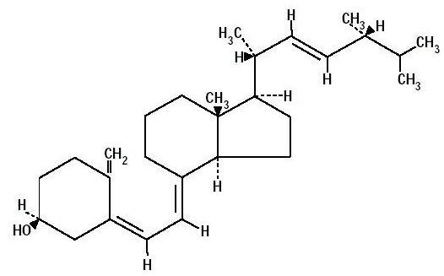

Slide 2
Vitamin D is a group of fat-soluble secosteroids responsible for intestinal absorption of calcium and phosphate.
It is not actually an essential dietary vitamin , as it can be synthesized in adequate amounts by most mammals exposed to sunlight.
So, vitamin D is called the sun-shine A substance is only classified as an essential vitamin when it cannot be synthesized in sufficient quantities by an organism, and must be obtained from its diet.

Slide 3
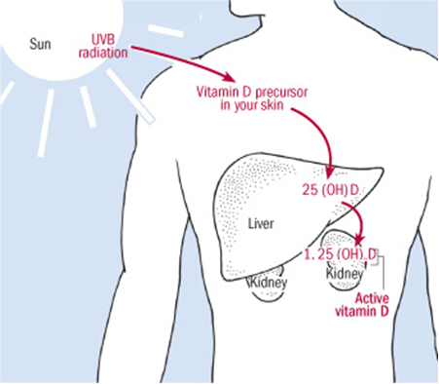

Slide 4
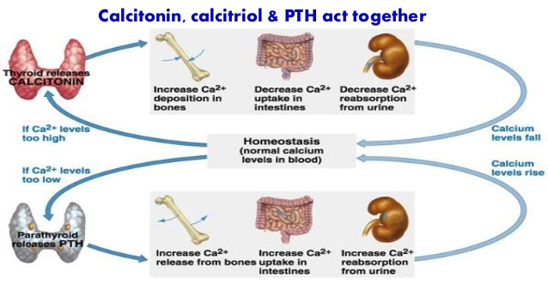
Calcitriol: is the physiological active form of vitamin D, it increases the blood calcium level.
Calcitonin: is the peptide hormone released from thyroid gland, it decreases the blood calcium.

Slide 5
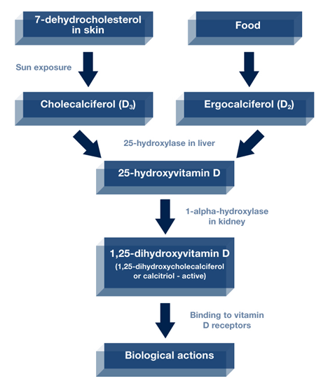

Slide 6
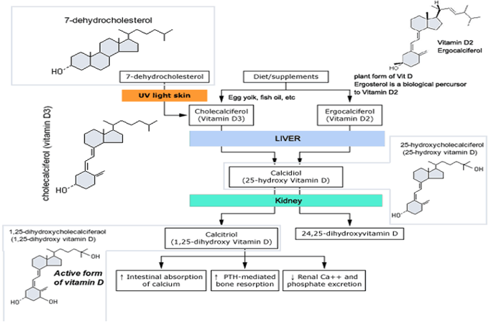
Which is more important for humans, vitamins D₂ or D₃?

Slide 7
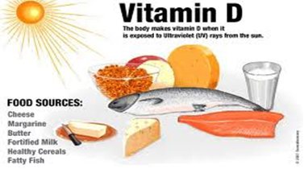
Sources of Vitamin D
Food
Sun exposure
Dietary supplements

Slide 8
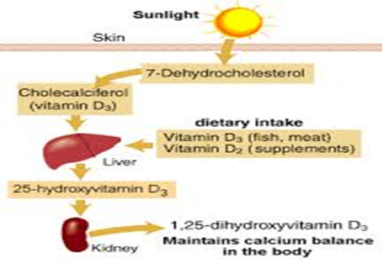

Slide 9
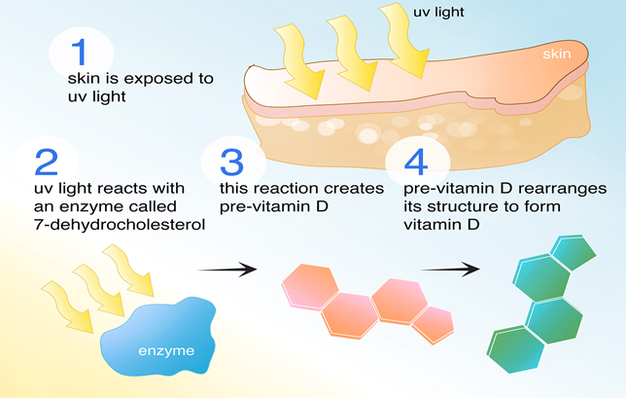

Slide 10
METABOLISM
Vitamin D3 produced in the epidermis must be further metabolized to be active.
The first step, 25-hydroxylation, takes place primarily in the liver, although other tissues have this enzymatic activity as well. There are several 25-hydroxylases.
25OHD is the major circulating form of vitamin D. However, in order for vitamin D metabolites to achieve maximum biologic activity they must be further hydroxylated in the 1α position by the enzyme CYP27B1;
1,25(OH)2D is the most potent metabolite of vitamin D and accounts for most of its biologic actions.

Slide 11
The activity of the 1, α- hydroxylase depends on:
a-Parathyroid hormone and plasma calcium: a low level of plasma calcium stimulates 1,α- hydroxylase through the secretion of parathyroid hormone.
b-Plasma Phosphate: reduced plasma phosphate activates the 1,α- hydroxylase but independent of parathyroid hormone.
c-Insulin,growth hormone prolactin and estrogen are affect (increase) the production of active form of vitamin D.
The most potent inhibitor of the 1,α- hydroxylase is the product of the reaction 1:25 dihydroxycholecalciferol.

Slide 12
Hepatic production of 25OHD.
The next step in the bioactivation of D2 and D3,is the hydroxylation to 25OHD. 25OHD is the major circulating form of vitamin D and provides a clinically useful marker for vitamin D status.
Renal production of 1, 25(OH) 2D.
1,25(OH)2D is the most potent metabolite of vitamin D, and mediates most of its hormonal actions especially those involving the vitamin D receptor (VDR), 1,25(OH)2D is produced from 25OHD by the enzyme 25OHD-1αhydroxylase (CYP27B1).
Renal production of 24, 25(OH) 2D. The kidney is also the major producer of a second important metabolite of 25OHD, namely 24, 25(OH) 2D, and the enzyme responsible is 25OHD-24 hydroxylase.

Slide 13
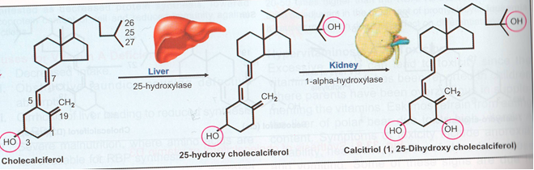

Slide 14
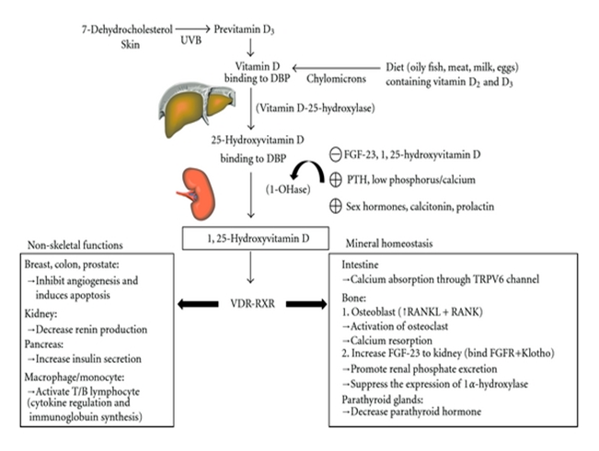

Slide 15
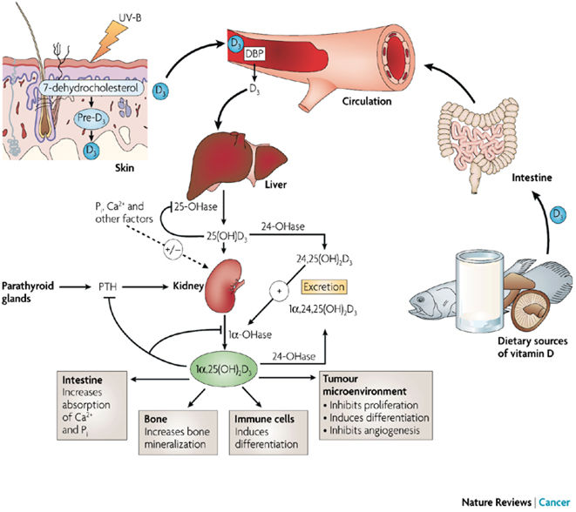

Slide 16
One of the most important roles of vitamin D is to maintain skeletal calcium balance by promoting:
1-Calcium absorption in the intestines.
2- Promoting bone resorption by increasing osteoclasts number.
3- Maintaining calcium and phosphate levels for bone formation.
4-Allowing proper functioning of parathyroid hormone to maintain serum calcium levels.

Slide 17
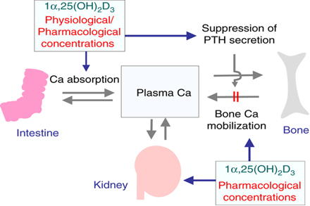

Slide 18
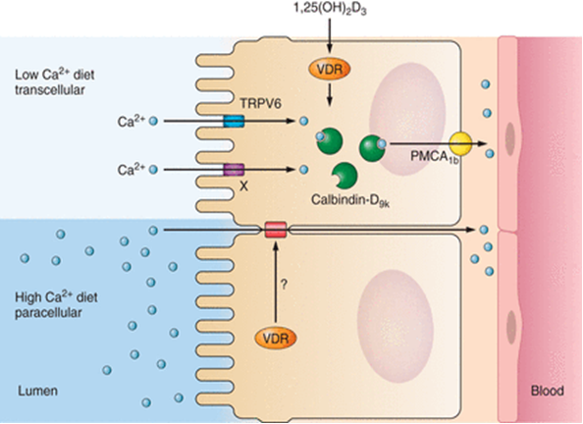

Slide 19
Vitamin D Deficiency
Vitamin D deficiency is known to cause several bone diseases including:
1-Rickets, a childhood disease characterized by impeded growth, and deformity, of the long bones.
2-Osteomalacia, a bone-thinning disorder that occurs exclusively in adults and is characterized by proximal muscle weakness and bone fragility.
3-Osteoporosis, a condition characterized by reduced bone mineral density and increased bone fragility.
4-Muscle aches and weakness. 5-Muscle twitching .

Slide 20
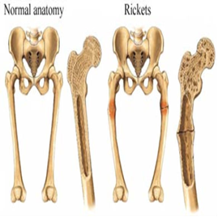
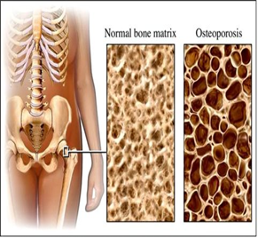

Slide 21
Vitamin D deficiency can occur for a number of reasons:
1-Don't consume the recommended levels of the vitamin over time.
2-Breastfed infants
3-Older adults
4-Exposure to sunlight is limited.
5-Have dark skin.
6- People with fat malabsorption (Digestive tract cannot adequately absorb vitamin D).
7-Kidneys cannot convert vitamin D to its active form.

