Slide 1
Hypersensitivity Reactions, Allergies
Refif alshawk (PhD)
Lec 2&3

Slide 2
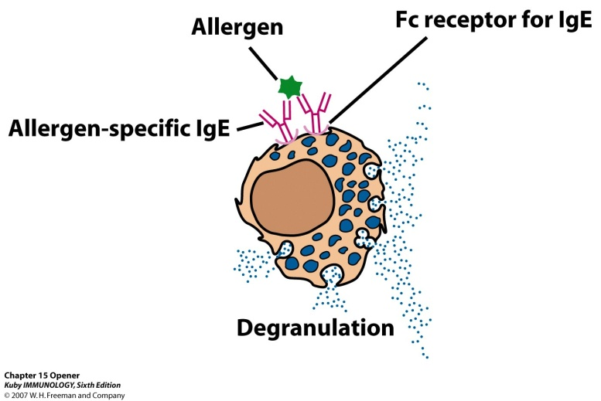
Hypersensitivity – responding inappropriately to an antigen
Inflammatory response can have deleterious effects
    Tissue injury
    Disease
    death

Slide 3
May develop in course of humoral OR cell-mediated response
    Immediate hypersensitivity
      Anaphylactic
      Antibody-antigen complexes
      Manifests in minutes
    Delayed-type hypersensitivity
      May occur in days

Slide 4
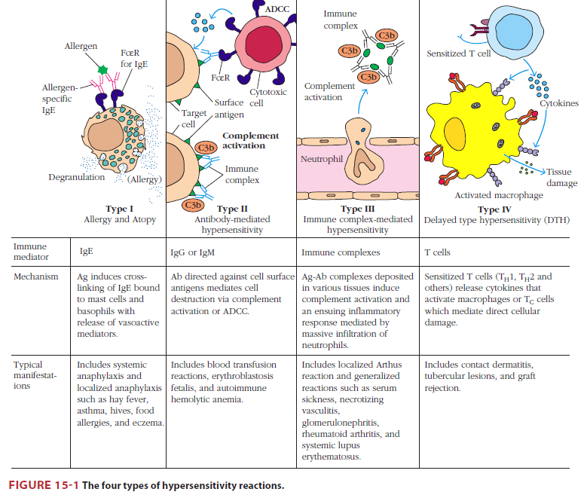

Slide 5
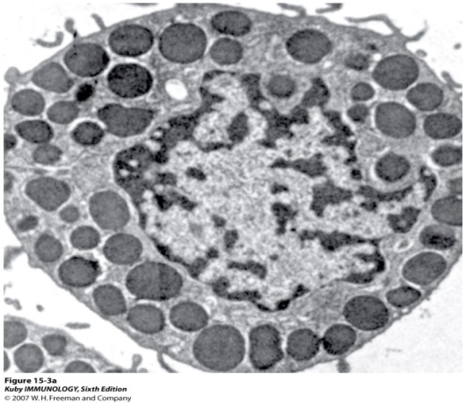
Types I : OVERVIEW OF IgE-DEPENDENT ALLERGIC REACTIONS
All allergic reactions share common feature:
the production of IgE antibody, which is dependent on the activation of IL-4–producing helper T cells.
allergic reactions differ greatly in the types of antigens that elicit these reactions and their clinical and pathologic manifestations.
Antigens that elicit immediate hypersensitivity reactions called allergens.

Slide 6
The typical sequence of events in immediate hypersensitivity consists
exposure to an antigen→
activation of lymphocytes (TH2 cells, and B cells) specific for the antigen→
production of IgE antibody→
binding of the antibody to Fc receptors of mast cells→
and triggering of the mast cells by re-exposure to the antigen→
resulting in the release of mediators from the mast cells →
and the subsequent pathologic reaction.

Slide 7
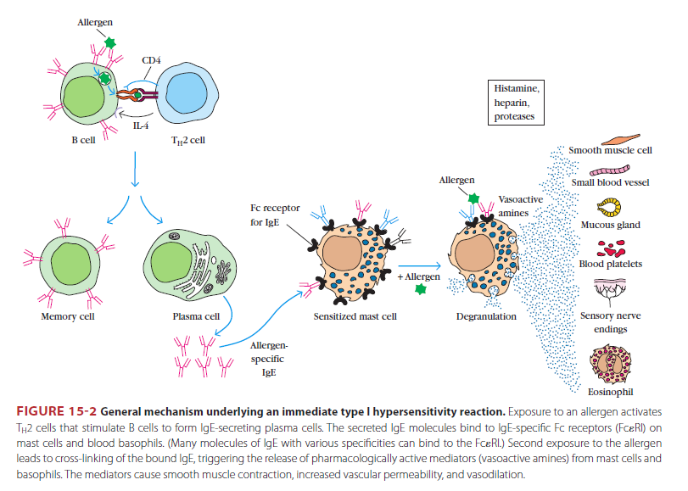

Slide 8
There is a genetic predisposition for the development of allergies.
Atopic individuals produce high levels of IgE in response to environmental allergens, whereas normal individuals generally produce other Ig isotypes, such as IgM and IgG, and only small amounts of IgE.

Slide 9
Antigens that elicit immediate hypersensitivity reactions (allergens) are proteins or chemicals bound to proteins.
The important characteristics of allergens that, unlike microbes, they do not generally stimulate the innate immune responses that are associated with macrophage and dendritic cell secretion of TH1- and TH17-inducing cytokines. WHY???
Chronic or repeated cell activation in the absence of strong innate immunity may drive CD4+ T cells preferentially toward the TH2 pathway.
The chemical nature. include low to medium molecular weight, stability, glycosylation, and high solubility in body fluids.These structural features probably protect the antigens from denaturation and degradation in the gastrointestinal tract and allow them to be absorbed intact.
Some nonprotein substances, such as penicillin, can elicit strong IgE responses, when react chemically with amino acid residues in self proteins to form hapten carrier conjugates, which induce IL-4–producing helper T cell responses and IgE production.

Slide 10
1- Activation of IL-4–Producing Helper T Cells
In allergic diseases, TH 2cells are required for differentiation of IgE-producing B cells, and play a central role in the inflammatory reaction in tissues.
2- Activation of B Cells and Switching to IgE
B cells specific for allergens are activated by TH 2 cells in lymphoid organs, as in other T cell–dependent B cell responses. In response to cytokines, mainly IL-4, the B cells undergo heavy chain isotype switching and produce IgE.

Slide 11
3- ROLE OF TH2 CELLS, MAST CELLS, BASOPHILS, AND EOSINOPHILS IN ALLERGIC REACTIONS
TH2 cells, mast cells, basophils, and eosinophils are the major effector cells of immediate hypersensitivity reactions and allergic disease.
+ Mast cells, basophils, and eosinophils, in distinction from TH2 cells, have cytoplasmic granules that contain preformed amines and enzymes, and all three cell types produce lipid mediators and cytokines that induce inflammation.
+ TH2 cells contribute to inflammation by secreting cytokines.

Slide 12
4- Role of TH2 Cells and Innate Lymphoid Cells in Allergic Disease
TH2 cells secrete cytokines, including IL-4, IL-5 IL-13 that work in combination with mast cells and eosinophils to promote inflammatory responses to allergens within tissues.
IL-4 secreted by TH2 cells induces expression of endothelial adhesion molecules VCAM-1→
that promotes the recruitment of eosinophils and additional TH2 cells into tissues→
IL-5 secreted by TH2 cells activates eosinophils→
IL-13 stimulates epithelial cells (e.g., in the airways) to secrete increased amounts of mucus, and excessive mucus production is also a common feature of these reactions→
TH2 cells also contribute to the inflammation of the late-phase reaction.

Slide 13
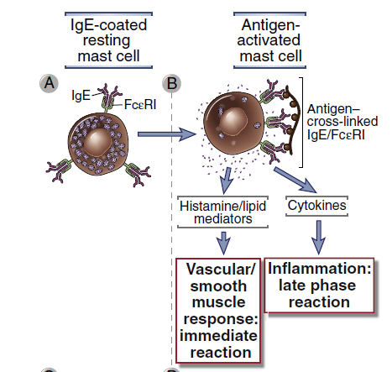
5- Binding of IgE to Mast Cells and Basophils: The Fcε Receptor
Mast cells and basophils express a high-affinity Fc receptor specific for ε heavy chains, called FcεRI, which binds IgE.
6- Activation of Mast Cells
In an individual allergic to a particular antigen, a large proportion of the IgE bound to FcεRI on the surface of mast cells is specific for that antigen→
Exposure to the antigen will cross-link sufficient IgE molecules to trigger mast cell activation→
Activation of mast cells results in three types of biologic response: degranulation→synthesis and secretion of lipid mediators→and synthesis and secretion of cytokines.

Slide 14
7- Mediators Derived from Mast Cells:
1) Biogenic Amines and proteolytic enzymes
Histamine
→Histamine acts by binding to target cell receptors (e.g., H1, H2, H3)
→The actions of histamine are contraction of the endothelial cells, leading to increased inter endothelial spaces, increased vascular permeability, and leakage of plasma into the tissues and other effect cause vasodilation also causes contraction of intestinal and bronchial smooth muscle.

Slide 15
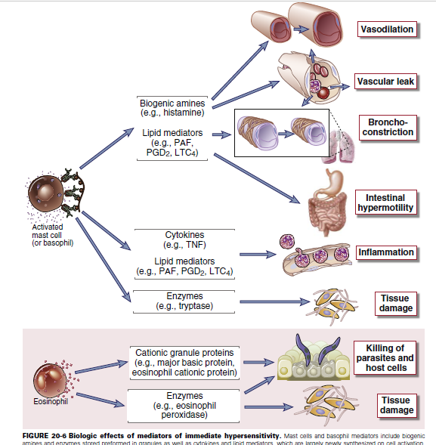

Slide 16
2) Lipid Mediators
→prostaglandin D2 (PGD2). Acts as a vasodilator and a bronchoconstrictor. PGD2 also promotes neutrophil chemotaxis and accumulation at inflammatory sites.
→leukotrienes its degradation products LTD4 and LTE4 which cause prolonged bronchoconstriction. (slow-reacting substance of anaphylaxis and are thought to be important mediators of asthmatic bronchoconstriction.
→platelet-activating factor (PAF) has direct bronchoconstricting actions.

Slide 17
3) Cytokines
Mast cells produce many different cytokines that contribute to allergic inflammation (the late-phase reaction).
These cytokines like TNF, IL-1, IL-4, IL-6, CCL3…... and granulocyte-monocyte colony-stimulating factor (GM-CSF). The cytokines that are released from activated mast cells and TH2 cells are mainly responsible for the inflammation associated with the late-phase reaction.
TNF activates endothelial expression of adhesion molecules and together with chemokines accounts for neutrophil and monocyte infiltrates.

Slide 18
8- Properties of Eosinophils
Cytokines produced by TH2 cells promote the activation of eosinophils and their recruitment to late-phase reaction inflammatory sites. Eosinophils release granule proteins that are toxic to helminthic parasites and may injure normal tissue

Slide 19
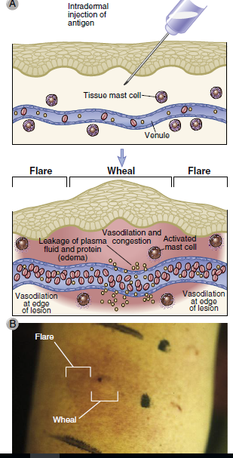
IgE- AND MAST CELL–DEPENDENT REACTIONS
1)The Immediate Reaction
The early vascular changes that occur during immediate hypersensitivity reactions are demonstrated by the wheal-and-flare reaction).
2) The Late-Phase Reaction
The immediate wheal-and-flare reaction is followed 2 to 4 hours later by a late-phase reaction consisting of the accumulation of inflammatory leukocytes, including neutrophils, eosinophils, basophils, and helper T cells.

Slide 20
ALLERGIC DISEASES IN HUMANS
The clinical and pathologic manifestations of the diseases depend on the:
tissues in which the mast cell mediators have effects
as well as the chronicity of the resulting inflammatory process.
The most common forms of these diseases are allergic rhinitis (hay fever), bronchial asthma, atopic dermatitis (eczema), and food allergies.

Slide 21
1) Systemic Anaphylaxis
Anaphylaxis is a systemic immediate hypersensitivity reaction characterized by edema in many tissues and a decrease in blood pressure, secondary to vasodilation.
These effects usually result from the systemic presence of antigen introduced by injection, an insect sting, or absorption across an epithelial surface such as gut mucosa.
The allergen activates mast cells in many tissues, resulting in the release of mediators that gain access to vascular beds throughout the body.
The decrease in vascular tone and leakage of plasma caused by mast cell mediators can lead to a significant decrease in blood pressure or shock, called anaphylactic shock, which is often fatal.
The cardiovascular effects are accompanied by constriction of the upper and lower airways, laryngeal edema
treatment is systemic epinephrine, which can be lifesaving by reversing the bronchoconstrictive and vasodilatory effects of mast cell mediators.

Slide 22
Bronchial Asthma
Asthma is an inflammatory disease caused by repeated immediate-type hypersensitivity and late-phase allergic reactions in the lung leading to the clinic-pathologic triad of intermittent and reversible airway obstruction, chronic bronchial inflammation with eosinophils, and bronchial smooth muscle cell hypertrophy and hyperreactivity to bronchoconstrictors
(Fig. 20-9

Slide 23
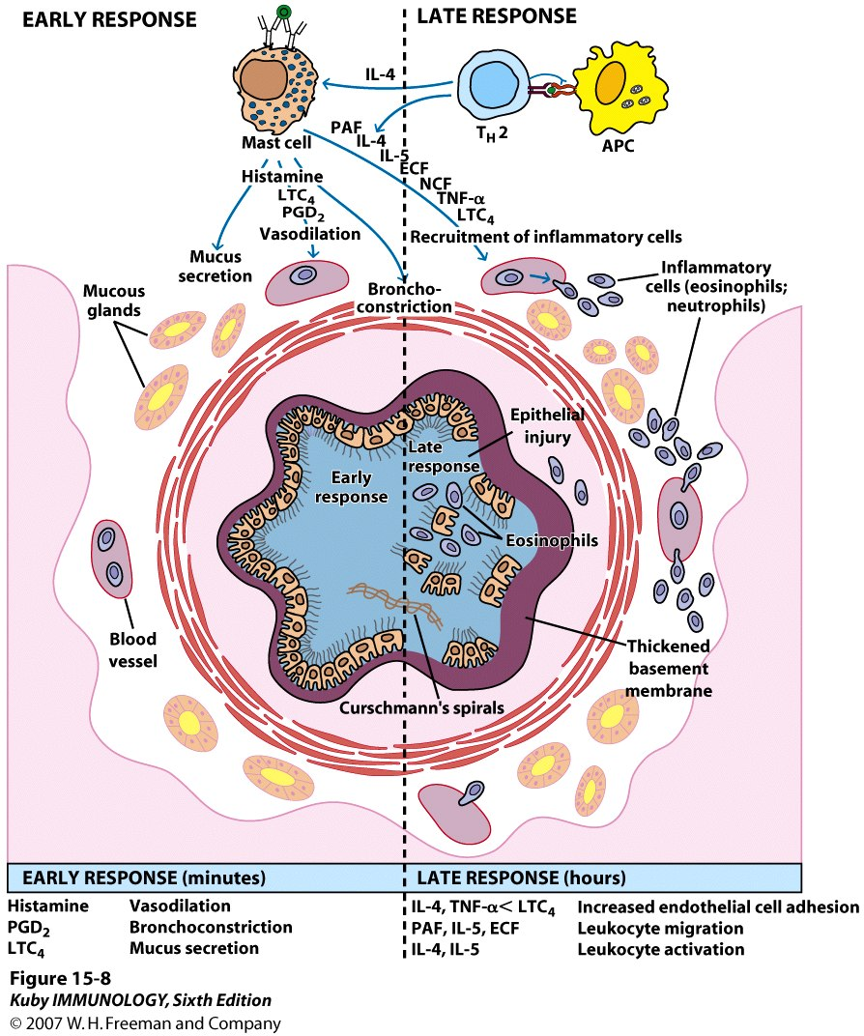
Asthma
Inflammatory disease
Induce expression of adhesion molecules on endothelial cells for eosinophils and neutrophils
    Cause significant injury because of toxic enzymes, cytokines
    Notice sloughing of the pseudostratified ciliated columnar epithelial cells lining the bronchiole

Slide 24
The pathophysiologic sequence in atopic asthma is probably initiated by mast cell activation in response to allergen binding to IgE as well as by TH2 cells reacting to allergens.
The lipid mediators and cytokines produced by the mast cells and T cells lead to the recruitment of eosinophils, basophils, and more TH2 cells.
The chronic inflammation in this disease may continue without mast cell activation.
Smooth muscle cell hypertrophy and hyperreactivity are thought to result from leukocyte-derived mediators and cytokines.
Mast cells, basophils, and eosinophils all produce mediators that constrict airway smooth muscle. The most important of the bronchoconstricting mediators are LTC4, LTD4, and LTE4.
Increased mucus secretion results from the action of cytokines, on bronchial epithelial cells.
Corticosteroids may also be given systemically, especially once an attack is under way, to reduce inflammation and bronchial smooth muscle cell relaxants

Slide 25
Allergic rhinitis, (hay fever) is a consequence of immediate hypersensitivity reactions to common allergens such as plant pollen or house dust mites localized to the upper respiratory tract by inhalation. → mucosal edema, leukocyte infiltration with abundant eosinophils, mucus secretion, coughing, sneezing, and difficulty in breathing.
Food allergies are immediate hypersensitivity reactions to ingested foods that lead to the release of mediators from intestinal mucosal and submucosal mast cells of the GI tract, including the oropharynx. →pruritis, tissue edema, enhanced peristalsis, increased epithelial fluid secretion, and associated symptoms of oropharyngeal swelling, vomiting and diarrhea. Allergic reactions to many different types of food most common are peanuts and shellfish.
Common allergic reactions in the skin include urticaria and atopic dermatitis. Urticaria, or hives, is an acute wheal-and-flare reaction induced by mast cell mediators and occurs in response to direct local contact with an allergen or after an allergen enters the circulation.
eczema . It is a common skin disorder that may be caused by a late-phase reaction to an allergen in the skin. In the cutaneous late-phase reaction, TNF, IL-4, and other cytokines, probably derived from TH2 cells and mast cells, act on endothelial cells to promote inflammation.

Slide 26
Type II – Antibody-Mediated Cytotoxic Hypersensitivity
involves the binding of IgG antibodies to:[cell surface antigens or extracellular matrix molecules]. Antibody bound to a cell-surface antigen can induce death of the antibody-bound cell by three distinct mechanisms.

Slide 27
Type II – Antibody-Mediated Cytotoxic Hypersensitivity
First, certain immunoglobulin subclasses can activate the complement system, creating pores in the membrane of a foreign cell.
Secondly, antibodies can mediate cell destruction by antibody dependent cell-mediated cytotoxicity (ADCC), in which cytotoxic cells bearing Fc receptors bind to the Fc region of antibodies on target cells and promote killing of the cells.
Finally, antibody bound to a foreign cell also can serve as an opsonin, enabling phagocytic cells with Fc or C3b receptors to bind and phagocytose the antibody-coated cell

Slide 28
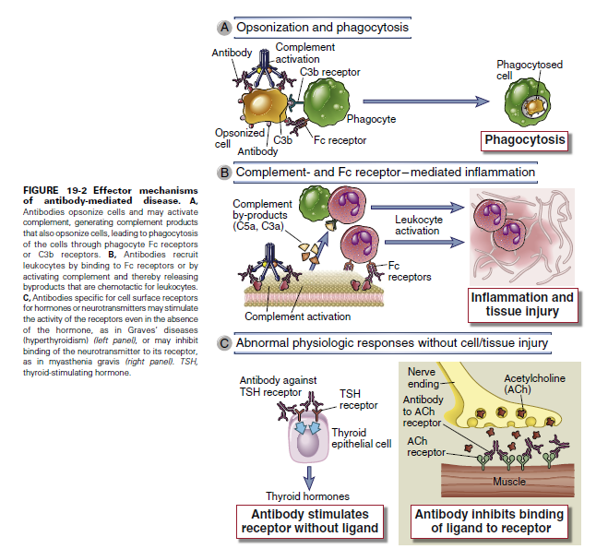

Slide 29
Type II – Antibody-Mediated Cytotoxic Hypersensitivity
Transfusion Reactions
  antigens that are associated with the blood types are identified as A, B, and H,
  Individuals have antibodies to blood types not their own and adults possess IgM antibodies to those Ag.
  Antibodies directed toward ABH antigens are termed isohemagglutinins
  Antibody attaches to RBC and initiates complement system to lyse RBC
  After lysis:
    Hemoglobin detected in plasma, starts to filter through kidneys and found in urine (hemoglobinuria)
    Hemoglobin converted to bilirubin – toxic at high levels
    Fever, chills, blood clotting

Slide 30
Type II – Antibody-Mediated Cytotoxic Hypersensitivity
Hemolytic disease of newborn
  Rh⁺ fetus, Rh⁻ mother
  IgG antibodies cross placenta(memory)
      Some of these antibodies may be anti-Rh antibodies
        Can have severe consequences
      Antibodies against ABO blood groups produce less consequences, can be easily treated
  Rhogam shot
    Given to mother
    Anti-Rh antibodies bind to fetal cells that might have entered mother’s system during birthing process, facilitates clearing before there is a B cell response

Slide 31
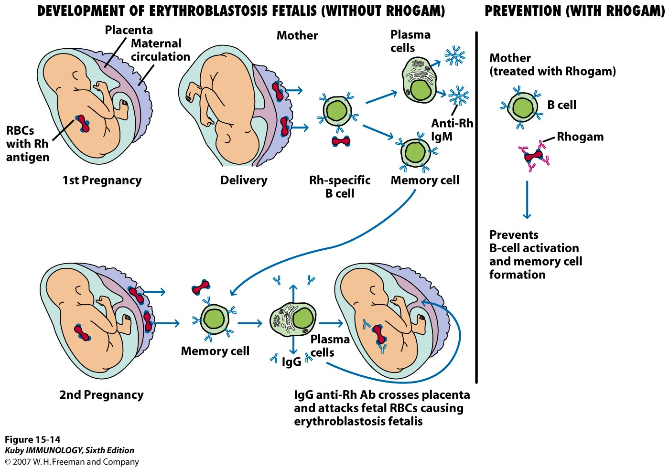

Slide 32
Type II – Antibody-Mediated Cytotoxic Hypersensitivity
Hemolytic Anemia Can Be Drug Induced
Certain antibiotics (e.g., penicillin, cephalosporins, and streptomycin), as well as other well-known drugs
adsorb nonspecifically to proteins on red blood cell membranes, forming a drug protein complex
induce formation of antibodies
inducing complement-mediated lysis
progressive anemia

Slide 33
Type III – Immune complex-mediated hypersensitivity
Complexing of antigen plus antibody facilitates phagocytosis and clearing of antigen
Large amounts of these complexes can lead to tissue damage & Type III hypersensitivity

Slide 34
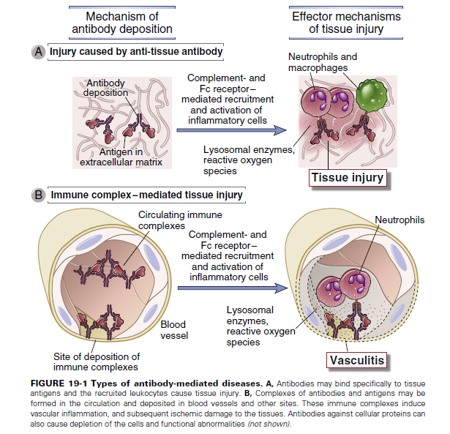

Slide 35
Conditions associated with the initiation of a type III response include :
the presence of antigens capable of generating particularly extensive antigen-antibody lattices,
a high intrinsic affinity of antigens for particular tissues
the presence of highly charged antigens (which can affect immune complex engulfment) and
a compromised phagocytic system.

Slide 36
Symptoms induced such as
fever, urticaria (rashes), joint pain, lymph node enlargement, and protein in the urine.
The resulting inflammatory lesion is referred to as vasculitis if it occurs in a blood vessel, glomerulonephritis if it occurs in the kidney, or arthritis if it occurs in the joints.

Slide 37
Type III can be localized
Injection of antigen intradermally or subcu into animal that has high level of antibody for that antigen
    Arthus reaction
    Bug bites

Slide 38
Local (Arthus reaction) and typically elicited in the skin when a low dose of antigen is injected and immune complexes form locally. IgG antibodies are involved, and the resulting activation of complement leads to activation of mast cells and neutrophils, mediator release, and enhanced vascular permeability. This typically occurs in about 12 hours.

Slide 39
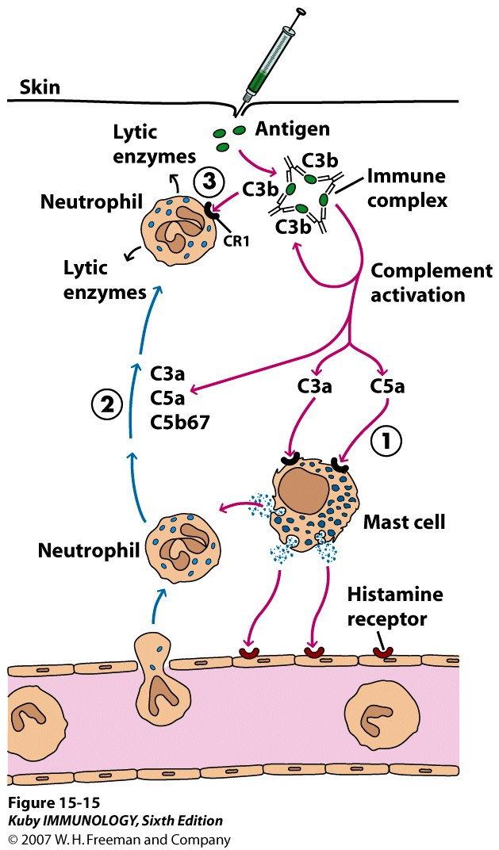

Slide 40
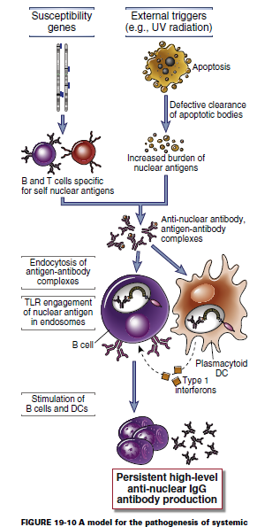
Type III can be generalized
Serum sickness
    After receiving antiserum (serum from another animal that may contain antitoxins for treatment)
Use of monoclonal antibodies for use of cancer treatment
    Patient developed antibody against mouse monoclonal antibody
Autoimmune diseases
  Lupus, Rheumatoid arthritis
Drug reactions
  Penicillin, sulfonamides
Infectious disease

Slide 41
Systemic immune complex acute poststreptococcal glomerulonephritis is a well known immune complex disease. Its onset occurs several weeks after a group A β-hemolytic streptococcal infection, particularly of the skin, and often occurs with infection due to nephritogenic types of streptococci.
It is likely that streptococcal antigen– antibody complexes are filtered out by glomeruli, fix complement, and attract neutrophils. This series of events results in an inflammatory process that damages the kidney.

Slide 42
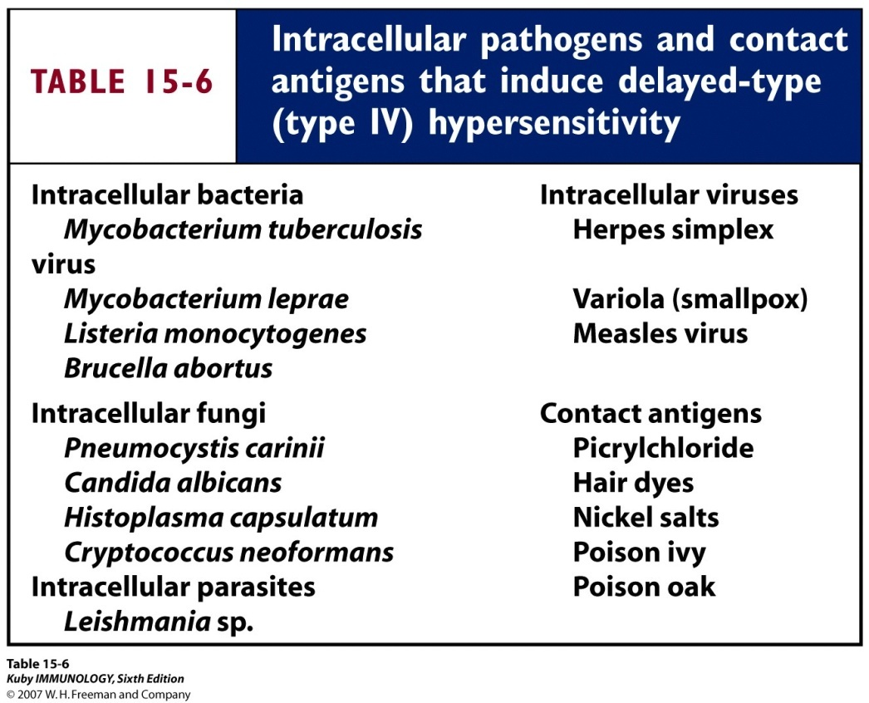
Type IV – Delayed-type Hypersensitivity
Some subpopulations of T_{H} cells encounter antigen, secrete cytokines and induce localized inflammatory response
Most cases are not detrimental(harmful)

Slide 43
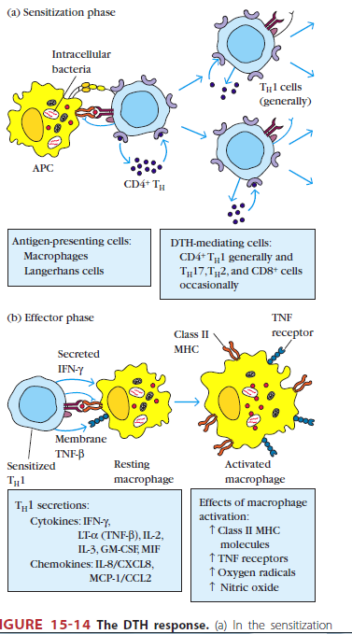
Type IV
Sensitization phase and
Effector phase of DTH

Slide 44
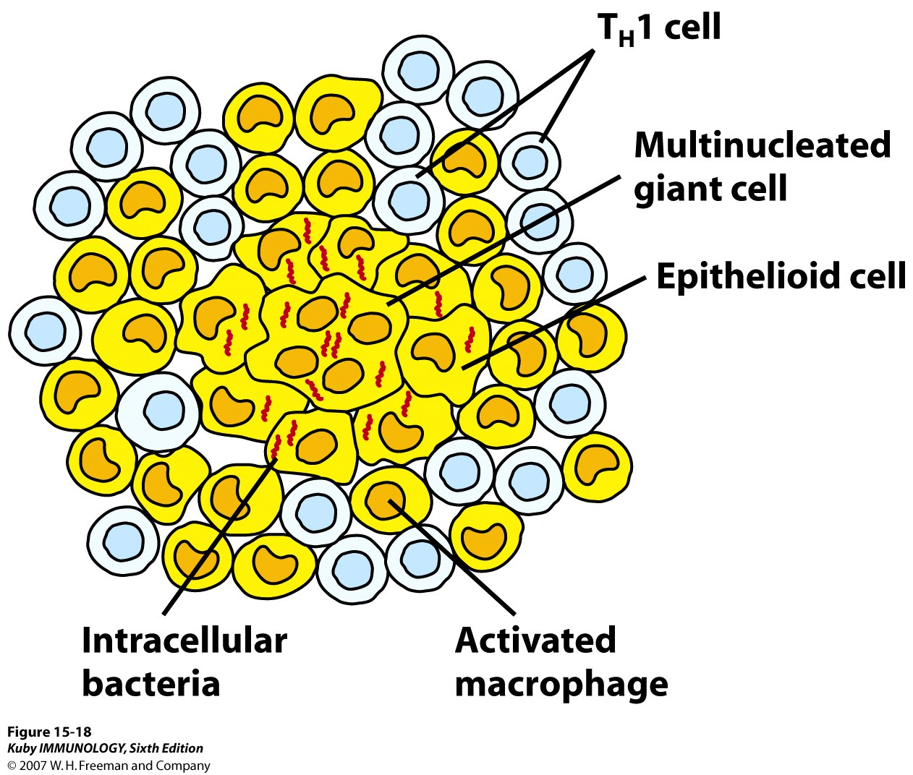
Prolonged DTH can lead to formation of granuloma
Tuberculosis test is done this way

Slide 45
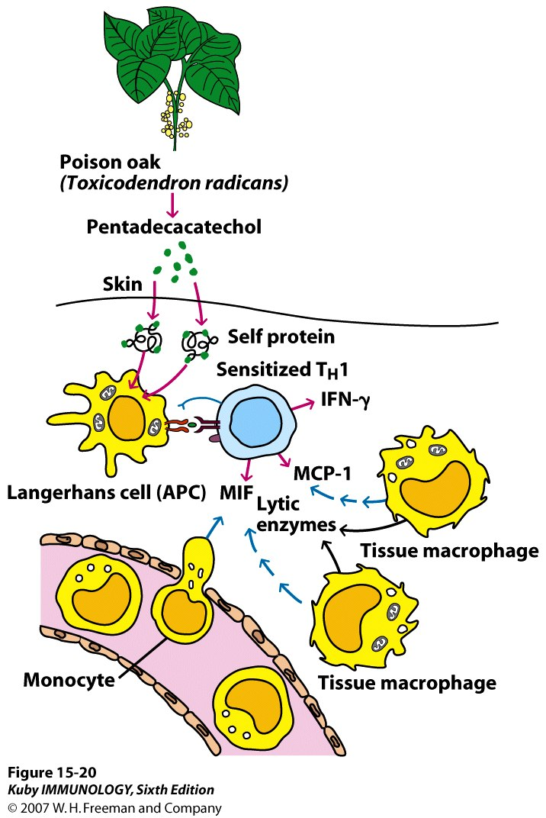
Type IV – contact dermatitis

Slide 46
Refferences :
Immunology , Kuby, seventh edition
Medical microbiology, Jawetz, 26th edition
Cellular and Molecular Immunology, Abul K. Abbas, 8th edition.

