Slide 1
Hyperbilirubinemia in the Newborn
Dr.Ban Adil
MBCHB,FICSM,MRCPCh

Slide 2
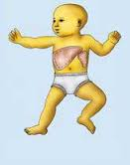
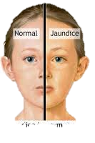
JAUNDICE (ICTERUS).
Def.:Yellow discoloration of the sclera, skin, and mucous membranes
Clinically apparent jaundice in children and adults occurs when the serum concentration of bilirubin reaches 2–3 mg/dL (34–51 μmol/L);
the neonate may not appear icteric until the bilirubin level is >5 mg/dL (85 μmol/L).

Slide 4
Types of jaundice

Slide 6
HB
globin
heme
iron
biliverdin
Unconjugated bilirubin
albumin
2 Glocoronic acid
UDPGT
Bilirubin diglocoronide
urobilinogen
Reabsorbed to blood
stercobilin
Absorbed back to liver by
E.H circulation

Slide 9
Jaundice and Hyperbilirubinemia in the Newborn
Hyperbilirubinemia is a common and, in most cases, benign problem in neonates. Jaundice is observed during the 1st wk of life in approximately 60% of term infants and 80% of preterm infants.

Slide 10
ETIOLOGY.
Unconjugated hyperbilirubinemia may be caused or increased by any factor that:
increases the load of bilirubin to be metabolized by the liver (hemolytic anemias, polycythemia, shortened red cell life as a result of immaturity or transfused cells, increased enterohepatic circulation, infection);
damages or reduces the activity of the transferase enzyme or other related enzymes (genetic deficiency, hypoxia, infection, thyroid deficiency);
competes for or blocks the transferase enzyme drugs and other substances requiring glucuronic acid conjugation.
leads to an absence or decreased amounts of the enzyme or to reduction of bilirubin uptake by liver cells (genetic defect, and prematurity).

Slide 11
HB
globin
heme
increases the load of bilirubin to be metabolized by the liver (
damages or reduces the activity of the transferase enzyme or other related enzymes
iron
biliverdin
Unconjugated bilirubin
albumin
competes for or blocks the transferase enzyme
leads to an absence or decreased amounts of the enzyme
genetic deficiency, hypoxia, infection, thyroid deficiency
2 Glocoronic acid
UDPGT
hemolytic anemias
polycythemia,
shortened red cell life as a result of immaturity or transfused cells,
increased enterohepatic circulation,
infection
Bilirubin diglocoronide
genetic defect, and prematurity
urobilinogen
Reabsorbed to blood
stercobilin
Absorbed back to liver by
E.H circulation

Slide 12
5.The toxic effects of elevated serum levels of unconjugated bilirubin are increased by factors that reduce the retention of bilirubin in the circulation hypoproteinemia,
6.displacement of bilirubin from its binding sites on albumin by competitive binding of drugs such as sulfisoxazole and moxalactam, acidosis, and
increased free fatty acid concentration secondary to hypoglycemia, starvation, or hypothermia

Slide 13
5. Factors that increase the toxic effects of elevated serum levels of unconjugated bilirubin
HB
globin
heme
displacement of bilirubin from its binding sites on albumin binding of drugs such as sulfisoxazole and moxalactam, acidosis, and increased free fatty acid concentration secondary to hypoglycemia, starvation, or hypothermia
iron
biliverdin
factors that reduce the retention of bilirubin in the circulation
Unconjugated bilirubin
albumin
2 Glocoronic acid
UDPGT
Bilirubin diglocoronide
urobilinogen
Reabsorbed to blood
stercobilin
Absorbed back to liver by
E.H circulation

Slide 14
the permeability of the blood-brain barrier neuronal susceptibility to injury, all of which are adversely influenced by asphyxia, prematurity, hyperosmolality, and infection.
Early and frequent feeding decreases whereas breast-feeding and dehydration increase serum levels of bilirubin
The neonatal production rate of bilirubin is 6–8 mg/kg/24 hr (in contrast to 3–4 mg/kg/24 hr in adults

Slide 15
Delay in passage of meconium, which contains 1 mg bilirubin /dL, may contribute to jaundice by enterohepatic circulation after deconjugation by intestinal glucuronidase (
Drugs such as oxytocin and chemicals used in the nursery such as phenolic detergents may also produce unconjugated hyperbilirubinemia

Slide 16
HB
globin
heme
iron
. Delay in passage of meconium, which contains 1 mg bilirubin/dL, may contribute to jaundice by enterohepatic circulation after deconjugation by intestinal glucuronidase
biliverdin
Unconjugated bilirubin
albumin
2 Glocoronic acid
UDPGT
Bilirubin diglocoronide
urobilinogen
Reabsorbed to blood
stercobilin
Absorbed back to liver by
E.H circulation

Slide 17
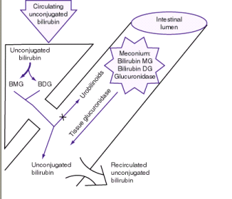

Slide 18
CLINICAL MANIFESTATIONS
Jaundice usually becomes apparent in a cephalocaudal progression starting on the face and progressing to the abdomen and then feet, as serum levels increase

Slide 19
Dermal pressure may reveal the anatomic progression of jaundice face, = 5 mg/dL; mid-abdomen, = 15 mg/dL; soles, = 20 mg/dL , but clinical examination cannot be depended on to estimate serum levels.
11/4/2014 6:37 PM - Screen Clipping

Slide 20
11/4/2014 6:37 PM - Screen Clipping
jaundice from deposition of indirect bilirubin in the skin tends to appear bright yellow or orange,
jaundice of the obstructive type (direct bilirubin) has a greenish or muddy yellow cast.
Although signs of kernicterus rarely appear on the 1st day, affected infants may present with lethargy and poor feeding and, without treatment, can progress to acute bilirubin encephalopathy

Slide 21
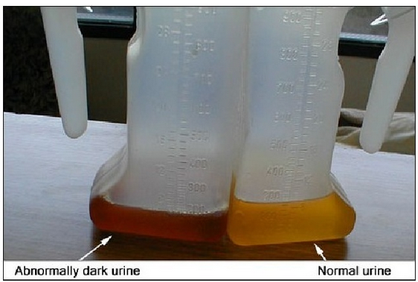

Slide 22
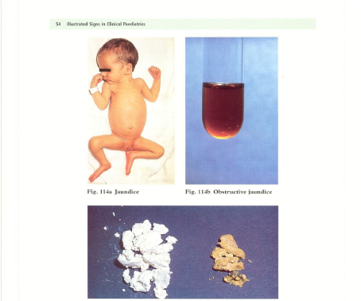

Slide 23
DIFFERENTIAL DIAGNOSIS. Jaundice that is present at birth or appears within the 1st 24 hr of life
erythroblastosis fetalis,
concealed hemorrhage,
sepsis,
congenital infections, including syphilis, cytomegalovirus, rubella, and toxoplasmosis

Slide 24
Jaundice that 1st appears on the 2nd or 3rd day
is
usually physiologic but may represent a more severe form.
Familial non-hemolytic icterus (Crigler-Najjar syndrome)
early-onset breast-feeding jaundice.

Slide 25
. Jaundice appearing after the 3rd day and within the 1st wk:
bacterial sepsis
urinary tract infection;
it may also be due to other infections, notably syphilis, toxoplasmosis, cytomegalovirus, (TORCH)or enterovirus

Slide 26
1st recognized after the 1st wk of life
There is a long differential diagnosis for jaundice :
Including
breast-milk jaundice,
septicemia,
congenital atresia or paucity of the bile ducts, hepatitis,
galactosemia,
hypothyroidism,
CF,
congenital hemolytic anemia crises related to red cell morphology and enzyme deficiencies spherocytosis,G6PD,pyruvate kinase def.(

Slide 27
The differential diagnosis for persistent jaundice during the 1st mo of life:
cholestasis,
hepatitis
, cytomegalic inclusion disease, syphilis, toxoplasmosis,
familial non-hemolytic icterus,
congenital atresia of the bile ducts,
galactosemia, or
inspissated bile syndrome following hemolytic disease of the newborn.
Rarely, physiologic jaundice may be prolonged for several wk, as in infants with hypothyroidism or pyloric stenosis.

Slide 28
DIAGNOSIS

Slide 29
Investigations for early jaundice
Serum bilirubin level+ pcv
Blood group
Maternal blood group
Direct and indirect fraction of bilirubin.
FBC and film
Direct coombs test
Consider G6PD level

Slide 30
Investigations for prolonged jaundice
Serum bilirubin level
Conjugated fraction of bilirubin
Liver function test (GGT, ALT, AST, Albumin)
Coagulation profile (PT, PTT, INR)
Abdominal ultrasound (gallbladder)
HIDA scan (with follow through)
Thyroid function test (TSH, free T4)
Metabolic screen (urine for reducing substance)
Hepatitis screen (TORCH)
Liver biopsy (bile duct proliferation)
FBC and film
Blood group
Maternal blood group
Direct coombs test
Notes:
DISIDA is radiotracer material.
DISIDA scan is hepatobiliary imaging, utilizing technetium-labeled diisopropyl iminodiacetic acid (DISIDA) nuclear scintiscan.
DISIDA scans are sometimes called nuclear medicine gall bladder or hepatobiliary scans. HIDA, its predecessor, is little used today because DISIDA can image the gall bladder better when liver function is poor. DISIDA scans try to determine if the small tube (cystic duct) which leads to the gall bladder is blocked.
A DISIDA scan is performed to visualize the gall bladder filling and emptying.

Slide 31
PHYSIOLOGIC JAUNDICE (ICTERUS NEONATORUM)
Under normal circumstances, the level of indirect-reacting bilirubin in umbilical cord serum is 1–3 mg/dL
rises at a rate of <5 mg/dL/24 hr;
thus, jaundice becomes visible on the 2nd–3rd day,
usually peaking between the 2nd and 4th days at 5–6 mg/dL
and decreasing to below 2 mg/dL between the 5th and 7th days of life

Slide 32
Cause of physiological jaundice
increased bilirubin production resulting from
increased RBC mass,
shortened RBC life span,
hepatic immaturity of glucuronosyltransferase.

Slide 33
Risk factors for elevated indirect hyperbilirubinemia include:
maternal age, race (Chinese, Japanese, Korean, and Native American),
maternal diabetes,
oxytocin induction,
prematurity,
drugs vitamin K₃
polycythemia,
male sex,
trisomy 21,
cutaneous bruising, blood extravasation (cephalohematoma),
breast-feeding,
weight loss (dehydration or caloric deprivation),
delayed bowel movement, and
a family history/sibling who had physiologic jaundice (

Slide 34
Prediction of which neonates are at risk for exaggerated physiologic jaundice can be based on hour-specific bilirubin levels in the 1st 24–72 hr of life ( Fig )
Indirect bilirubin levels in full-term infants decline to adult levels (1 mg/dl) by 10–14 days of life.

Slide 36
In premature infants, the rise in serum bilirubin tends to be the same or somewhat slower but of longer duration than in term infants.
Peak levels of 8–12 mg/dL are not usually reached until the 4th–7th day,
and jaundice is infrequently observed after the 10th day, corresponding to the maturation of mechanisms for bilirubin metabolism and excretion.

Slide 37
Pathological jaundice is suspected if :
it appears in the 1st 24–36 hr of life.
serum bilirubin is rising at a rate faster than 5 mg/dL/24 hr, (
serum bilirubin is >12 mg/dL in full-term infants (especially in the absence of risk factors) or 10–14 mg/dL in preterm infants,
jaundice persists after 10–14 days of life,
direct-reacting bilirubin is >2 mg/dL at any time.

Slide 38
Other factors suggesting a nonphysiologic cause of jaundice are family history of hemolytic disease, pallor, hepatomegaly, splenomegaly, failure of phototherapy to lower bilirubin, vomiting, lethargy, poor feeding, excessive weight loss, apnea, bradycardia, abnormal vital signs (including hypothermia), light-colored stools, dark urine positive for bilirubin, and signs of kernicterus

Slide 39
breast-feeding jaundice
JAUNDICE ASSOCIATED WITH BREAST-FEEDING
occurs in the 1st week of life, in breast-fed infants who normally have higher bilirubin levels than formula-fed infants .
Hyperbilirubinemia (>12 mg/dL) develops in 13% of breast-fed infants in the 1st wk of life
may be due to decreased milk intake with dehydration
and/or reduced caloric intake.
More in primi- mother,C/S

Slide 40
Giving supplements of glucose water to breast-fed infants is associated with higher bilirubin levels,
in part because of reduced intake of the higher caloric density of breast milk.

Slide 41
Frequent breast-feeding(>10/24 hr),
rooming-in with night feeding,
discouraging 5% dextrose or water supplementation,
and ongoing lactation support may reduce the incidence of early breast-feeding jaundice

Slide 42
JAUNDICE ASSOCIATED WITH BREAST-FEEDING.
breast-milk jaundice
Significant elevation in unconjugated bilirubin (breast-milk jaundice) develops in an estimated 2% of breast-fed term infants
after the 7th day of life,
with maximal concentrations as high as 10–30 mg/dL reached during the 2nd–3rd week
If breast-feeding is continued, the bilirubin gradually decreases but may persist for 3–10 wk at lower levels.

Slide 43
If nursing is discontinued, the serum bilirubin level falls rapidly, reaching normal levels within a few days.
With resumption of breast-feeding, bilirubin levels seldom return to previously high levels.
Phototherapy may be of benefit .
Although uncommon, kernicterus can occur in patients with breast-milk jaundice.
The etiology of breast-milk jaundice is not entirely clear, but may be attributed to the presence of glucuronidase in some breast milk.

Slide 44
Kernicterus
Kernicterus: or bilirubin encephalopathy, is a neurologic syndrome resulting from the deposition of unconjugated (indirect) bilirubin in the basal ganglia and brainstem nuclei.

Slide 45
The precise blood level above which indirect-reacting bilirubin or free bilirubin will be toxic for an individual infant is unpredictable.
Kernicterus usually does not develop in term infants when bilirubin levels are less than 20 to 25 mg/dL.
The incidence of kernicterus increases as serum bilirubin levels increase to greater than 25 mg/dL.

Slide 46
Kernicterus may be noted at bilirubin levels less than 20 mg/dL→ in the presence of sepsis, meningitis, hemolysis, asphyxia, hypoxia, hypothermia, hypoglycemia, bilirubin-displacing drugs (sulfa drugs), and prematurity.
Other risks for kernicterus in term infants are hemolysis, jaundice noted within 24 hours of birth, and delayed diagnosis of hyperbilirubinemia.
.

Slide 47
In previously healthy, predominantly breast-fed term infants, kernicterus has developed when bilirubin levels exceed 30 mg/dL.
Onset is usually in the 1st wk of life, but may be delayed to the 2nd–3rd wk
Kernicterus has developed in extremely immature infants weighing less than 1000 g when bilirubin levels are less than 10 mg/dL because of a more permeable blood-brain barrier associated with prematurity.

Slide 48
CLINICAL MANIFESTATIONS
Signs and symptoms of kernicterus usually appear 2–5 days after birth in term infants
and as late as the 7th day in premature infants,
but hyperbilirubinemia may lead to encephalopathy at any time during the neonatal period.
.

Slide 49
The early signs may be subtle and indistinguishable from those of sepsis, asphyxia, hypoglycemia, intracranial hemorrhage, and other acute systemic illnesses in a neonate.
Lethargy, poor feeding, and loss of the Moro reflex are common initial signs.
Subsequently, the infant may appear gravely ill and prostrated, with diminished tendon reflexes and respiratory distress.
Opisthotonos with a bulging fontanel, twitching of the face or limbs, and a shrill high-pitched cry may follow.

Slide 50
Opisthotonos

Slide 51
In advanced cases, convulsions and spasm occur,
with affected infants stiffly extending their arms in an inward rotation with the fists clenched . Rigidity is rare at this late stage.
Infants with severe cases of kernicterus die in the neonatal period.
Spasticity resolves in surviving infants, who may manifest later nerve deafness, choreoathetoid cerebral palsy, mental retardation, enamel dysplasia, and discoloration of teeth as permanent sequelae.

Slide 52
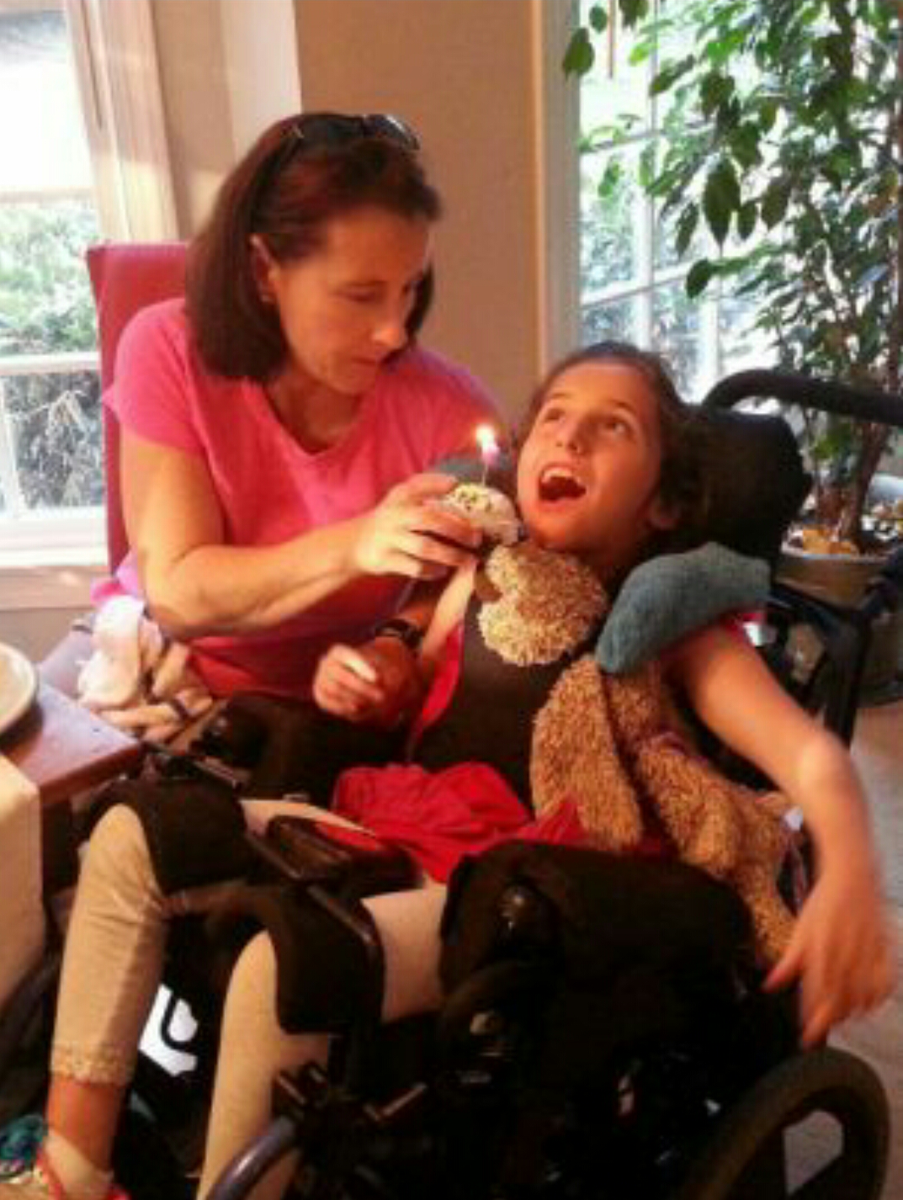

Slide 53
Clinical Features of Kernicterus
ACUTE FORM | Phase 1 (1st 1–2 days): poor sucking, stupor, hypotonia, seizures
 | Phase 2 (middle of 1st wk): hypertonia of extensor muscles, opisthotonos, retrocollis, fever
 | Phase 3 (after the 1st wk): hypertonia
CHRONIC FORM | First year: hypotonia, active deep tendon reflexes, obligatory tonic neck reflexes, delayed motor skills
 | After 1st yr: movement disorders (choreoathetosis, ballismus, tremor), upward gaze, sensorineural hearing loss

Slide 54
Therapy of Indirect Hyperbilirubinemia
Phototherapy
is an effective and safe method for reducing indirect bilirubin levels.
Bilirubin absorbs light maximally in the blue range (420–470 nm).
Broad-spectrum white, blue, and special narrow-spectrum (super) blue lights have been effective in reducing bilirubin levels

Slide 55
Unconjugated bilirubin
(4Z, 15Z configuration)
phototherapy (light 425- to 475-nm)
isomer 4Z, 15E bilirubin
lumirubin
Mode of action of phototherapy
photochemical reaction producing configurational isomer
the reversible, more water-soluble
bypassing the liver's conjugation system
excreted in bile without conjugation.
a more water-soluble structural isomer which does not spontaneously revert to unconjugated native bilirubin (irreversible)
can be excreted in urine.

Slide 56
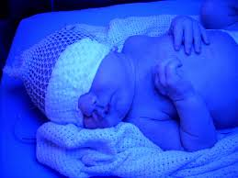
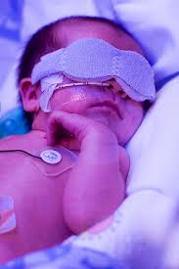
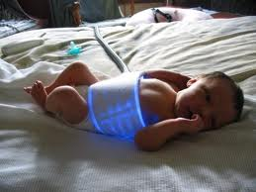
Conventional phototherapy
is applied continuously, and the infant is turned frequently for maximal skin surface area exposure
. It should be discontinued as soon as the indirect bilirubin concentration has reduced to levels considered safe with respect to the infant's age and condition.

Slide 57
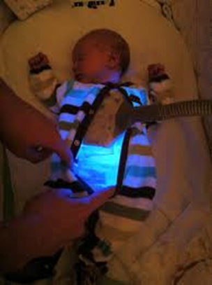
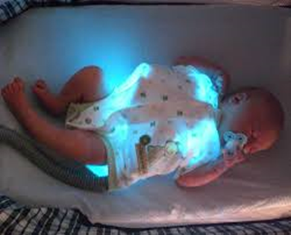
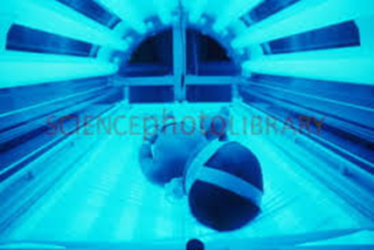
Maximal intensive phototherapy
Such therapy includes “special blue” fluorescent tubes,
placing the lamps within 15–20 cm of the infant,
and placing a fiberoptic phototherapy blanket under the infant's back to increase the exposed surface area.

Slide 58
Because phototherapy may require 6–12 hr to have a measurable effect,
it must be started at bilirubin levels below those indicated for exchange transfusion.
In term infants, phototherapy is begun when indirect bilirubin levels are between 16 and 18 mg/dL.
Phototherapy is initiated in premature infants when bilirubin is at lower levels

Slide 59
Suggested Maximal Indirect Serum Bilirubin Concentrations (mg/dL) in Preterm Infants
BIRTHWEIGHT (g) | UNCOMPLICATED | COMPLICATED[*]
<1,000 | 12–13 | 10–12
1,000–1,250 | 12–14 | 10–12
1,251–1,499 | 14–16 | 12–14
1,500–1,999 | 16–20 | 15–17
2,000–2,500 | 20–22 | 18–20

Slide 60
Phototherapy is usually started at 50–70% of the maximal indirect level.
If values greatly exceed this level, if phototherapy is unsuccessful in reducing the maximal bilirubin level, or if signs of kernicterus are evident, exchange transfusion is indicated.

Slide 61
Serum bilirubin levels and hematocrit should be monitored every 4–8 hr in infants with hemolytic disease or those with bilirubin levels near toxic range for the individual infant.
Others, particularly older infants, may be monitored less frequently.
Serum bilirubin monitoring should continue for at least 24 hr after cessation of phototherapy in patients with hemolytic disease because unexpected rises in bilirubin may occur and require further treatment.

Slide 62
NOTES
Skin color cannot be relied on for evaluating the effectiveness of phototherapy;
the skin of babies exposed to light may appear to be almost without jaundice in the presence of marked hyperbilirubinemia.
Although not necessary for all affected infants, intravenous fluid supplementation added to oral feedings may be beneficial in dehydrated patients or those with high bilirubin levels nearing exchange transfusion.
Dark skin does not reduce the efficacy of phototherapy.

Slide 63
Complications of phototherapy
increased insensible water loss
diarrhea
dehydration
macular-papular red skin rash
lethargy
masking of cyanosis
nasal obstruction by eye pads
potential for retinal damage
Skin bronzing may be noted in infants with direct-reacting hyperbilirubinemia

Slide 64
Exchange transfusion
usually is reserved for infants with dangerously high indirect bilirubin levels who are at risk for kernicterus.
As a rule of thumb, a level of 20 mg/dL for indirect-reacting bilirubin is the "exchange number" for infants with hemolysis who weigh more than 2000 g.
Asymptomatic infants with physiologic or breast milk jaundice may not require exchange transfusion, unless the indirect bilirubin level exceeds 25 mg/dL.

Slide 65
The exchangeable level of indirect bilirubin for other infants may be estimated by calculating
10% of the birth weight in grams
the level in an infant weighing 1500 g would be 15 mg/dL. Infants weighing less than 1000 g usually do not require an exchange transfusion until the bilirubin level exceeds 10 mg/dL.

Slide 66
Small infusions of fresh whole blood crossmatched with that of the mother and infant
are alternated with withdrawals of an equivalent quantity of the infant's blood, which is discarded.
Depending on the size of the infant, aliquots of 5 to 20 mL per cycle are withdrawn and infused,
with the total procedure lasting 45 to 60 minutes.

Slide 67
The total amount of blood exchanged is equal to twice the infant's blood volume, calculated as:
Weight (kg) X 85 ml/kg X 2

Slide 68
This volume should remove 85% of the infant's RBCs (the source of bilirubin), maternal antibodies.
The exchange transfusion usually is performed through an umbilical venous

Slide 69
The level of serum bilirubin immediately after the exchange transfusion declines to levels that are about half of those before the exchange;
levels rebound 6 to 8 hours later as a result of continued hemolysis and redistribution of bilirubin from tissue stores.

Slide 70
Complications of exchange transfusion
 | Graft versus reaction | Related to the blood
Hepatitis B,C ,HIV,CMV..) | infection
Hypoglycemia Hypocalcemia Hypomagnesemia hyperkalemia | Metabolic
 | Anemia/polycythemia
 | Perforation | Related to the catheter
 | Haemorrhage
 | vasospasm
 | Hypo-or hyperthermia | Related to the procedure
 | Volume overload
 | Necrotizing entrerocolitis
 | arrythmia
 | Late anemia | Late complications
persistent icterus with significant elevations in direct and indirect bilirubin in infants with hemolytic disease. The cause is unclear, but the jaundice clears spontaneously within a few weeks or months. | Inspissated bile syndrome
 | Portal vein thrombosis and portal hypertension

Slide 71
Other medical modalities of treatment
Intravenous Immunoglobulin
Early administration of intravenous immunoglobulin (IVIG) may reduce
hemolysis,
peak serum bilirubin levels,
and the need for exchange transfusions.
the duration of phototherapy, and \
the length of hospitalization.
A dose of 0.5-1 g/kg may be used..

Slide 72
Hemolytic disease of the newborn caused by blood group a and b incompatibility
ABO incompatibility is the most common cause of hemolytic disease of the newborn.
Approximately 15% of live births are at risk, but manifestations of disease develop in only 0.3-2.2%.

Slide 73
Major blood group incompatibility between the mother and fetus generally results in milder disease than Rh incompatibility does.
Maternal antibody may be formed against B cells if the mother is type A or against A cells if the mother is type B. Usually, the mother is type O and the infant is type A or B.

Slide 74
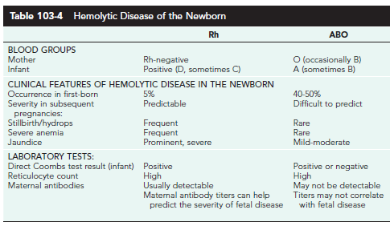
10/8/2016 9:21 AM - Screen Clipping

Slide 75
Although ABO incompatibility occurs in 20-25% of pregnancies,
hemolytic disease develops in only 10% of the offspring in such pregnancies.
Low antigenicity of the ABO factors in the fetus and newborn infant may account for the low incidence of severe ABO hemolytic disease relative to the incidence of incompatibility between the blood groups of the mother and child.

Slide 76
Although antibodies against A and B factors occur without previous immunization (“natural” antibodies),
they are usually IgM antibodies that do not cross the placenta.
However, IgG antibodies to A antigen may be present and these do cross the placenta, so A-O isoimmune hemolytic disease may be found in first-born infants.

Slide 77
Mothers who have become immunized against A or B factors from a previous incompatible pregnancy also exhibit IgG antibody. These “immune” antibodies are the primary mediators in ABO isoimmune disease.

Slide 78
Clinical Manifestations
Most cases are mild, with jaundice being the only clinical manifestation.
The infant is not generally affected at birth; pallor is not present,
and hydrops fetalis is extremely rare. The liver and spleen are not greatly enlarged, if at all. Jaundice usually appears during the 1st 24 hr.
Rarely, it may become severe, and symptoms and signs of kernicterus
develop rapidly.

Slide 79
Diagnosis
A presumptive diagnosis is based on the presence of ABO incompatibility,
a weakly to moderately positive direct Coombs test result, and
spherocytes in the blood smear, which may at times suggest the presence of hereditary spherocytosis. Hyperbilirubinemia is often the only other laboratory abnormality. The hemoglobin level is usually normal

Slide 80
but may be as low as 10-12 g/dL. Reticulocytes may be increased to10-15%, with extensive polychromasia and increased numbers of nucleated RBCs.
In 10-20% of affected infants, the unconjugated serum bilirubin level may reach 20 mg/dL or more unless phototherapy is administered.

Slide 81
Thank you

