Slide 1
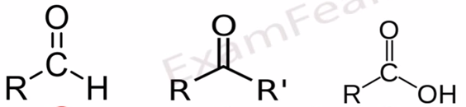
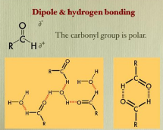
In most organic compounds there is a substituents, they are a functional part of the molecule, and are the non- hydrocarbon part, specific arrangement of atoms often (contain O, N, S, or P)in an organic compound called(Functional-group).Carbonyl group is a functional group of (Aldehyde, Ketone), and in carboxylic acid both carbonyl group and hydroxyl group are the functional groups, figure(1) indicate the carbonyl group.
Lecture three:عضوية
Aldehyde, Ketone, and carboxylic acids
Functional group:
Figure 1: The functional groups of Aldehyde , Ketone, and carboxylic acids. Carbonyl group (>C=O) is a functional group of (Aldehyde, Ketone), and in carboxylic acid both carbonyl group and hydroxyl group (-OH)are the functional groups functional group.
What are Carbonyl Compounds?
Aldehyde, Ketone, and carboxylic acids are all of carbonyl group, containing carbon- oxygen double bounded (>C=O), so they called Carbonyl Compounds. In Aldehyde a carbonyl group (>C=O) bounded one carbon and one Hydrogen atom, while Ketones bounded to two other carbon atoms. In carboxylic acid the carbonyl group is bounded to carbon atom and hydroxyl group by the other side. Carbonyl group is polar or water soluble due to ability to form Hydrogen bonding as in, figure(2) bellow.
figure(2): carbonyl group.

Slide 2
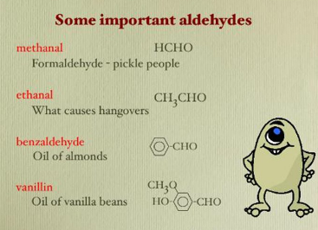
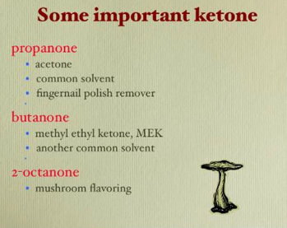
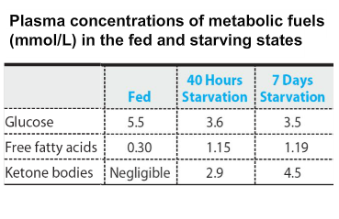
Properties: Aldehydes and ketones have special importance by location or their activity. They are act as flavoring agents, and can used as a polar – non polar solvent (formaldehyde used as a preservative solution), figure (3) bellow.
Biological Significance of Ketone Bodies:
Ketone Bodies replace glucose (glucose: is the major source of energy for brain, heart, and muscles.) during starvation figure(4) indicate the levels of Ketone Bodies & glucose. Ketone Bodies are accumulated in diabetic due to shortages cause the liver to increase the production of Ketone Bodies from fatty acid oxidation causing Ketosis.
Ketosis cause diabetes mellitus or starvation, diabetic Ketosis consist of (Ketonemia, Ketonuria, Small of acetone in urine).
figure (3):
Aldehydes & ketones
are flavoring agents.
figure(4):Plasma concentration of Ketone Bodies & glucose in fed and starvation states.

Slide 3
The presence of Aldehyde, Ketone, and carboxylic acids:
Aldehyde, Ketone, and carboxylic acids are present in different compounds of human body, here is some of them:-
The presence of Aldehyde, Ketone, and carboxylic acids:
Aldehyde, Ketone, and carboxylic acids are present in different compounds of human body, here is some of them:-
①-Monosaccharides:
Monosaccharide's are carbohydrates which can not be hydrolyzed to small molecules, contain carbons with functional aldehyde or keto group are present in nature. Aldohexose is glucose, Fructose is ketohexose respectively. Glucose is present in our blood and gives rise to energy on oxidation.
②- Aldopentose Ribose is constituent of nucleic acids monomer of DNA.
③ -Ketone Bodies:
Ketone Bodies are : acetoacetate, beta-hydroxybutyrate, & acetone. Ketone Bodies are water soluble fuels normally exported by the liver but overproduced during fasting or diabetes mellitus. Ketone Bodies are formed in the hepatic mitochondria to be used as fuel for human activities.

Slide 4

CARBOXYLIC ACIDS: Also have a carbonyl group(>C=O), attached to a hydroxyl group to generate a carboxyl group R-COOH, it’s a weak acid. Acetic acid meaning Vinegar, the other example is are the human fatty acids.
The Normal Arterial pH in Human Body is (7.35-7.45).
The LOW Arterial pH cause Metabolic Acidosis refer to increase acid generation.
Metabolic Acidosis cause:
Diabetes Mellitus (DM).
Alcoholic.
Starvation.
Ingestion Salicylates.
The clinical Features evolved rapidly over 24 hours and early signs: Cause nausea, vomiting, and abdominal pain.
The Carboxylic Acid Derivatives
The group (Rـــــ CO) is called the acyl group, which is a part of the functional group of the carboxylic acid derivatives, these derivatives include, esters, acid chlorides, and amides.
CARBOXYLIC ACIDS
The Carboxylic Acid Derivatives
Carboxylic Acid Derivatives | Esters | acid chlorides | amides
RCOOH Derivatives | R-COOR | RCOCL | RCOCl
Examples in living systems | acetyl coenzyme A | acetyl chloride | Paracetamol, penicillin.

