Slide 1
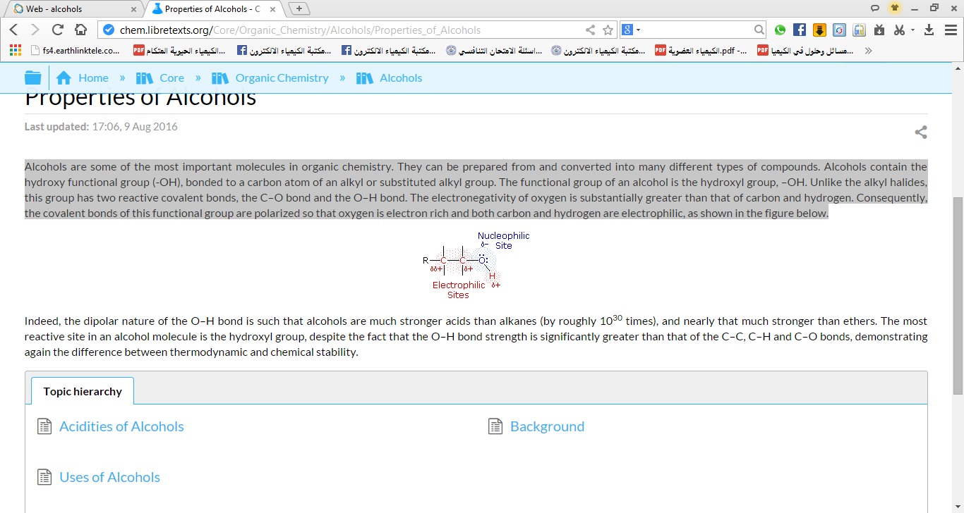
Lecture two: عضوية
Alcohols
Alcohols are some of the most important molecules in organic chemistry. They contain the hydroxyl functional group(-OH), bonded to a carbon atom of an alkyl or substituted alkyl group. The electronegativity of oxygen is greater than that of carbon and hydrogen, this group has two reactive covalent bonds, the C–O bond and the O–H bond. Consequently, the covalent bonds of this functional group are polarized so that oxygen is electron rich and both carbon and hydrogen are electrophilic, as shown in Figure (1) below. Alcohol is created when grains, fruits, or vegetables are fermented. Fermentation is a process that uses yeast or bacteria to change the sugars in the food into alcohol. Fermentation is used to produce many necessary items everything from cheese to medications.
Figure (1): The dipolar nature of the O–H bond
Alcohols Uses : The important uses of simple alcohols, such as methanol, and ethanol.
Ethanol:
Industrial methylated spirits: its usually sold as industrial methylated spirits, which is ethanol with a small quantity of methanol and possibly some color added. Because methanol is poisonous, industrial methylated spirits are unfit to drink.
Alcoholic Drinks: The word "alcohol" in alcoholic drinks refers to presence of ethanol (CH3CH2OH).
Use of ethanol as a fuel: Ethanol burns to produce carbon dioxide and water, as shown in the equation below, and can be used as a fuel.
CH₃CH₂OH + 3O₂ → 2CO₂+ 3H₂O.
Ethanol as a solvent: its widely used as a solvent, relatively safe and can be used to dissolve many organic compounds that are insoluble in water. It is second only to water in importance as a solvent in medicine and is used particularly to extract active constituents from inert parts of crude drugs, besides It is used, in paints, many perfumes and cosmetics.

Slide 2
Methanol :
Methanol as a fuel: Methanol also burns to form carbon dioxide and water:
2CH₃OH + 3O₂ → 2CO₂ + 4H₂O.
The Effect Of Alcohol on human system:
Alcohol swallowed by mouth then to the stomach a small amount pass by stomach wall to the blood stream, while most alcohol through intestine then to blood stream (then to all over the body by blood).
1-The Effect Of Alcohol On Brain :
Alcohol can reach the brain in a short time. Alcohol interferes with the brain’s communication pathways, and can affect the way of the brain looks and works. These disruptions can change mood and behavior, and make the brains ability to control the body greatly affect, speech, vision and harder to think clearly.
2-The Effect Of Alcohol On Nervous system (CNS) :
The nervous system CNS: slow down CNS function, and cause
High blood pressure: Alcohol can disrupt the sympathetic nervous system (damage nervous cells). sympathetic nervous system controls the constriction and dilation of blood vessels in response to heavy drinking causing blood pressure to rise. Over time, this effect can become chronic. High blood pressure can lead to many other health problems, including kidney disease, heart disease.
3-The Effect Of Alcohol On Heart :
Alcohol causes the heart rate to increase and expanding of blood vessels. Heavy drinking, makes platelets more likely to clump together into blood clots, which can lead to heart attack & doubled the risk of death. Heavy drinking can also cause Cardiomyopathy – Stretching, a potentially deadly condition in which the heart muscle weakens and fails, and in the absence of immediate treatment, cause sudden death.

Slide 3
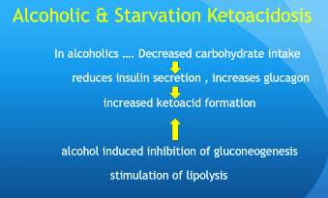
4-The Effect Of Alcohol On Liver:
When a liver is working well, it cleans the blood, helps digest food . It is a bodily superhero, it has the power to regenerate when it has been damaged, replacing old tissue with new cells. “Anything that keeps your liver from doing its job — or from growing back after injury — may put your life in danger”. Alcohol interferes with the liver‘s ability to function properly, so the liver unable to break down fats creating fatty acids, and the liver is damaged, possibly resulting in Cirrhosis. Cirrhosis is a condition in which liver tissue is destroyed and then replaced with scarred tissue. (scarred that it is unable to function, no blood flow in scared area.) Most peoples die due to Cirrhosis are heavy drinkers.
Symptoms of Cirrhosis :
-High blood pressure, and abdominal swelling.
-jaundice yellowing skins and eyes.
-destruction of the liver.
-IRREVERSIBLE.
5-The Effect Of Alcohol On Gastro intestinal tract(GIT) :
The gastrointestinal system is damaged by alcohol. Thus it is less able to absorb nutrients, which can lead to malnutrition. Because alcohol supplies calories, alcoholic drinks can be very fattening. Alcohol is absorbed so quickly that its energy is available almost immediately. This energy is burned first, so the body fuel that would normally be used for energy is instead stored as fat.

Slide 4

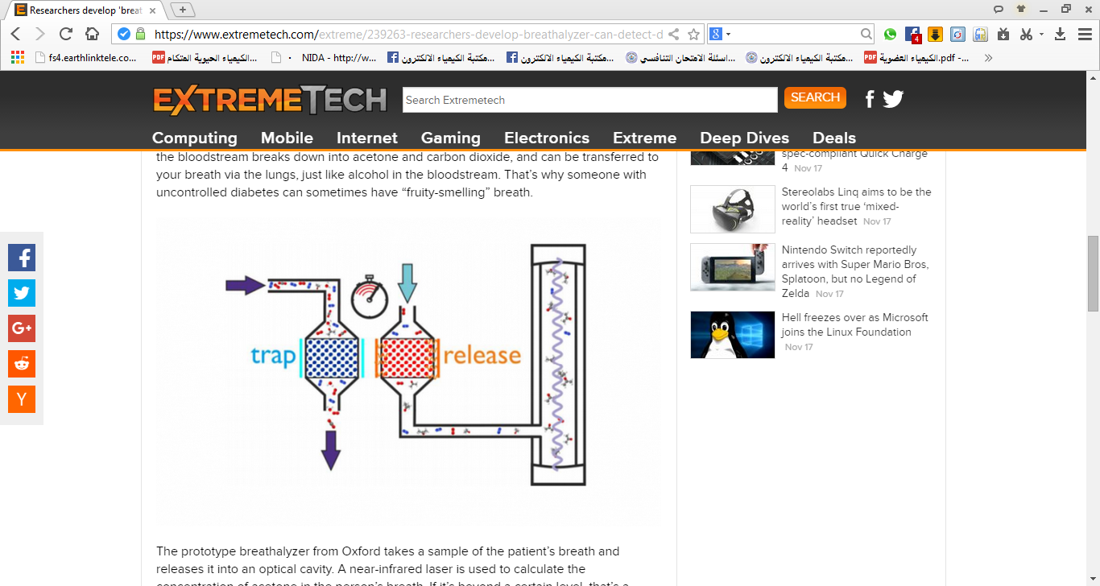

Alcoholism:
A disease in which a person has a physical or psychological dependence on drinks alcohol, characterized as an impaired ability to work or socialize normally.
The relation of Alcohol and Blood pressure:
Alcohol can disrupt the nervous system, which, among other things, controls the constriction and dilation of blood vessels in response to stress, temperature, etc. Heavy drinking makes platelets more likely to clump together into blood clots, which can lead to blood pressure to rise & doubled the risk of death among people who initially survived a heart attack.
Blood Alcohol Concentration(ABC):
Blood Alcohol Concentration ABC : a content of alcohol in human system compared to the content of alcohol in total blood.8% is the legal driving limit.
The breathalyzer :
To test the amount of alcohol consumed, a sample of the patient’s breath releases it into an optical cavity figure(2) breathalyzer. A near-infrared laser is used to calculate the concentration of alcohol.
figure(2) breathalyzer.

