Slide 1
بسم الله الرحمن الرحيم

Slide 2
Introduction to surgery
Abdominal incision and
suturing

Slide 3
Skin incisions
Incising the skin is the first step in most surgeries.
In order to begin our operation correctly, we should do the incision in the right way.

Slide 4
The skin incision is made with a scalpel with the blade being pressed firmly on skin at a right angle.
Then draw it gently over the skin.

Slide 5
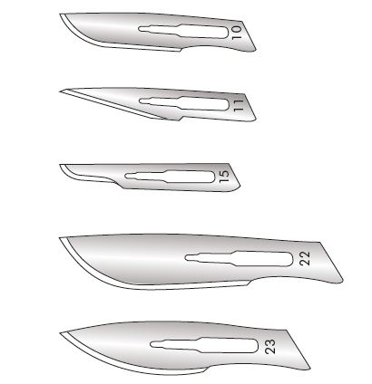
Figure 1: scalpel blades shapes and sizes.

Slide 6
When planning a skin incision, 4 factors should be considered:
1 Skin tension lines (Langer’s lines). These lines represent the orientation of the dermal collagen fibres and any incision placed parallel to these lines result in a better scar.
2 Anatomical structure. Incisions should avoid bony prominences and crossing skin creases if possible, and take into consideration underlying structures, such as nerves and vessels.

Slide 7
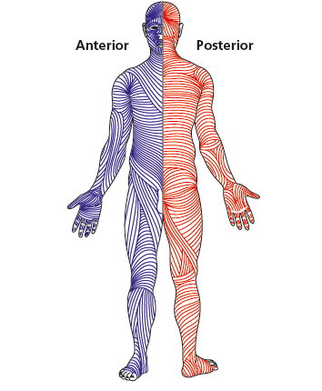
Figure2; langers lines

Slide 8
3. Cosmetic factors. Any incision should be made bearing in mind the ultimate cosmetic result, especially in exposed parts of the body, as an incision is the only part of the operation
the patient sees.
4. Adequate access for the procedure.

Slide 9
Abdominal incisions
In the past they depend solely on vertical incisions.
Nowadays there is a current trend toward transverse ones, as they decrease respiratory complications and has better cosmetic outcome.
For abdominal wound closure the suture should be 4 times the length of the wound to minimize risk of dehiscence and late incisional hernia.

Slide 10
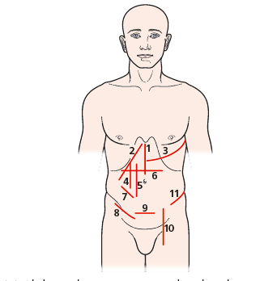
Figure3: abdominal incisions, 1, Midline; 2, Kocher’s;
3, thoracoabdominal; 4, rectus split; 5, paramedian; 6, transverse;
7, McBurney’s gridiron; 8, inguinal; 9, pfannenstiel; 10, McEvedy;
11, Rutherford Morison.

Slide 11
Examples:
Midline incision: from xiphisternum to the symphisis pubis.
It can be shortened into either
Upper midline
Lower midline

Slide 12
Kocher's incision: right sub costal incision.
Paramedin incision(right or left).
Pfannenstiel incision( lower transverse)
Upper transverse (rooftop)
Grid iron incision.

Slide 13
Wound closure
There is no ideal wound closure technique for all situations and the ideal suture has yet to be produced.
Factors for good wound closure :
Adequate and proper incision and operative technique
Correct choice of suture material and technique.

Slide 14
3. Good blood supply without any tension at closure.

Slide 15
Suturing
The use of suture material differ from one surgery to another , also differing throughout the stages of same surgery, this depend on:
Site
Type of surgery and technique.
State of the wound.

Slide 16
Suture characteristics
Physical structure into:
a. Monofilament, that is smooth, slide through the tissues but difficult to knot effectively and easily damaged by needle holder.
b. Multifilament (braided) which is easier to knot and has a large surface area predisposing to persistent infection.

Slide 17
2. Strength:
The strength of suture depend upon its constituent material, its thickness and how its handled in the tissue.
The tensile strength of the suture can be expressed as the force required to break it when pulling the two ends apart.

Slide 18
3.Tensile behavior:
Flexibility and coiling, the suture lose 50% of its strength at the knot.
4. absorbability: it reflect the fate of the suture, its use depend on the site.

Slide 19
5. Biological behavior:
The Biological behavior of the suture depend on its raw material.
Natural synthetic suture such as catgut are proteolyzed and its degradation is not predictable so causing local irritation and its rarely used nowadays.
While man made synthetic polymers are hydrolyzed and are more predictable.

Slide 20
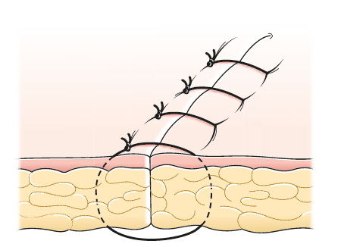
Suturing technique
Interrupted suture , the distance of suture entrance and exit should be equal, which is half the distance between two sutures.
Figure 4: interrupted sutures

Slide 21
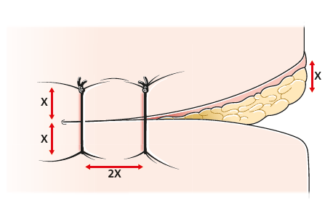
Figure 5: the sitting of suture.

Slide 22
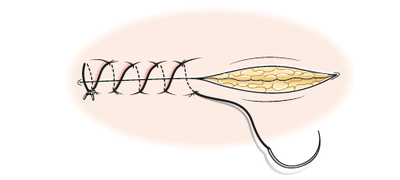
2. Continuous suture
The suture should be at least 3-4 times the length of the wound.
There is risk of tension or loosening.
Figure 6: Continuous suture.

Slide 23
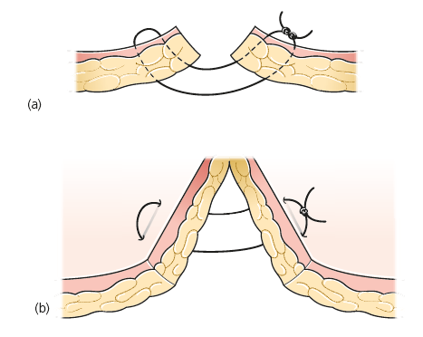
3. Mattress suture:
Either vertical or horizontal.
Produce accurate approximation of wound edges
Figure 7: mattress suture
a: vertical
b: horizontal

Slide 24
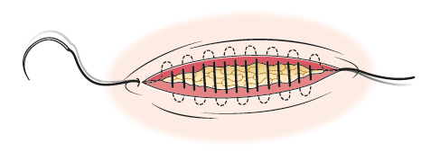
4. Subcuticular suture:
For cosmetic purposes.
Figure 8: Subcuticular suture

Slide 25
Alternative to suturing
Skin adhesive strips:
there should be no tension and not to much moisture, its used in areas of soft skin for example in face or breast, its also used to decrease spread of scar.
Tissue glue:
it’s a solution of n-butyl 2- cyanoacrylate monomer, when its applied to the skin it polymerize to form a firm adhesive band.

Slide 26
But the wound need to be dry with near perfect homeostasis, clean and under no tension.
Advantage:
Quick to use
Does not delay wound healing
Low infection rate
but its expensive.

Slide 27
The other one is fibrin glue which work on the principle of converting fibrinogen to fibrin thus accelerating homeostasis, so its used to achieve homeostasis in liver, spleen and ENT surgery.

Slide 28
3. Clips:
it produce a very near scar, good wound eversion and minimal cross hatching effect.
it can be placed faster than sutures.
Having lower risk of infection.
Disadvantage:
Can be uncomfortable to the patient.
Require special instrument to remove it.
But more expensive.

Slide 29
Thank you

