Slide 1
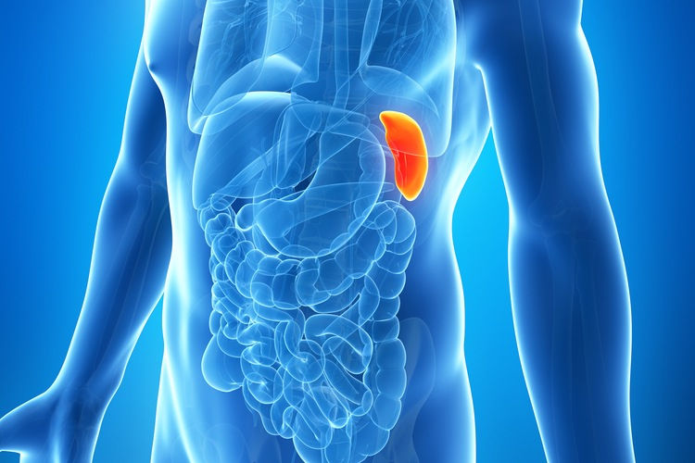
spleen

Slide 2
Clinical Applied Anatomy
Embryology: Dorsal Mesogastrium.
The weight is 75-250 g.
Anatomy: Lt Hypochondrial region.( 11-9th rib) along the 10 th rib upto Mid Ax. Line.
The notch is in the I.L. border may be papable. the retroperitoneal attachments of the spleen, the splenocolic, splenorenal, and splenophrenic ligaments
- Splenic. Artery runs along the upper border of Pancreas And is divided into Sup. & Inf. Branches.

Slide 3
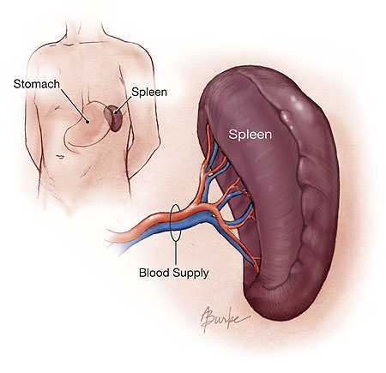
- Splenic Vein join superior mescentric vein to form portal vein.
- Lymphatic drainage by lymph vessels of the white pulp.
- Accessory Spleen ( Splenunculi ) in hilum most common, pedicle, tail of pancreas, Sp-Colic lig., G.O. & Mesentry.

Slide 4
Physiology and histology:
The spleen consist of trabicular vessels surrounded by the white pulp, then marginal zone which is covered by red pulp.
The white pulp consist of lymphatic sheaths contains plasma cells (Igs), and T lymphocytes.
It represent the immune center of the spleen and 25% of its weight.
The red pulp consist of cords and sinuses and represent the hemopoietic function of the spleen.

Slide 5
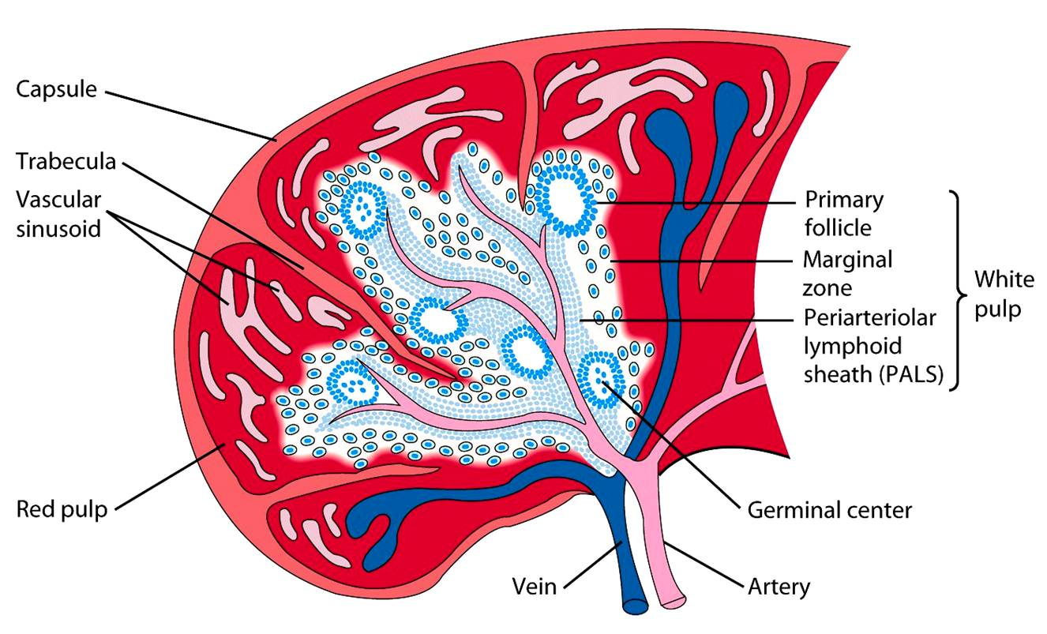

Slide 6
Functions of Spleen
Immune Function. IgM. Production and foreign antigens processing.
Filter Function. ( Cellular & Non Cellular ).
Pitting. Repair of RBC.( Inclusion bodies).
Resevoir .
Cytopoiesis.

Slide 7
Assessment
History, Examination, Investigations
Palpation
Technique
Start in RLQ (so you don’t miss a giant spleen).
Get your fingers set then ask patient to take a deep breath. Don’t dip your fingers or do anything but wait. When patient expires, take up new position.
Note lowest point of spleen below costal margin, texture of splenic contour, and tenderness
If spleen is not felt, repeat with pt lying on right side. Gravity may bring spleen within reach.

Slide 8
“LET THE SPLEEN PALPATE YOUR FINGERS AND NOT THE OTHER WAY AROUND. THERE IS NO GOLD, SO DON’T DIG!”
Remember that the spleen can become very enlarged and fragile (e.g. infectious mononucleosis); overly aggressive palpation may cause injury

Slide 9
Investigations
Laboratories.
Imaging.
Plain XR, U.S, Doppler, CT scan, MRI & ^{99m}Tc – labelled colloid.
.splenectomy

Slide 10
Disorders of Spleen:
Trauma
Isolated
or Combined
Diseases
Congenital abnormality
Blunt
Splenic artery aneurysm, infarct & rupture.
Penetrated
Splenomegaly & Hyperspleenism.
Neoplasms

Slide 11
Congenital Abnormality
Splenic agenesis 10% in children with CHD.
Polysplenia is rare due to failure of splenic fusion. They are functionless.
3. Splenunculi :
Accessory spleens, 10 – 30% of population, hilum 50%, tail of pancreas 30%, mesocolon, splenic ligament & G.O.
They are functioning.
You have to identify them during splenectomy.

Slide 12
Hamartomas
Splenic Hamartomas is a rare, benign vascular proliferation that is often found incidentally while working up on other complaints or at autopsy. Women more commonly present with symptoms related to mass effect than men. Histologically : it may resemble the white or red pulp. Treatment: Splenectomy for Diagnostic purpose to exclude malignancy or for pressure symptoms.

Slide 13
Non paracytic Cyst
Primary Cyst ( True )
Secondary (pseudocyst) caused by trauma.
True wall ,may be calcified.
( Cystic haemangioma,lymphangiomas and dermoid and epidermoid cyst).
DDx is psuedocyst.& hydatid cyst.
Treatment: if > 5 cm Splenectomy.

Slide 14
Splenic Abscess
Infected embolus, association or with typhoid & PT fever, osteomyelitis, otitis media, infected splenic infarct, pancreatic necrosis or other intra abdominal infection & puerperal sepsis.
Complication : 1. Lt sub diaphragmatic abscess
2. peritonitis
Treatment: is of underlying cause, plus either:
Percutaneous Drainage under U/S guidance if unilocular or Surgical drainage if multilocular .

Slide 15
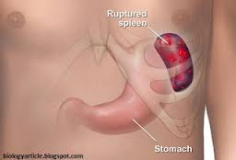
Splenic Rupture
Due to blunt abdominal trauma to the Lt UQ of the abdomen.
Emergency case .
DDx: Rupture haemangioma, Rupture hydatid cyst., Rupture malarial spleen.
Ruptured malarial spleen. Is the most common cause of non traumatic rupture.

Slide 16
Splenic artery aneurysm
Occur in 0.04-1 per cent of population.
Twice more common in females.
Usually single, multiple in a quarter of cases.
Caused by : intra-abdominal sepsis, pancreatic necrosis and atherosclerosis.
Its usually symptomless but present as rupture.
Surgery is indicated in the following cases:
1.Symptomatic
2.More than 2cm
Pregnancy
pancreatitis
.

Slide 17
Surgical intervention includes:
Embolization
Endovascular stenting
Ligation of proximal and distal ends of the sac
Partial or complete appendectomy

Slide 18
Splenomegaly
Hypersplenism
Clinical syndrome that is characterized by splenic enlargement and any combination of anaemia, leukopenia or thrombocytopenia, compensatory B.M. hyperplasia & improvement after splenectomy.

Slide 19
INFECTION Bacterial T.B., Abscess.
Viral HIV related TCP
Protozoa & Parasitic
Schistosomiasis
H.C.
Tropical Splenomegaly
BLOOD DISEASE ITP
Hereditary Spherocytosis
Autoimmune Haemolytic Anaemia
Thalassemia
Sickle Cell Disease
METABOLIC Gaucher’s disease, Porphyria
CIRCULATORY Segmental Portal HT
COLLAGEN disease Felty’s syndrome
NEOPLASTIC Hodjkin Lymphoma
mylofibrosis

Slide 20
Tuberculosis
Cardinal symptoms is:
Young age with Splenomegaly, asthenia weight loss and fever.
it may cause portal HT rarely cold abscess .
Treatment :anti TB drugs . Splenectomy is not normally required
Tropical SPLENOMEGALY
Massive splenomegally caused by Malaria, Kala-azar & Schistosomiasis. .
May require splenectomy for anaemia or pressure symptoms.
Antimalaria drugs may be indicated for long life in endemic areas.

Slide 21
Schistosomiasis:
Its prevalent in Africa, Asia, and South America .
Schistosoma Mansoni in 75% of cases.
Splenomegally result from portal hypertension.
Splenectomy indicated for symptomatic relief.

Slide 22
Idiopathic thrombocytopenic purpura
Low platelet count result from the development of IgG.
Associated with normal bone marrow and absence of other causes of thrombocytopenia.
It can be divided into child and adult form.

Slide 23
ITP
CHILD FORM
ADULT FORM
Acute
Follows acute infection
Spontaneous resolution within 2 months
Occur in 50 cases per million annually.
Chronic
No specific cause
Persist longer than six months
50-75 cases per million

Slide 24
Spleen is palpable in 10% of cases.
Intracranial hemorrhage is the most common cause of death.
Treatment:
Started if platelet fall below 10,000, includes
Steroids
Intravenous Igs.
splenectomy, indicated if
2 relapse on steroid therapy
Platelet count remains low
Treatment persist 6-9 months.

Slide 25
HERIDITARY SPHEROCYTOSIS
Autosomal dominant
RBCs are spherocytic
There is defect in membrane proteins: alpha and beta spectrin, ankyrin, band 3 protein and protein 4.2.
There is increase membrane permeability to Na, influx of Na into the cell increase osmotic pressure resulting in swelling and fragility of the RBCs.
Why splenomegally occur?

Slide 26
Clinical features:
Usually present in childhood
Anaemia
Jaundice
Gallstone
Splenomegally, may be hepatomegally
Leg ulcers
Diagnosis:
Blood film: round shape RBCs
Fragility test: RBCs hemolyse in 0.6% solution
Increase faecal urobilinogen
Radioactive chromium

Slide 27
Treatment:
All patients need splenectomy, in juvenile cases it should be postponded to the age of 6 years but before the development of gallstones.

Slide 28
Acquired autoimmune haemolytic anaemia
It may arise following exposure to chemicals, infection or drugs e.g. alpha-methyldopa.
More common in females.
Splenomegally occur in 50%
Gallstone occur in 20%
Divided into immune (diagnosed by coombes test) and non immune
Treatment: steroid, if failed or complication develop then proceed to splenectomy.

Slide 29
Thalassemia
Transmitted as recessive trait
Divided into alpha, beta and gamma
Most patients suffers from beta(major) type.
Diagnosis: by 1. resistance to osmotic lysis
2. Hb electrophoresis
Treatment:
Blood transfusion
Splenectomy: in transfusion dependent patient and if haemolytic antibodies develop.

Slide 30
end

