Slide 1
Ethics and Social Responsibility
What is Business Ethics?
The Idea of Business Ethics:
It’s in the best interest of a company to operate ethically. Trustworthy companies are better at attracting and keeping customers, talented employees, and capital. Those tainted by questionable ethics suffer from dwindling customer bases, employee turnover, and investor mistrust.

Slide 2
Let’s begin this section by addressing this question: What can individuals, organizations, and government agencies do to foster an environment of ethical behavior in business? First, of course, we need to define the term.

Slide 3
Ethical dilemmas are situations in which it is difficult for an individual to make decisions either because the right course of action is unclear or carries some potential negative consequences for the person or people involved.

Slide 4
Corporate Social Responsibility :
Corporate social responsibility refers to the approach that an organization takes in balancing its responsibilities toward different stakeholders when making legal, economic, ethical, and social decisions. The term social responsibility refers to the approach that an organization takes in balancing its responsibilities toward their various stakeholders.

Slide 5
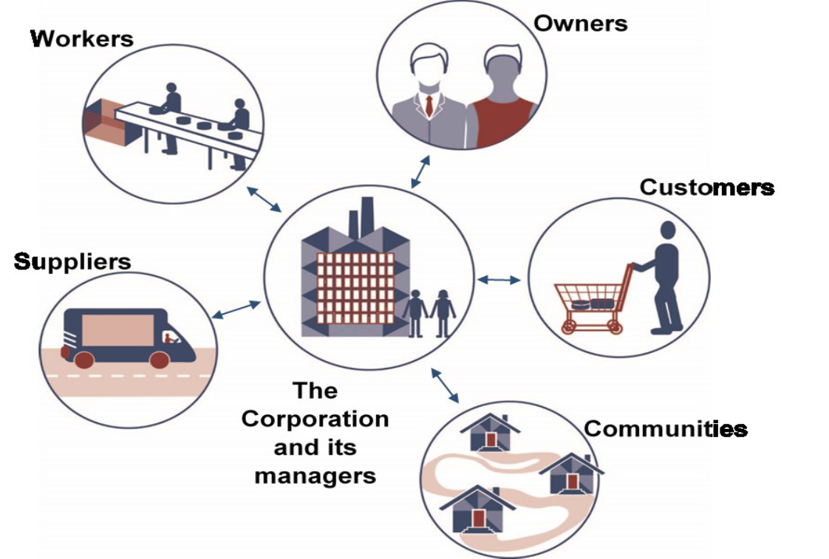
Management’s relationships with stakeholders

Slide 6
Owners invest money in companies. In return, the people who run a company have a responsibility to increase the value of owners’ investments through profitable operations. Managers also have a responsibility to provide owners with accurate, reliable information about the performance of the business.

Slide 7
Customers
The purpose of any business is to satisfy customers, who reward businesses by buying their products. Sellers are also responsible—both ethically and legally—for treating customers fairly. consumer issues identified four consumer rights:

Slide 8
1) The right to safe products. A company should sell no product that it suspects of being unsafe for buyers. Thus, producers have an obligation to safety-test products before releasing them for public consumption.
2) The right to be informed about a product. Sellers should furnish consumers with the product information that they need to make an in- formed purchase decision.
3) The right to choose what to buy. Consumers have a right to decide which products to purchase, and sellers should let them know what their options are.
4) The right to be heard. Companies must tell customers how to contact them with complaints or concerns. They should also listen and respond.

Slide 9
Communities
For obvious reasons, most communities see getting a new business as an asset and view losing one—especially a large employer—as a detriment. After all, the economic impact of business activities on local communities is substantial: They provide jobs, pay taxes, and support local education, health, and recreation programs.

Slide 10
Workforce Diversity
In addition to complying with equal employment opportunity laws, many companies make special efforts to recruit employees in the workforce according to race, or some other characteristic. In helping to build more diverse workforces, such initiatives contribute to competitive advantage for two reasons:

Slide 11
1) People from diverse backgrounds bring new talents and fresh perspectives to an organization, typically enhancing creativity in the development of new products.
2) By more accurately reflecting the demographics of the marketplace, a diverse workforce improves a company’s ability to serve an ethnically diverse population.

